Slide 1
Stefano Profumo
Santa Cruz Institute for Particle Physics
University of California, Santa Cruz
An Introduction to
Particle Dark Matter
Pre-SUSY Summer School
Melbourne, June 29-July 1, 2016

Slide 2
Thank you to those who came and introduced themselves,
asking lots of great questions!
Looking forward to more interactions!

Slide 3
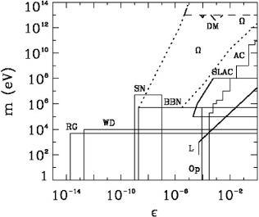
Quick summary of key concepts from Lecture 1
Dark matter key ingredient to seed timely structure formation
[MOND does not work: baryon acoustic oscillations…]
Dark Matter as a particle:
Dark
Collisionless (σ /m < 1 cm²/g,
or 1 barn/GeV)
Classical (de Broglie; Pauli-blocking)
Fluid
Right abundance, ~0.3 critical

Slide 4
Quick summary of key concepts from Lecture 1
Paradigm of thermal decoupling
Example: hot relic (e.g. SM neutrinos)
doesn’t always work… relic protons-antiprotons
relic protons, antiprotons: ~ 10⁻¹⁵ obs. baryon density
Cold relics!

Slide 5
Cold Relic
Works for WIMPs, but also for lighter, more weakly coupled particles
Mass Range: m=0.1 eV [1 MeV]… 120 TeV
Assuming weak interactions, m>10 GeV [Lee-Weinberg]
Proper formulation:
Boltzman equation L=C

Slide 6
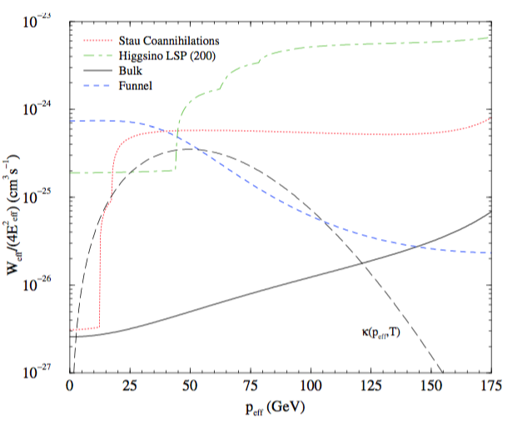
There exist important "exceptions" to this standard story:
1. Resonances
2. Thresholds
3. Co-annihilation
Affects what the
pair-annihilation
rate today is compared to
what it was at freeze-out!

Slide 7
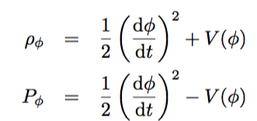
So far we looked into what happens if we
fiddle with the left hand side of
Consider a "Quintessence" dark energy model –
homogeneous real scalar field

Slide 8
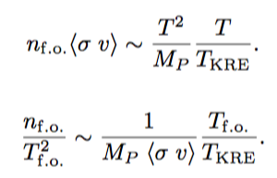

Slide 9
After chemical decoupling (number density freezes out), DM can still be in kinetic equilibrium
(i.e. its velocity distribution is in equilibrium)
generically, this is the case, since for cold relics

Slide 10
Think of a prototypical WIMP:
Problem: every collision has a momentum transfer
...but we need to keep the (cold) DM momentum in equilibrium, i.e.
so δp << p, we need a bunch of kicks!

Slide 11
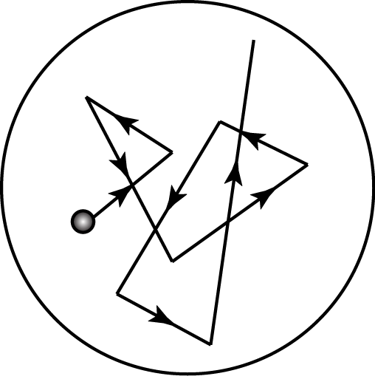
However, subtlety: kicks are in random directions!
Let's estimate a typical WIMP kinetic decoupling temperature

Slide 12
What does this implies for structure formation?
First structures that collapse are these tiny minihalos
(maybe some survive today?)
Structures then merge into bigger and bigger halos
(bottom-up structure formation)

Slide 13
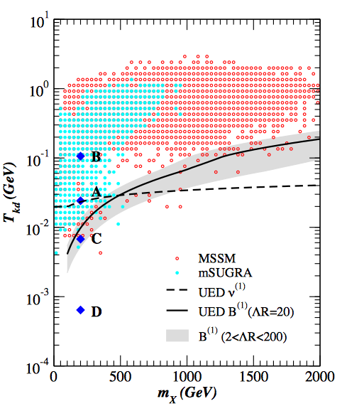
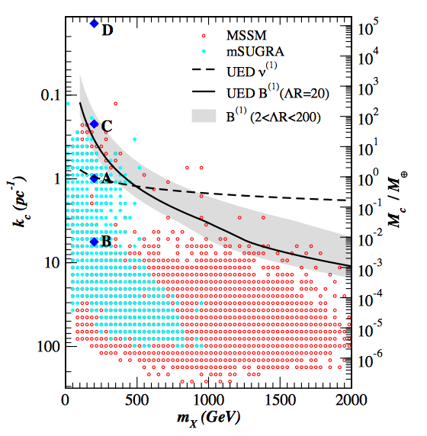
Notice that the kinetic decoupling/cutoff scale varies significantly
even for a selected particle dark matter scenario!
e.g. for SUSY, UED

Slide 14
What happens instead for hot relics?
They decouple when T >> m_{ν}
Structures can only collapse when T ~ m_{ν}
(i.e. when things slow down enough for gravitational collapse!)
Structures are cutoff to the horizon size at that temperature

Slide 15
How does this compare with observations?

Slide 16
Observational constraints give
So at best dark matter can be keV scale, if produced thermally

Slide 17
Structure formation looks strikingly different
for hot and cold dark matter
Hot Dark Matter
Top-Down
[doesn’t work!]
Cold Dark Matter
Bottom-Up
[Yeah!]

Slide 18
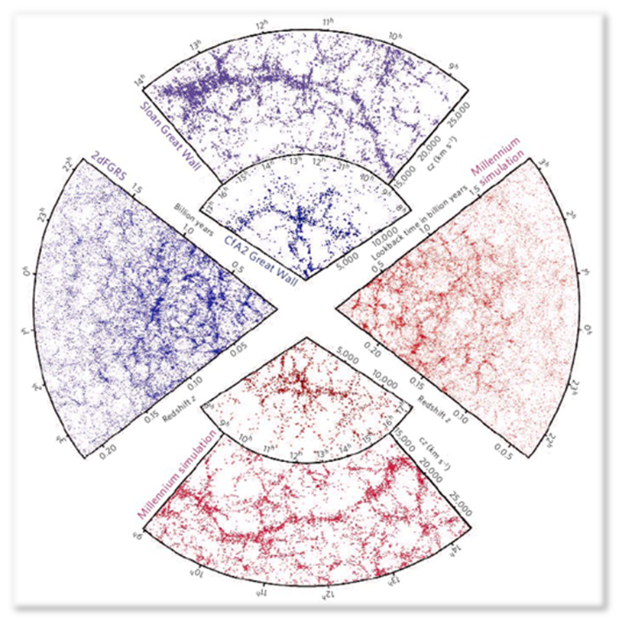
1980’s: Davis, Efstathiou, Frenk and White show that simulations of structure formation in a universe with cold dark matter match observed structure incredibly well!!

Slide 19
gravity
“ordinary”
matter
[Standard Model]
dark
matter
weak int.?
“dark” force?
Notes:
To learn something about this new elementary particle, we need to detect it.
Now, all we know is that there are gravitational interactions
however, in many motivated models of dark matter, there also are other (weak) interactions

Slide 20
Dark Matter
Particles
Standard Model
(ordinary) Particles
Notes:
schematically, the most likely possibilities are that dark matter pair-annihilate

Slide 21
collider production
direct detection
thermal equilibrium ?
[pair annihilation]
Notes:
schematically, the most likely possibilities are that dark matter pair-annihilate

Slide 22
long-lived, but metastable
Notes:
schematically, the most likely possibilities are that dark matter pair-annihilate

Slide 23
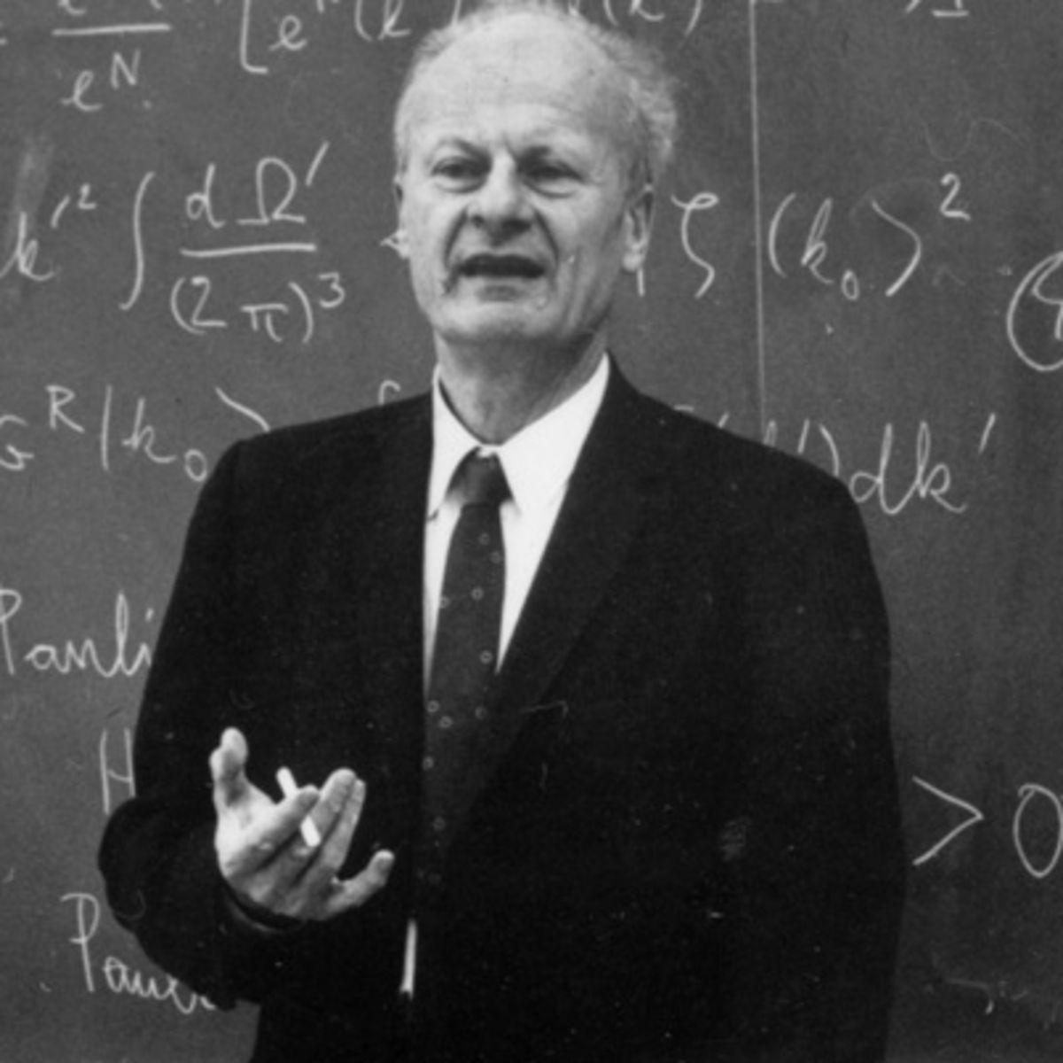
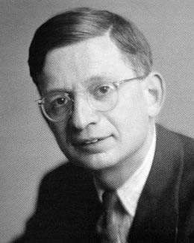
Consider direct detection
Detecting particles that interact weakly has always been
known to be a tough job
After estimating in 1934 the cross section for
“It is therefore absolutely impossible to observe processes of this kind”

Slide 24
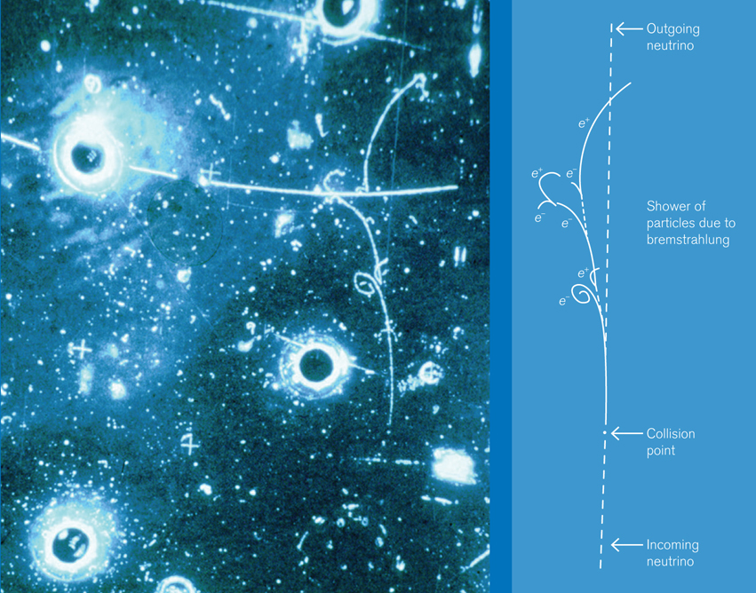
Bethe and Peierls were too pessimistic/conservative:
neutrinos were detected in 1953, abundantly in 1956
Inelastic process (maybe relevant for DM?)
Elastic neutrino scattering took much longer (Gargamelle 1973)

Slide 25
Let's use WIMPs again as prototypical DM particles
First, which energies and what masses are we talking about?
maximal recoil momentum for a DM particle
with velocity v is 2m_{χ}v, so maximal energy
Now, the maximal velocity a DM particle can have in the Galaxy is the escape velocity v_{max} ~ 500-700 km/s
→ E~ keV for GeV particles!
Plug in numbers for a detector with an energy threshold ~ keV... minimal detectable DM mass ~ GeV

Slide 26
OK, now what about the event rate?
Plug in sensible benchmark values…

Slide 27
To have a detection need both enough signal events,
and enough background suppression
slowly decaying "primeval" nuclides (U, Th, ⁴⁰K), ab. 10⁻⁴, half lives ~10⁹ yr
2. rare, fast decaying trace elements like tritium, ¹⁴C: ab 10⁻¹⁸ , half lives 10 yr
Big detectors, in underground, actively shielded environments...

Slide 28
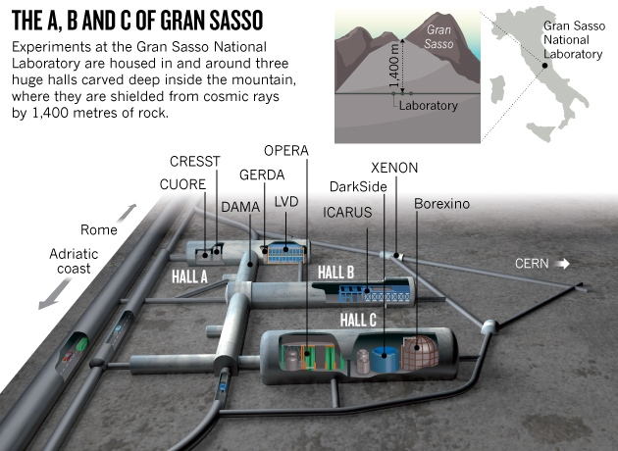
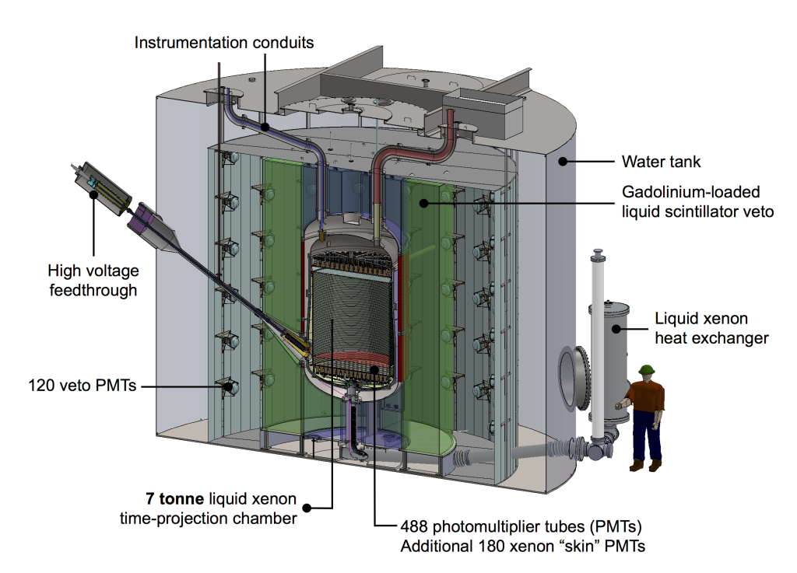

Slide 29
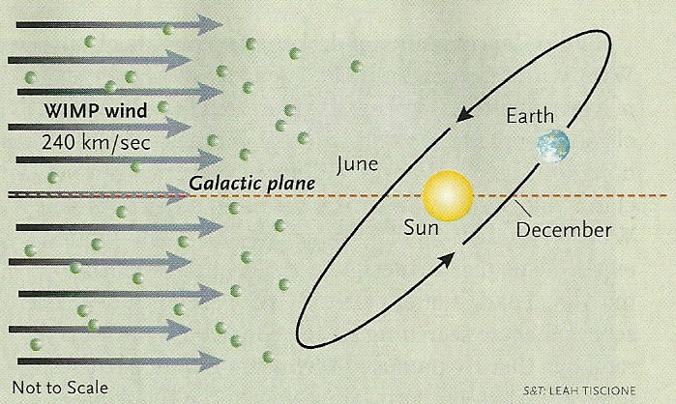
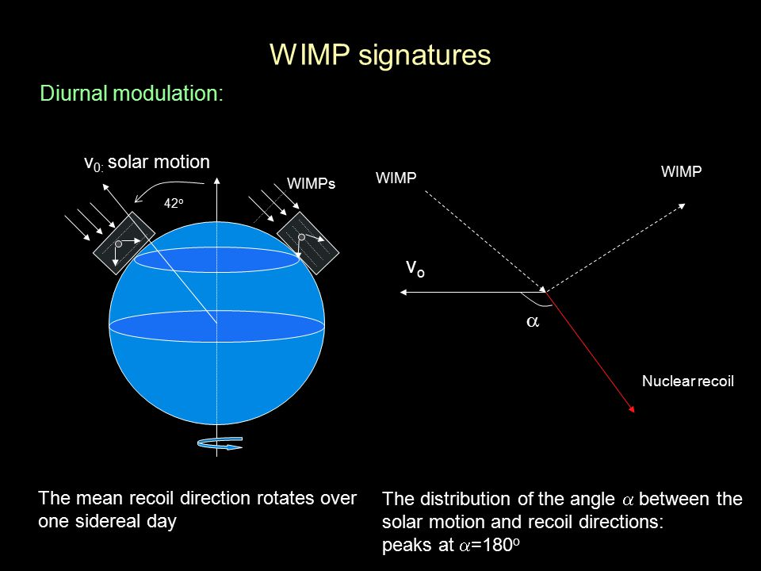
Other handles on a DM signal versus radioactive background:
1. Seasonal modulation
2. Diurnal modulation
3. Directional information

Slide 30
Now: direct detection event rates, for real!

Slide 31
How do we calculate the scattering cross section?
Non-relativistic limit, the scattering matrix element is the
Fourier transform of WIMP-nucleus potential
to the lowest order in velocity, the potential is just a
contact interaction of spin-independent and axial
where the G's are the effective DM-nucleon interactions for
scalar and axial interactions

Slide 32
Coherence requires the nucleus size to be much smaller than the momentum transfer wavelength (1/q)
Loss of coherence is phenomenologically accounted for by introducing form factors describing the nucleus response

Slide 33
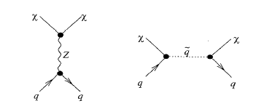
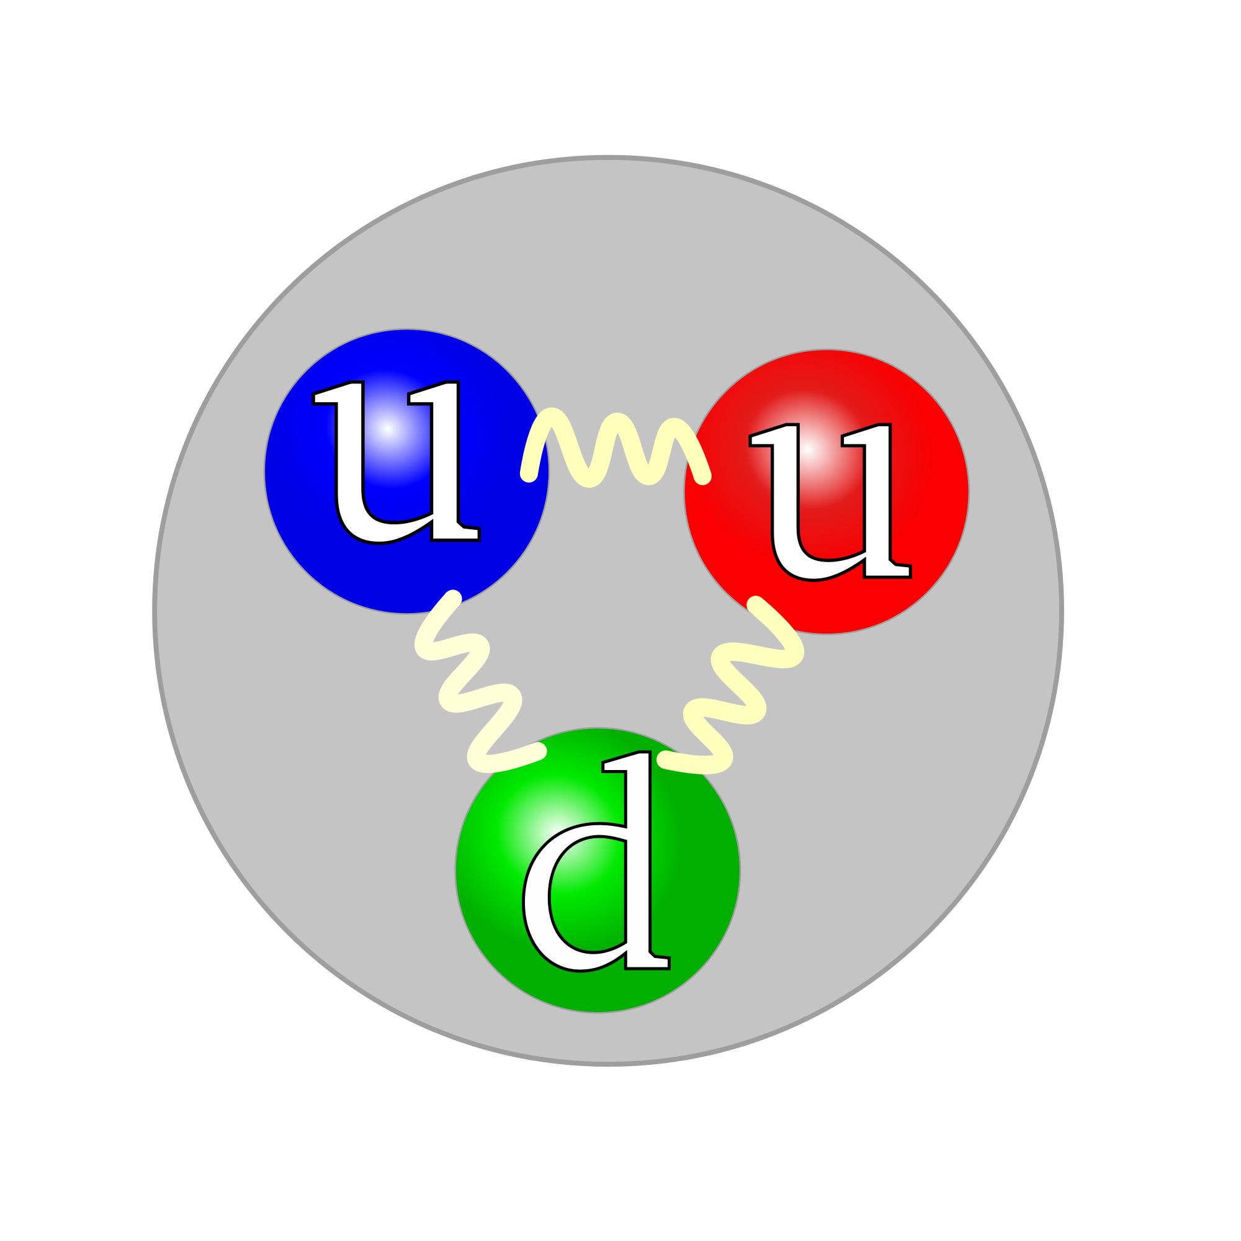
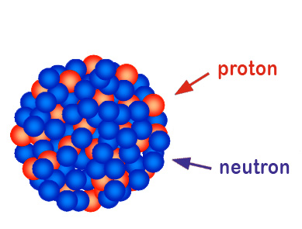
Given a microscopic theory of dark matter,
how does one get to the DM-nucleus cross section?
An interesting multi-layered problem in effective field theory!
Dark Matter-quark
Low-energy EFT
Nucleon matrix elements
Dark Matter-nucleon
Form factors
Dark Matter-nucleus

Slide 34
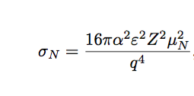
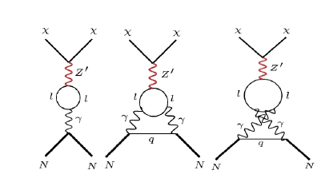
Sometimes life is simpler, e.g. if DM is (milli-electric-)charged
Sometimes life is nastier, e.g. if DM is lepto-philic

Slide 35
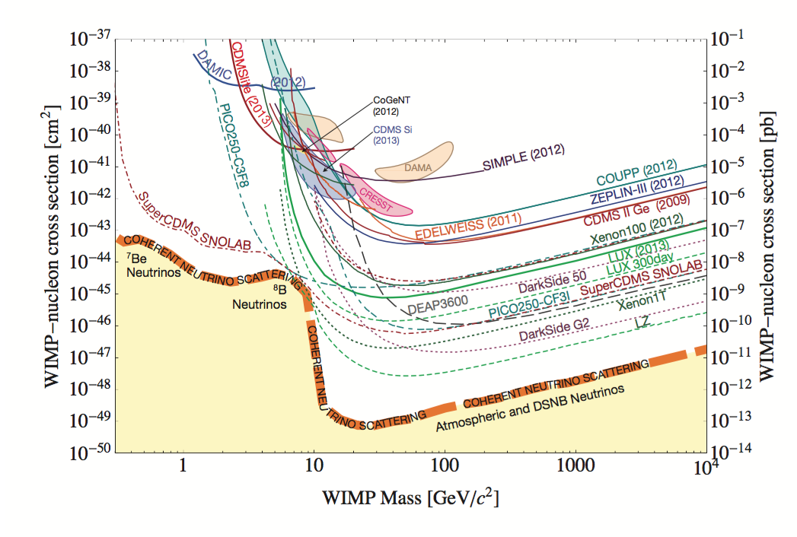

Slide 36
Now off to indirect dark matter detection
Idea: use the debris of DM pair-annihilation
(likely large if thermal relic) or decay
What do we know about these rates?
σv from thermal production (with caveats!)
How about decay rate?

Slide 37
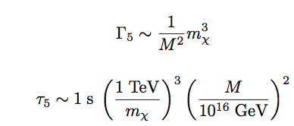
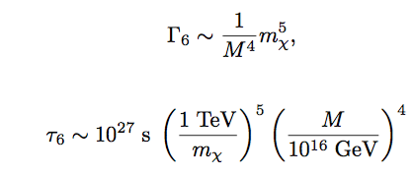
Suppose DM decay mediated by high-scale physics at scale M
Dimension-5 operator doesn't work – would be too short lived!
Interesting, well motivated!

Slide 38
What about annihilation final state?
Very model-dependent
1. if DM belongs to an SU(2) multiplet, then well-defined combination of ZZ, WW final states...
2. In UED, DM is KK-1 mode of hypercharge gauge boson, thus
3. Special "selection rule", e.g. helicity suppression for Marjorana fermion (analogous to charged pion decay)

