Slide 1
Stefano Profumo
Santa Cruz Institute for Particle Physics
University of California, Santa Cruz
An Introduction to
Particle Dark Matter
Pre-SUSY Summer School
Melbourne, June 29-July 1, 2016

Slide 2
PhD Theoretical Particle Physics (2004)
International School for Advanced Studies (SISSA-ISAS), Trieste, Italy
Postdoc, FSU and California Institute of Technology (2005-2007)
Theoretical Astrophysics and Particle Physics
Joined UCSC Physics Faculty (Assistant Professor, 2007-2011,
Associate Professor, July 2011-2015
Full Professor, July 2015-)
Director of UCSC Physics Graduate Studies (2012-)
SCIPP Deputy Director for Theory (July 2011-)

Slide 3
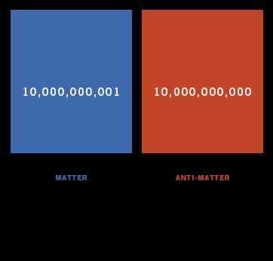
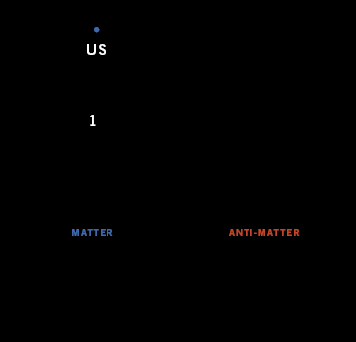
1. What is the origin of the tiny
excess of matter over anti-matter?

Slide 4
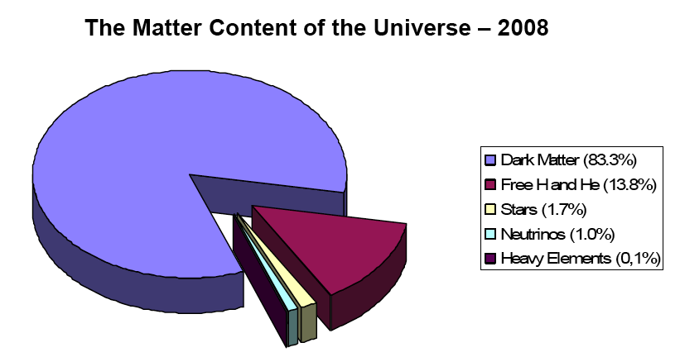
2. What is the fundamental particle
physics nature of Dark Matter?

Slide 5
Please come introduce yourselves!
[to myself, other Instructors, to each other...]
If you are ever on the US West Coast please let me know!
Never underestimate the importance of networking in science!

Slide 6
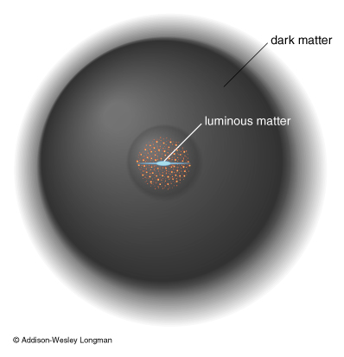
Notes:
the picture we have of galaxies such as our own Milky Way is one where the visible matter – stars, gas etc – is embedded in halo of DARK matter, whose fundamental, particle nature is at present unknown

Slide 7
4/5
Notes:
there is overwhelming evidence that in the universe as a whole, 4 out of 5 grams of matter are not made of “ordinary matter” but of this “dark matter”

Slide 8
a new
elementary particle
...as such it is of interest
to particle physicists!
Notes:
there also is rather conclusive evidence that the dark matter is made out of a new, as yet undiscovered elementary constituent

Slide 9
What this mini-lecture series is not:
Review of “evidences” for dark matter
Review of “models” for dark matter
Review of possible claimed “signals” from dark matter

Slide 10
What this mini-lecture series will be
Gross features of dark matter as a particle (lecture 1)
Paradigms for dark matter in the early universe (lecture 1/2)
Schematics of dark matter searches (lecture 2/3)
Selected lessons from old and new particle dark matter models (lecture 3)

Slide 11
One thing we do know well about dark matter
Global amount of dark matter in the universe
Reason: very good handles on total energy density,
total matter density, total baryonic matter
CMB data indicate the universe is nearly flat
→ energy density is close to critical...
What is the critical density? (very good number to have in mind!)
...since 1 GeV ~10⁻²⁴ g, 10 protons per cubic meter (=tincy!)

Slide 12
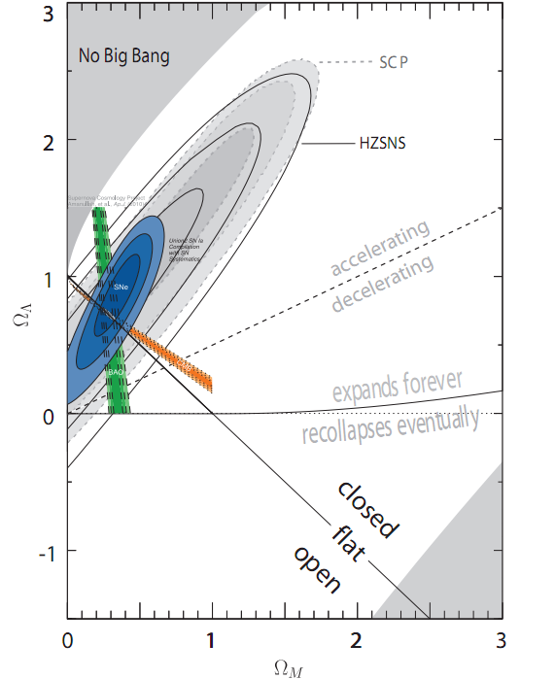
Various ways to "weigh" matter versus dark energy (CMB+SN+BAO)
...and ordinary (baryonic) matter versus non-baryonic (BBN, CMB)
Global amount of dark matter
in the universe
from simple subtractions!

Slide 13
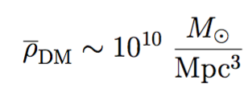
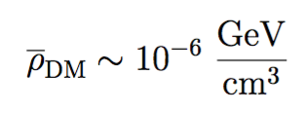
in "astro" units...
clusters... 10⁵ denser!
in "particle physics" units...
galaxies... 10⁶ denser!
the Universe is highly non-linear!
...which is one of the reasons why modified gravity does not work!

Slide 14
CMB sky is very boring – T fluctuations very small!
T fluctuations proportional to (baryonic) density fluctuations,
Good news! Matter over-densities in linear regime
grow linearly with scale factor
But the scale factor since CMB decoupling grew by z_{rec}~1,100
Not enough time for structures to go non-linear!

Slide 15
We need a species that has decoupled from photons
much earlier (Dark Matter) so that its density perturbations
are much larger at recombination!
Dark matter seeds timely structure formation!

Slide 16
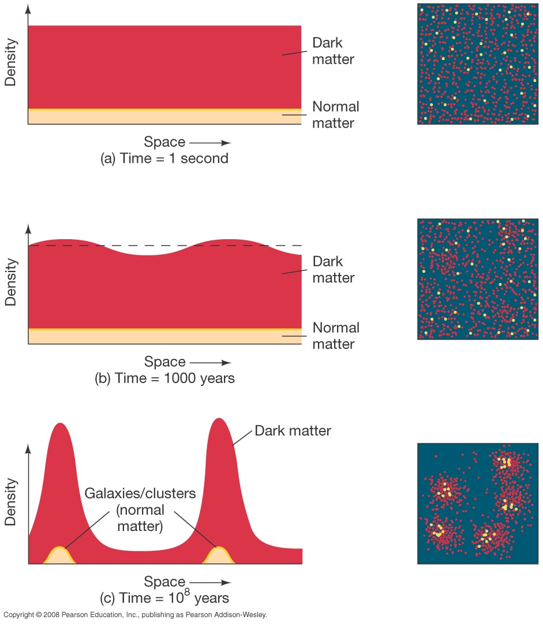

Slide 17
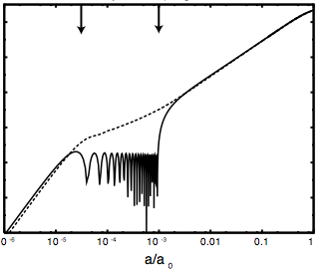
Recombination
Dark Matter
Baryon-photon
fluid oscillations

Slide 18
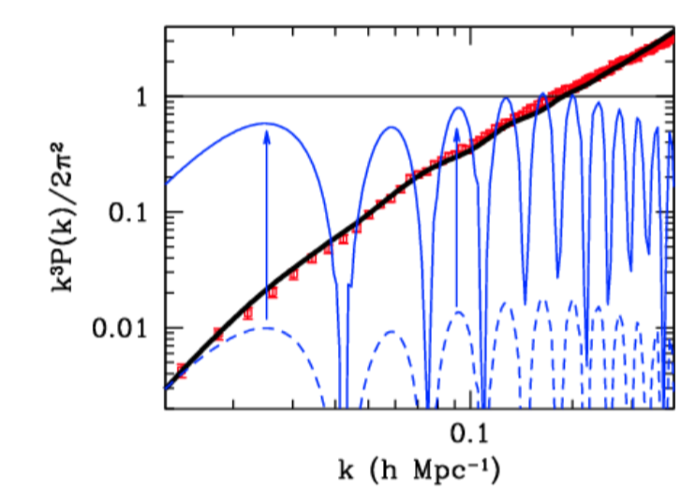
Things go badly wrong without DM for structure formation!
δρ/ρ∼1
Power spectrum
of density
perturbations
Even with best (covariant) incarnation of modified gravity (TeVeS), structure goes non-linear, but the power spectrum of matter density fluctuation is entirely wrong...

Slide 19
Don’t get fooled by the “Volcano” versus “Neptune” analogy
[Volcano: No new planet between Mercury and the Sun, but GR
Neptune: New planet]
Modified Gravity [MOND,TeVeS] actually does not work at all!!

Slide 20
Knowledge of the dark matter average density
is a powerful model-building tool
Models that predict the “right” amount of dark matter get kudos
Dark Matter “cosmogony” well-motivated guideline to model building
prototypical example: dark matter
as a thermal relic… more on this shortly

Slide 21
What else do we know about the
microscopic nature of dark matter
from its macroscopic features?
"Dark": ...for the reason above! But detailed constraints on electric charge of dark matter are model-dependent... Milli-charge allowed... Phenomenologically: DM is nearly dissipationless (maybe not entirely though, see dark photons, dark disks...)
Collisionless... really? Let's calculate the relevant constraints!

Slide 22
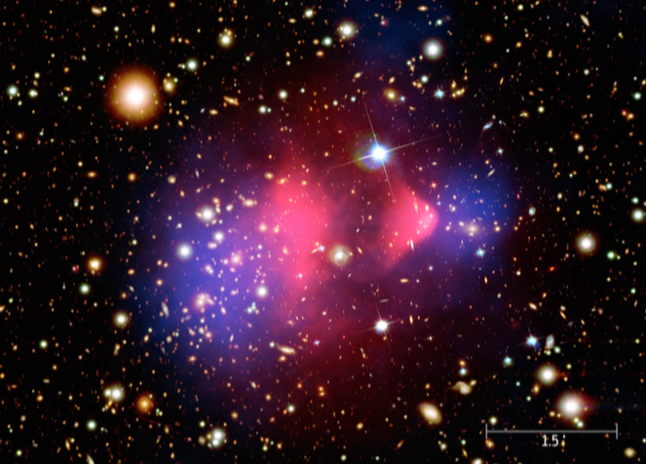
mean free path λ larger than cluster size, ~ 1 Mpc
cluster density: ρ ~ 1 GeV/cm³, thus…
λ = 1/(σ (ρ/m)) > 1 Mpc → σ /m < 1 Mpc / 1 GeV/cm³
→ σ /m < 1 cm²/g, or 1 barn/GeV

Slide 23
1 barn/GeV… which is strong interaction-size...
is this small?
Also, if cross section is slightly smaller, no visible effect...
if cross section slightly larger, disaster...
Begs the question: is “collisional” self-interacting dark matter a “natural” possibility??

Slide 24
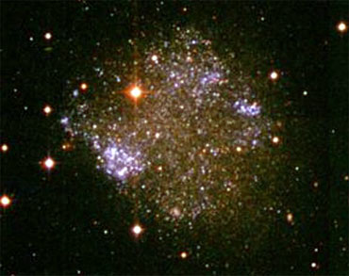
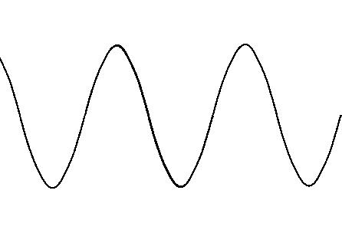
Classical: needs to be confined (gravitationally bound) on scales at least as large as dSph... if de Broglie wavelength is larger, disaster strikes!

Slide 25
little exercise: consider v ~ 100 km/s, show that λ = h/p is
which means that to have λ << kpc ~ 3x10²¹ cm, m>10⁻²² eV

Slide 26
Much, much better constraints if the DM is a fermion – we know that the phase space density is bounded
(Pauli blocking): f= gh⁻³
Using observed density and velocity dispersion of dSph, Tremaine-Gunn limit (1979): observed phase space density cannot exceed upper bound!
(Liouville theorem?) Exercise!

Slide 27
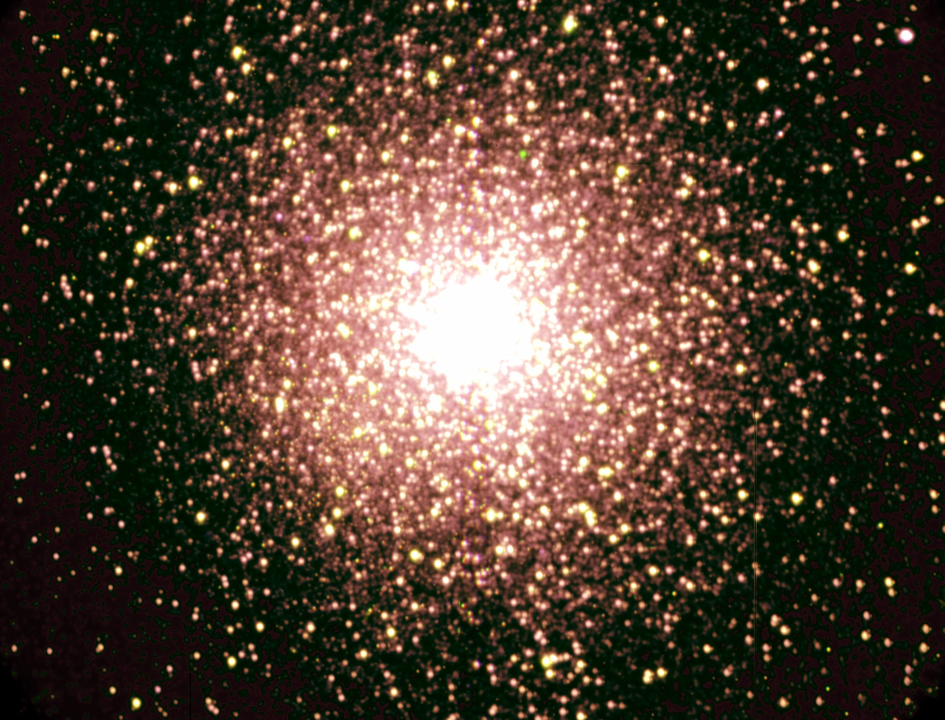
Fluid: don't want to disrupt pretty (and old!) clusters of stars
Neat exercise to estimate the energy exchanged by encounters of GC and BH, in the impulse approximation, demand that that energy be smaller than binding energy, get maximal mass for BH
Also constraints on disk disruption ("heating")
Bottom line: m > 10³ solar masses ~ 10⁷⁰ eV

Slide 28
…here's the name of the game:
(i) Mass: >90 orders of magnitude for bosons, 70 for fermions
(ii) Interactions: ~dark, self-interacting at most ~ strong interactions
(iii) Abundance

Slide 29
Think left and think right and think low and think high.
Oh the things you can think up, if only you try!
Dr. Seuss

Slide 30
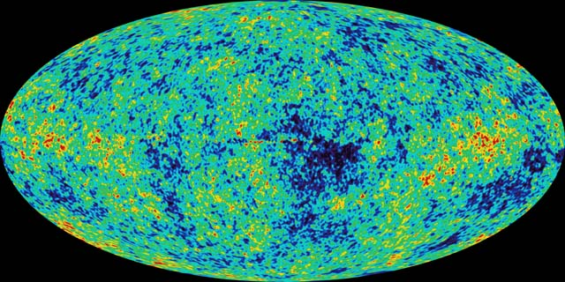
A successful framework for the origin of species in the early universe: thermal decoupling

Slide 31
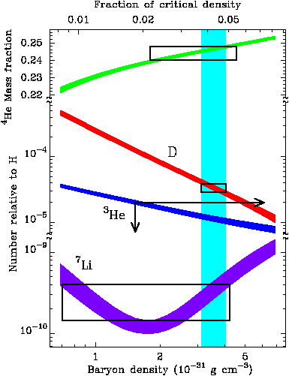
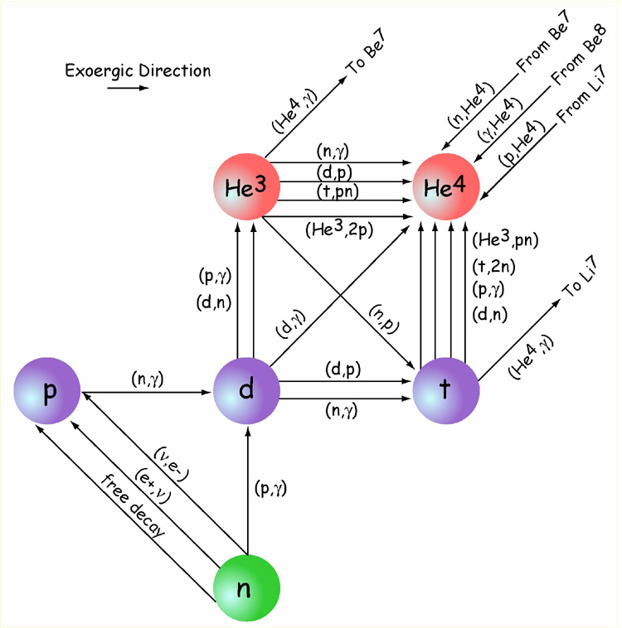
A successful framework for the origin of species in the early universe: thermal decoupling
A successful synergy of statistical mechanics,
general relativity, and of nuclear and particle physics
making predictions testable to exquisite accuracy
with astronomical observations!

Slide 32
Key idea of thermal decoupling:
if the reaction keeping a species in equilibrium
is faster than the expansion rate of the universe,
the reaction is in statistical equilibrium;
if it’s slower, the species decouples (“freeze-out”)
the reaction rate (from definition of cross section!)

Slide 33
(1) borrow equilibrium number densities from stat mech
(2) borrow Hubble rate from general relativity
(FRW solution to Einstein's eq.)

Slide 34
GR+SM: energy density in radiation

Slide 35
first application: hot thermal relic
language definition: hot = relativistic at T_{f.o}
cold = v<c=1. (actually not by much, typically!)
simple application: relic SM neutrinos (cosmo ν background)

Slide 36
suppose this is a hot relic… n~T_{ν}³

Slide 37
happy about two things in particular:
1. hot relic assumption works!
2. Fermi effective theory OK!

Slide 38
now, how do we calculate the relic thermal abundance
of this prototypical hot relic?
Introduce Y=n/s (number and entropy density, V=a³)
If universe is iso-entropic, s x a³=S is conserved
Y ~ n a³ is thus ~ comoving number density, and
(without entropy injection)

Slide 39
Cowsik-Mc-Clelland limit

Slide 40
That was fun! Let's see if it works for something else...
Try proton-antiproton freeze-out:
what’s the relic matter abundance in a baryon-symmetric Universe?
n σ = H → T³ Λ⁻² = T²/M_{P} → T = Λ²/M_{P}
doesn't quite work, we're way outside
the regime of validity for hot relics, since T<<<<<<<m_{p} ...
Need to work out the case of cold relics, which looks nastier by eye

Slide 41
Here's the trick: freeze-out condition gives
now define
(cold relic: x>>1)
Freeze-out condition (x) now reads
…so we gotta solve

Slide 42
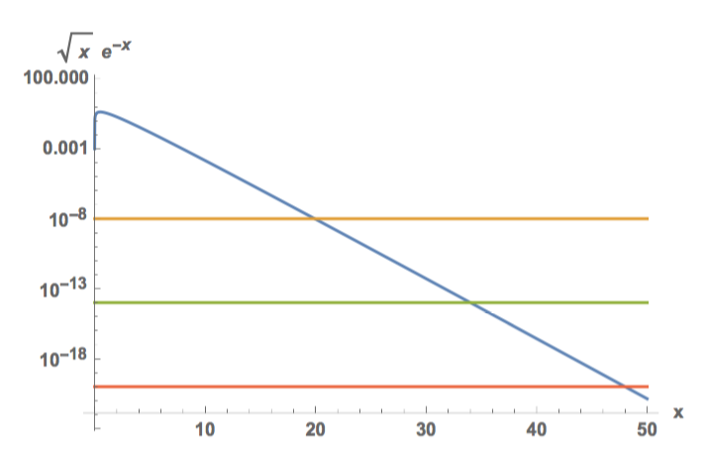

Slide 43
Take e.g. a "weakly interacting massive particle"
thus x = m_{χ} / T ~ 35

Slide 44
Off to calculating the thermal relic density

Slide 45
Notice we neglected relative velocity...
What is the velocity of a cold relic at freeze-out?
...just use equipartition theorem...
Now, back to relic density:

Slide 46
Is this unique to WIMPs? No.
"WIMPless" miracle... what did we use?
Substitute and find that m_{χ} >> 0.1 eV !
In practice various constraints on light thermal relics from structure formation, relativistic degrees of freedom at BBN, CMB... m_{χ}> MeV

Slide 47
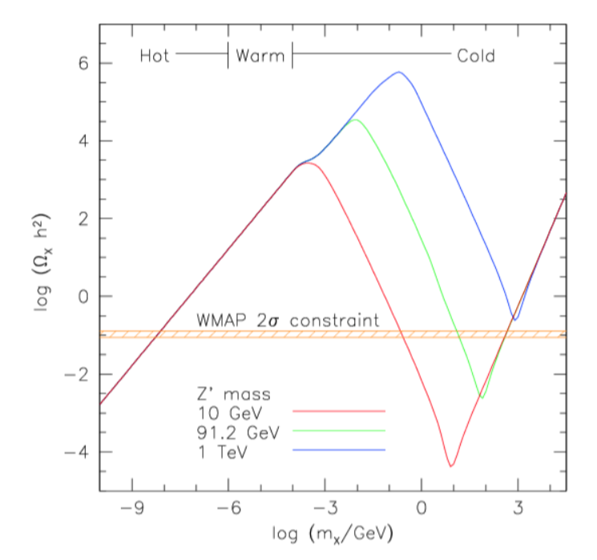
Put everything together: suppose you have a mediator Z’, mass m_{Z'}

Slide 48
What is the range of masses expected for cold relics?
Cross section cannot be arbitrarily large: unitarity limit

Slide 49
What is the range of masses expected for cold relics?
If you have a WIMP, defined by a cross section
"Lee-Weinberg" limit

Slide 50
Discussion so far OK for a qualitative assessment of relic density
State of the art much more sophisticated: Solve Boltzmann equation
Looks ugly, but for the FRW metric phase-space density simplifies…

Slide 51
Now, what we are interested in are number densities,
which in terms of phase-space densities are simply…
…integrate the Liouville operator over momentum space and get

Slide 52
Back to Boltzmann equation, suppose a 2-to-2 reaction, with 3, 4 in eq.
Consider the collision factor, and again integrate over momenta…
…where the cross section

Slide 53
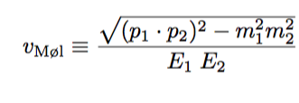
let’s understand the rest of the equation:
Final version of
Boltzmann Eq.

Slide 54
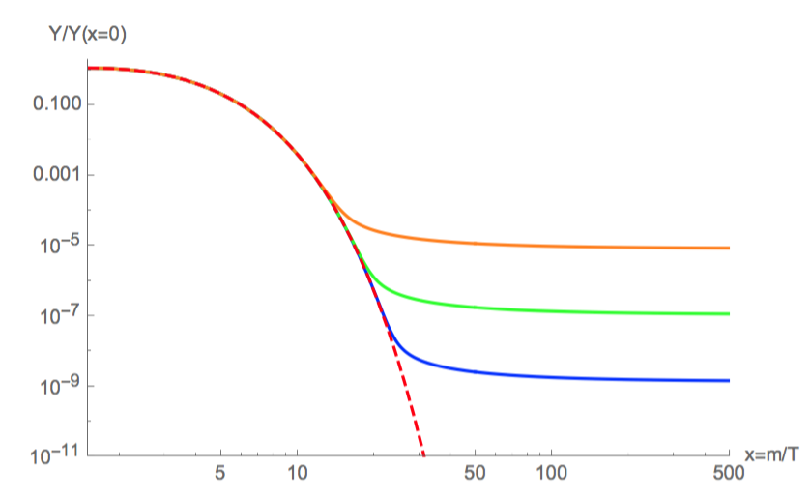

Slide 55
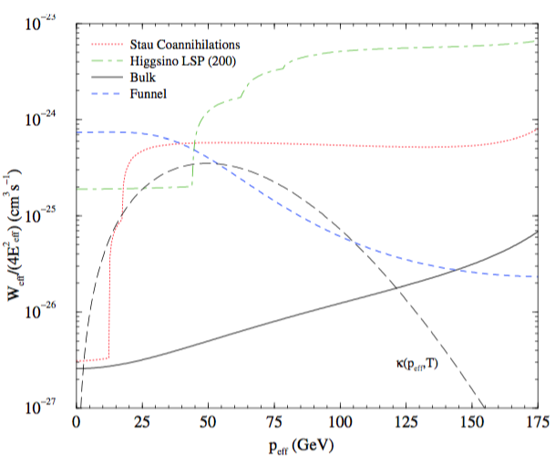
There exist important "exceptions" to this standard story:
1. Resonances
2. Thresholds
3. Co-annihilation
Affects what the
pair-annihilation
rate today is compared to
what it was at freeze-out!

