Slide 1
Stefano Profumo
Santa Cruz Institute for Particle Physics
University of California, Santa Cruz
An Introduction to
Particle Dark Matter
Pre-SUSY Summer School
Melbourne, June 29-July 1, 2016

Slide 2
Quick summary of key concepts from Lecture 2
There are several caveats to using the pair-annihilation at freeze-out as a proxy for the pair-annihilation today
A modified expansion rate at freeze-out can have a huge impact on the thermal relic density [quintessence]
After chemical decoupling, DM is in kinetic equilibrium, freeze-out must account for multiple scattering
Kinetic decoupling sets the scale of the smallest collapsed structures in cold DM cosmologies
Hot DM suppresses small-scale unacceptably, ruled out

Slide 3
Quick summary of key concepts from Lecture 2
Direct detection is a tough business (such as neutrino detection)
E_{th} ←→ lowest DM mass that can be detected (v² ~ 10⁻⁵)
Direct Detection: sequence of EFT: quark-gluon → nucleon → nuclei
Indirect detection:
Final state: no idea, model dependent:
SU(2) multiplet
couples to hypercharge
selection rule (e.g. Majorana fermion)

Slide 4
Annihilation (or decay) of DM can be detected or constrained in a variety of ways
Here's one possible classification:
1. Very Indirect: effects induced by dark matter on astrophysical objects or on cosmological observations
2. Pretty Indirect: probes that don’t “trace back” to the annihilation event, as their trajectories are bent as the particles propagate: charged cosmic rays
3. Not-so-indirect: neutrinos and gamma rays, with the great added advantage of traveling in straight lines

Slide 5
Very indirect probes include e.g.
Solar Physics (dark matter can affect the Sun’s core temperature, the sound speed inside the Sun,...)
Neutron Star Capture, possibly leading to the formation of black holes (notably e.g. in the context of asymmetric dark matter)
Supernova and Star cooling
Protostars (e.g. WIMP-fueled population-III stars)
Planets warming
Big Bang Nucleosynthesis, on the cosmic microwave background, on reionization, on structure formation…

Slide 6
Pretty Indirect Probes: charged cosmic rays
Good idea is to use rare cosmic rays, such as anti-matter
antiprotons, positrons relatively abundant
(mostly from inelastic processes CR p on ISM p)
Interesting probe: antideuterons (or even anti-³He !!)
large energy threshold (~17 GeV), so typically large momentum, while from DM produced at very low momentum! Select low-energy antideuterons

Slide 7
positrons (and in part antiprotons) have attracted attention because of "anomalies" reported by PAMELA, AMS-02
general scheme for Galactic CR's: diffusion (leaky-box) models
Things can be made arbitrarily more complicated/sophisticated:

Slide 8
Boundary conditions:
Useful to simplify the diffusion equation assuming steady-state, using typical diffusion and energy loss time-scales, defined by
Diff. Eq. then looks like
with solution

Slide 9
If the source is cosmic rays accelerated via a Fermi mechanism,
…in agreement with CR protons (where en. losses are irrelevant)
For CR electrons, energy losses are efficient above a certain energy,

Slide 10
Therefore (as observed) we expect a broken power-law
Also, secondary-to-primary ratios are generically

Slide 11
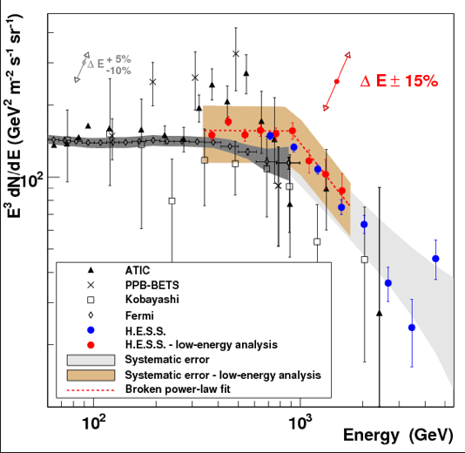
Electron spectrum looks pretty good

Slide 12
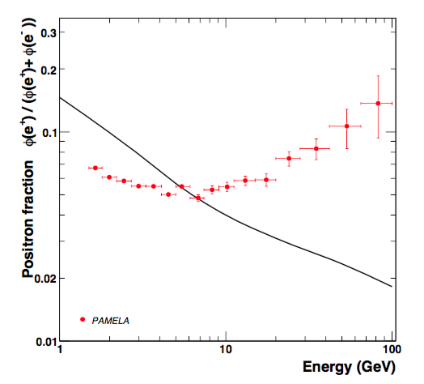
but the secondary-to-primary ratio prediction is
at odds with observed rising positron fraction
Much hype about this possibly being from DM – but very problematic

Slide 13
No excess anitprotons – must be "leptophilic" (possible but not generic)
No observed secondary radiation from brems or IC
Needed pair-annihilation rate very large for thermal production, leads to unseen gamma-ray or radio emission

Slide 14
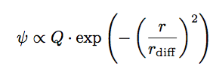
Alternate explanation: nearby point source
injecting a burst of positrons (a.k.a. Green’s function, a.k.a. PSR)
Estimate Age and Distance of putative source

Slide 15
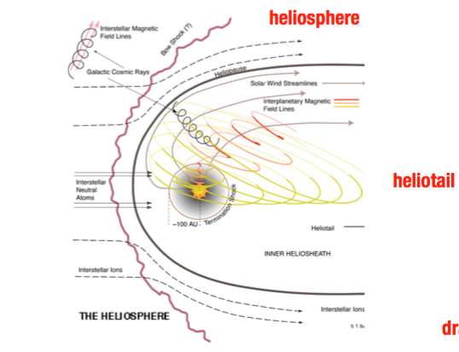
One possible way to disentangle PSR from DM: anisotropy
Complication: Larmor radius for heliospheric magnetic fields
B~ nT, is of the order of the solar system size (exercise)

Slide 16
Not-so-indirect DM detection: neutrinos!
Only two observed astrophysical sources of neutrinos!
Hard (but not impossible) to detect particles
flip side: neutrinos have very long mean free paths in matter!
idea: DM can be captured in celestial bodies, accrete in sizable densities, start pair-annihilating
if the process of capture and annihilation is in equilibrium, large fluxes of neutrino can escape

Slide 17
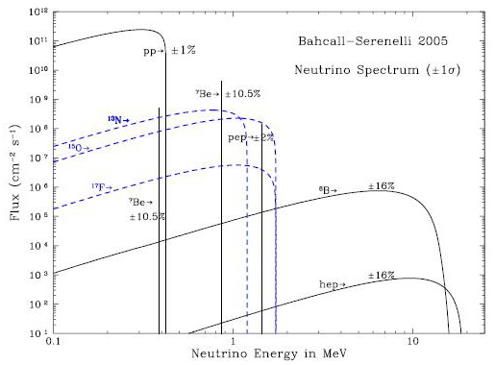
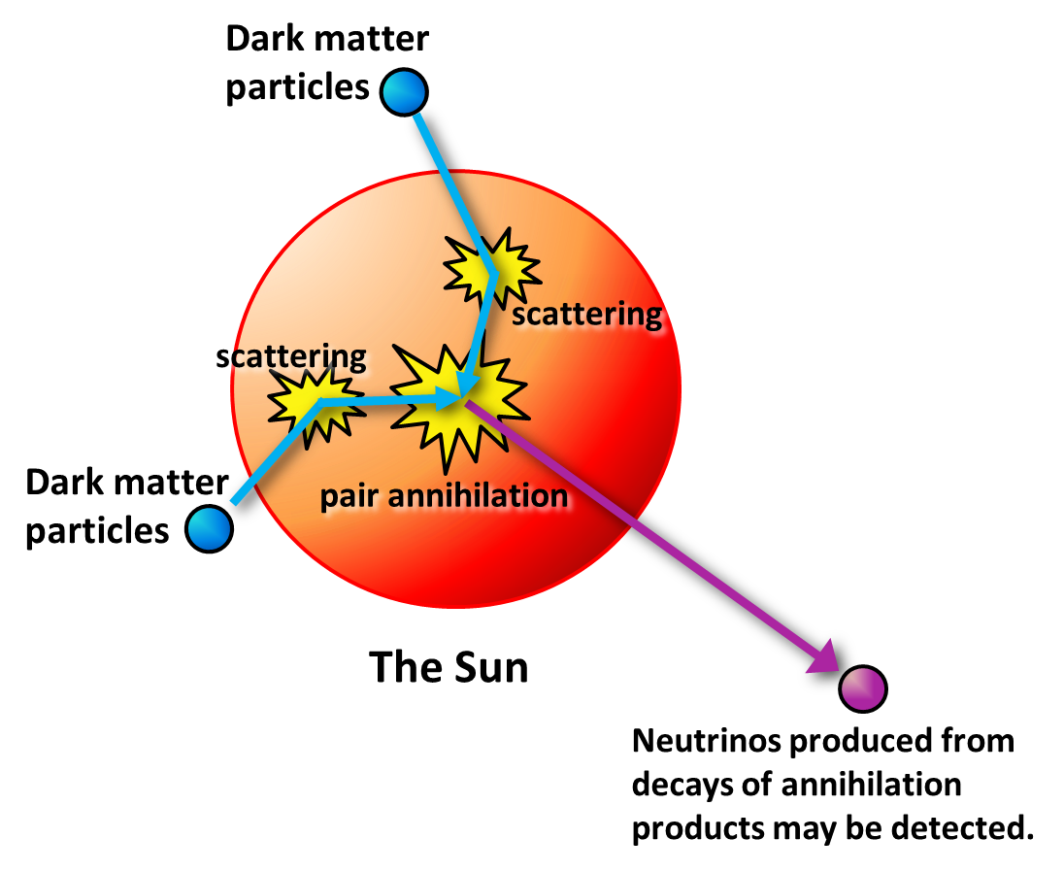
best target: Sun! Large, nearby, low-E neutrino emission

Slide 18
Estimate the process quantitatively!
First: capture rate

Slide 19
Number of accreted DM particles N

Slide 20
So yes thermal DM is in equilibration as long as
WIMP-nucleon cross section is larger than

Slide 21
With equilibration, flux of neutrinos only depends on capture rate!
flux of neutrinos is then
...and the number of events at IceCube

Slide 22
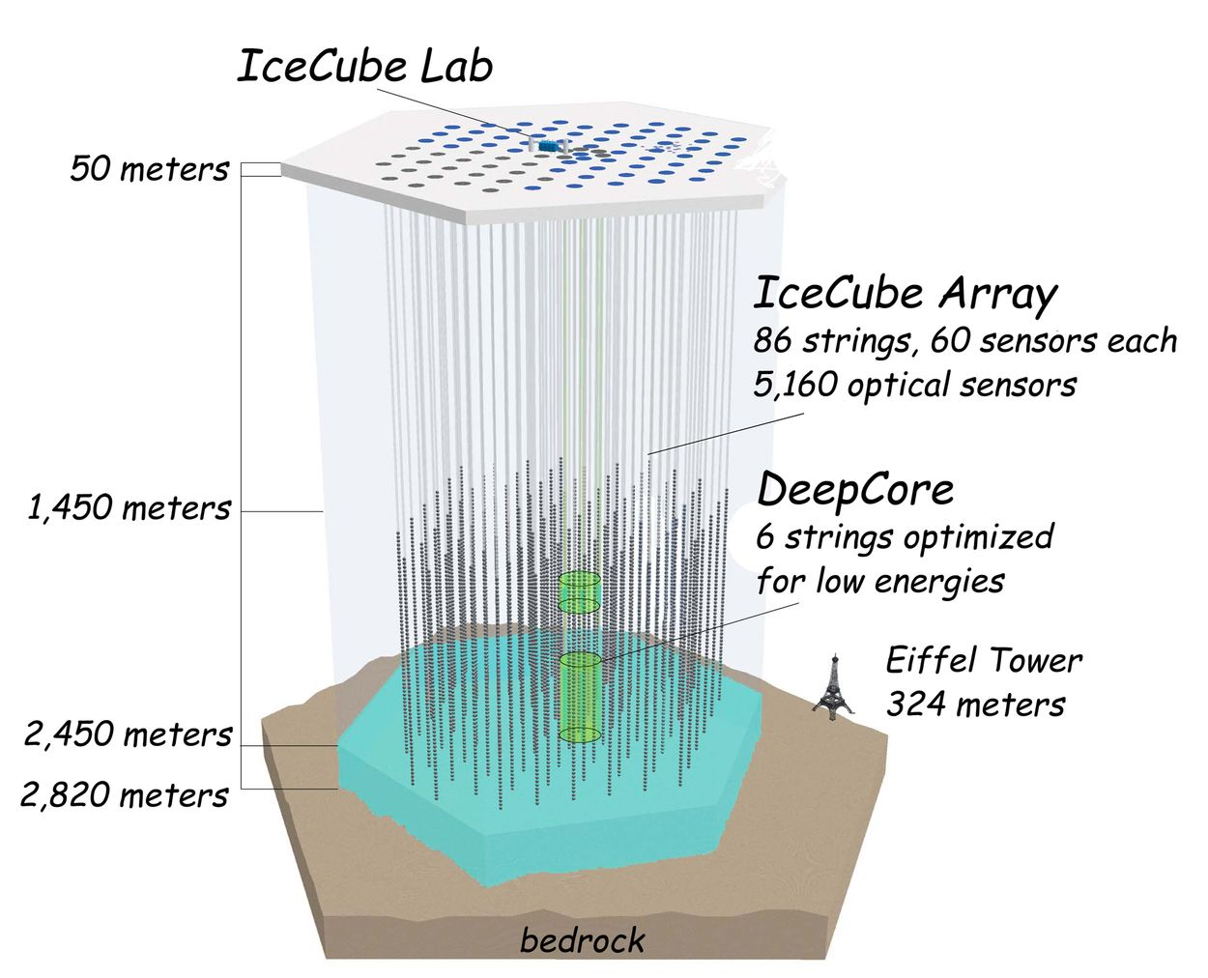
Best final states: WW, ZZ, or leptophilic
So far no anomalous events from Sun observed; Earth less promising
Opportunities with
lower-energy
threshold sub-detectors
DeepCore, PINGU

Slide 23
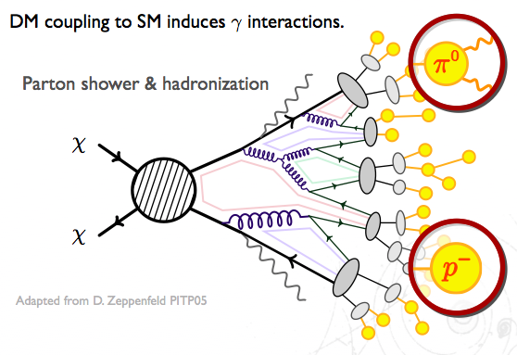
Light from dark matter!
Primary photons: prompt, or internal brems; just run Pythia (if you can!)
Secondary photons: IC, synchrotron

Slide 24
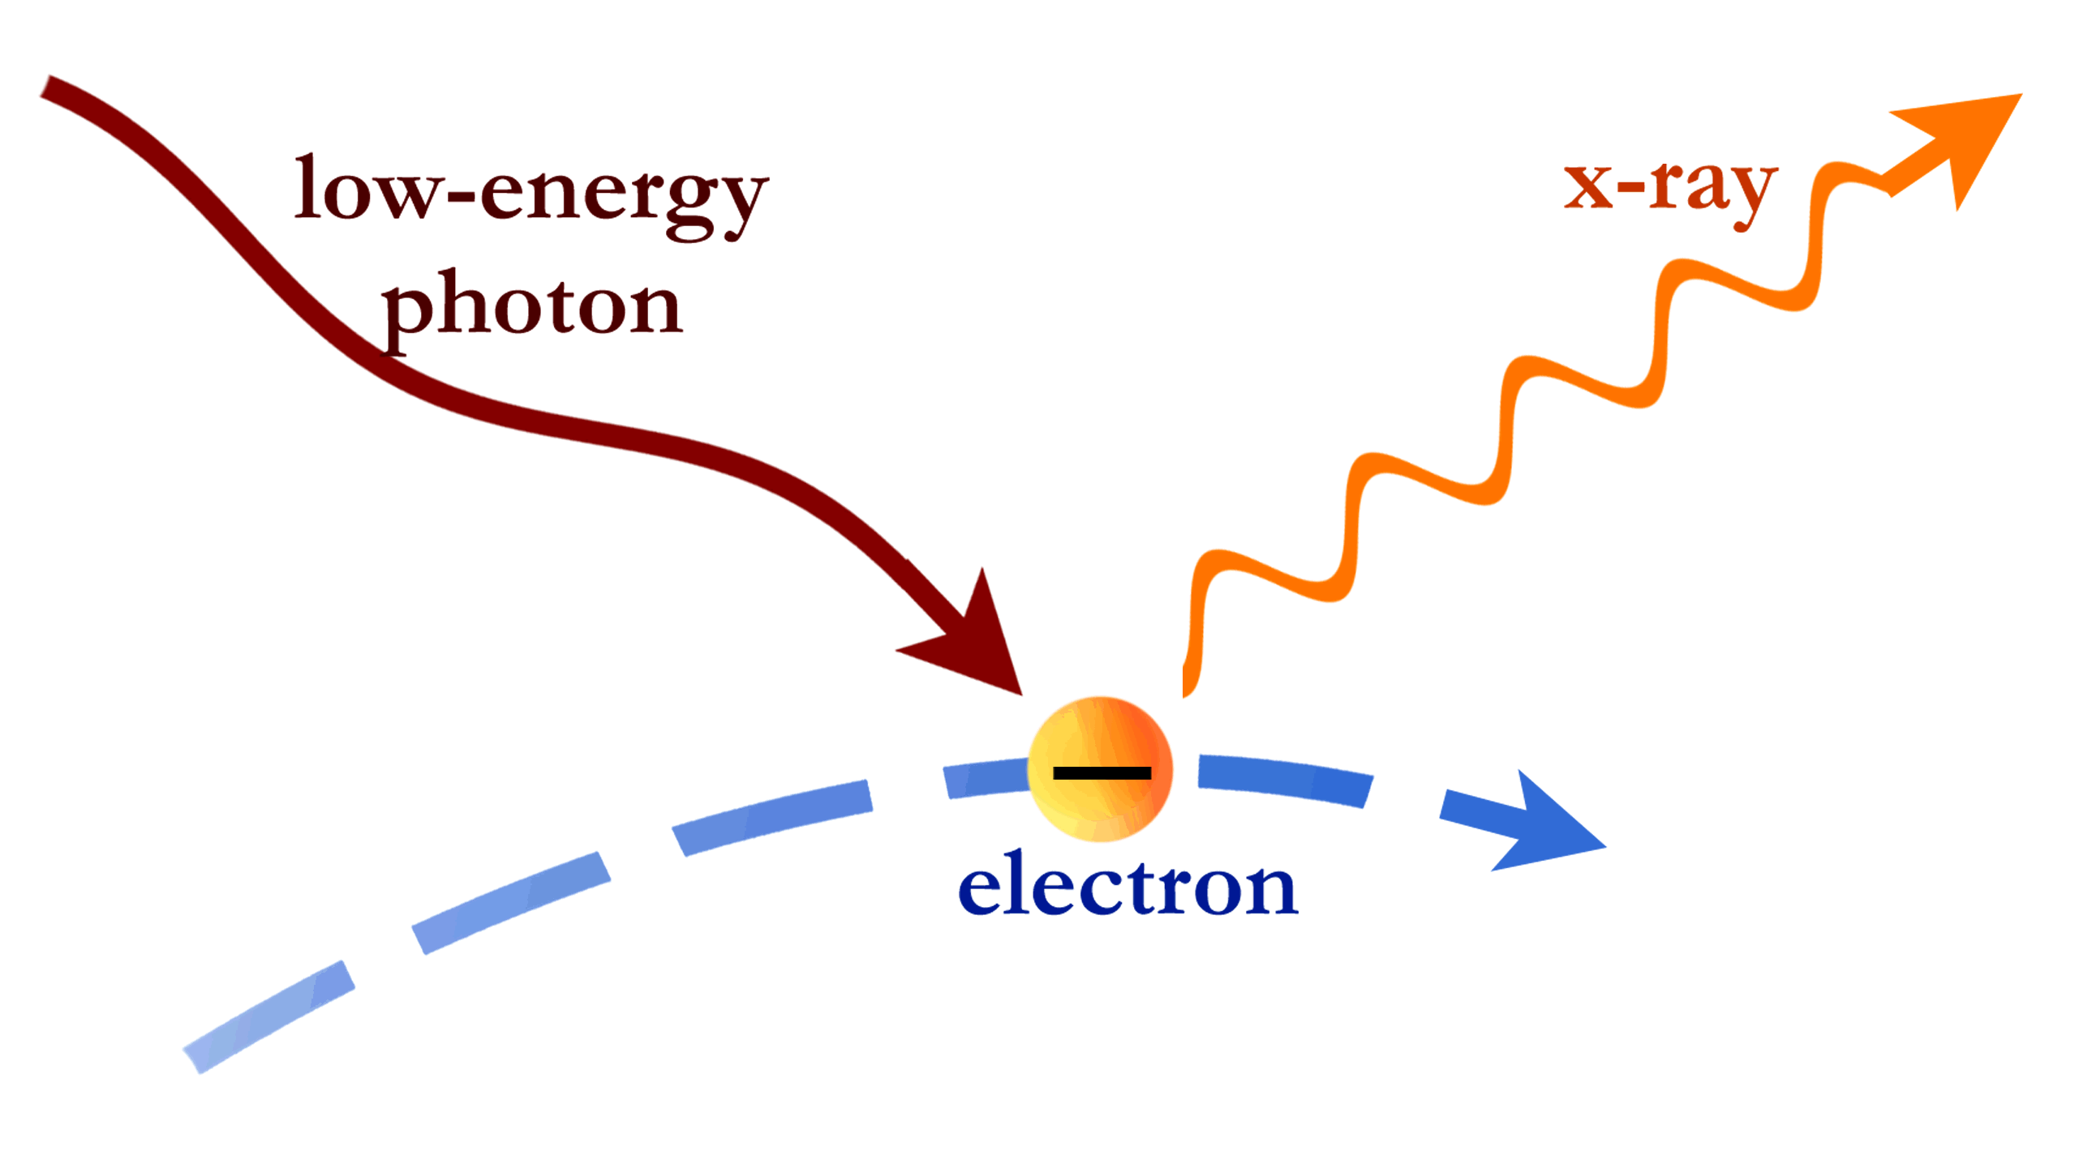
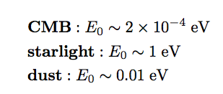

Slide 25
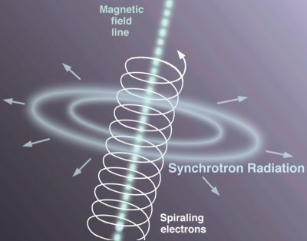

Slide 26
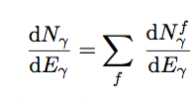
Prompt emission simply depends on
annihilation final state, and target of choice

Slide 27
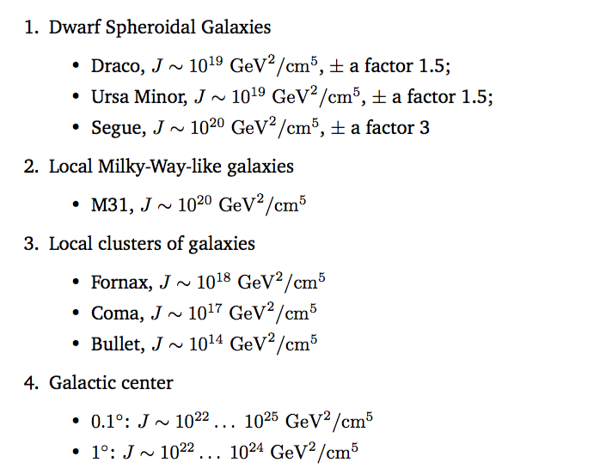
Angular region varies from 1 degree, to 0.1 degrees (10⁻³, 10⁻⁵ sr, resp)

Slide 28
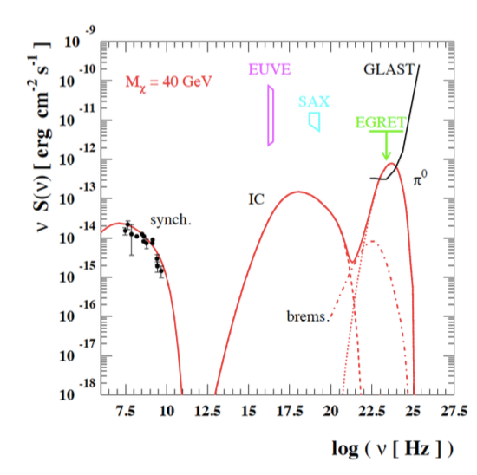
Overall emission looks like this, e.g. in a cluster of galaxies
here, normalization chosen to fit radio emission

Slide 29
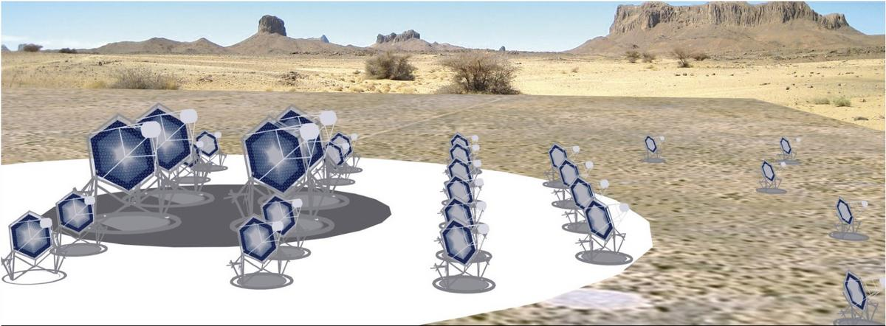
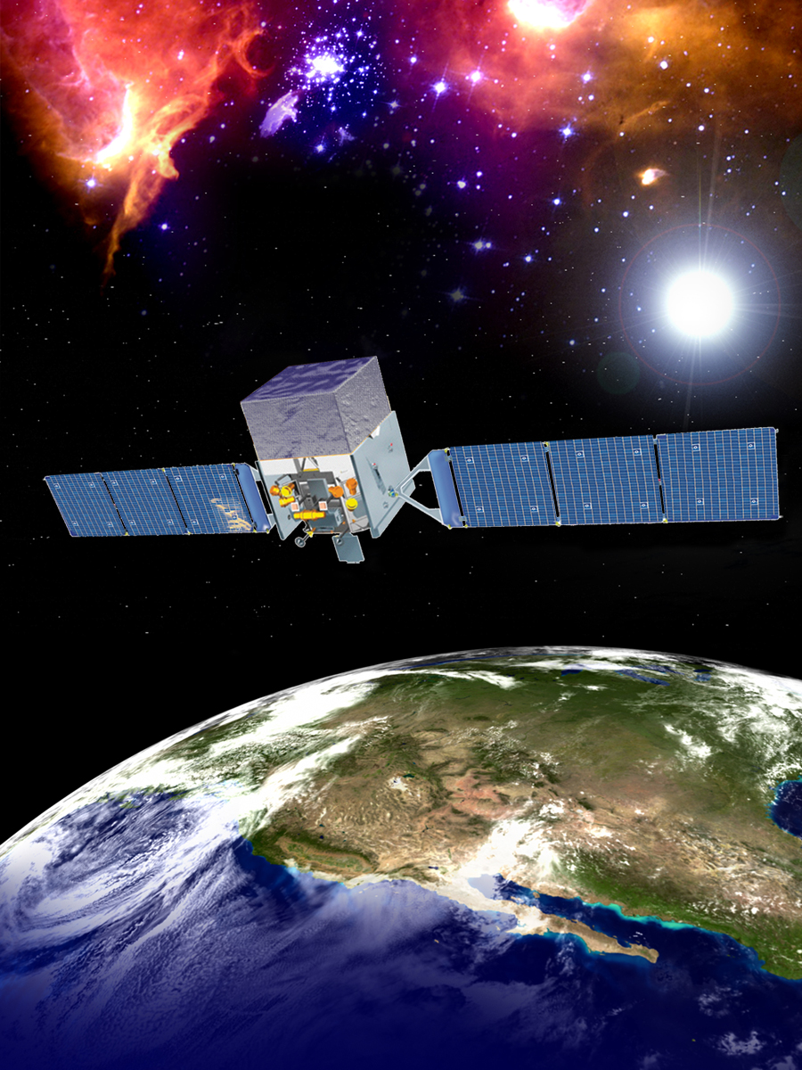
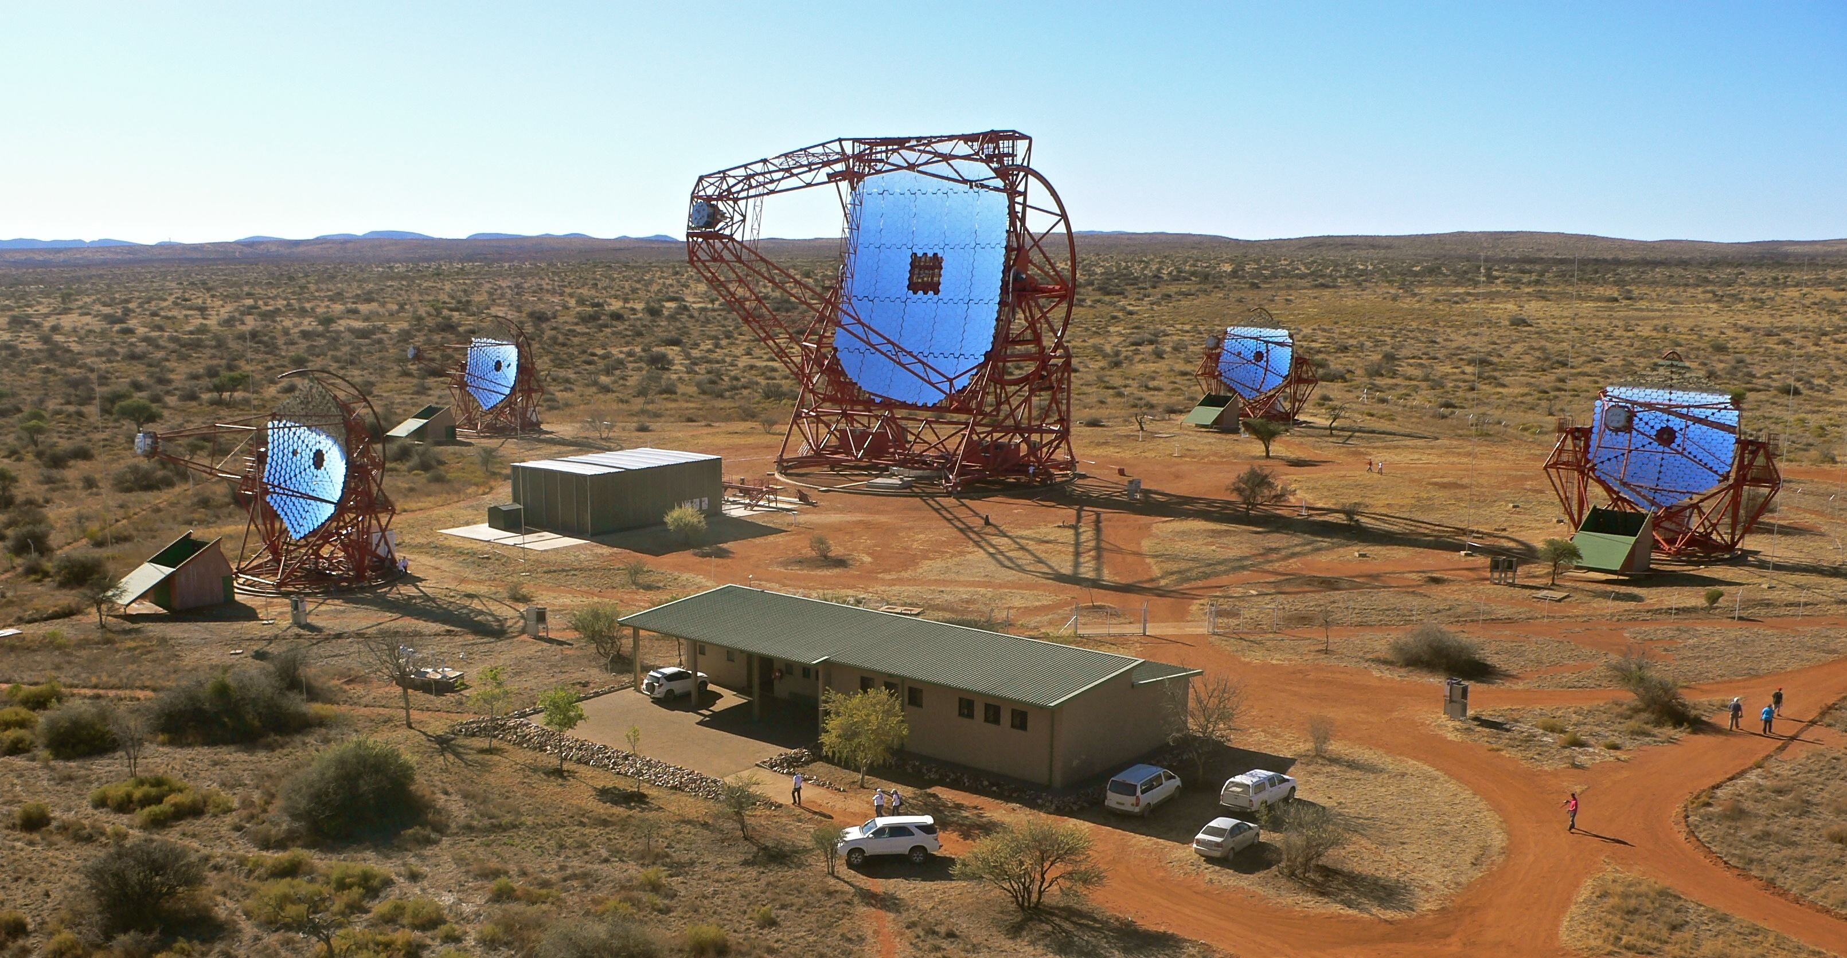

Slide 30
to have a detection: collect some photons, beat background (S/N>>1)

Slide 31
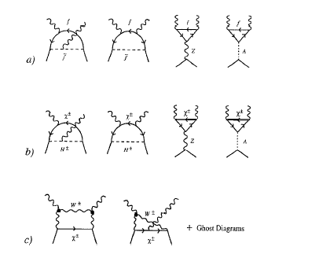
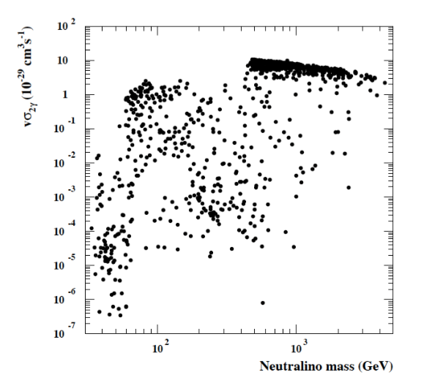
In addition, monochromatic photons

Slide 32
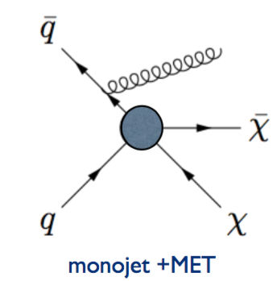
DM particles can be produced at colliders, but at very low rates compared to Galactic DM fluxes... (see problem on next slide)
Idea: look for anomalous events with missing energy and SM particles
(e.g. monojets, monophotons, etc)

Slide 34
Two possible approaches:
(i) top-down: pick a model, select best search strategies, optimize cuts, scan parameter space (e.g. SUSY, UED)
(ii) bottom-up: effective theory, or simplified model – sketch of how DM could manifest itself at colliders...

Slide 35
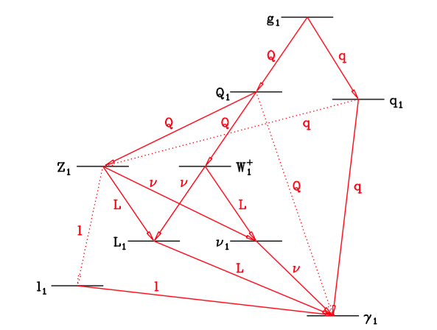

Slide 36
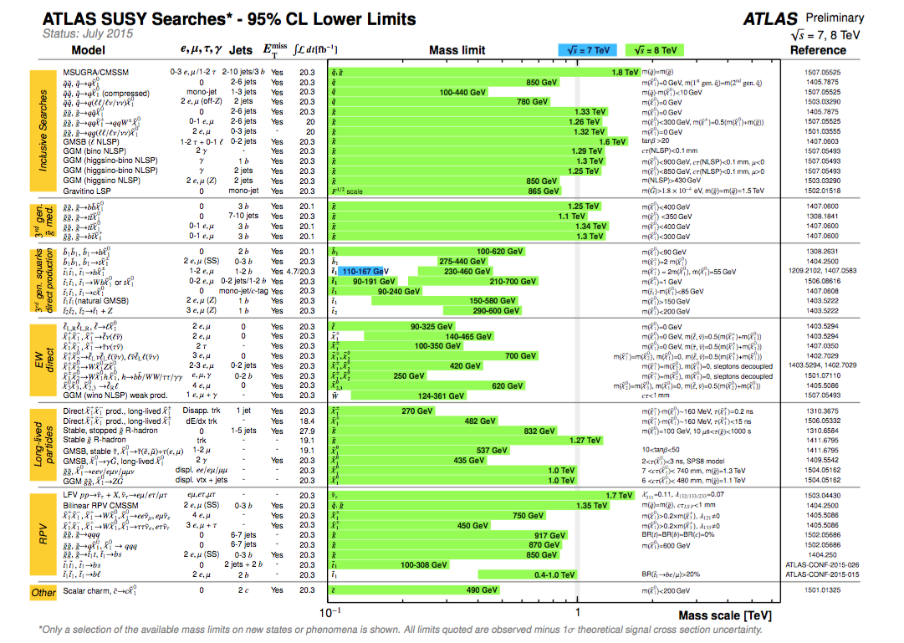

Slide 37
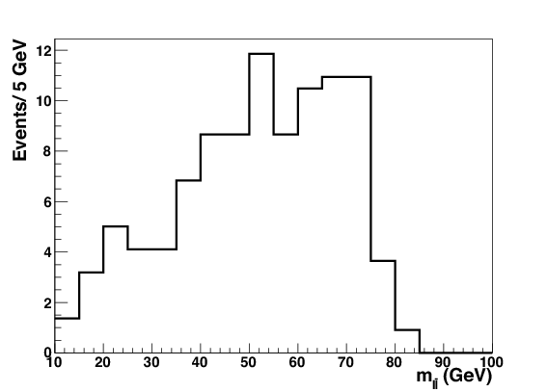
Particle properties can then be reconstructed using e.g. kinematic edges in invariant mass distributions:

Slide 38
Possible to construct invariant mass of multiple particles,
Name of the game: devise cuts
(missing energy, number of jets, OS, SS leptons etc) that maximize S/N

Slide 39
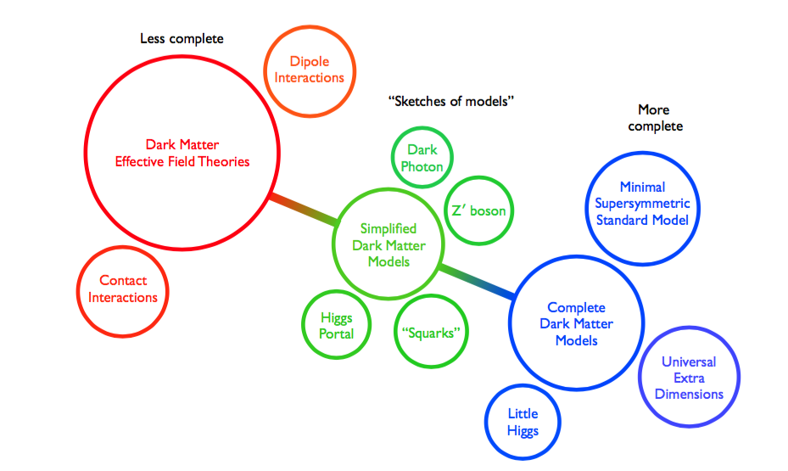

Slide 40
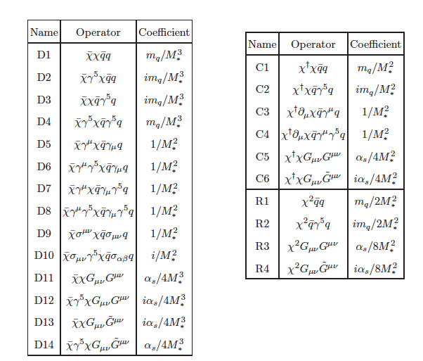
EFT approach: assume some quantum numbers for DM (m,J),
write down effective operators
arXiv:1008.1783 [hep-ph]

Slide 41
Algorithm is usual: calculate production cross section, simulate events, devise best possible set of cuts,
compare S/N, set limits on effective operator scale
Issue: EFT has certain range of validity!
(“cutoff”) scale Λ corresponds to
Whether or not constraints make sense depends on whether the typical energy of the reaction (say momentum transfer P_{tr}) is smaller than, say, 4πΛ

Slide 42
Good example of a test:
In practice, scales probed by LHC very borderline for EFT to make sense... cutoff scale close to P_{tr},
one would expect to produce new physics on-shell...

Slide 43
Alternate approach of simplified models, e.g.
Set (meaningful) constraints on combinations of mediator mass and couplings, for given DM masses
Can compare with direct detection results, but
beware of RG effects in matching scales!!

Slide 44
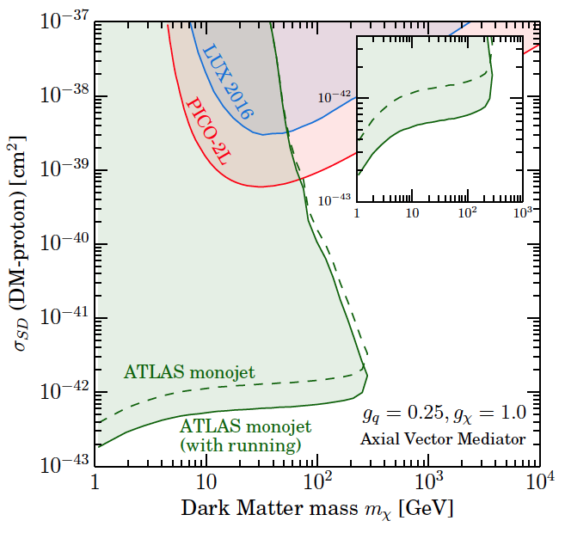

Slide 45
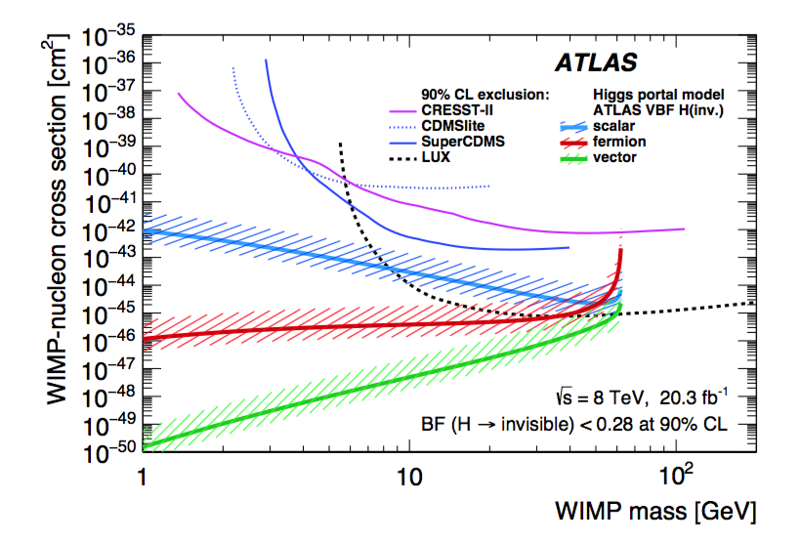
Additional probe: invisible Higgs decay to DM!

Slide 46
Particle properties can then be reconstructed using e.g. kinematic edges in invariant mass distributions:

Slide 47
Possible to construct invariant mass of multiple particles,
Name of the game: devise cuts
(missing energy, number of jets, OS, SS leptons etc) that maximize S/N

Slide 49
EFT approach: assume some quantum numbers for DM (m,J),
write down effective operators
arXiv:1008.1783 [hep-ph]

Slide 50
Algorithm is usual: calculate production cross section, simulate events, devise best possible set of cuts,
compare S/N, set limits on effective operator scale
Issue: EFT has certain range of validity!
(“cutoff”) scale Λ corresponds to
Whether or not constraints make sense depends on whether the typical energy of the reaction (say momentum transfer P_{tr}) is smaller than, say, 4πΛ

Slide 51
Good example of a test:
In practice, scales probed by LHC very borderline for EFT to make sense... cutoff scale close to P_{tr},
one would expect to produce new physics on-shell...

Slide 52
Alternate approach of simplified models, e.g.
Set (meaningful) constraints on combinations of mediator mass and couplings, for given DM masses
Can compare with direct detection results, but
beware of RG effects in matching scales!!

Slide 54
Additional probe: invisible Higgs decay to DM!

Slide 55
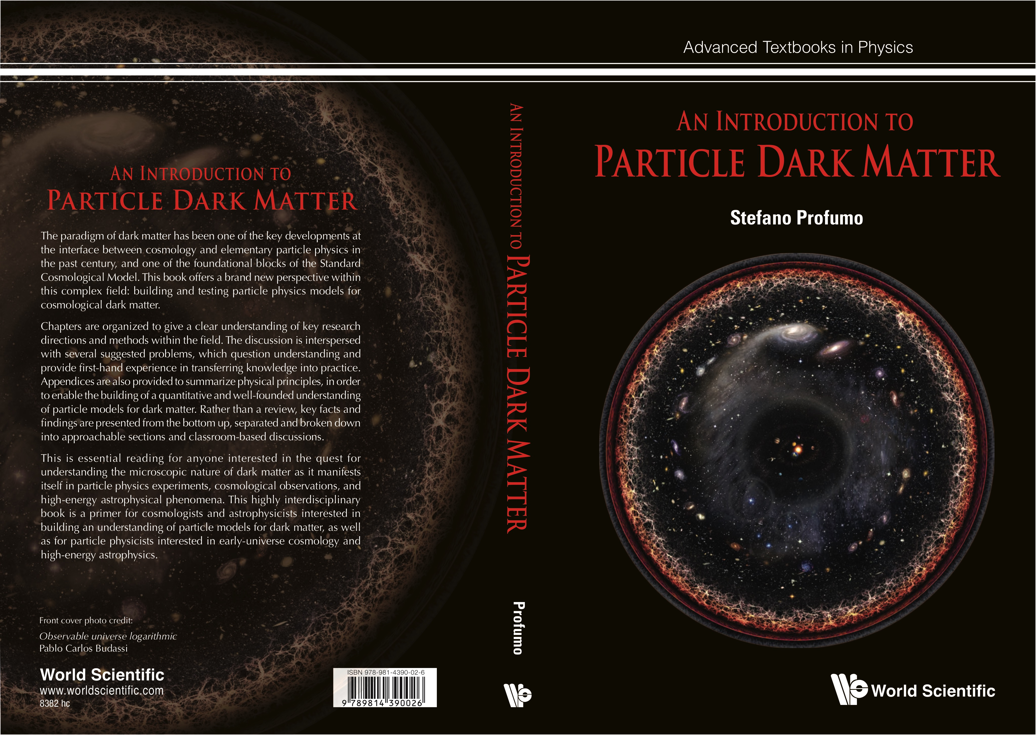
* to appear end of 2016/beginning 2017
Notes:
Also, I have just completed a book on particle dark matter…
I have tested this textbook with the grad students and postdocs in the group, who have been quite enthusiastic about it; I hope it will be useful to the broader community

