Slide 1
The Muon Lifetime
Experiments from the Dark Side of the Muon

Slide 2
The Question:
Does the experimental value for muon lifetime change if it's trajectory is stopped by materials of varying density?
The Hypothesis:
The lifetime will vary, and the packing peanuts will reflect the muon lifetime closest to the accepted value.

Slide 3
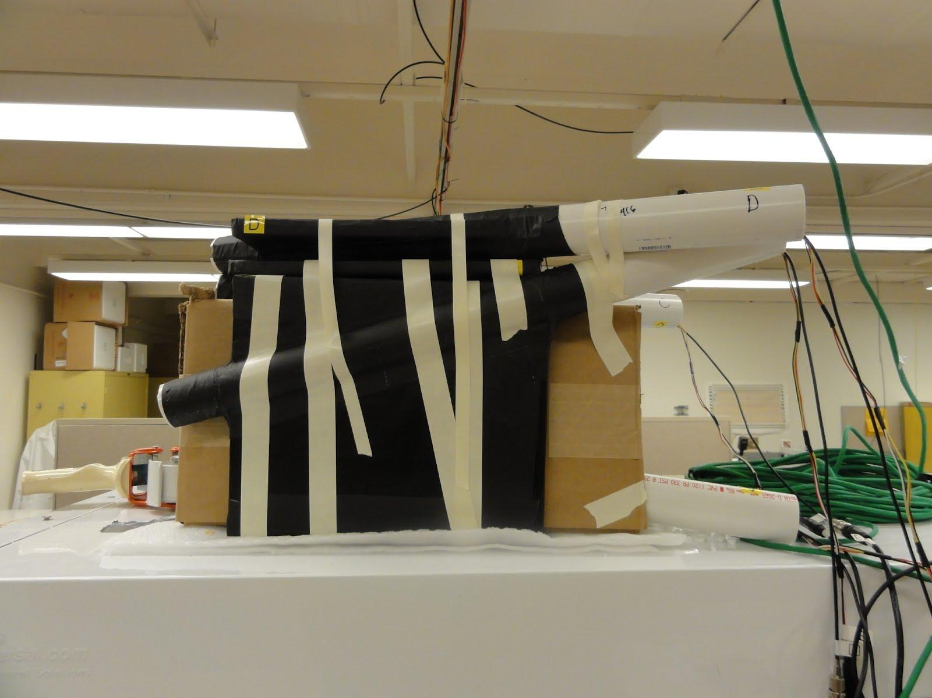
Setup
4 scintilllators
Right trigonal prism
2-fold coincidence between top scintillators
2 filling materials used: air and packing peanuts

Slide 4
Setup

Slide 5
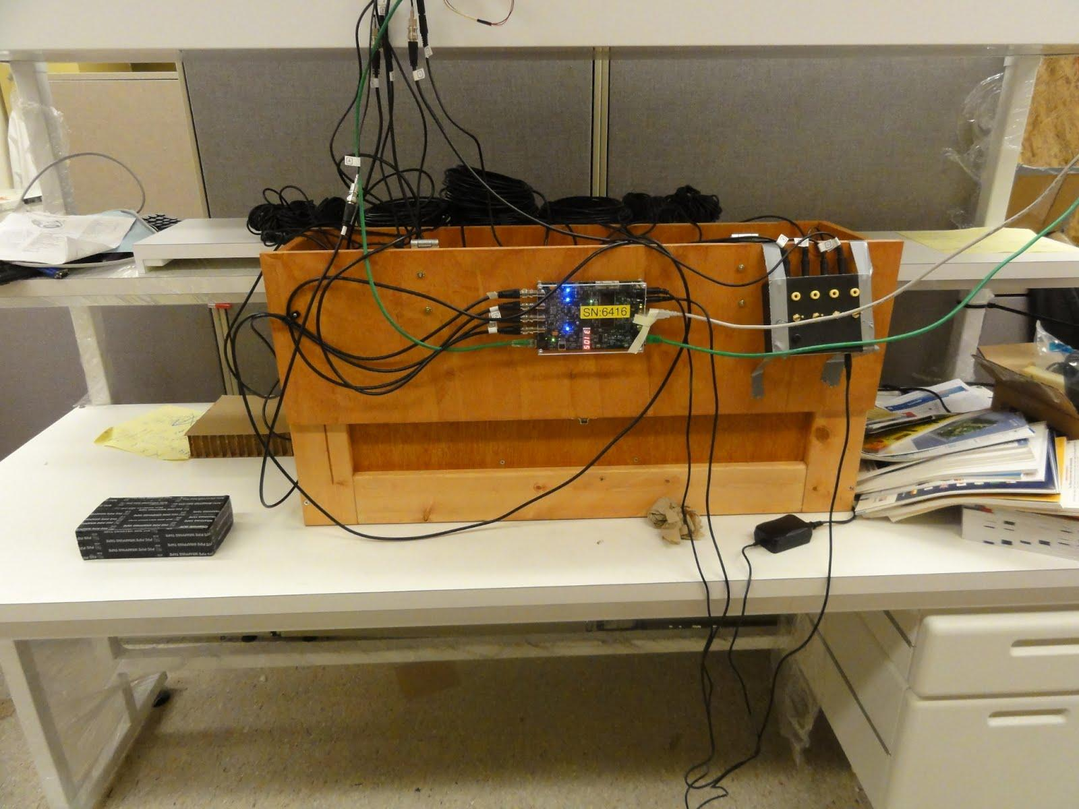
Setup

Slide 6
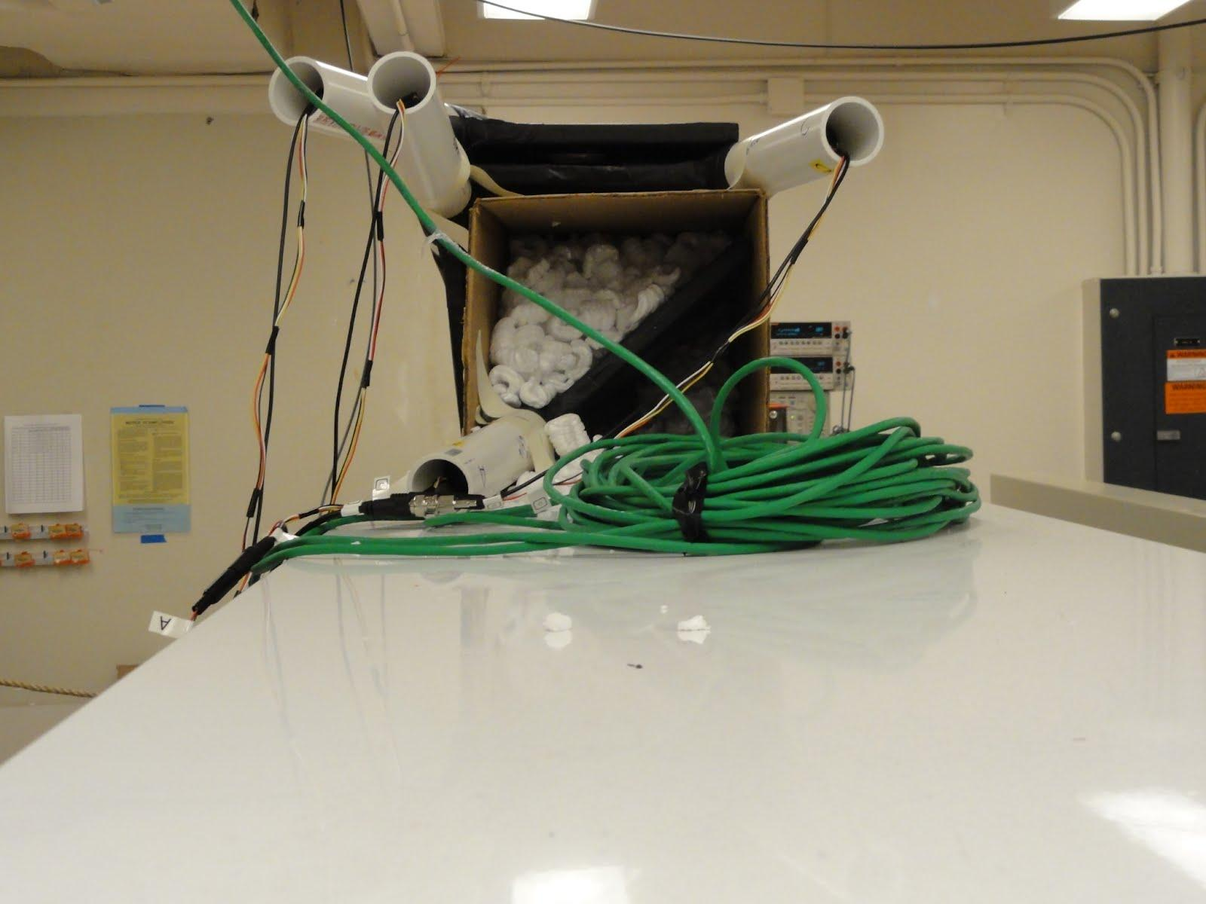
Setup

Slide 7
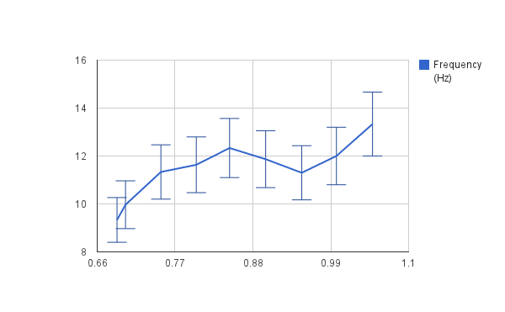
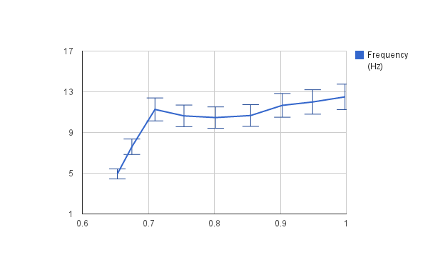
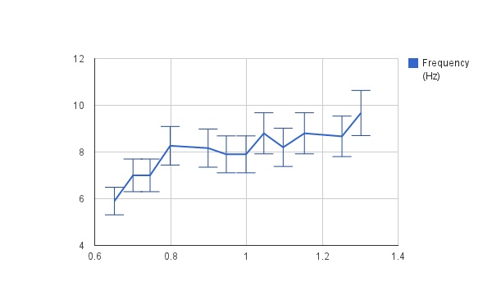
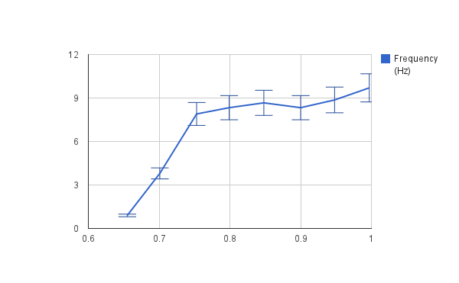
Calibration Plots
A
B
Hz
Hz
V
V
C
D
Hz
Hz
V
V

Slide 8
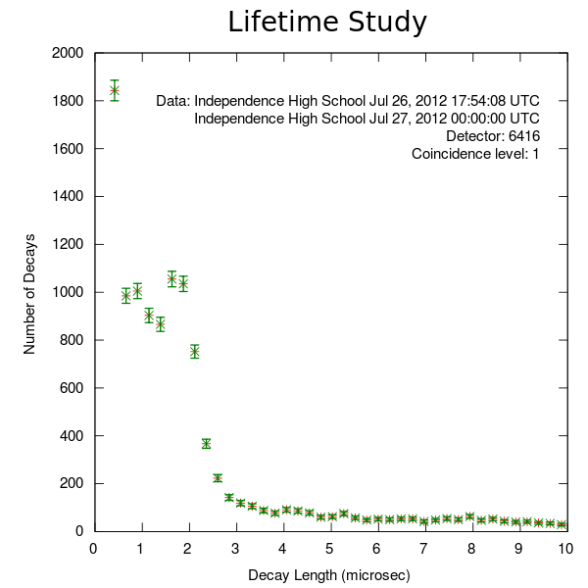
Take One
Air

Slide 9
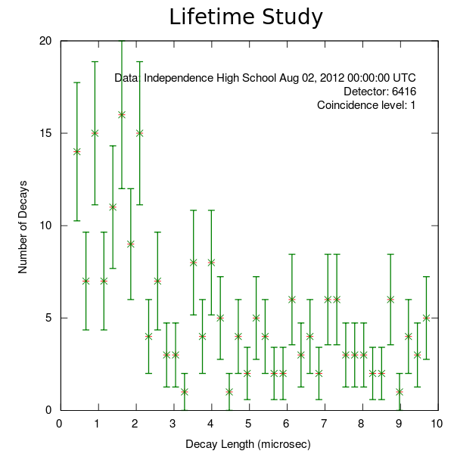
Take Two
Packing Peanuts

Slide 10
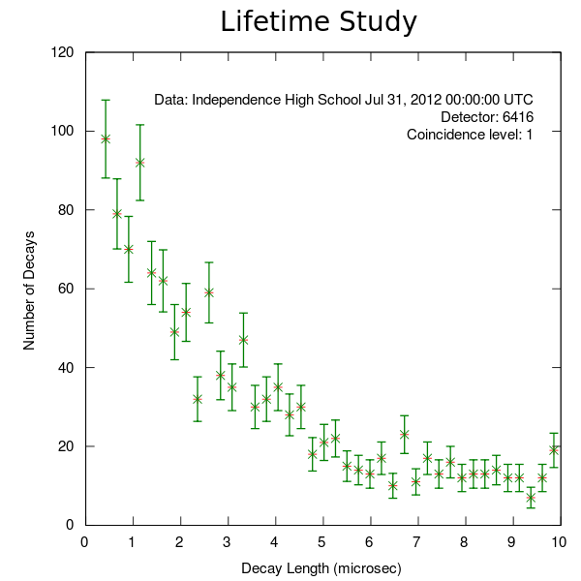
Take Three
Air

Slide 11
Results
Accepted Muon Lifetime | 2.2 microseconds
Packing Peanuts | 7.64
Air Filling | 4.61

Slide 12
Conclusion
We need to test more materials before concluding on an optimal density for measuring muon lifetime.
The density of the material through which muons pass did affect the experimental lifetime. This makes sense, because a denser material will have more atomic nuclei per unit volume, resulting in a larger chance of muon to atom collisions

Slide 13
Works Cited
Muon lifetime: Determination of the fundamental weak coupling constant . Informally published manuscript, Physics, University of Notre Dame, Notre Dame, Retrieved from http://isnap.nd.edu/Lectures/Laboratory/16_Muon_Lifetime.pdf
Thrasher, M. E. (1998). The measurement, simulation, and interpretation of the lifetime of cosmic ray muons . Informally published manuscript, Physics, Harvard University, Cambridge, Retrieved from http://web.mit.edu/rsi/www/pdfs/papers/98/mthrashe.pdf
Special thanks to Steve Ritz, Stu Briber, and Paul Bergeron for their expertise and guidance.

