Slide 1
The ATLAS experiment at the Large Hadron Collider
Jason Nielsen
UC Santa Cruz
July 28, 2010
VERTEX 2004
Notes:
“some of the darkest and most forbidding zones of ignorance in
the existing landscape of fundamental physics”

Slide 2
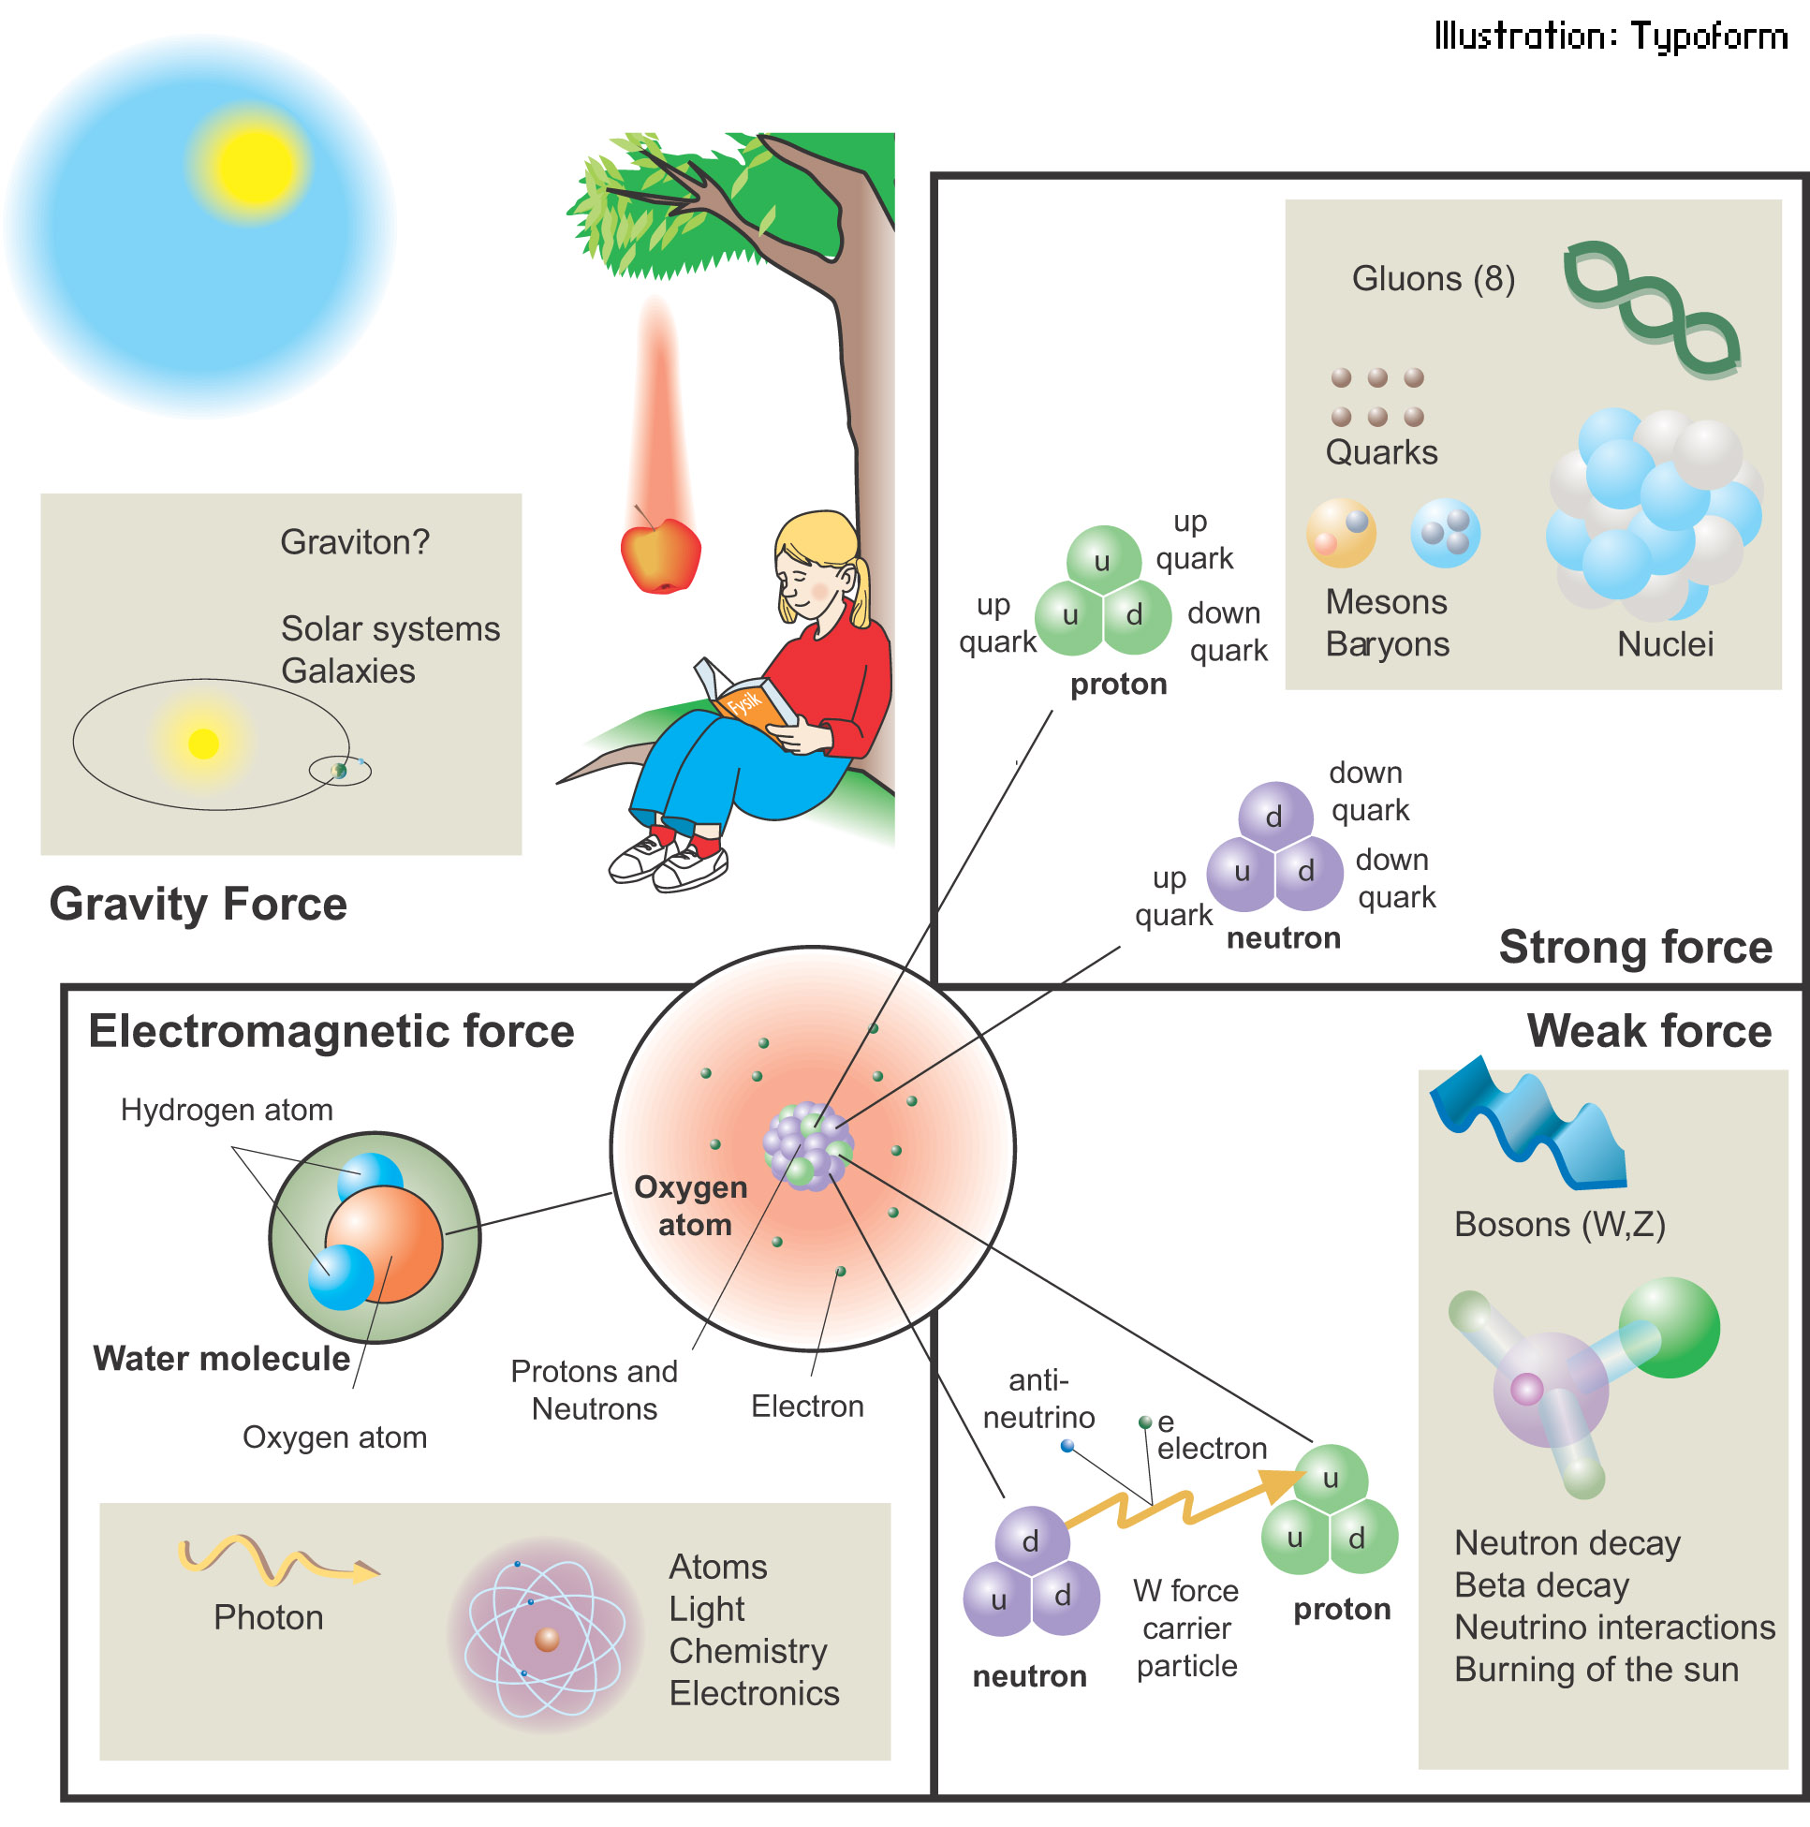
Fundamental Particles & Forces

Slide 3
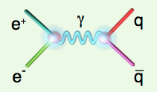
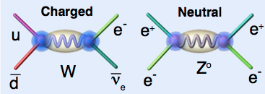
Force Carrier Quanta
Photon (electromagnetic)
verified 1922
mass of photon = 0
W,Z bosons (weak force)
verified 1983
m_{W}, m_{Z}: 80 GeV/c², 91 GeV/c²
Gauge symmetry is fundamental to electrodynamics
when extended to electroweak theory, requires massless W,Z
how to accomodate their large masses?

Slide 4
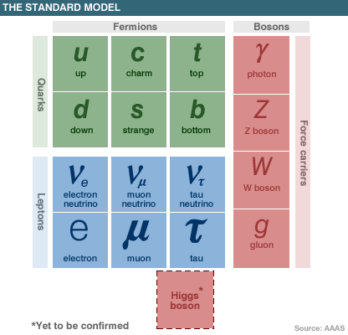
Standard Model of Particle Physics

Slide 5
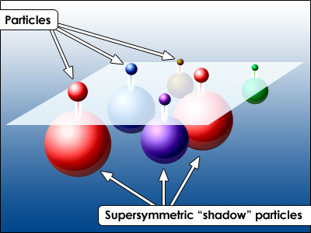
Beyond the Standard Model
Maybe these “shadow” particles are the astronomical dark matter

Slide 6
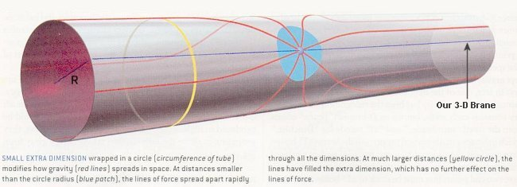
Hunting for Extra Dimensions
Excitations of particles in extra dimensions will show up as high-mass particles in the ATLAS detector

Slide 7
So What IS the Higgs boson?
Higgs boson is a condensate of the pervasive Higgs field
Higgs field “grabs” particles and slows them down (gives them mass)
Similar to photon, except Higgs boson is not a force carrier
What kinds of particles do it couple to?
Its couplings are proportional to the fermion masses
So it couples most strongly to the most massive particles
This makes it clear how to search for it, if it exists…

Slide 8
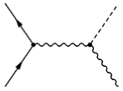
How to Produce a Higgs Boson
-
Physical Higgs bosons can be produced, given enough energy
q
H
Z*
(Here E_{CM} > m_{H} + m_{Z})
q
Z
That’s where the collider comes in
But Higgs boson is fleeting:
decays immediately to
characteristic “final state”
b
H
b
Z
q
q
That’s where the detector comes in

Slide 9
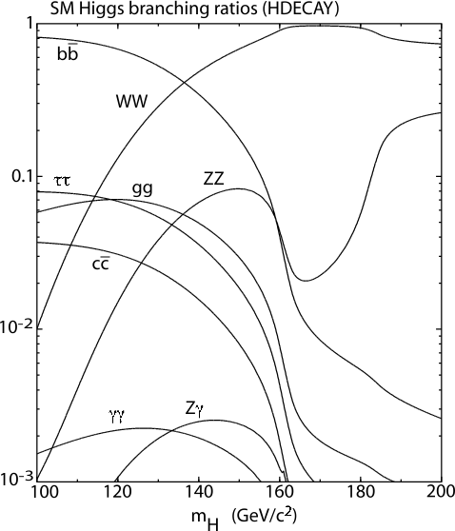
How does the Higgs Boson Decay?
Notice coupling to massive particles (bb, ττ, WW, ZZ)
For low mass Higgs, expect decay to b quark pairs;
For very high mass Higgs expect decay to ZZ

Slide 10
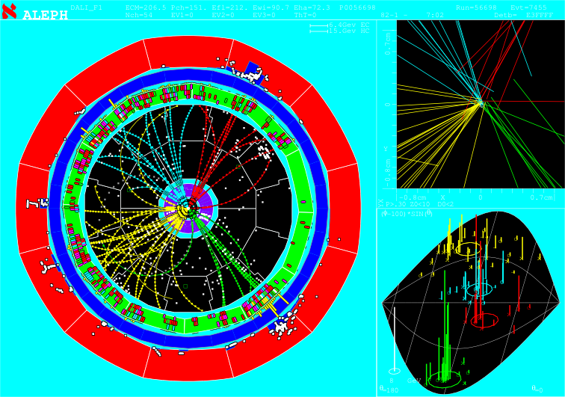
One Provocative Candidate Event
HZ → bbbb selection
E_{CM}=206.7 GeV
3 NN b-tagged jets
Reconstructed m_{H} = 110 ± 3 GeV/c²

Slide 11
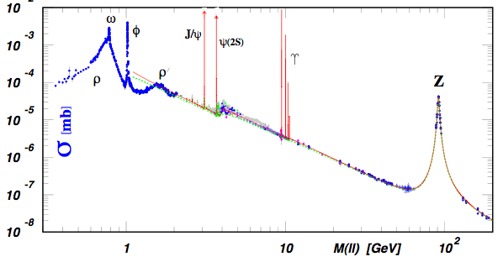
Bumps in the Mass Spectrum
Decay products of the Higgs boson form a mass resonance
- similar to resonances from past discoveries of new particles
Strategy for identifying Higgs boson production:
Excess of events in Wbb signature (or other signature)
Higgs decay products form a invariant mass peak

Slide 12
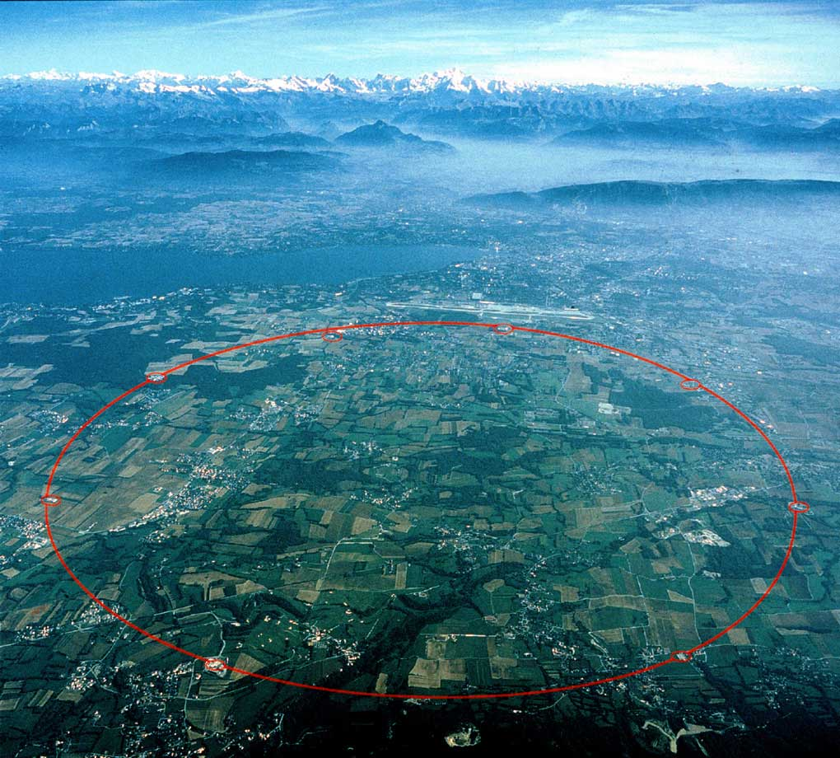
Large Hadron Collider at CERN
Next generation collider: currently taking data
Italy
Luminosity target: 10³⁴cm⁻² s⁻¹
Total stored energy > 1 GJ
p
14 TeV
p
Increased production of heavy
particles like Higgs, top quark
ATLAS
CMS
More particles at higher energy
requires new detector design
and technology

Slide 13
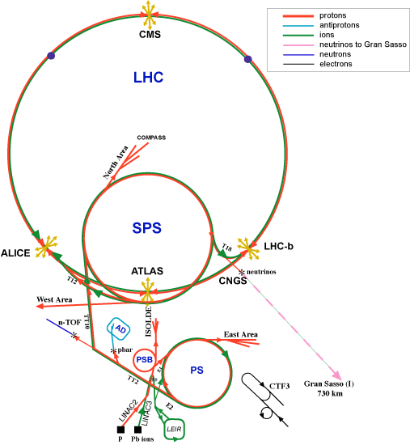
CERN Accelerator Chain

Slide 14
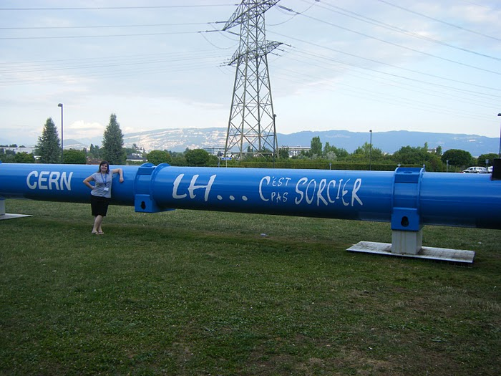
CERN LHC Bending Magnet (Dipole)

Slide 15
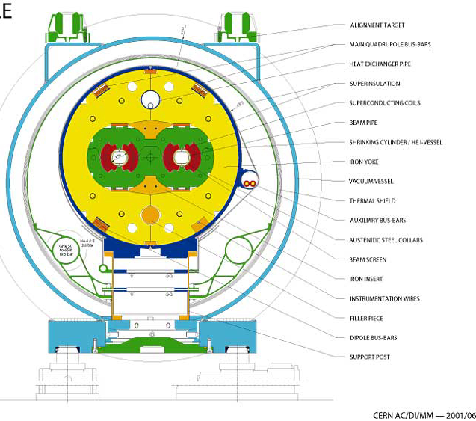
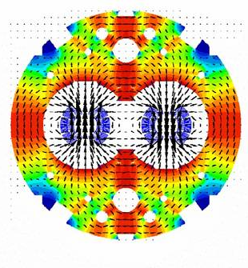
Two Beams in the Same Cryostat

Slide 16
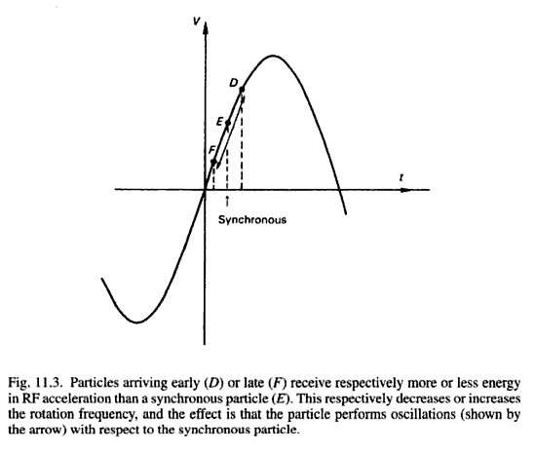
Surfing the Radio-frequency Wave
D
E
F

Slide 17
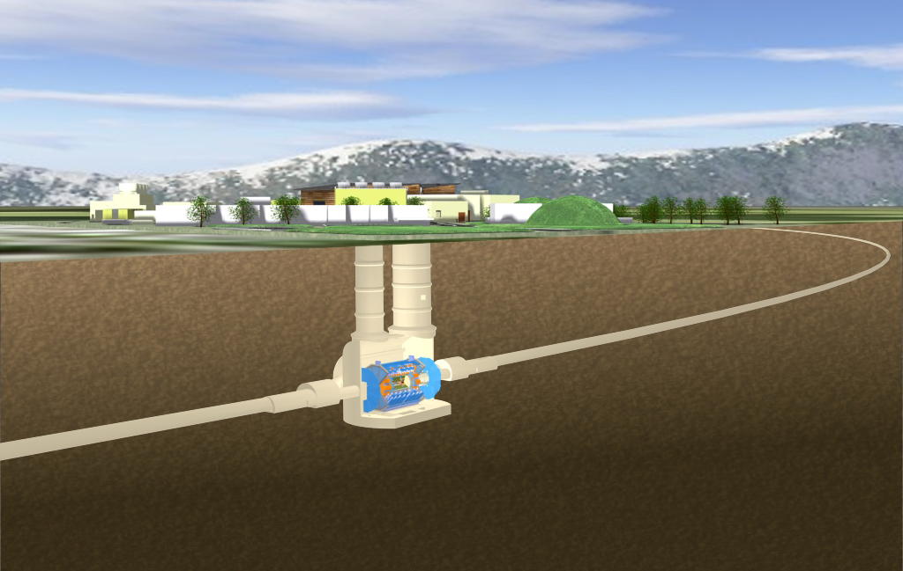
ATLAS Experiment at LHC

Slide 18
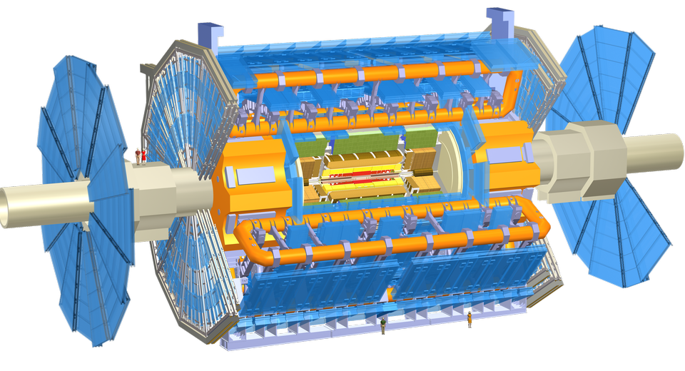
ATLAS Experiment at LHC
ATLAS
collaborator

Slide 19
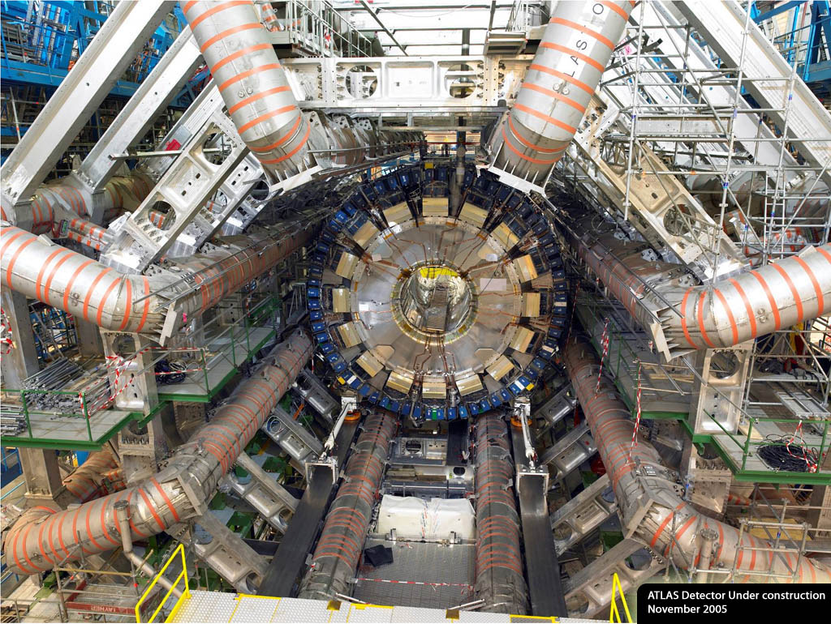
ATLAS DETECTOR
Nov. 2005

Slide 20
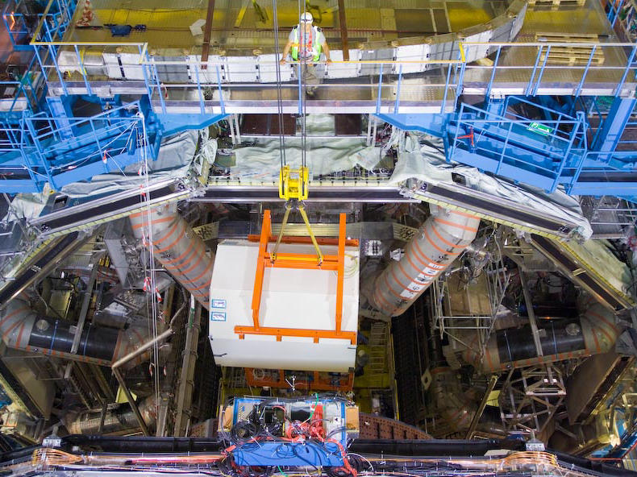
Installation of inner detector end-cap

Slide 21
More videos at http://www.atlas.ch/

Slide 22
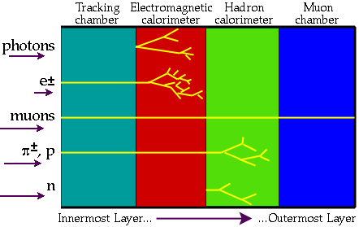
Identifying Particle Signatures
ATLAS trigger system can identify specific signatures online

Slide 23
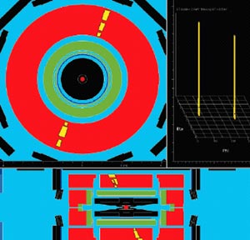
Cosmic-ray Tests with ATLAS

Slide 24
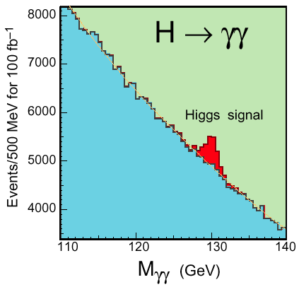
Higgs Decay to Photons
Rare decay in SM
t
γ
H
t
γ
LHC detectors have been optimized to find this peak!

Slide 25
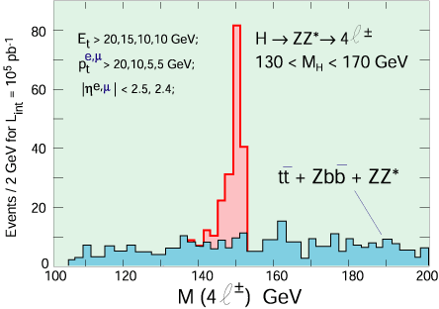
Higgs Decay to ZZ
Requires precise measurement of muon curvature

Slide 26
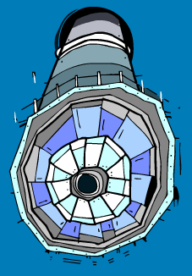
“Hunt for Higgs” WWW Site
One of the best I’ve seen at describing what really happens
http://www.sciencemuseum.org.uk/antenna/bigbang/huntforhiggs/index.asp
Let’s have a look together at the “Hunt for Higgs”

Slide 27
