Slide 2
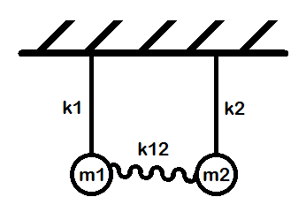
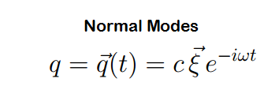
Solving Vibrational Problems… So easy!!

Slide 3
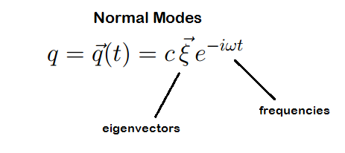
Solving Vibrational Problems… So easy!!

Slide 4
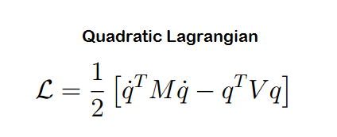
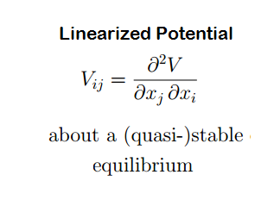
Solving Vibrational Problems… So easy!!

Slide 5
Solving Vibrational Problems… So easy!!
…right?
How to model the potential?
9x9 matrix.
Don’t screw up your partials!

Slide 6
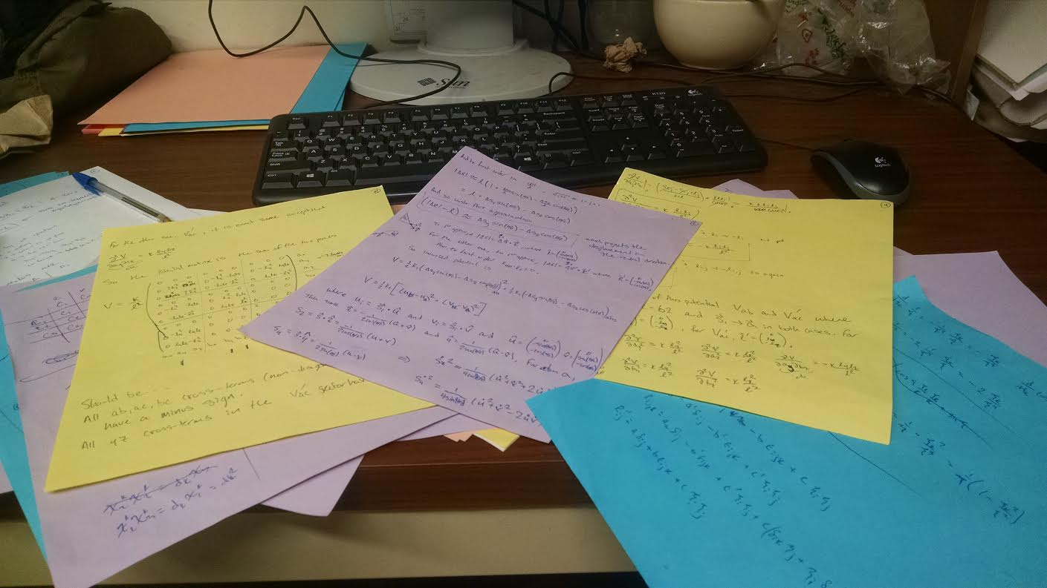
Model needs Simplicity, Complexity, Symmetry, Accuracy.
Forget it! ---------- What can SYMMETRY ALONE tell us?

Slide 8
Deduce Vibrations of H₂0 with Group Theory
Find H20 symmetry group.
What rep acts on our coord space?
Find which irreps correspond to a normal mode.
Get degeneracies and eigenvectors.

Slide 9
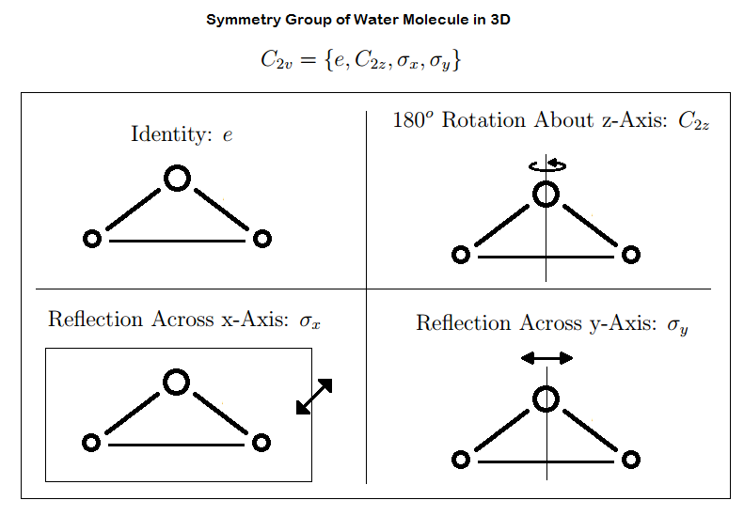

Slide 10
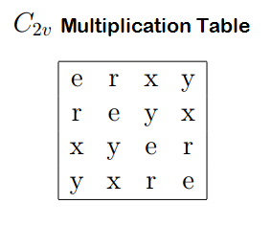
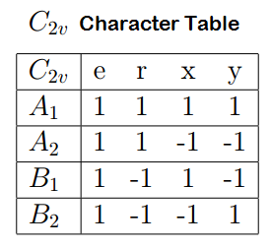

Slide 11
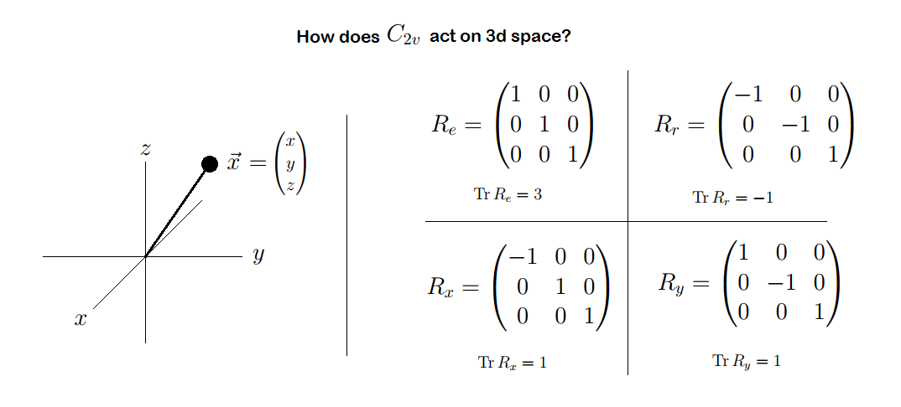

Slide 12
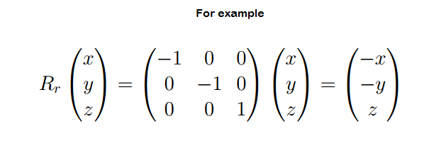

Slide 13
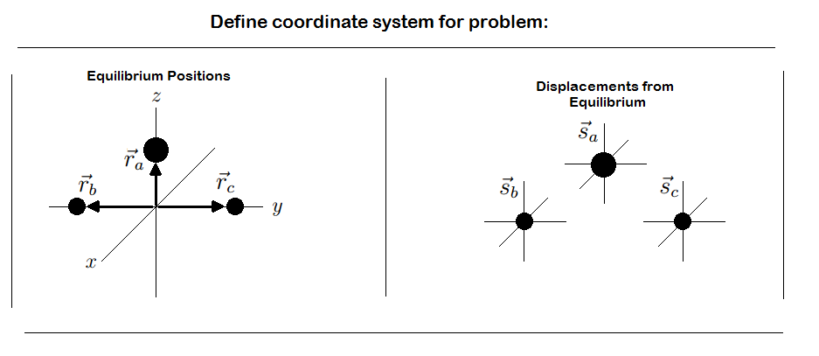

Slide 16
Can’t change the frequency!

Slide 17
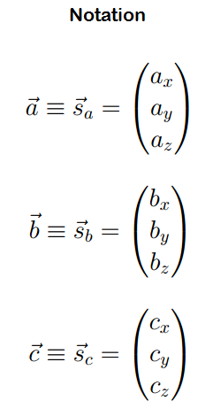
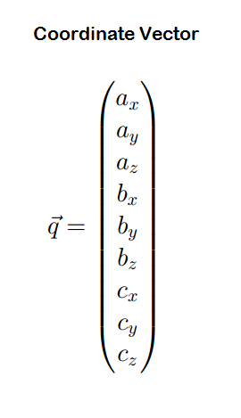
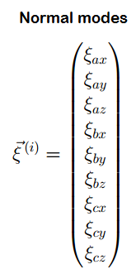
Aside: Notation

Slide 18
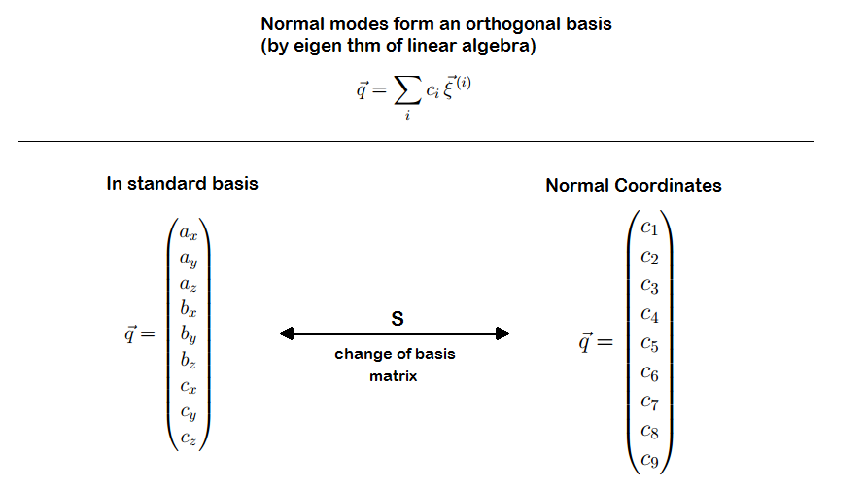
Aside: Notation
OK, back to it…

Slide 19
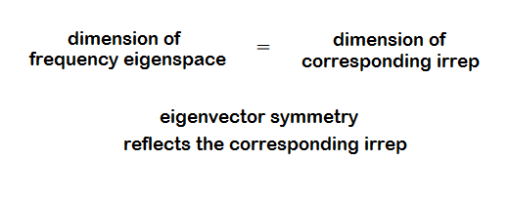
Rep on coordinate space is equivalent to rep in normal mode space.
Each frequency eigenspace is an invariant subspace of the representation!!
Thus each frequency eigenspace corresponds to some irrep of G such that:
Use characters to deduce which irreps are present. Then eliminate translations and rotations and identify eigenvectors using symmetry.

Slide 20
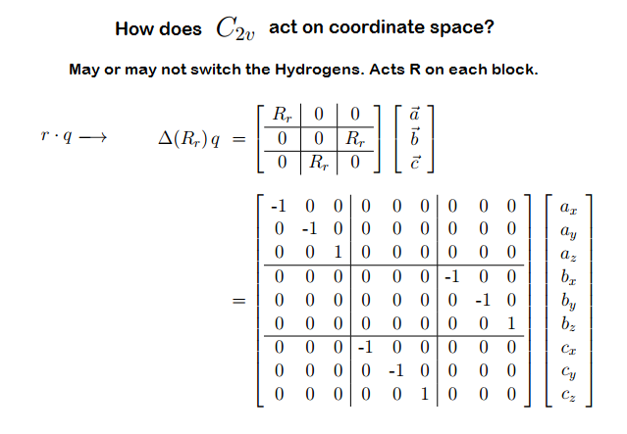

Slide 21
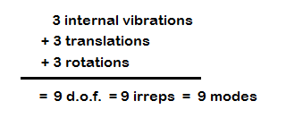

Slide 22
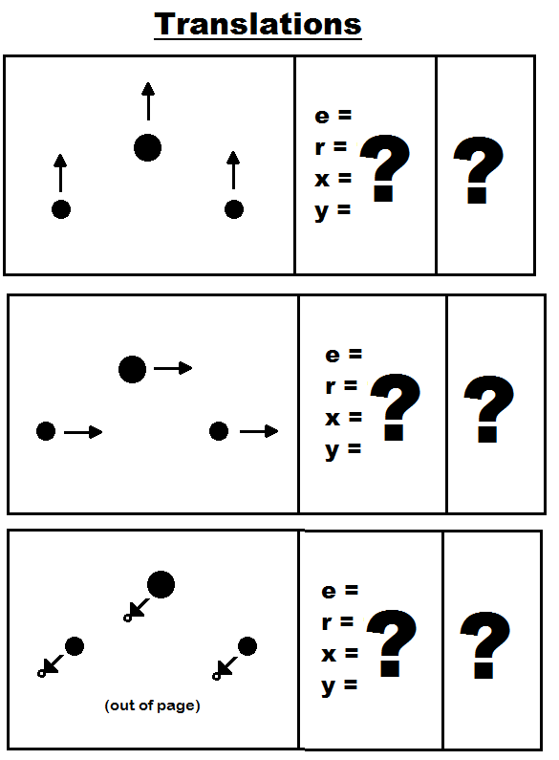
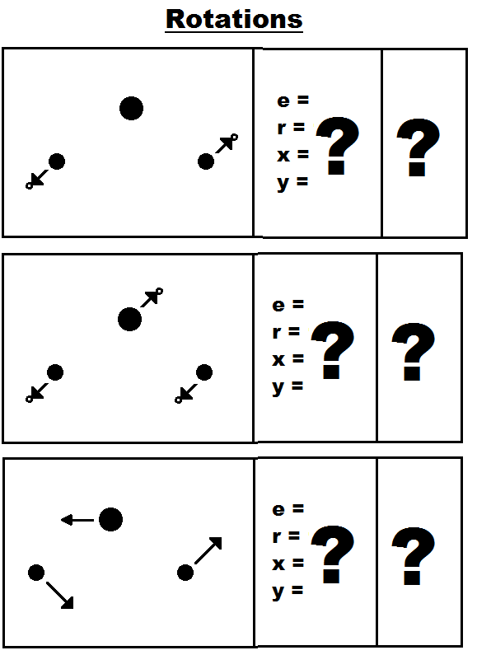
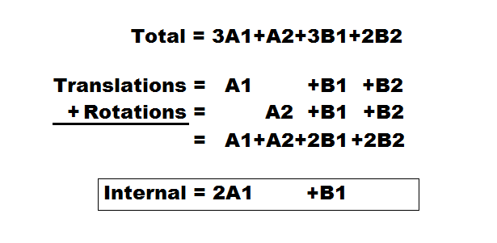
How many reps?

Slide 23
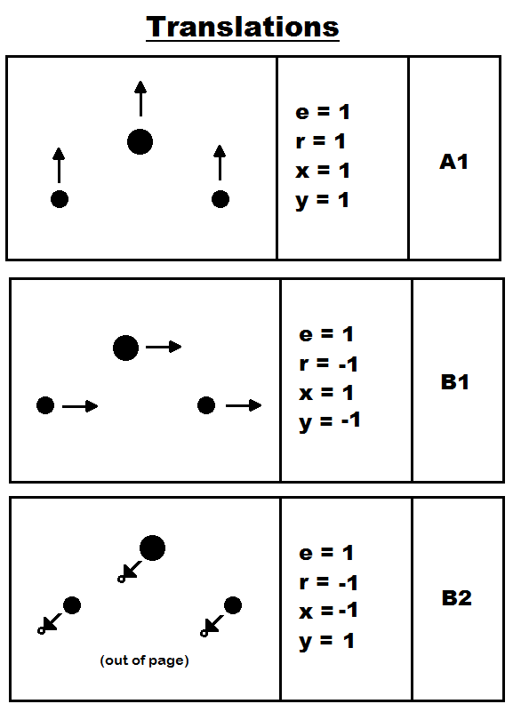
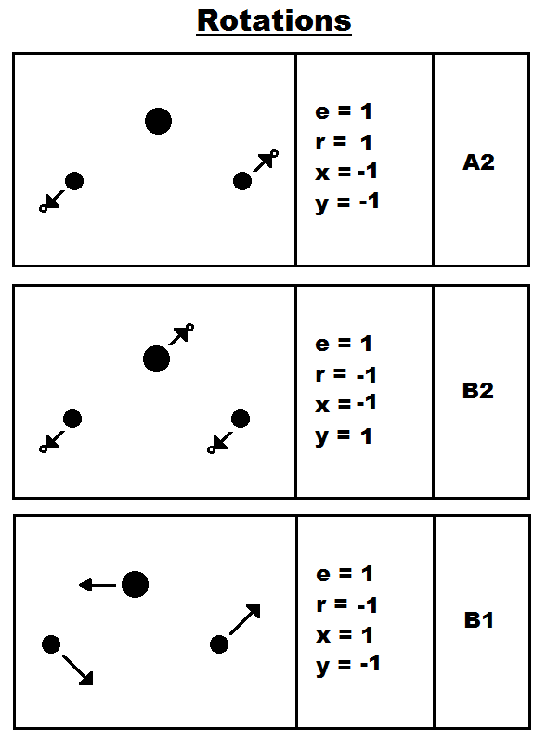
How many reps?

Slide 24
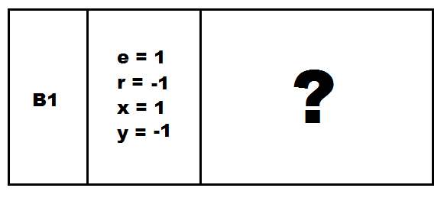
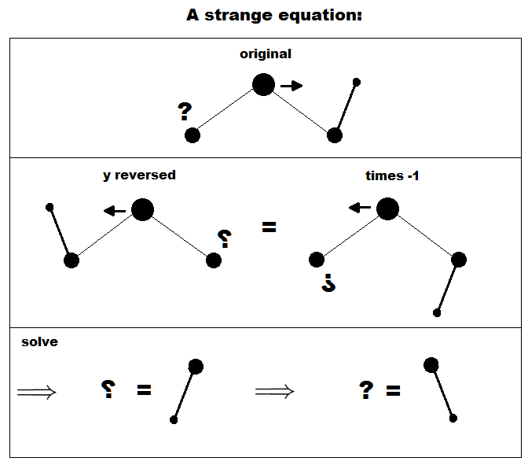
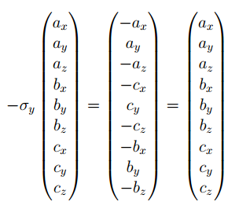
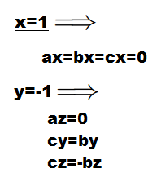
Internal Vibrations: B1 Mode

Slide 25
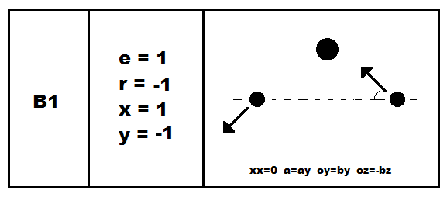
Internal Vibrations: B1 Mode

Slide 26
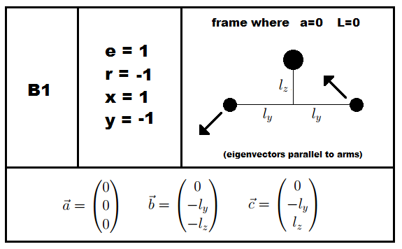
B1 Mode

