Slide 1
Research on the Theory of the Terascale
Howard Haber
SCIPP Theory
January 11, 2016

Slide 2
SCIPP Particle Theory Group
Michael Dine: supersymmetry, string theory, and the early universe
Howard Haber: Higgs bosons, collider physics, new physics beyond the Standard Model at the terascale (including supersymmetry)
Stefano Profumo: Theories of particle dark matter and their implications for astrophysics and collider phenomenology
In addition, Anthony Aguirre and Joel Primack work on a variety
of topics overlapping particle theory and astroparticle theory,
including dark matter, early universe cosmology, inflation, …

Slide 3

The Standard Model (SM) of Particle Physics
The elementary particles consists of three generations of spin-1/2 quarks and leptons and the gauge bosons of SU(3)xSU(2)xU(1).
Technically, massive neutrinos
require an extension of the Standard
Model, but most likely the relevant
scale of the new physics lies way
beyond the terascale.

Slide 4
Origin of mass for elementary particles
Naively, an SU(3)xSU(2)xU(1) gauge theory yields massless gauge bosons and massless quarks and leptons, in conflict with observation. The Standard Model employs the Higgs mechanism for mass generation. The SU(2)xU(1) electroweak gauge invariance is spontaneously broken down to U(1)_{EM}, which yield the massive W and Z gauge bosons. In the simplest implementation, a spinless physical Higgs scalar is predicted.

Slide 5
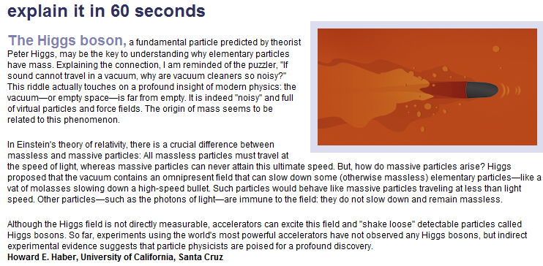
From Symmetry Magazine, volume 3, issue 6, August 2006

Slide 6
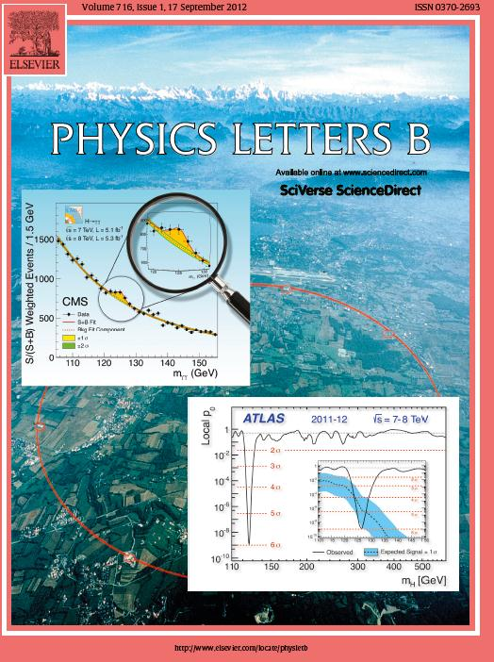
On July 4, 2012, the discovery
of a new boson is announced
which may be the long sought
after Higgs boson.
The discovery papers are
published two months later
In Physics Letters B.
ATLAS Collaboration:
Physics Letters B716 (2012) 1—29
CMS Collaboration:
Physics Letters B716 (2012) 30—61

Slide 7
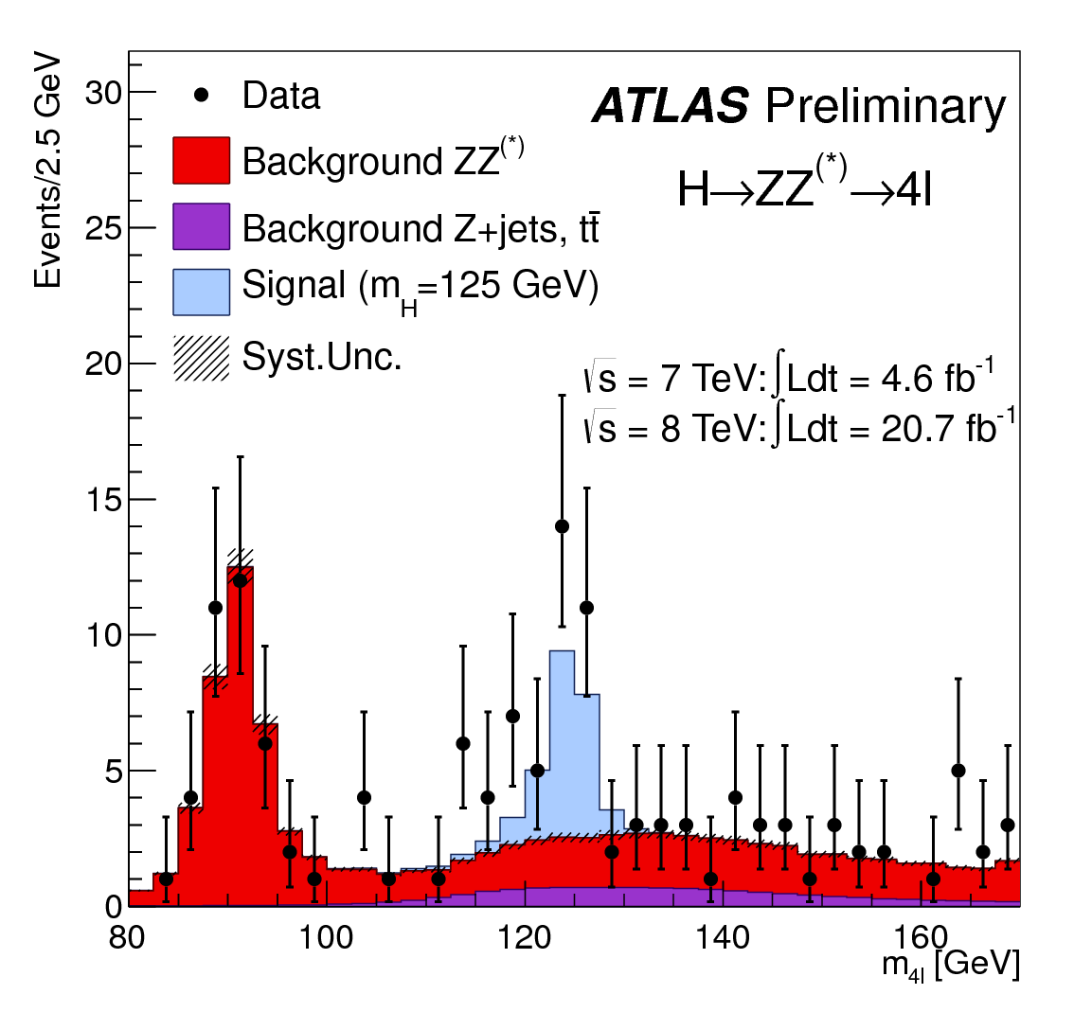
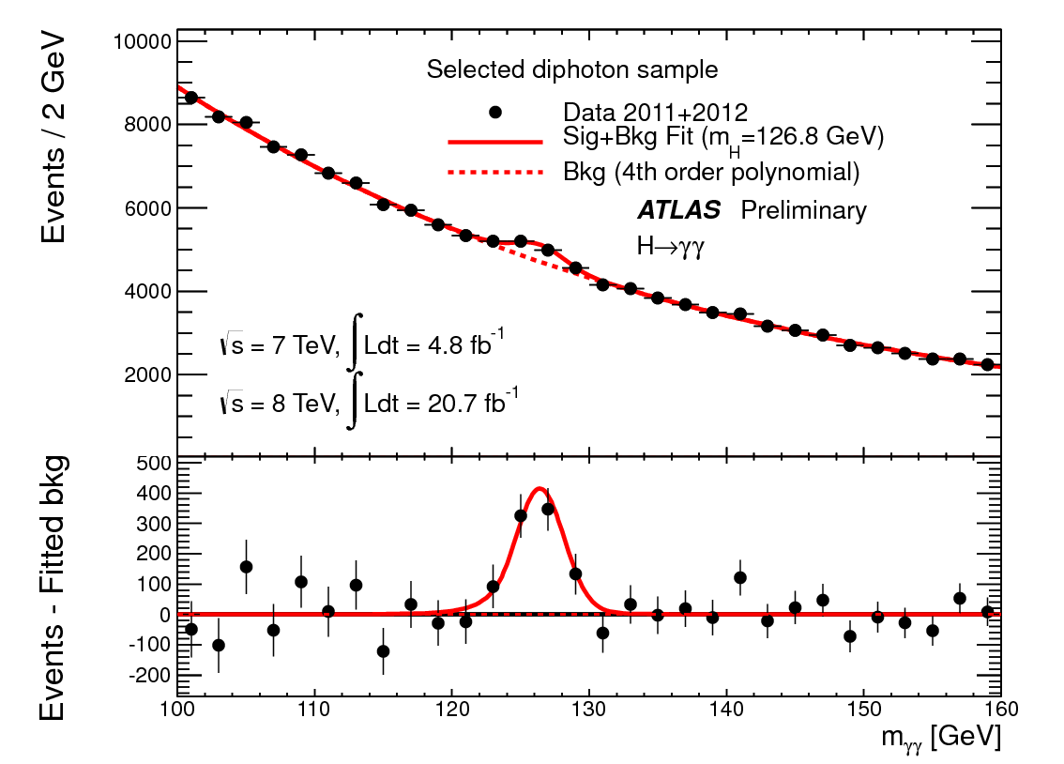
A boson is discovered at the LHC by the ATLAS Collaboration
Invariant mass distribution of diphoton candidates for the combined 7 TeV and 8 TeV data samples. The result of a fit to the data of the sum of a signal component fixed to
m_{H} = 126.8 GeV and a background component described by a fourth-order Bernstein polynomial is superimposed. The bottom inset displays the residuals of the data with respect to the fitted background component. Taken from
ATLAS-CONF-2013-012 (March, 2013).
The distribution of the four-lepton invariant mass for the selected candidates, compared to the background expectation in the 80 to 170 GeV mass range, for the combination of the 7 TeV
8 TeV data. The signal expectation for a Higgs boson with m_{H}=125 GeV is also shown. Taken from ATLAS-CONF-2013-013 (March, 2013).

Slide 8
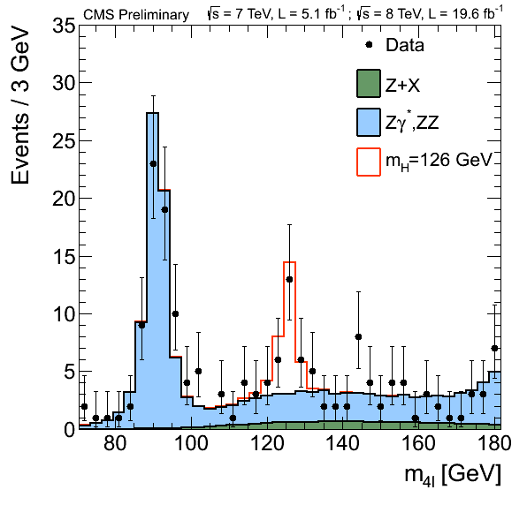
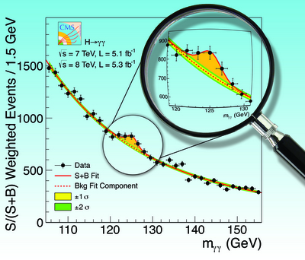
A boson is discovered at the LHC by the CMS Collaboration
The diphoton invariant mass distribution
with each event weighted by the S/(S+B)
value of its category. The lines represent the
fitted background and signal, and the colored
bands represent the ±1 and ±2 standard deviation
uncertainties in the background estimate. The
inset shows the central part of the unweighted
invariant mass distribution. Taken from
Physics Letters B716 (2012) 30—61.
Distribution of the four-lepton reconstructed mass in full mass range for the sum of the 4e, 4μ, and 2e2μ channels. Points represent the data, shaded histograms represent the background and unshaded histogram the signal expectations. The expected distributions are presented as stacked histograms. The measurements are presented for the sum of the data collected at √s = 7 TeV and √s = 8 TeV. [70-180] GeV range - 3 GeV bin width. Taken from
CMS-PAS-HIG-13-002 (March, 2013).

Slide 9
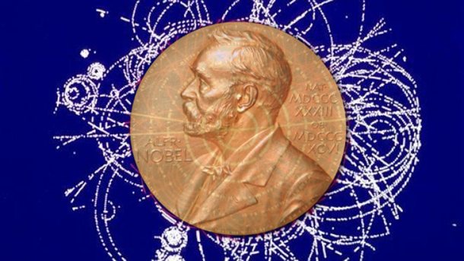
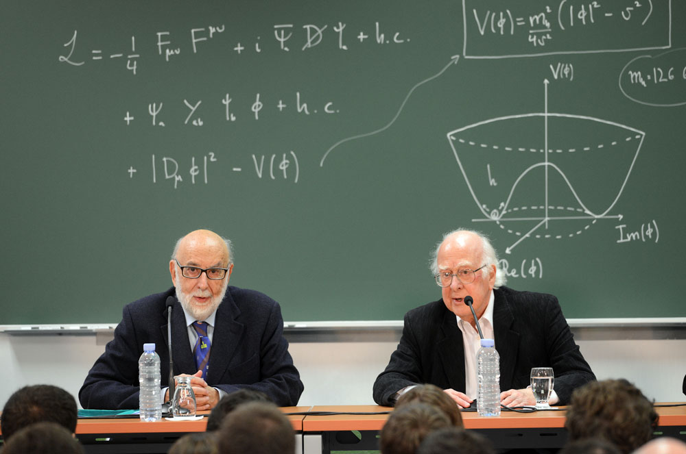
Winners of the 2013 Nobel Prize in Physics
François Englert
and
Peter Higgs

Slide 10
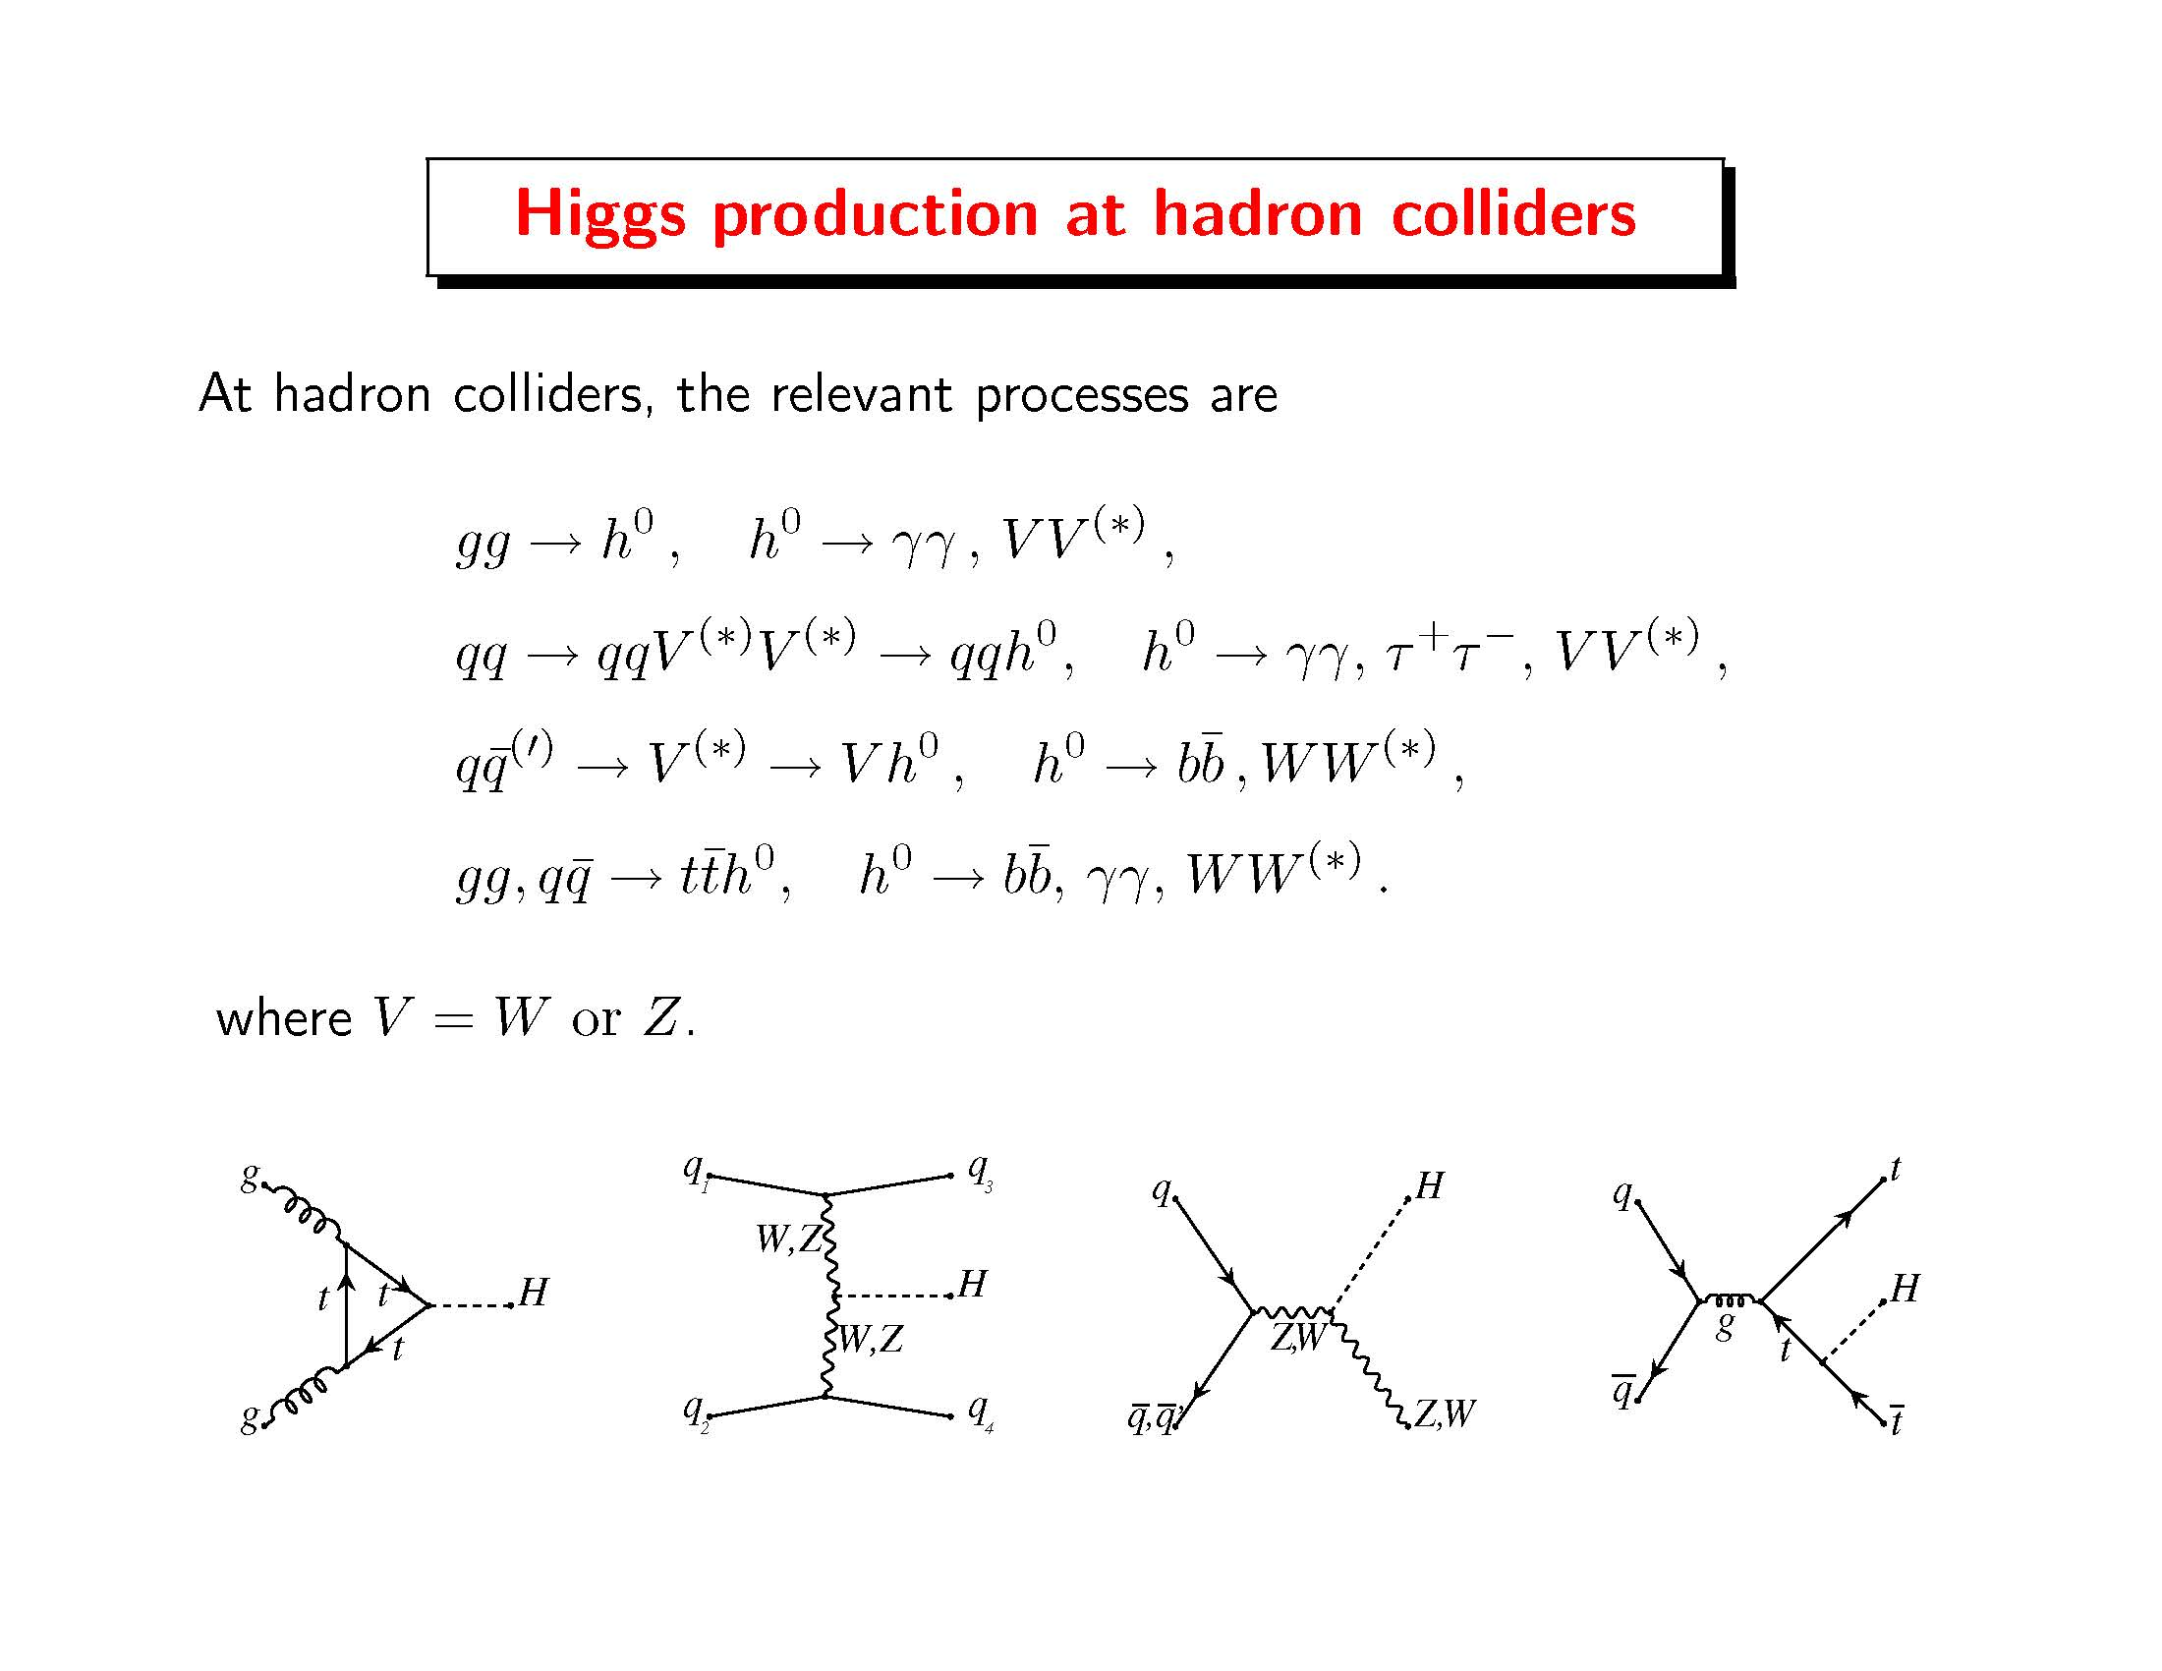

Slide 11
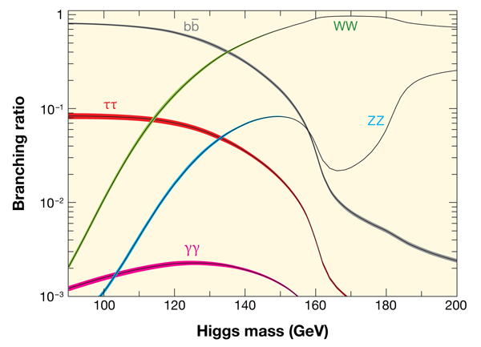
Probability of Higgs boson decay channels

Slide 12
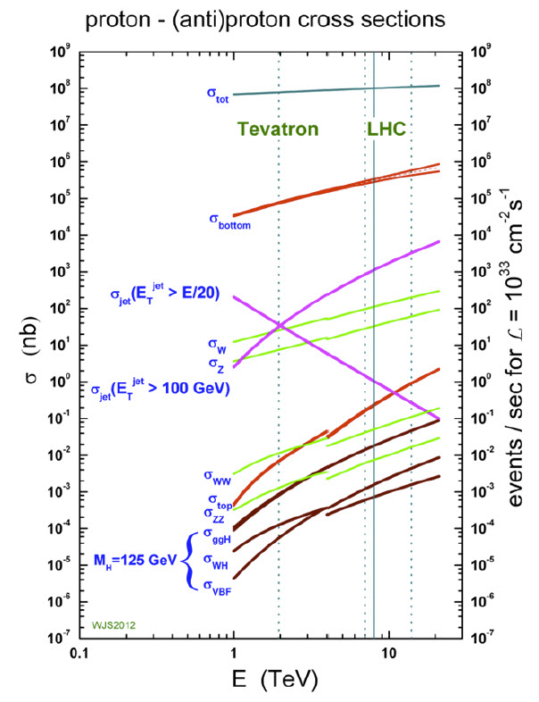
Question: why not search
for Higgs bosons produced
in gluon-gluon fusion that
decay into a pair of b-quarks?
Answer: The Standard Model
background is overwhelming.
There are more than 10⁷ times
as many b-quark pairs produced
in proton-proton collisions as
compared to b-quark pairs that
arise from a decaying Higgs boson.
Roughly 250,000 Higgs bosons
per experiment were produced
at the LHC from 2010—2013.

Slide 13
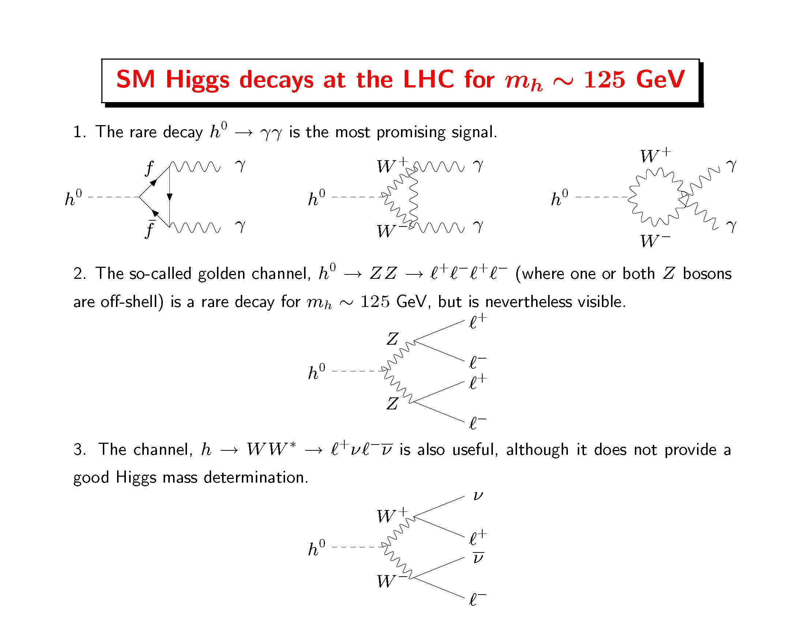

Slide 14
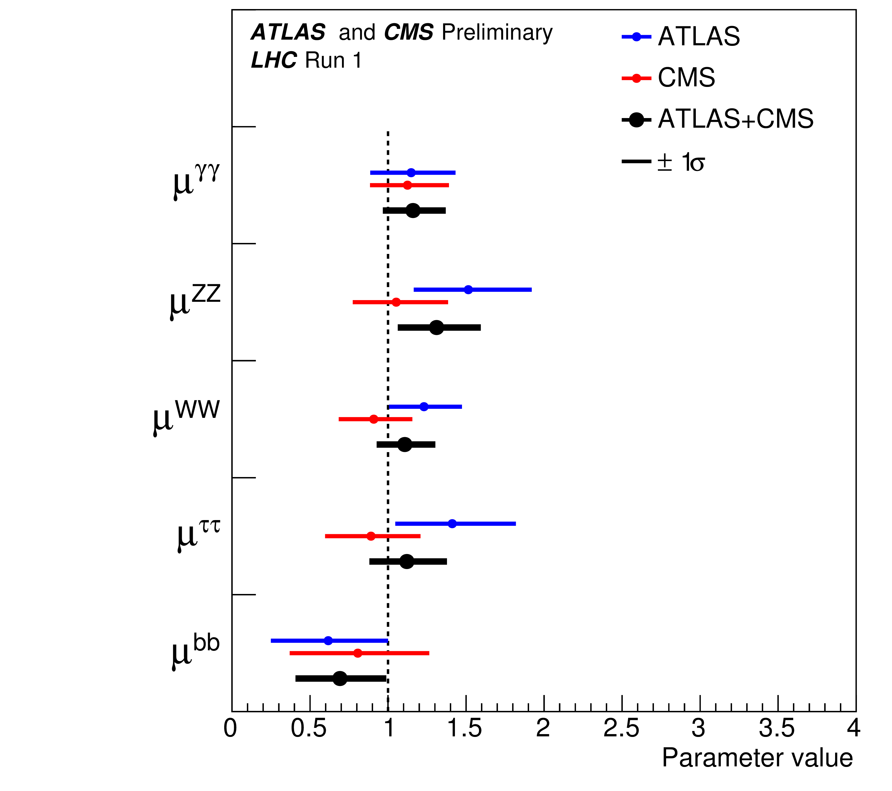
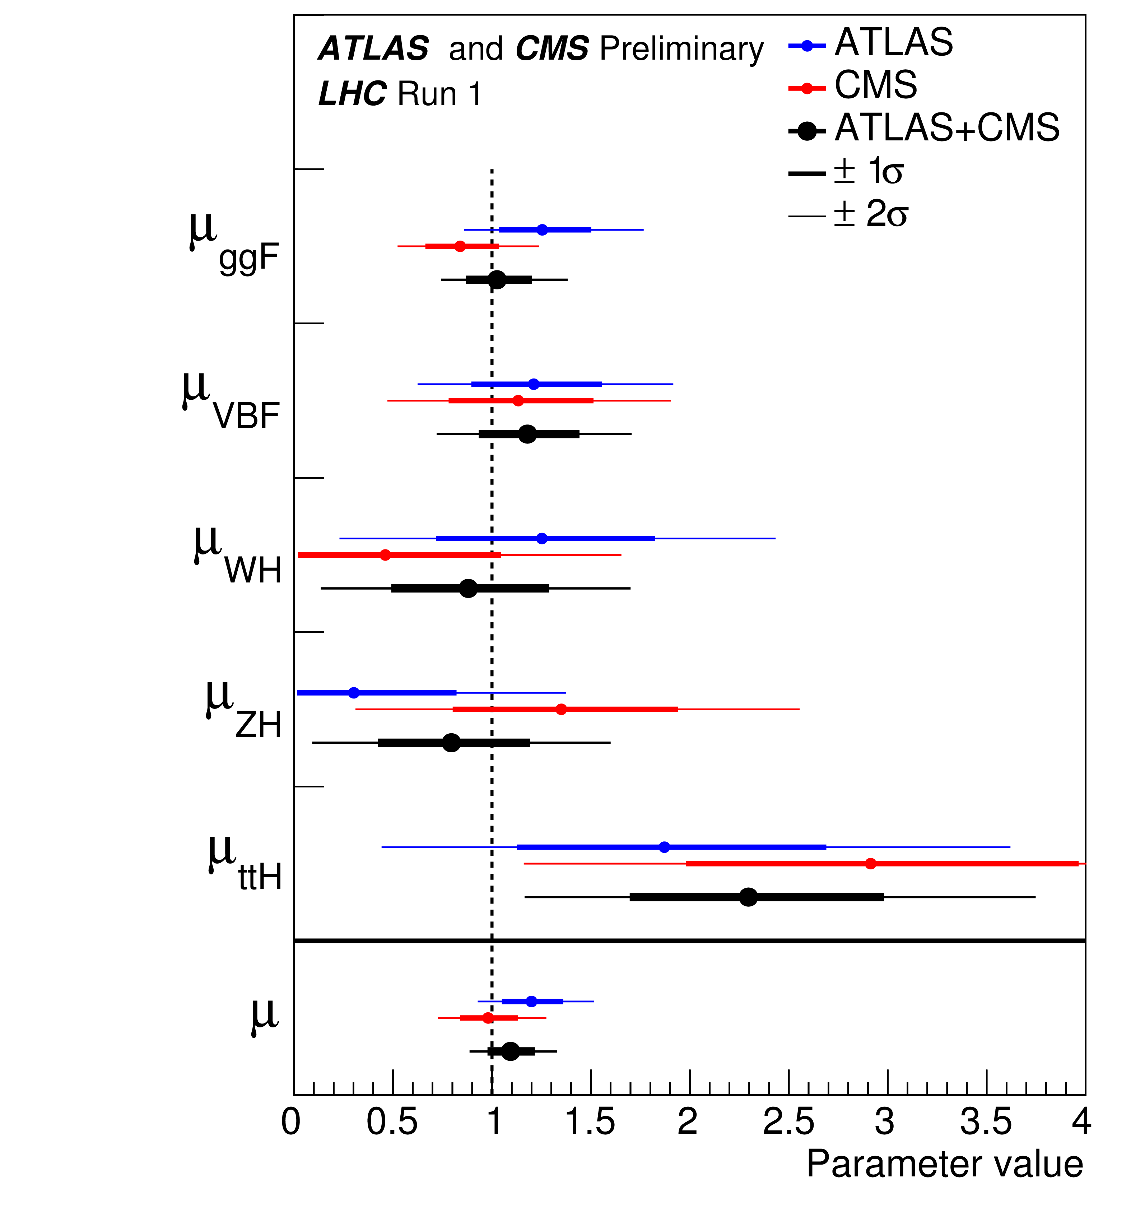
Is the observed scalar at 125 GeV the SM Higgs boson?
Best-fit results for the decay [left] and production [right] signal strengths (normalized to the SM
predicted values) for the combination of ATLAS and CMS. The error bars indicate the 1σ (thick lines) and 2σ (thin lines) intervals. Reference: ATLAS-CONF-2015-044; CMS-PAS-HIG-15-002.

Slide 15
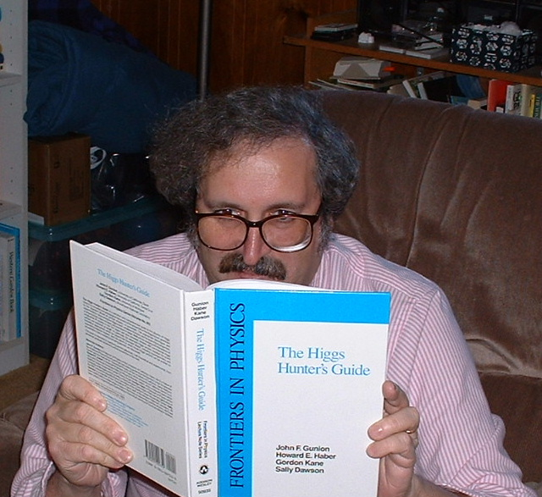
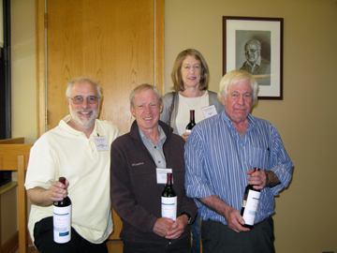
Research program 1: theory and phenomenology of Higgs bosons

Slide 16

Research program 2: theory and phenomenology of TeV-scale supersymmetry (SUSY)
For a review, see H.E. Haber, Supersymmetry Theory, in K.A. Olive et al. [Particle Data
Group Collaboration], Review of Particle Physics, Chin. Phys. C 38, 090001 (2014); and
in the 2015 partial update for the 2016 edition, available on the web shortly.

Slide 17
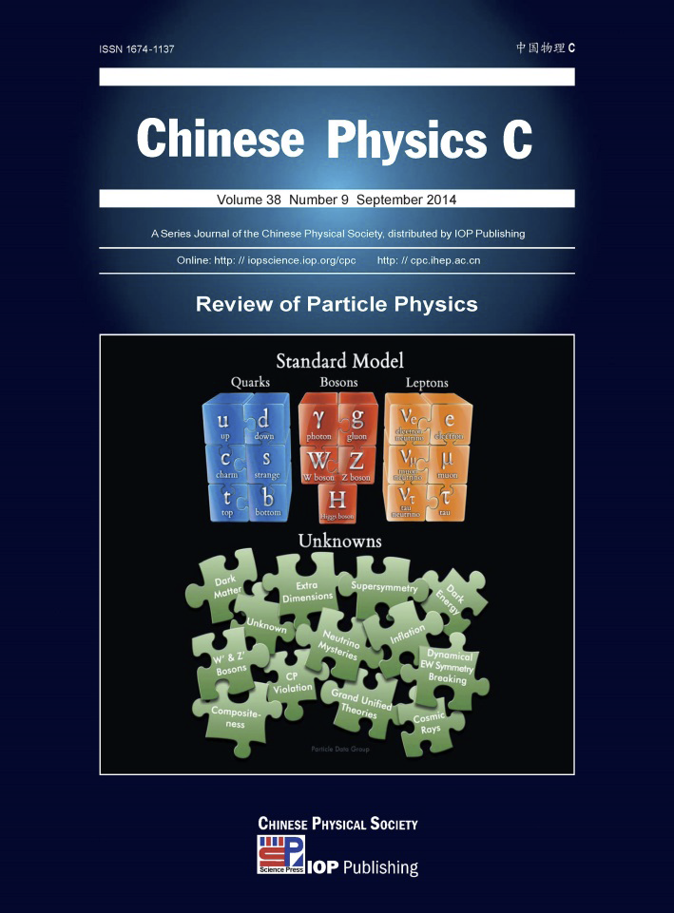
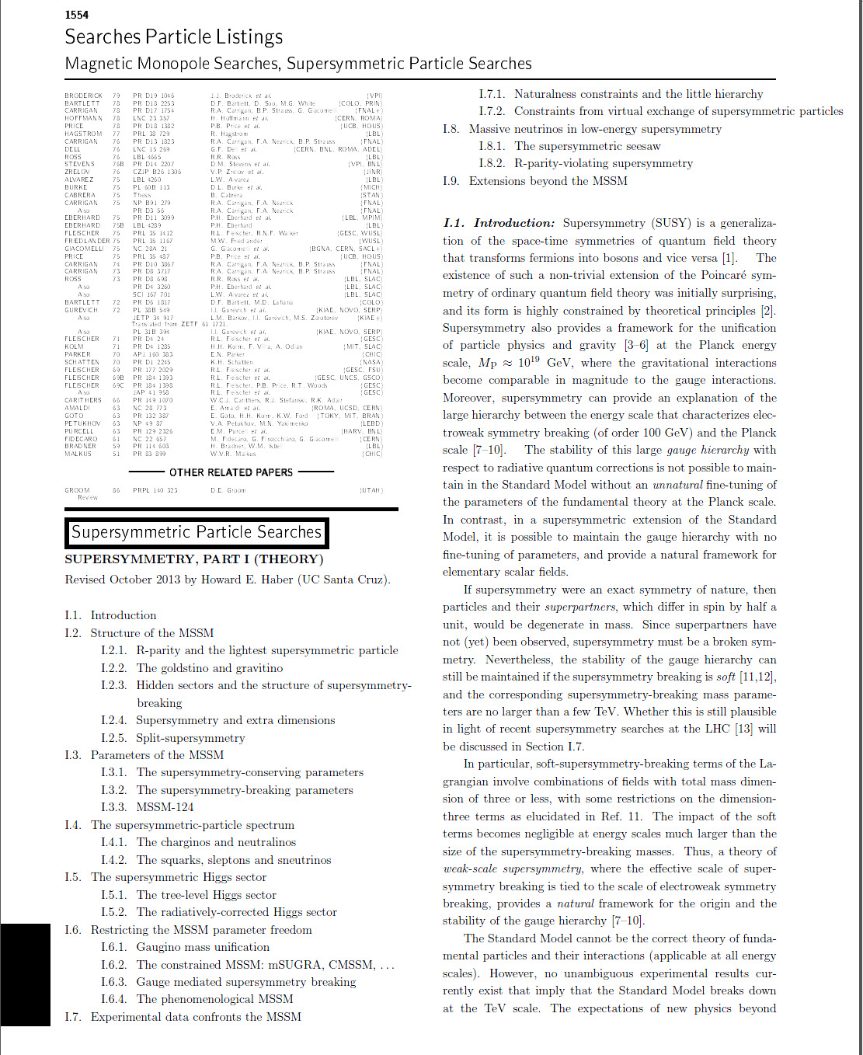
As a member of the Particle Data Group, I am the author
of the biennial Supersymmetry Theory review

Slide 18
Research program 3: explorations of the Terascale at present and future colliders (LHC and ILC)
Studies of the non-minimal Higgs sector
Precision measurements of new physics observables
Distinguishing among different theoretical interpretations of new physics signals
Employing the ILC as a precision Higgs factory
Terascale footprints of lepton-number-violating physics (e.g. R-parity-violation or the SUSY seesaw)
New sources for CP-violation (Higgs and/or SUSY mediated)

Slide 19
2015 Publications
Scrutinizing the Alignment Limit in Two-Higgs-Doublet Models. Part 2: m_{H}=125 GeV
J. Bernon, J.F. Gunion, H.E. Haber, Y. Jiang and S. Kraml, arXiv:1511.03682 [hep-ph].
On the Alignment Limit of the NMSSM Higgs Sector
M. Carena, H. E. Haber, I. Low, N.R. Shah and C.E.M. Wagner, arXiv:1510.09137 [hep-ph].
New LHC Benchmarks for the CP-conserving Two-Higgs-Doublet Model
H.E. Haber and O. Stål, Eur. Phys. J. C 75, 491 (2015).
Scrutinizing the Alignment Limit in Two-Higgs-Doublet Models. Part 1: m_{h} = 125 GeV
J. Bernon, J.F. Gunion, H.E. Haber, Y. Jiang and S. Kraml, Phys. Rev. D 92, 075004 (2015) .
Preserving the validity of the Two-Higgs Doublet Model up to the Planck scale
P. Ferreira, H.E. Haber and E. Santos, Phys. Rev. D 92, 033003 (2015).
Complementarity Between Non-Standard Higgs Boson Searches and Precision Higgs Boson
Measurements in the MSSM
M. Carena, H.E. Haber, I. Low, N.R. Shah and C.E.M. Wagner, Phys. Rev. D 91, 035003 (2015).

Slide 20
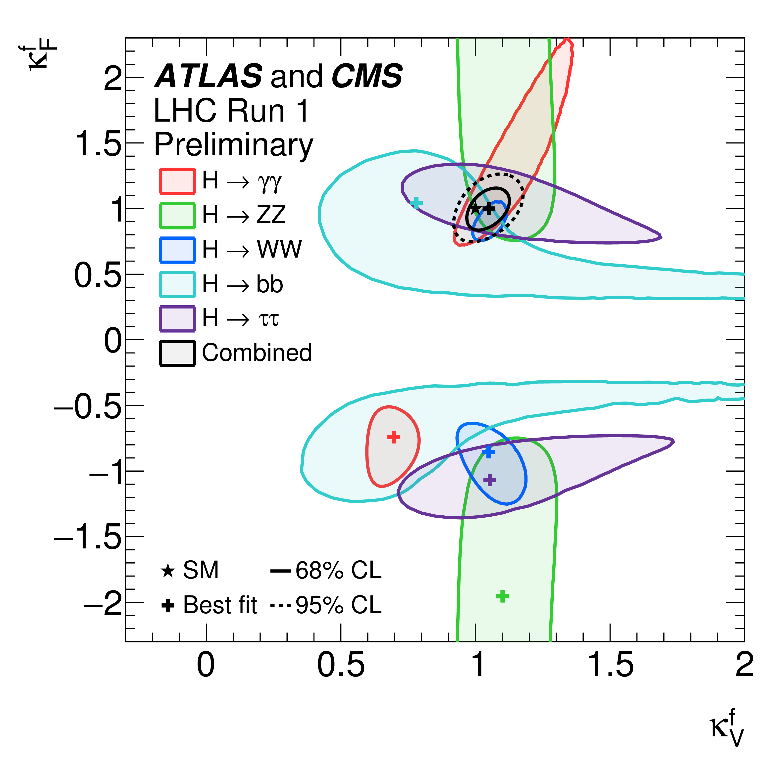
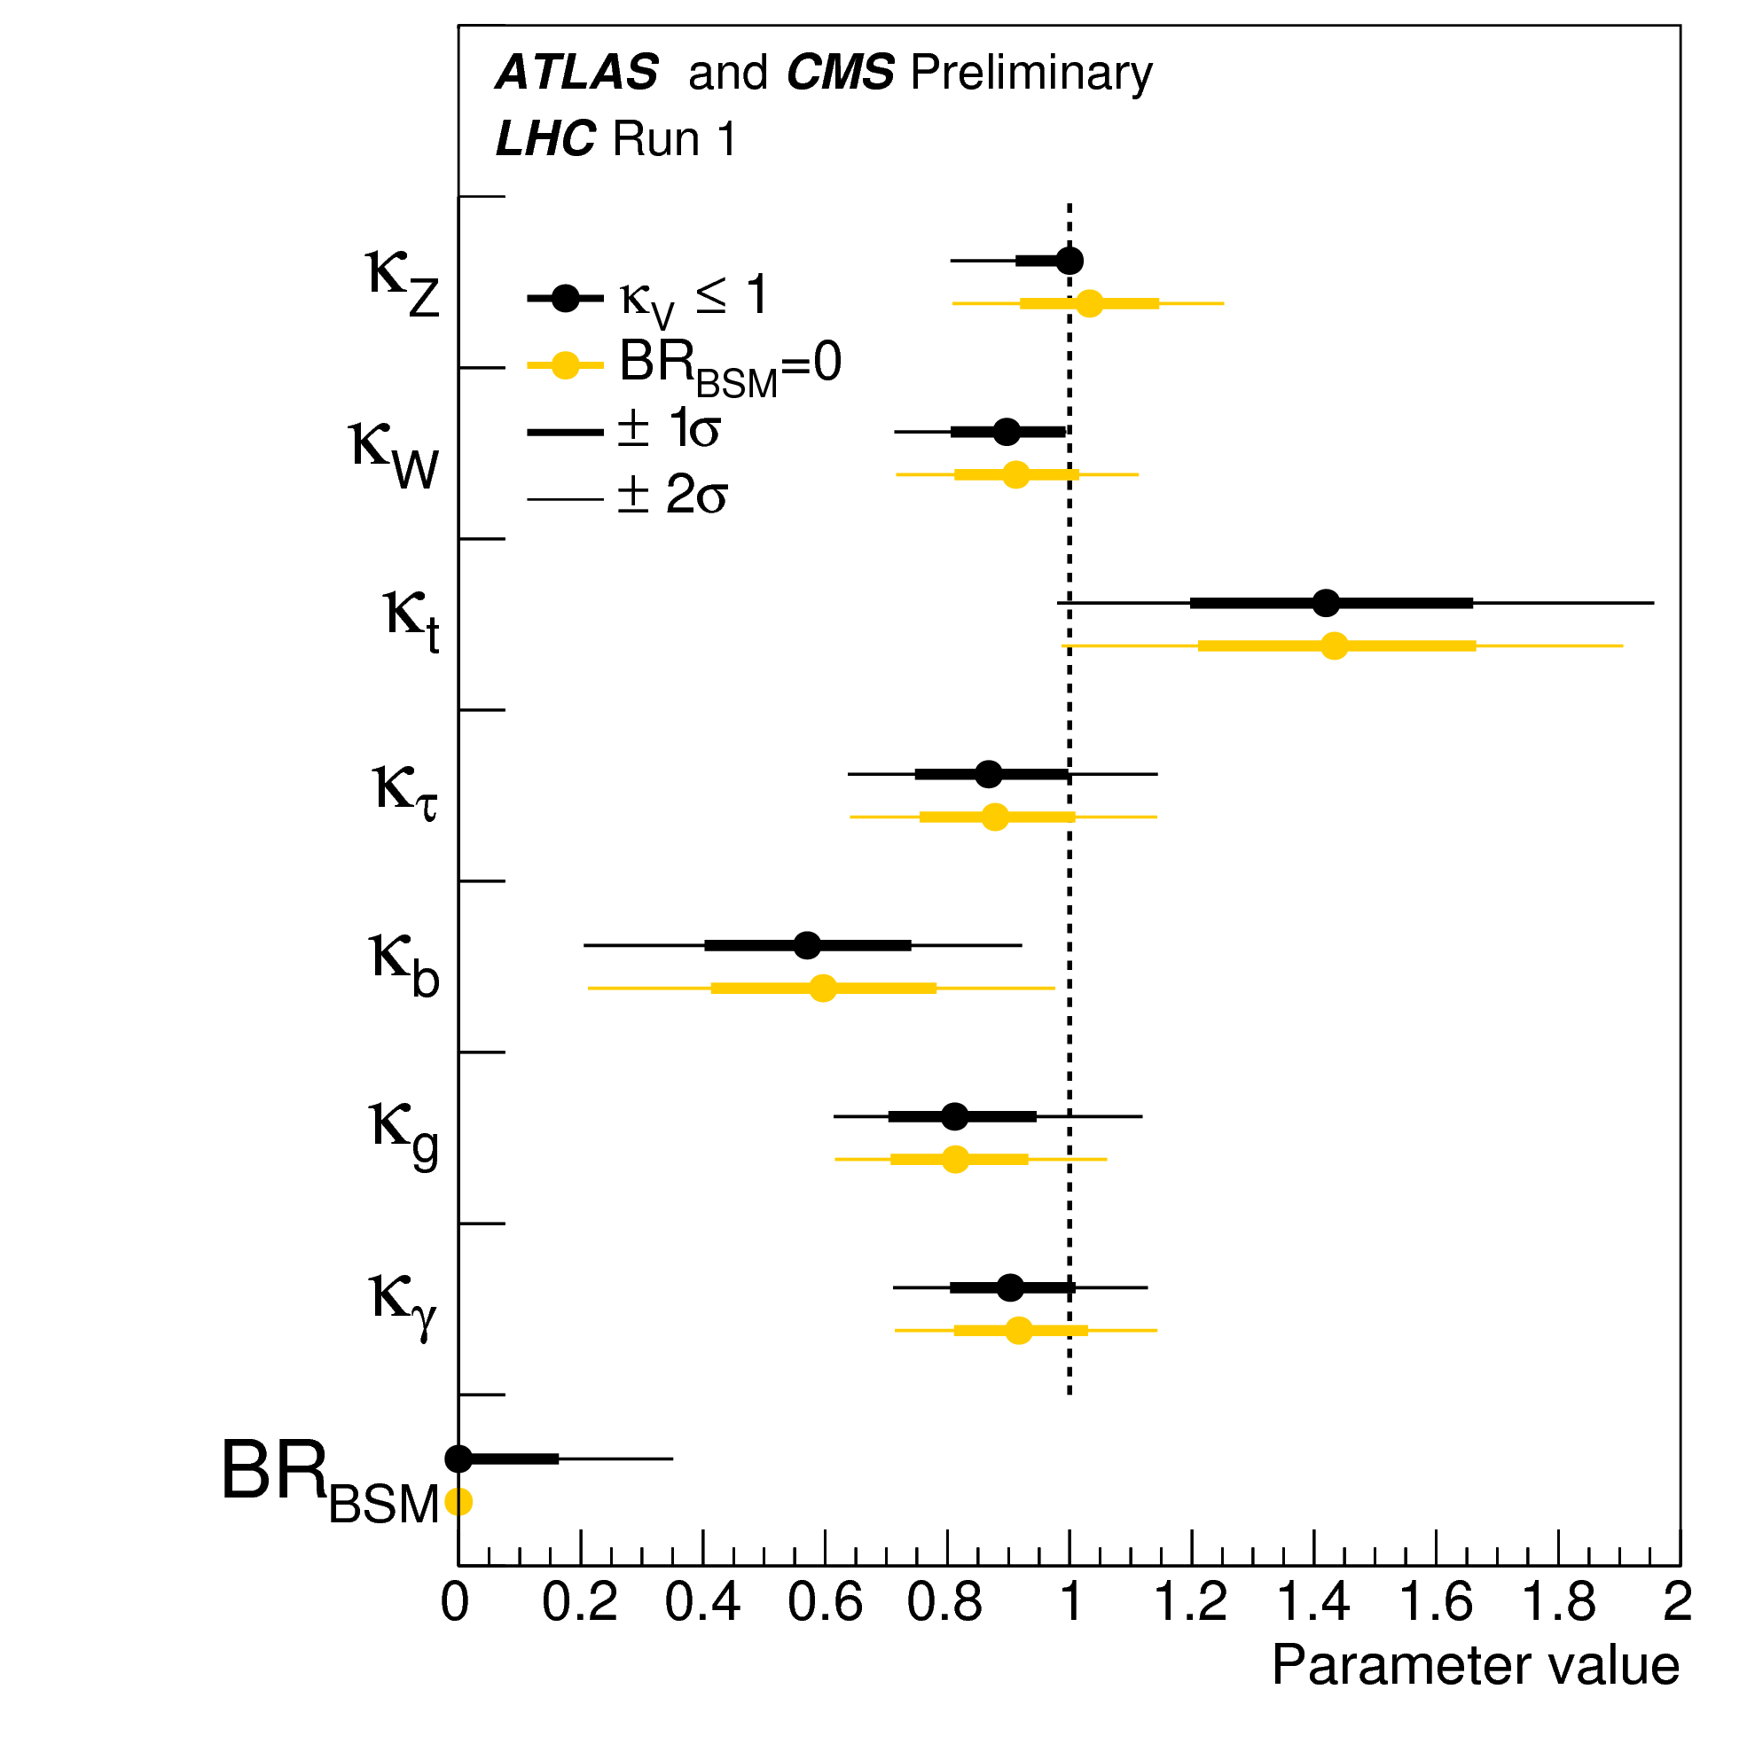
Search for deviations from SM-Higgs couplings
2D test statistics q(κ_{V}, κ_{F}) scan. Negative log-likelihood contours of κ_{F}^{f} versus κ_{V}^{f} for the combination of ATLAS and CMS and for the individual decay channels, as well as for their global combination (κ_{F} versus κ_{V} shown in black), without any assumptions on the sign of the coupling modifiers.
Fit results for the two parameterizations allowing BSM loop couplings, with κ_{V} ≤ 1, where κ_{V} stands for κ_{Z} or κ_{W}, or without additional BSM contributions to the Higgs boson width, i.e. BR_{BSM}=0. The measured results for the combination of ATLAS and CMS are reported together with their uncertainties. The error bars indicate the 1σ (thick lines) and 2σ (thin lines) intervals.
Taken from ATLAS-CONF-2015-044; CMS-PAS-HIG-15-002 (September, 2015)

Slide 22
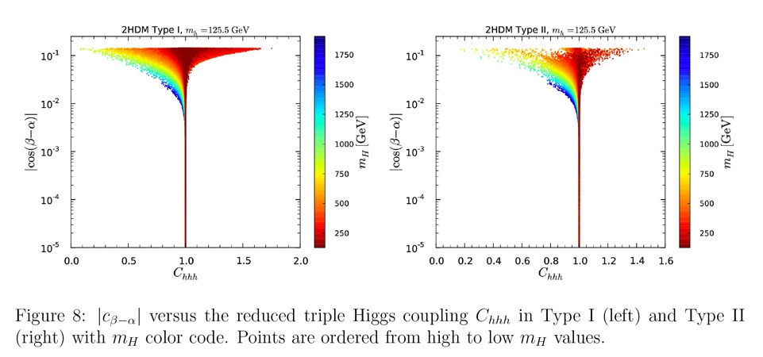
In the alignment limit, significant deviations from SM behavior can be seen in the triple
Higgs coupling in certain regions of the two Higgs doublet model parameter space.
Taken from J. Bernon et al., Phys. Rev. D 92, 075004 (2015) .

Slide 23
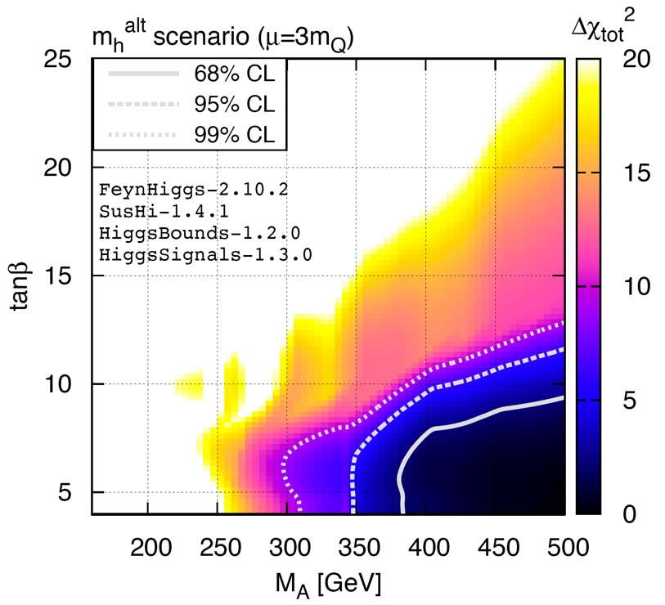
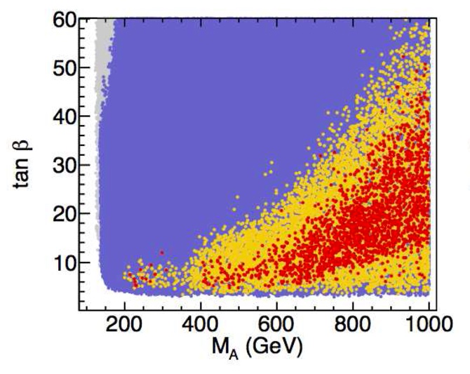
Allowed region of MSSM Higgs parameter space in the m_{h}^{alt} scenario where 2HDM alignment without decoupling is achieved for tan𝛽～10 due to one-loop radiative corrections.
A 7 parameter pMSSM scan to generalize the constraints on the m_{h}^{alt} scenario. Red points are with 1σ of the best fit point and yellow points are within 2σ of the best fit point.
[T. Stefaniak and collaborators, after revisiting the results obtained by M. Carena et al.]

Slide 24
My recent Ph.D. students and their thesis projects
John Mason (2008): Hard Supersymmetry-Breaking “Wrong-Higgs” Couplings
of the MSSM
Deva O’Neil (2009): Phenomenology of the Basis-Independent CP-Violating
Two-Higgs Doublet Model
Laura Fava (2015): Precision Measurement of UED Coupling Constants Using
Like-Sign Leptons at the LHC
Edward Santos (2015): Renormalization Group Constraints on the Two-Higgs
Doublet Model
Where are they now?
J. Mason – following a three-year post doctoral research associate in particle
theory at Harvard University, John accepted a position as an
assistant professor of physics at Western State College of Colorado
D. O’Neil – assistant professor of physics at Bridgewater College (in Virginia)
L. Fava and E. Santos – participated in the Insight Data Science Fellows Program;
found employment in Silicon Valley.

Slide 25
Current Ph.D. students
Laurel Stephenson Haskins:
Puzzle in the relation between the quark anomalous
dimension and the mass anomalous dimension in
supersymmetric non-abelian gauge theory.
This project led to a more careful study of infrared
divergences and gauge invariance in Supersymmetric
QED (in collaboration with Michael Dine and Patrick
Draper).

Slide 26
Ongoing and Future Activities
Partially Natural 2HDM (with P. Draper and J. Ruderman)
  Implementing the second fine tuning of the 2HDM with a symmetry.
Implications of 2HDM flavor alignment at a very high energies
(with S. Gori and E. Santos)
  Generating manageable flavor violation at the electroweak
  scale via renormalization group running.
LHC Benchmarks for more general 2HDMs (with T. Stefaniak)
  Putting in CP violation and Z₂ symmetry breaking effects in
  the 2HDM in the HiggsSignals program.
Higgs alignment in the radiatively corrected 2HDM revisited
(with T. Stefaniak)
  A more comprehensive scan of the pMSSM parameter space.
Implications of evidence for new physics in Run II of the LHC
  Co-convening the Higgs sessions of the KITP Workshop, Experimental Challenges for the LHC Run II (March 28—June 3)

Slide 27
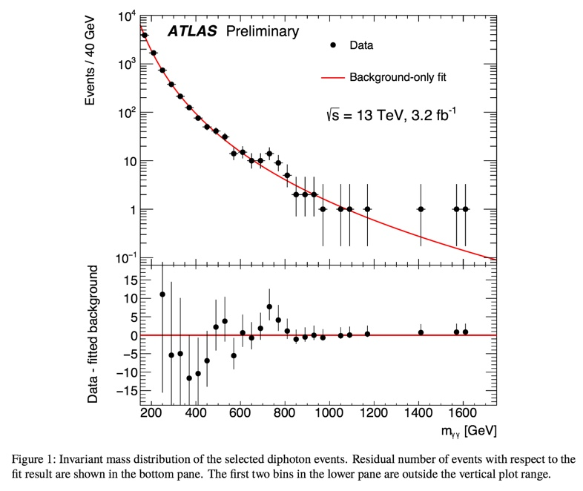

Slide 28
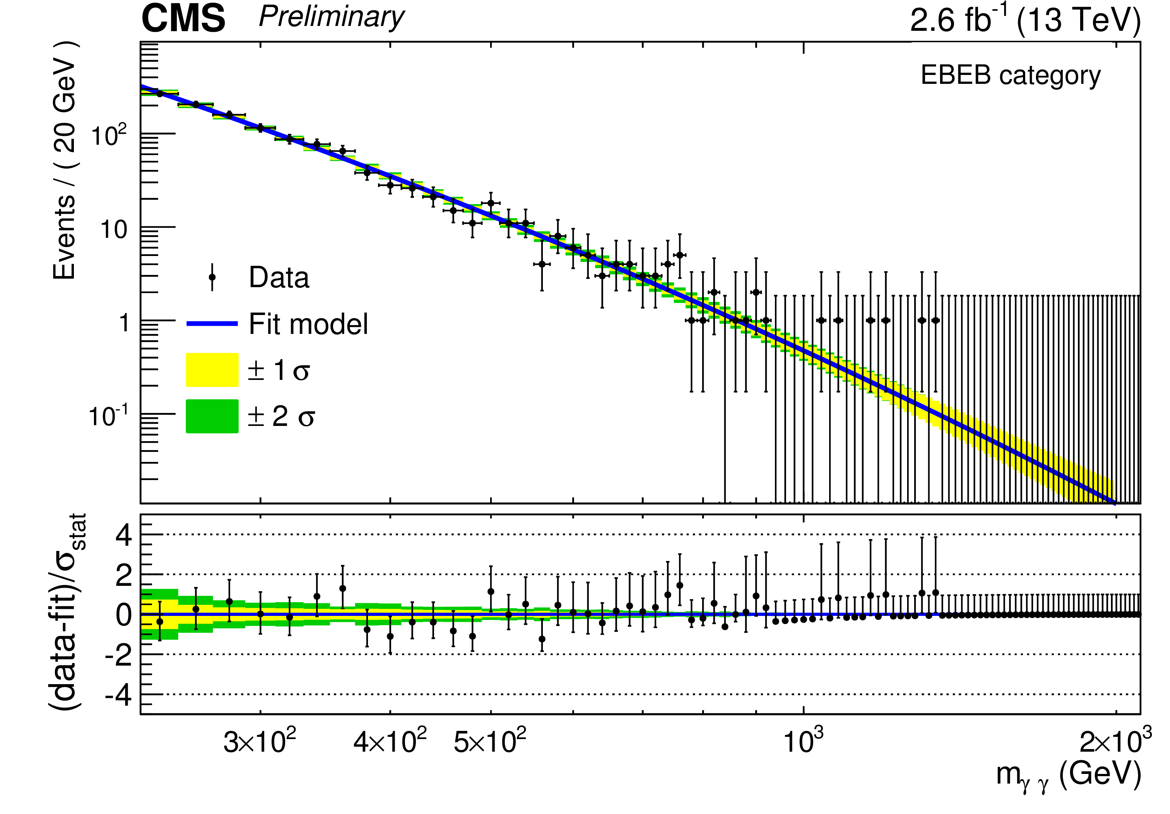

Slide 29
