Slide 1
Research on the Theory of the TeV energy scale (Terascale)
Howard Haber
SCIPP Theory
January 9, 2019
For further details, check out my webpage:
http://scipp.ucsc.edu/~haber/

Slide 2
SCIPP Particle Theory Group
Michael Dine: supersymmetry, string theory, instantons, axions, inflation and the early universe
Stefania Gori: phenomenology of new physics beyond the Standard model, dark matter and dark sectors, Higgs physics
Howard Haber: Higgs bosons, collider physics, new physics beyond the Standard Model at the terascale (including supersymmetry)
Stefano Profumo: Theories of particle dark matter and their implications for astrophysics and collider phenomenology
Wolfgang Altmannshofer: Flavor physics theory and phenomenology, CP violation, neutrino physics, Higgs physics
In addition, Anthony Aguirre and Joel Primack work on a variety
of topics overlapping particle theory and astroparticle theory,
including dark matter, early universe cosmology, inflation, …

Slide 3
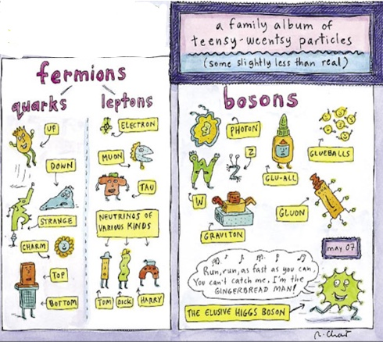
Fundamental particles:
the view in May 2007

Slide 4

The Standard Model (SM) of Particle Physics
The elementary particles consists of three generations of spin-1/2 quarks and leptons and the gauge bosons of SU(3)xSU(2)xU(1).
Technically, massive neutrinos
require an extension of the Standard
Model, but most likely the relevant
scale of the new physics lies way
beyond the terascale.

Slide 5
Origin of mass for elementary particles
Naively, an SU(3)xSU(2)xU(1) gauge theory yields massless gauge bosons and massless quarks and leptons, in conflict with observation. The Standard Model employs the Higgs mechanism for mass generation. The SU(2)xU(1) electroweak gauge invariance is spontaneously broken down to U(1)_{EM}, which yield the massive W and Z gauge bosons. In the simplest implementation, one spinless physical Higgs scalar is predicted.

Slide 6
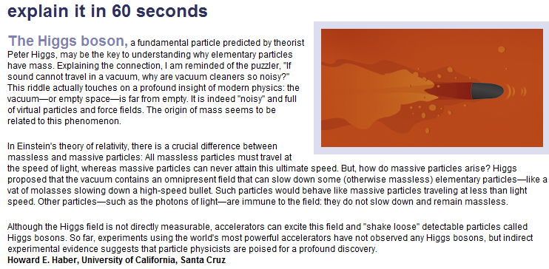
From Symmetry Magazine, volume 3, issue 6, August 2006

Slide 7
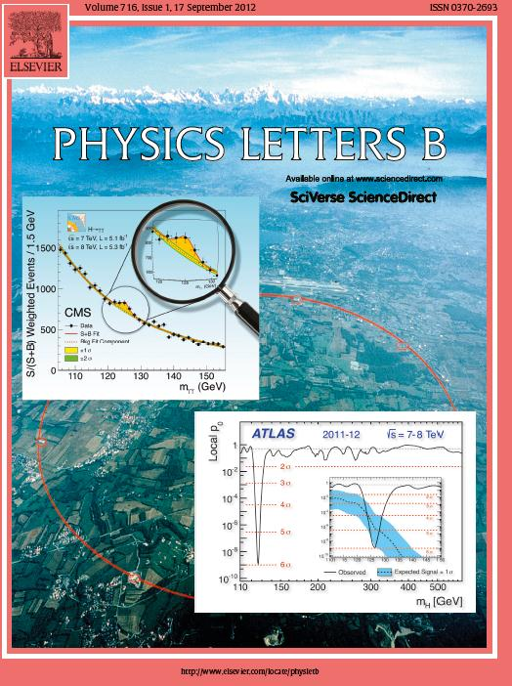
On July 4, 2012, the discovery
of a new boson is announced
which may be the long sought
after Higgs boson.
The discovery papers are
published two months later
In Physics Letters B.
ATLAS Collaboration:
Physics Letters B716 (2012) 1—29
CMS Collaboration:
Physics Letters B716 (2012) 30—61

Slide 8
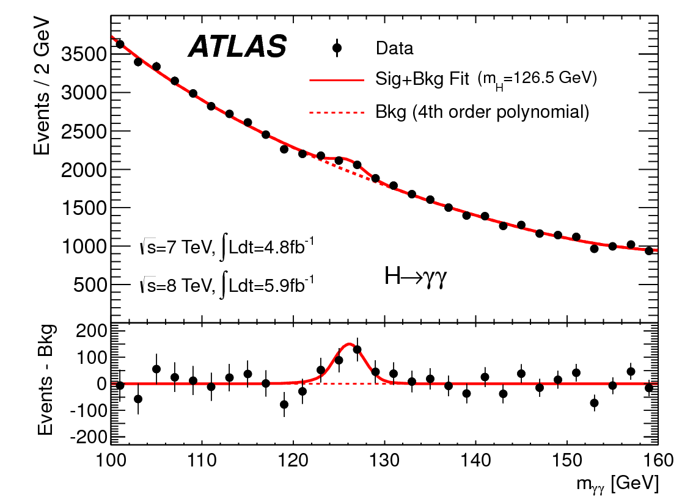
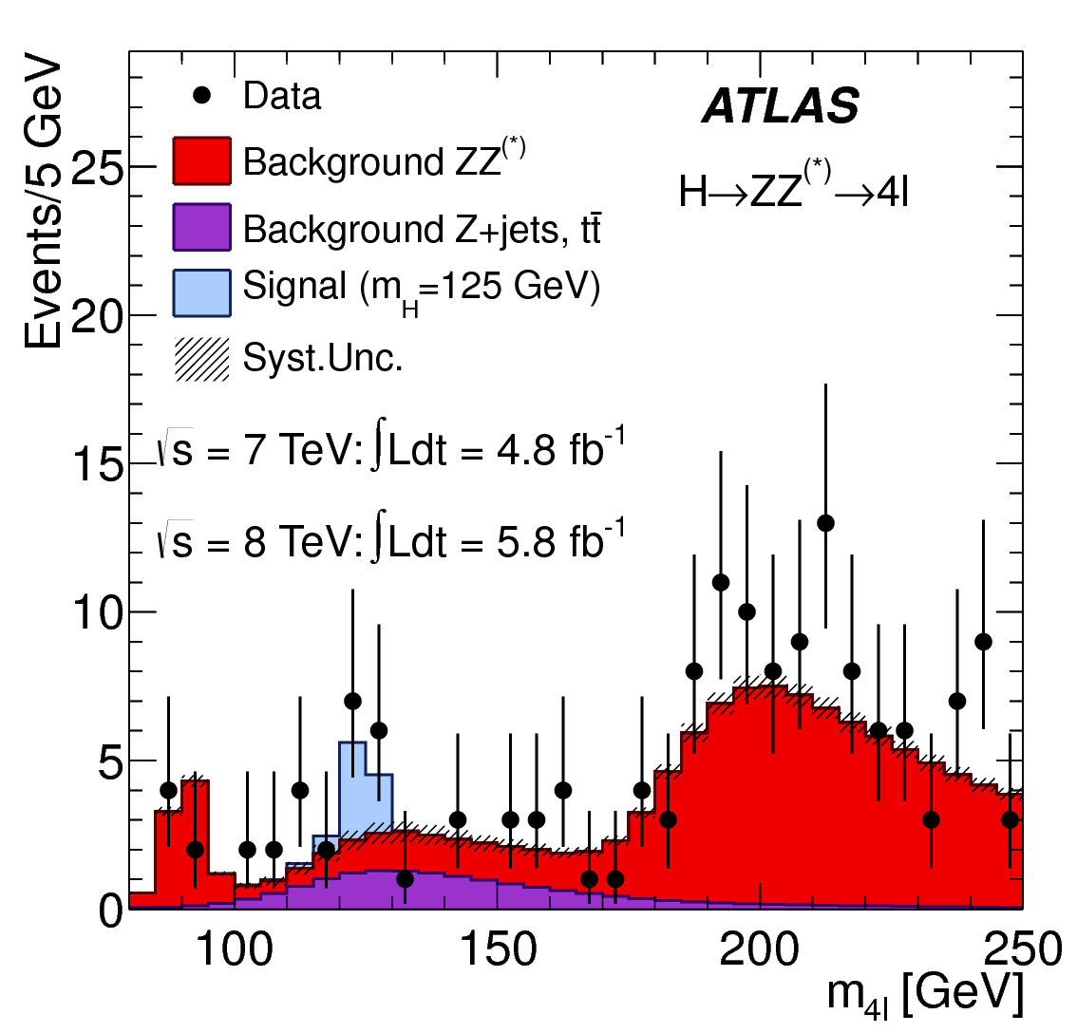
A boson is discovered at the LHC by the ATLAS Collaboration
Invariant mass distribution of diphoton candidates for the combined 7 TeV and 8 TeV data samples. The result of a fit to the data of the sum of a signal component fixed to
m_{H} = 126.5 GeV and a background component described by a fourth-order Bernstein polynomial is superimposed. The bottom inset displays the residuals of the data with respect to the fitted background component.
The distribution of the four-lepton invariant mass, m_{4l}, for the selected candidates, compared to the background expectation in the 80 to 250 GeV mass range, for the combination of the 7 TeV
8 TeV data. The signal expectation for a Higgs boson with m_{H}=125 GeV is also shown.
(Taken from Physics Letters B716 (2012) 1-29.)

Slide 9
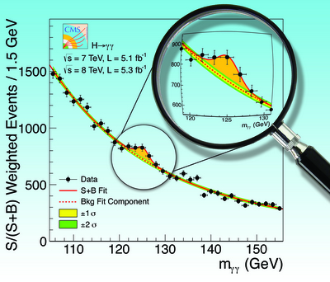
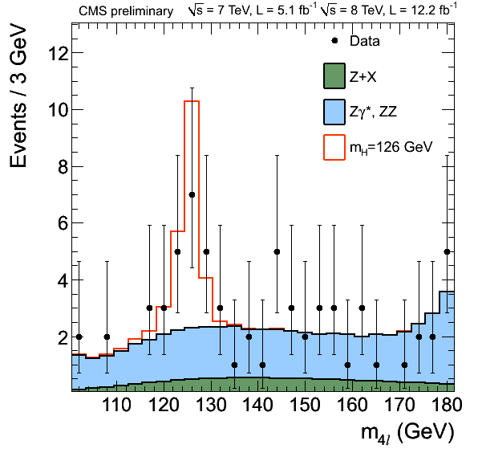
A boson is discovered at the LHC by the CMS Collaboration
The diphoton invariant mass distribution
with each event weighted by the S/(S+B)
value of its category. The lines represent the
fitted background and signal, and the colored
bands represent the ±1 and ±2 standard deviation
uncertainties in the background estimate. The
inset shows the central part of the unweighted
invariant mass distribution. Taken from
Physics Letters B716 (2012) 30—61.
Distribution of the four-lepton invariant mass for the
ZZ→4 leptons analysis. The points represent the data,
the filled histograms represent the background, and
the open histogram shows the signal expectation for
a Higgs boson of mass m_{H} = 126 GeV, added to the
background expectation. Taken from https://
twiki.cern.ch/twiki/bin/view/CMSPublic/Hig12041TWiki.

Slide 10

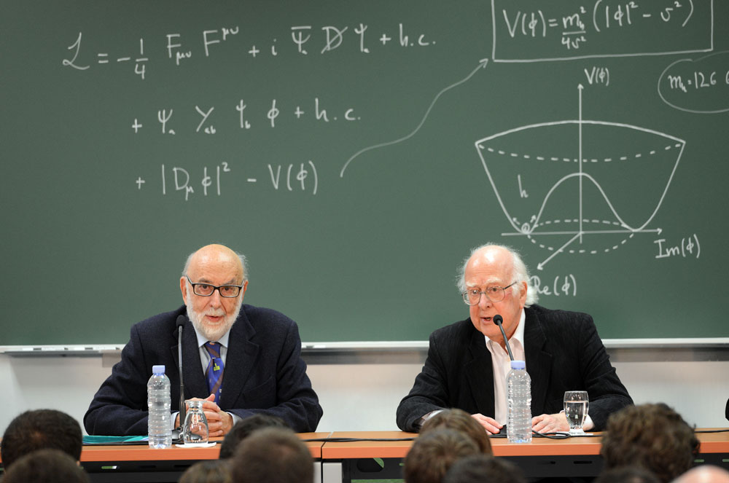
Winners of the 2013 Nobel Prize in Physics
François Englert
and
Peter Higgs

Slide 11
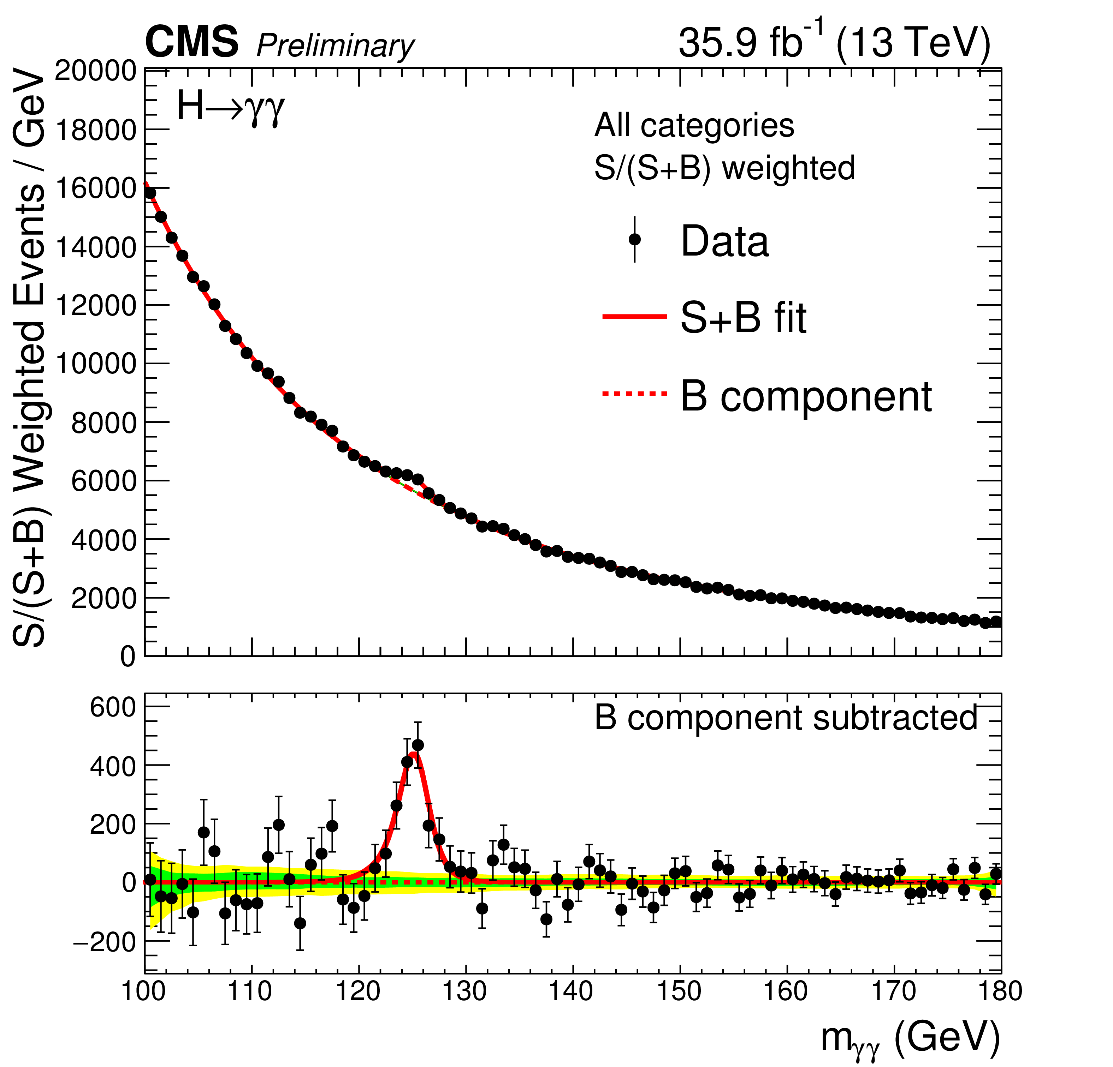
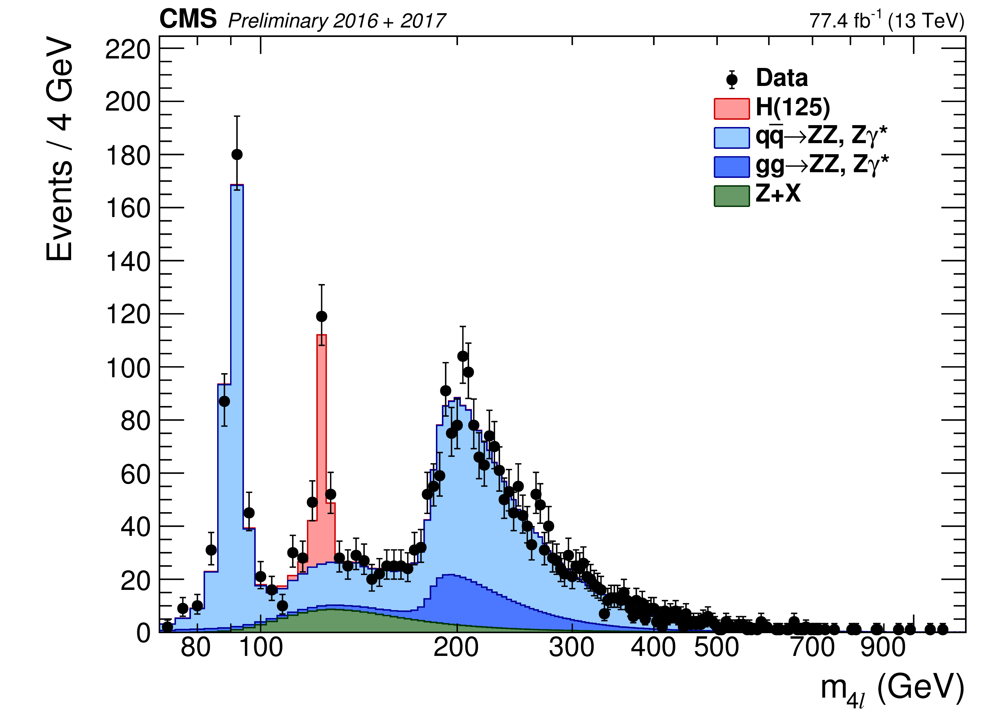
CMS Run-2 observations of the Higgs boson

Slide 12
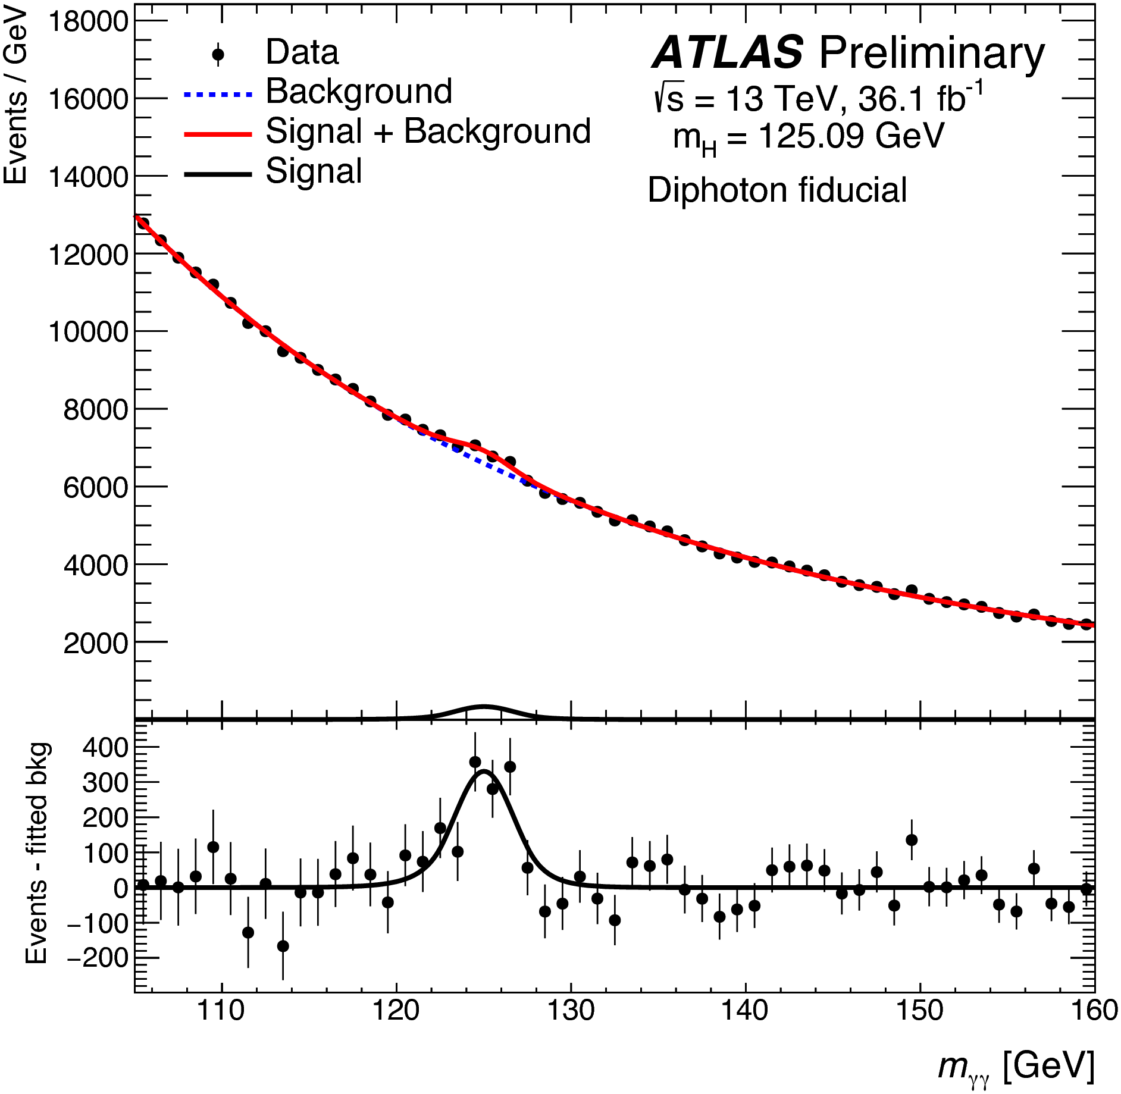
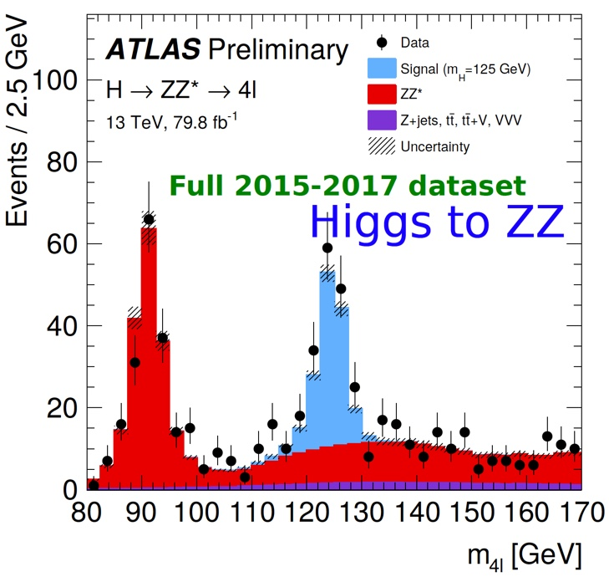
ATLAS Run-2 observations of the Higgs boson

Slide 14
Higgs boson production cross sections at a pp collider
With 40 fb⁻¹ of data delivered by the LHC to both ATLAS and CMS in 2015—2016 at a center of mass energy of 13 TeV, roughly 2 million Higgs bosons per experiment were produced, assuming the Higgs mass is 125 GeV. Still to be analyzed: 50 fb⁻¹ of 2017 data and 65 fb⁻¹ of data in 2018.

Slide 15
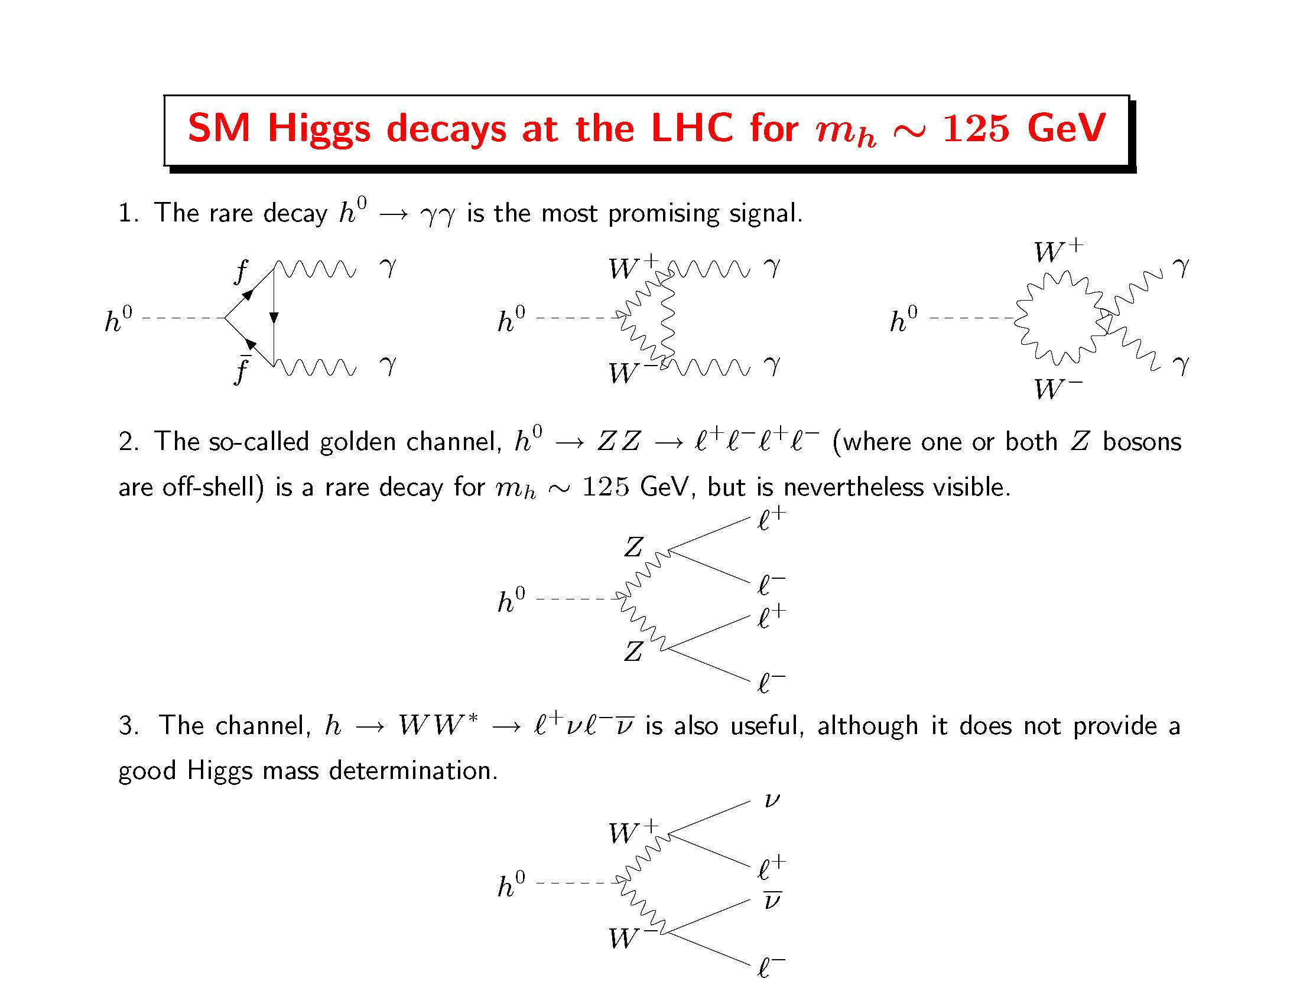

Slide 16
Higgs boson decay channels observed at the LHC
Higgs boson decay mode | Branching ratio (for m_{h} = 125 GeV)
H⁰ → bb | 0.582
H⁰ → 𝞃⁺ 𝞃 ⁻ | 6.27 x 10⁻²
h⁰ → 𝓵⁺ 𝓵⁻ 𝝂𝝂 (𝓵 = e or 𝞵) | 1.06 x 10⁻²
h⁰ → 𝛄𝛄 | 2.27 x 10⁻³
h⁰ → 𝓵⁺ 𝓵⁻ 𝓵⁺ 𝓵⁻ (𝓵 = e or 𝞵) | 1.24 x 10⁻⁴
Taken from https://twiki.cern.ch/twiki/bin/view/LHCPhysics/CERNYellowReportPageBR#Branching_Ratios
Remarks:
h⁰ ➞ WW* is observed primarily via the 𝓵⁺ 𝝂 𝓵⁻ 𝝂 (𝓵 = e or 𝞵) final state.
h⁰ ➞ ZZ* is observed primarily via the 𝓵⁺𝓵⁻ 𝓵⁺𝓵⁻ (𝓵 = e or 𝞵) final state.
In the decays to the diboson final state, kinematics dictates that one of the vector bosons is off-shell (i.e., “virtual”) and is thus indicated by a superscript star.

Slide 17
Question: why not search
inclusively for Higgs bosons that decay into a pair of
b-quarks?
Answer: The Standard Model
background is overwhelming.
There are more than 10⁷ times as many b-quark pairs produced in proton-proton collisions as compared to
b-quark pairs that arise from a decaying Higgs boson.
Nevertheless, the observation of
H → bb in the VH channel was confirmed by ATLAS and CMS in 2018!

Slide 18
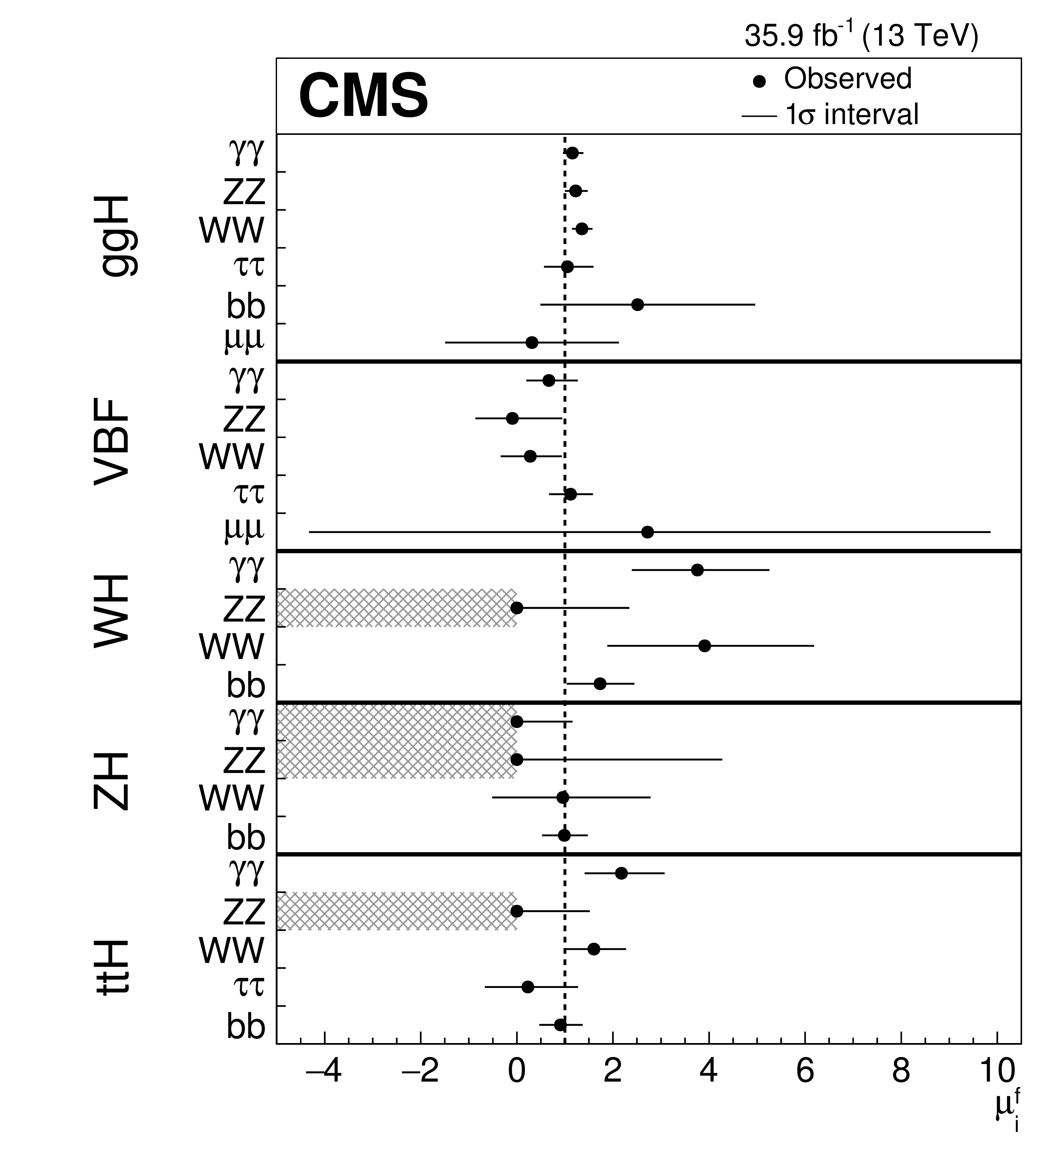
Is the observed 125 GeV scalar
the SM Higgs boson?
After the end of Run-1 of the LHC (2011—2013), the ATLAS and CMS Collaborations provided a combined analysis of the Higgs boson data.
The properties of the Higgs boson were consistent with Standard Model predictions (within the statistical power of the Higgs boson data).
The Higgs data taken at Run-2 of the LHC (2015—2016) have confirmed the Run-1 observations (with potential deviations from the Standard Model further reduced).
Taken from A.M. Sirunyan et al. [CMS Collaboration], arXiv:1809.10733.

Slide 19
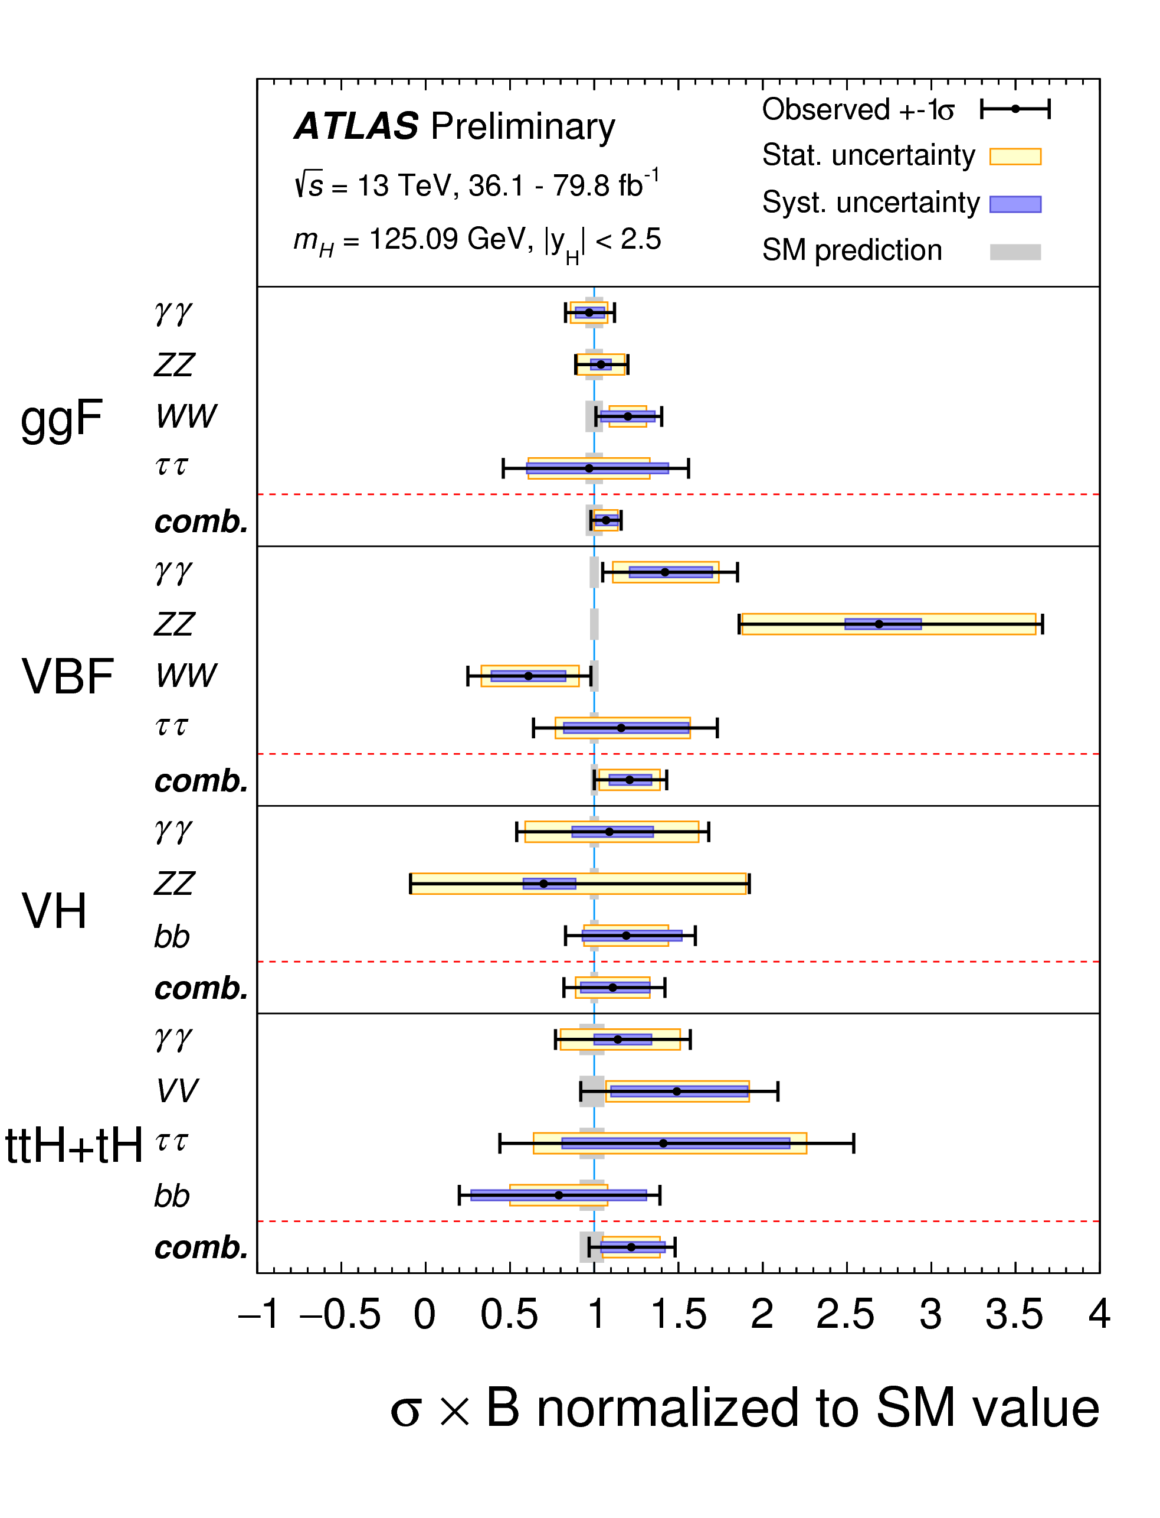
Taken from ATLAS collaboration, ATLAS-CONF-2018-031,
presented at the
XXXIX International Conference on High Energy Physics in
Seoul, Korea, 4—11 July 2018

Slide 20

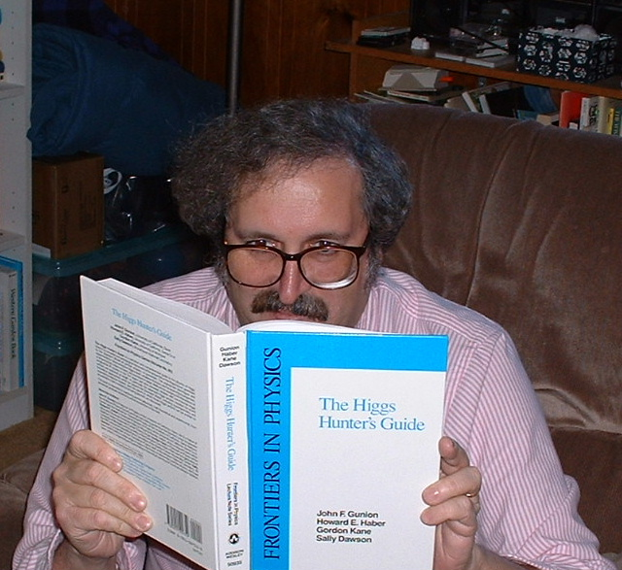
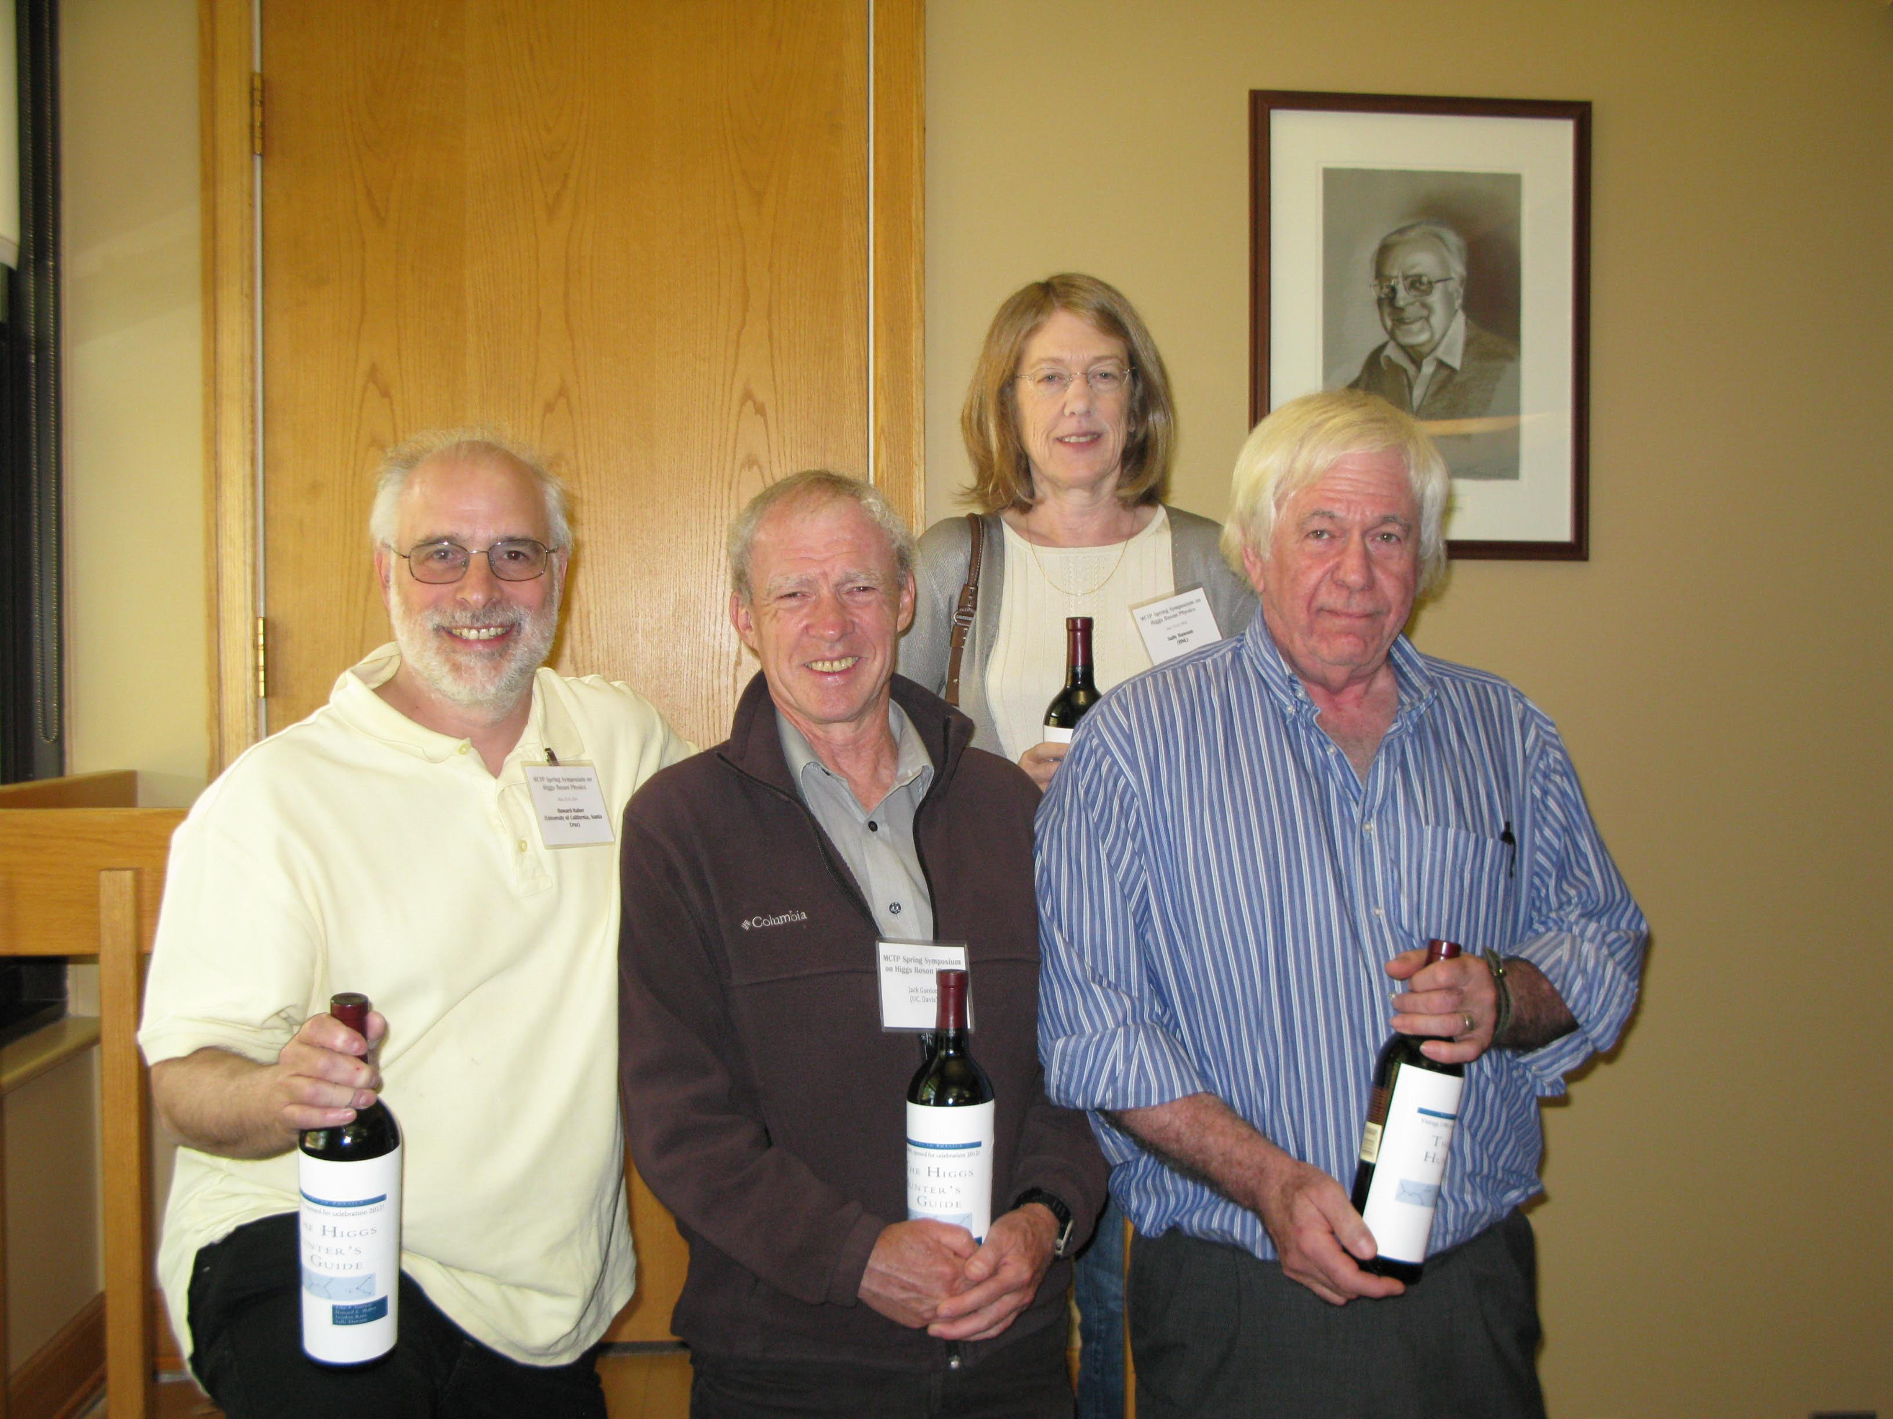
Research program 1: theory and phenomenology of Higgs bosons

Slide 21

Research program 2: theory and phenomenology of TeV-scale supersymmetry (SUSY)
For a review, see H.E. Haber, Supersymmetry Theory, in M. Tanabashi et al. [Particle Data Group Collaboration], Review of Particle Physics, Phys. Rev. D 98, 030001 (2018) pp. 790—806.

Slide 22
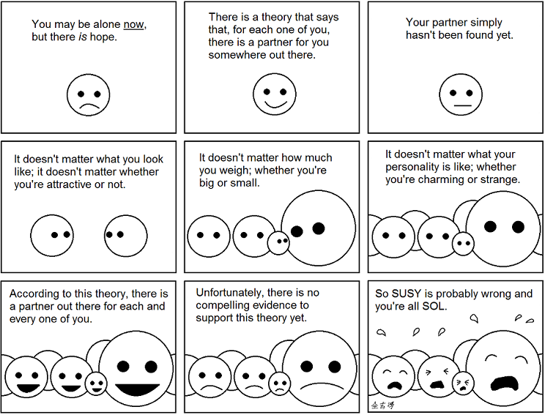

Slide 23
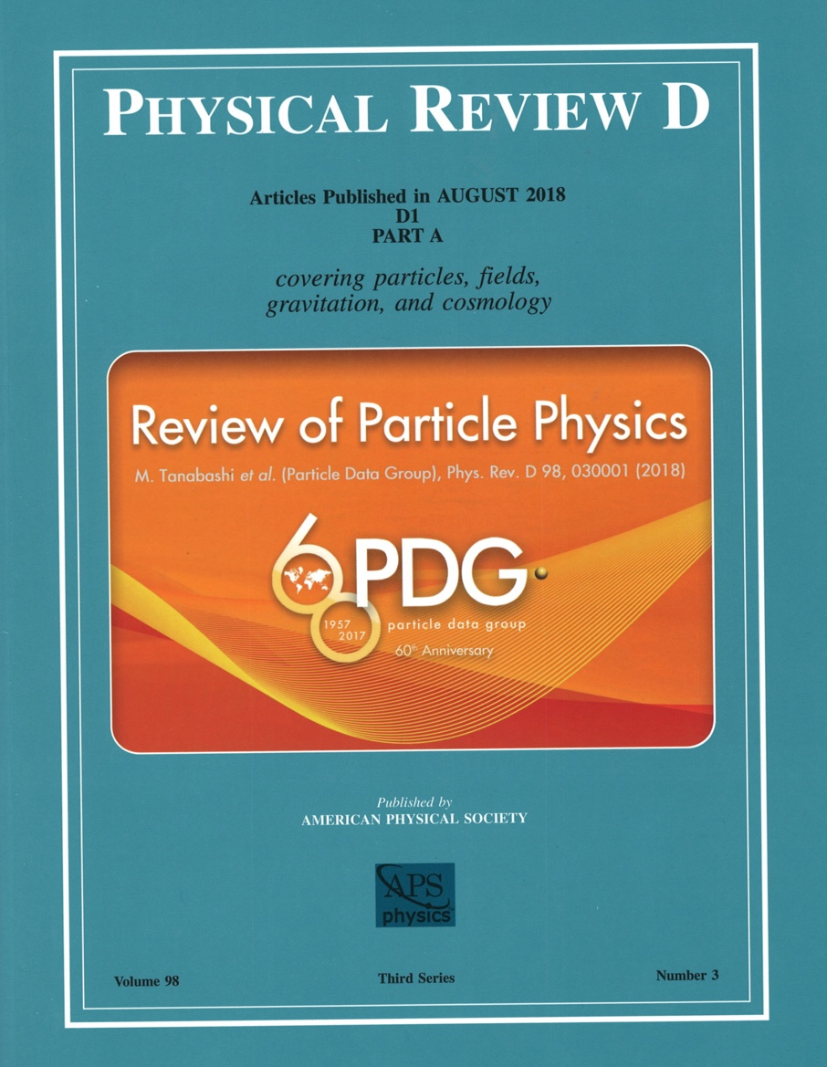
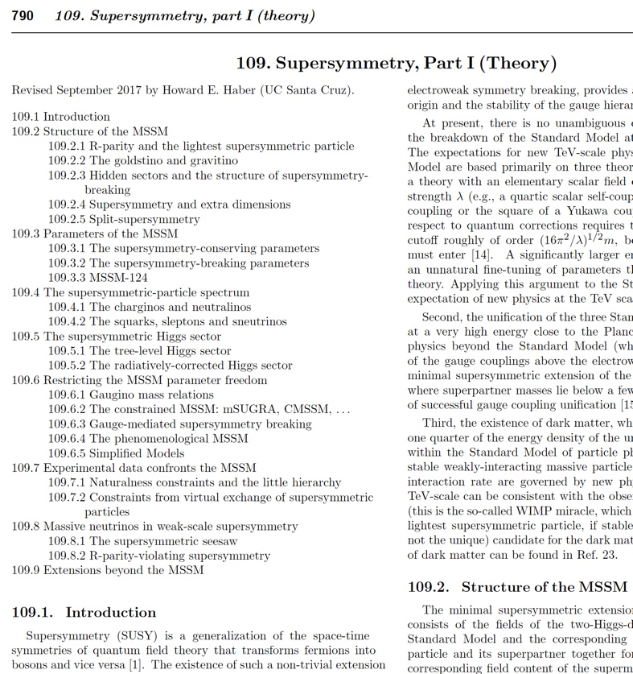
As a member of the Particle Data Group, I am the author
of the biennial Supersymmetry Theory review

Slide 24
Research program 3: explorations of the Terascale at present and future colliders (LHC and ILC)
Studies of the non-minimal Higgs sector
Precision measurements of new physics observables
Distinguishing among different theoretical interpretations of new physics signals
Employing the ILC as a precision Higgs factory
Terascale footprints of lepton-number-violating physics (e.g. R-parity-violation or the SUSY seesaw)
New sources for CP-violation (Higgs and/or SUSY mediated)

Slide 25
2018--19 Publications
Symmetries and Mass Degeneracies in the Scalar Sector
H.E. Haber, O.M. Ogreid, Per Osland and M.N. Rebelo, JHEP 1901 (2019) 042.
Heavy Higgs boson decays in the alignment limit of the 2HDM
B. Grzadkowski, H.E. Haber, O.M. Ogreid and Per Osland, JHEP 1812 (2018) 056.
Multi-Higgs doublet models: the Higgs-fermion couplings and their sum rules
M.P. Bento, H.E. Haber, J.C. Romão and J.P. Silva, JHEP 1810 (2018) 143.
Viewpoint: Higgs Decay into Bottom Quarks Seen at Last
H.E. Haber, APS Physics 11 (2018) 91.
Approximate Higgs alignment without decoupling
H.E. Haber, in the Proceedings of the 53th Rencontres de Moriond, QCD Session, March 17—24, 2018, in La Thuile, Aosta Valley, Italy, edited by E. Augé, J. Dumarchez and J. Trân Thanh Vân (ARISF Publishers, France, 2018) pp. 139–142.
Supersymmetric Theory and Models
H.E. Haber and L. Stephenson Haskins, arXiv:1712.05926 [hep-ph], in Chapter 6 of TASI 2016: Anticipating the Next Discoveries in Particle Physics, edited by Rouven Essig and Ian Low (World Scientific, Singapore, 2018) pp. 355--499.
UCSC graduate student authors in red.

Slide 26
Should we expect an extended Higgs sector beyond the SM?
The fermion and gauge boson sectors of the SM are not of minimal form (“who ordered that?”). So, why should the spin-0 (scalar) sector be minimal?
Adding new scalar states can alleviate the metastability of the vacuum, allowing the Higgs-sector-extended SM to be valid all the way up to the Planck scale.
Extended Higgs sectors can provide a dark matter candidate.
Extended Higgs sectors can provide new sources of CP violation (which may be useful in baryogenesis).
Models of physics beyond the SM often require additional scalar Higgs states. E.g., two Higgs doublets are required in the minimal supersymmetric extension of the SM (MSSM).

Slide 27
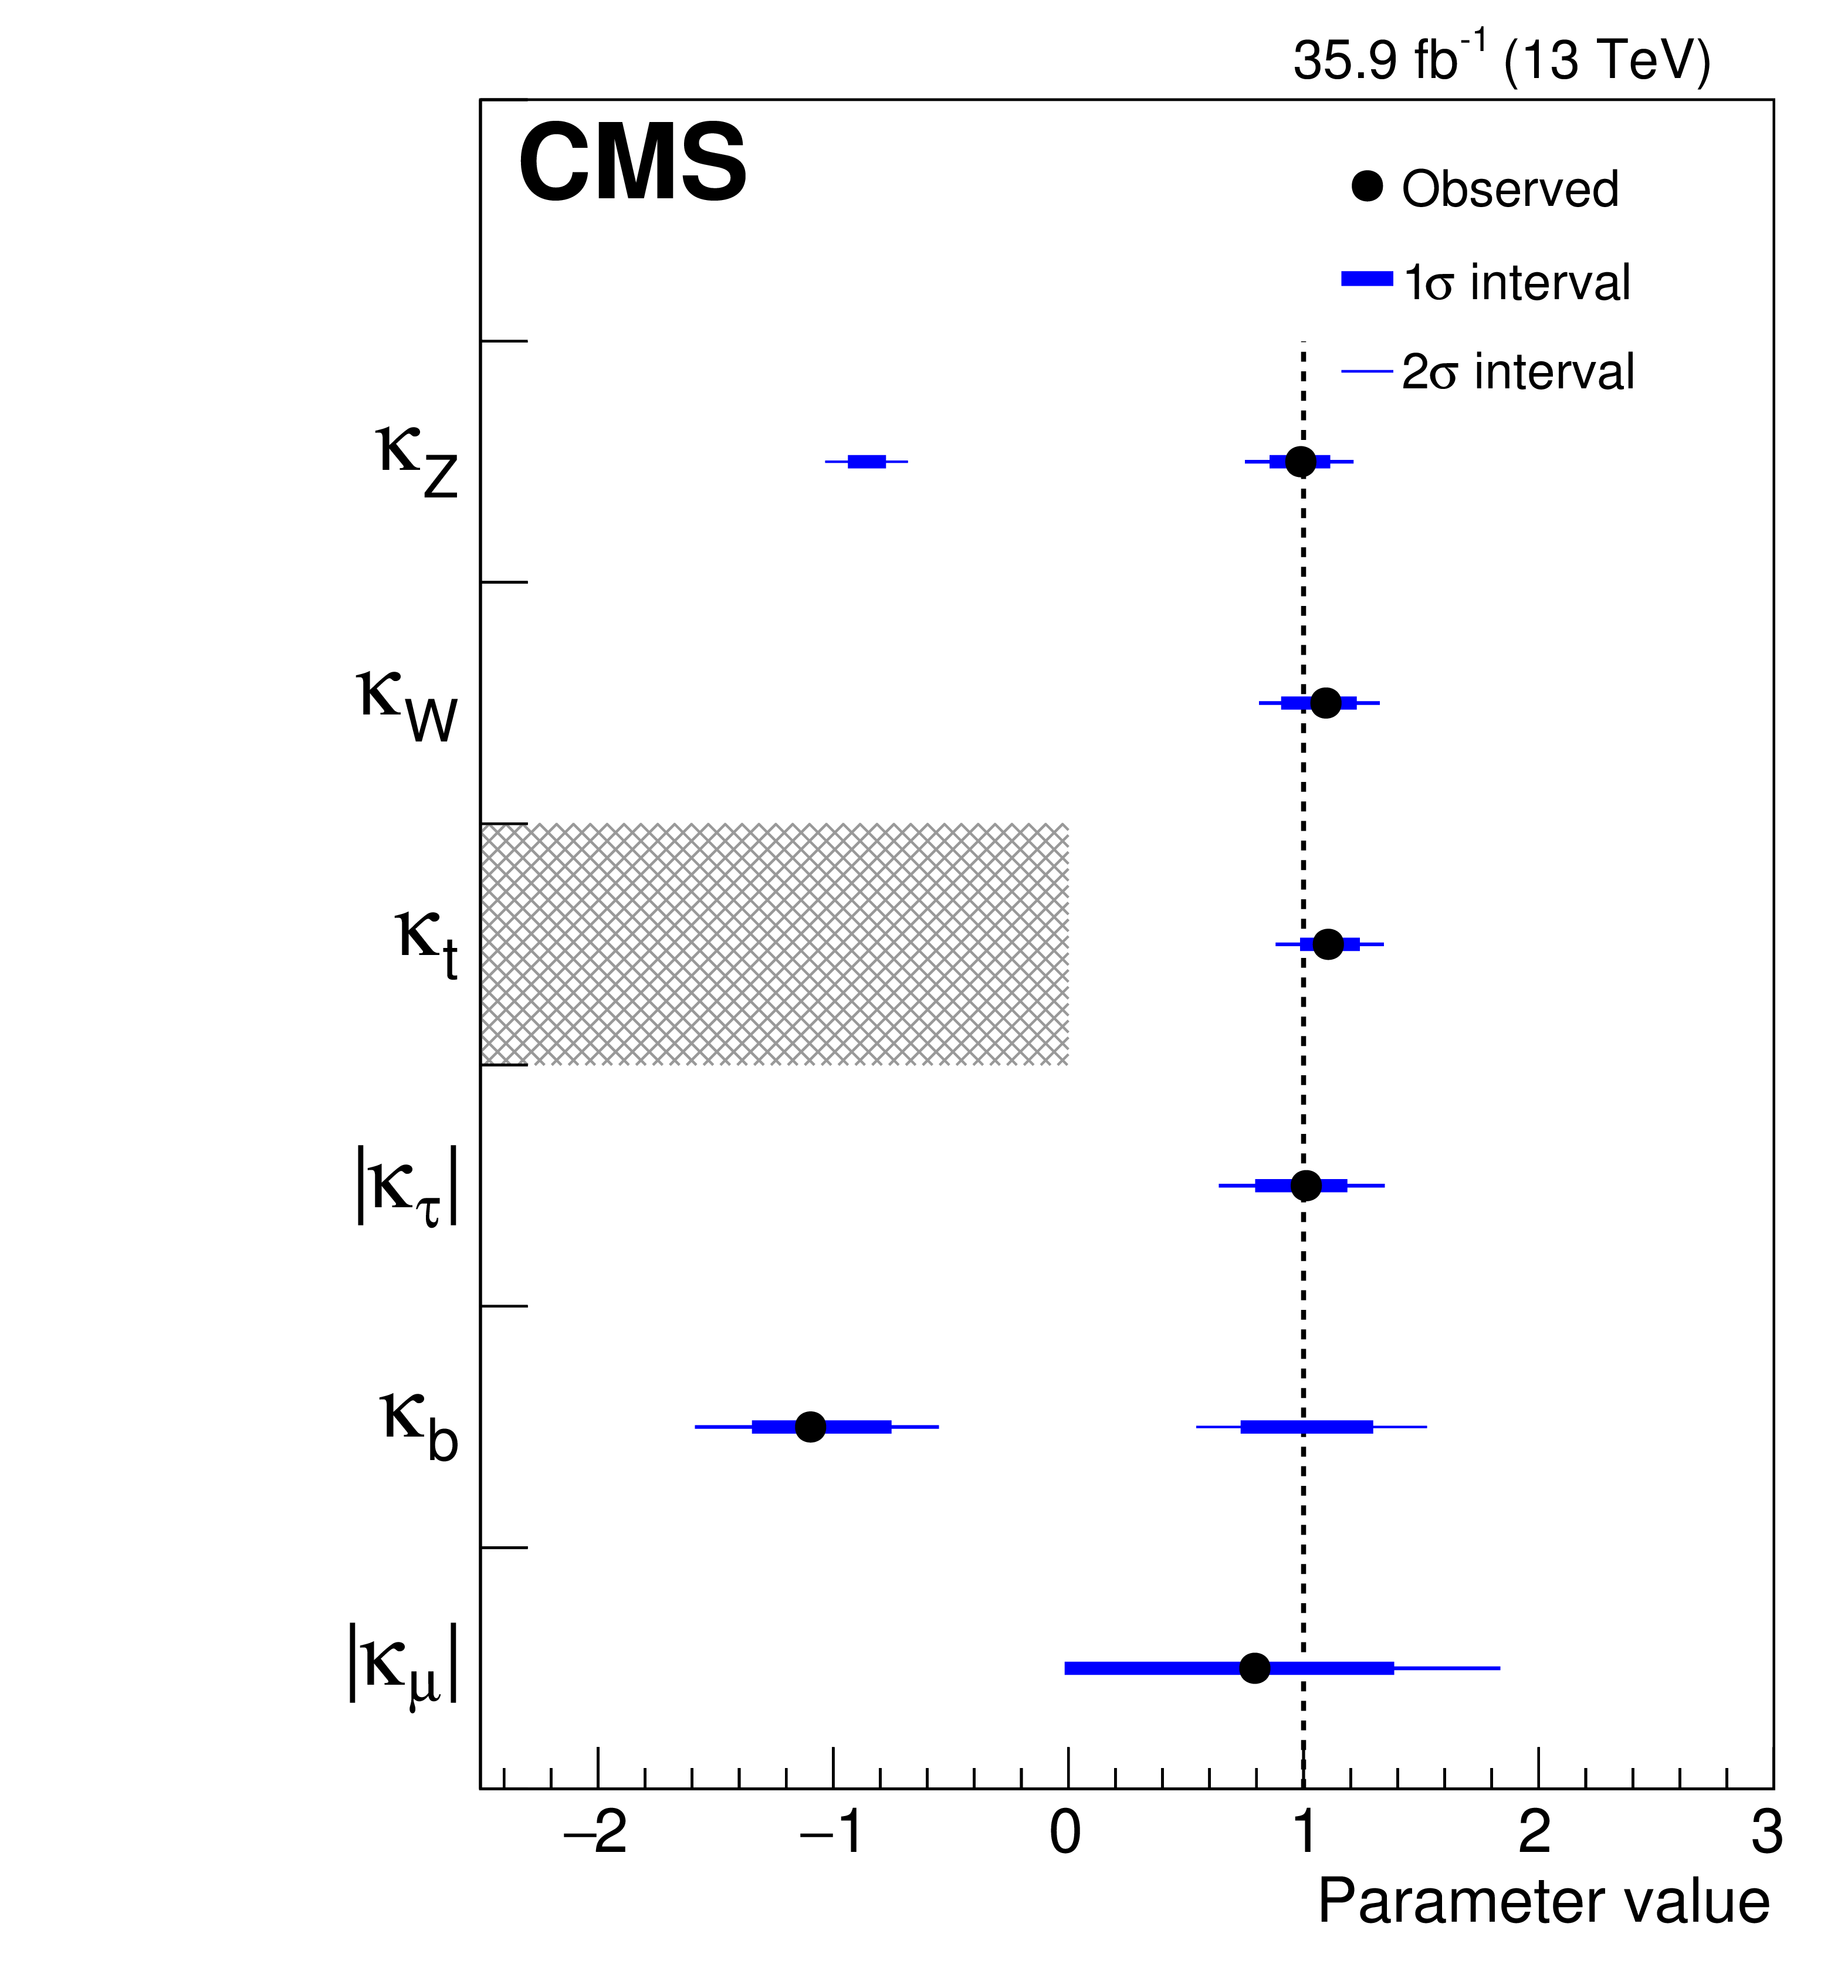
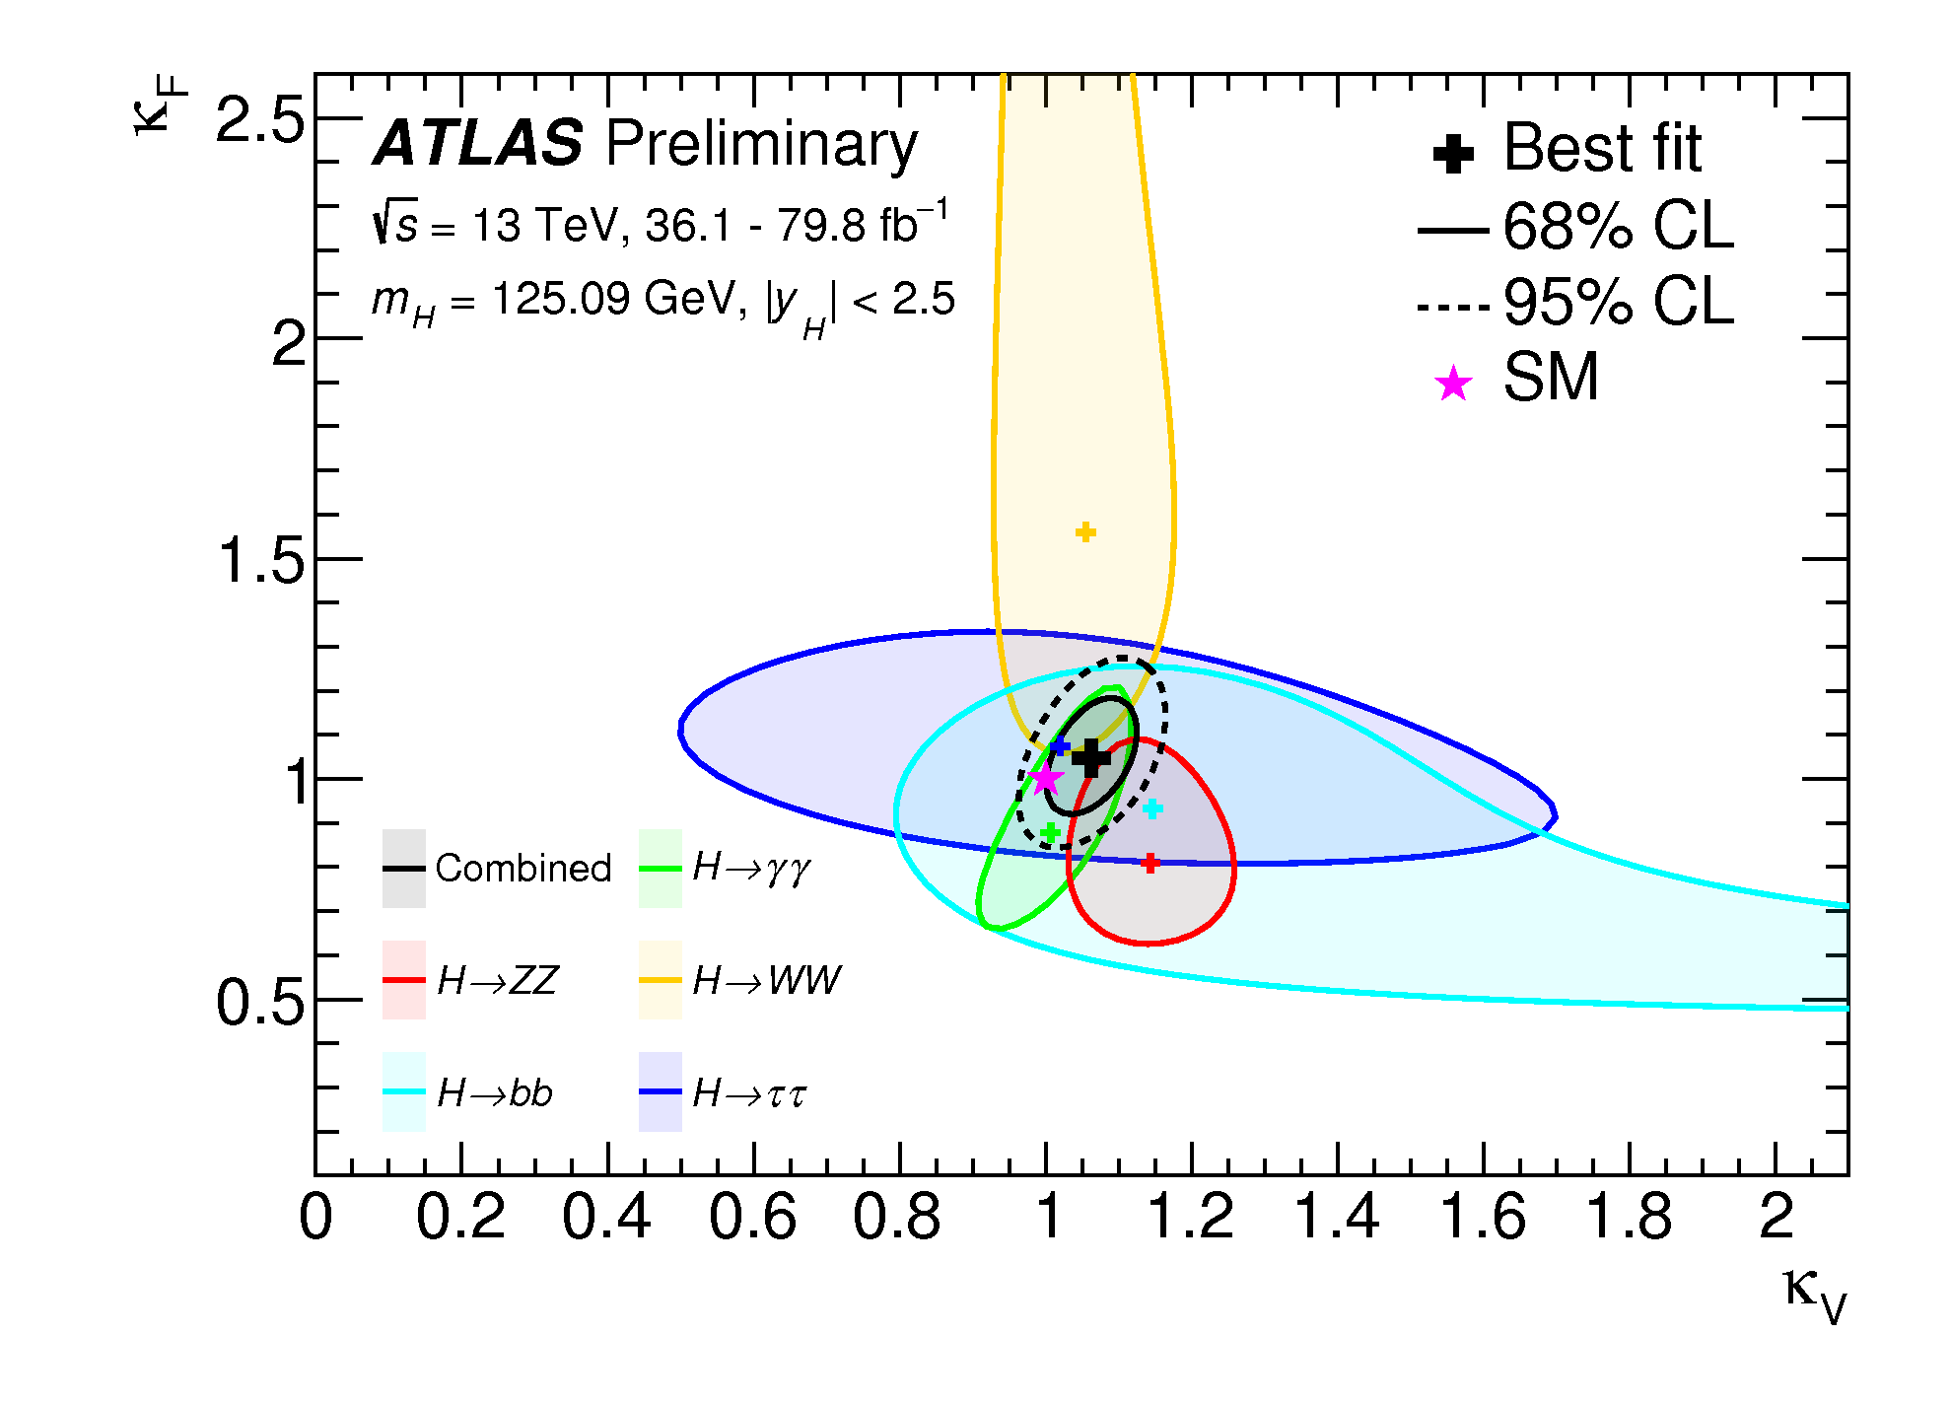
Search for deviations from SM-Higgs couplings
Negative log-likelihood contours at 68% and 95% CL in the (κ_{F} ,κ_{V}) for the individual decay channels and the combined fit. The crosses indicate the best-fit values and the star the Standard Model prediction. Taken from ATLAS collaboration, ATLAS-CONF-2018-031.
Summary of the κ framework model assuming that there are no additional BSM contributions to the Higgs boson width, i.e. BR_{BSM}=0. The points indicate the best fit values while the thick and thin horizontal bars show the 1𝜎 and 2𝜎 CL intervals, respectively. Taken from A.M. Sirunyan et al. [CMS Collaboration], arXiv:1809.10733.

Slide 28
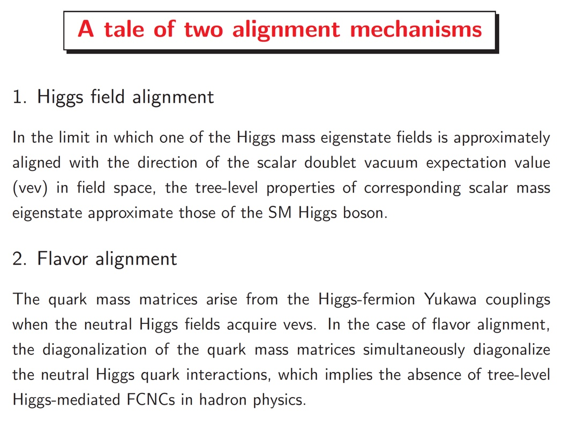

Slide 29
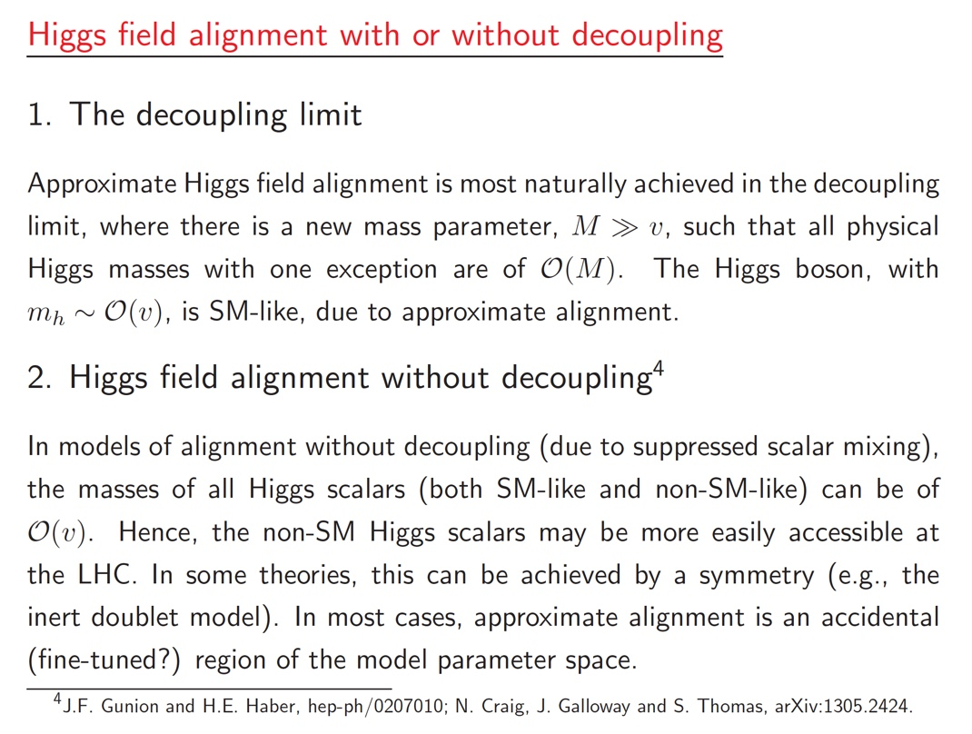

Slide 30



Evidence for new physics beyond the SM in B decays to muon pairs?
Recent results from LHCb and CMS at the LHC yield the following branching ratios (BR):
which should be compared with the SM predictions,
In S. Gori, H.E. Haber and E. Santos, JHEP 1706 (2017) 110, new contributions to these decays were considered in the two Higgs doublet model (2HDM) where flavor alignment is imposed at very high energies. However, renormalization group running generates small flavor-changing neutral Higgs couplings that do not exist in the SM and can contribute to neutral B decays.
The present data already puts interesting constraints on the flavor alignment parameters a^{U} and a^{D} of our model.

Slide 31
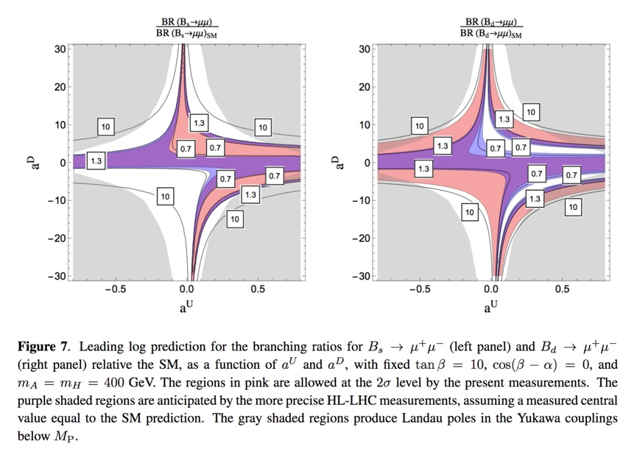

Slide 32
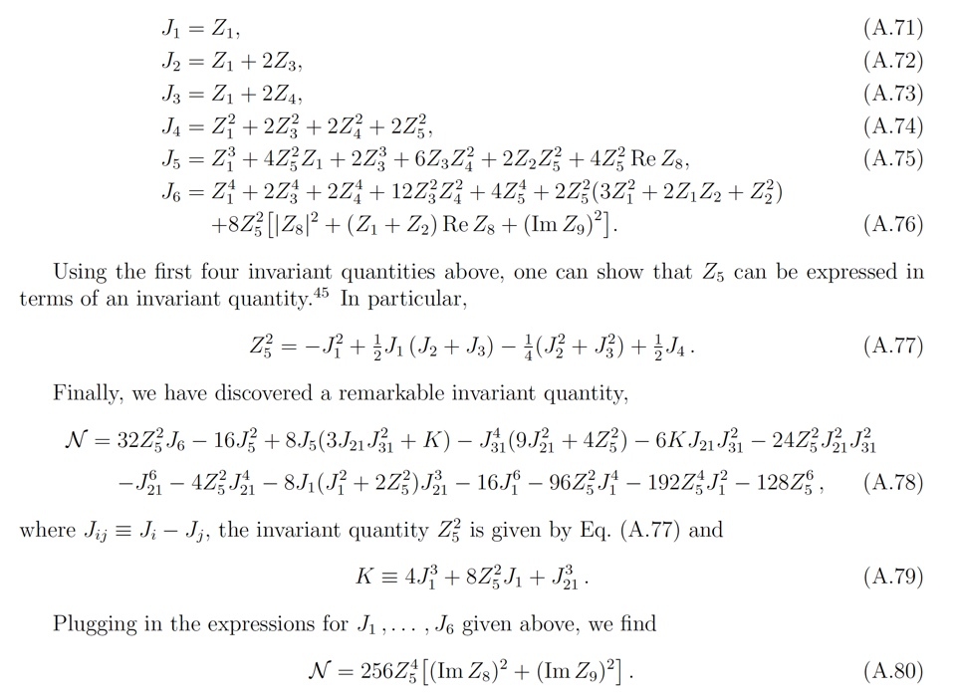
Exploring some consequences of the Ivanov-Silva 3HDM
The physical consequence of the non-vanishing of this invariant quantity is the existence of a coupling of Z to four mass-degenerate inert scalars. For more details, see H.E. Haber, O.M. Ogreid, Per Osland and M.N. Rebelo, JHEP 1901 (2019) 042.

Slide 33
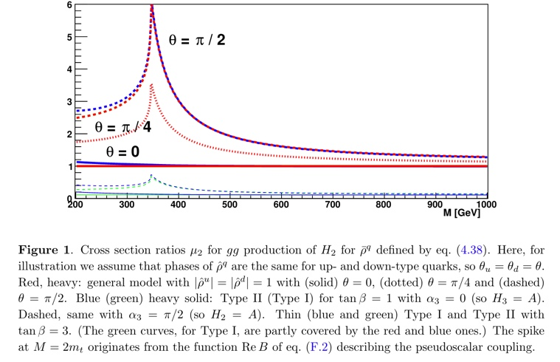
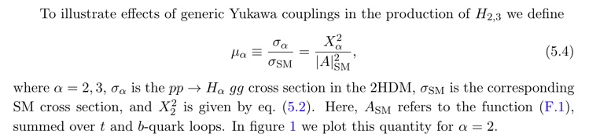
Exploring heavy Higgs boson decays in the alignment limit of the 2HDM
𝜇₂
Taken from B. Grzadkowski, H.E. Haber, O.M. Ogreid and Per Osland, JHEP 1812 (2018) 056.

Slide 34
My recent Ph.D. students and their thesis projects
John Mason (2008): Hard Supersymmetry-Breaking “Wrong-Higgs” Couplings
of the MSSM
Deva O’Neil (2009): Phenomenology of the Basis-Independent CP-Violating
Two-Higgs Doublet Model (2HDM)
Laura Fava (2015): Precision Measurement of UED Coupling Constants Using
Like-Sign Leptons at the LHC
Edward Santos (2015): Renormalization Group Constraints on the Two-Higgs
Doublet Model
Where are they now?
J. Mason – following a three-year post doctoral research associate in particle
theory at Harvard University, John accepted a position as an
associate professor of physics at Western State College of Colorado
D. O’Neil – associate professor of physics at Bridgewater College (in Virginia)
L. Fava and E. Santos – participated in the Insight Data Science Fellows Program;
initially found employment in Silicon Valley.
E. Santos – presently works for Google (will give Physics Colloquium next month)

Slide 35
Recent Ph.D. student (co-advised with Michael Dine)
and her thesis project
Laurel Stephenson Haskins (2017): Supersymmetry , Inflation and Dark Matter
Current position
Post Doctoral Research Associate at the Racah Institute of Physics at the Hebrew University of Jerusalem
We collaborated on two projects:
1. M. Dine, P. Draper, H.E. Haber and L. S. Haskins, Perturbation Theory in
Supersymmetric QED: Infrared Divergences and Gauge Invariance,
Phys. Rev. D 94, 095003 (2016).
2. H.E. Haber and L. Stephenson Haskins, Supersymmetric Theory and Models,
arXiv:1712.05926 [hep-ph], in Chapter 6 of TASI 2016: Anticipating the Next
Discoveries in Particle Physics, edited by Rouven Essig and Ian Low (World
Scientific, Singapore, 2018) pp. 355--499.

Slide 36
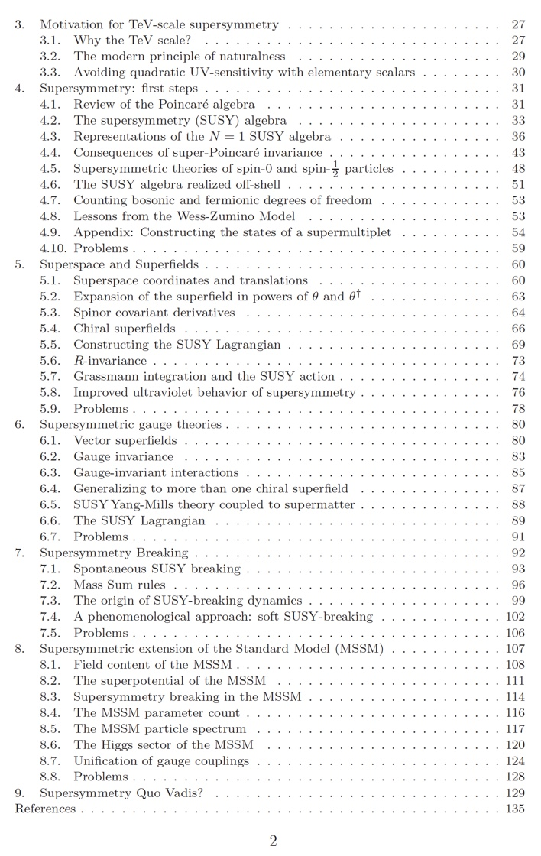
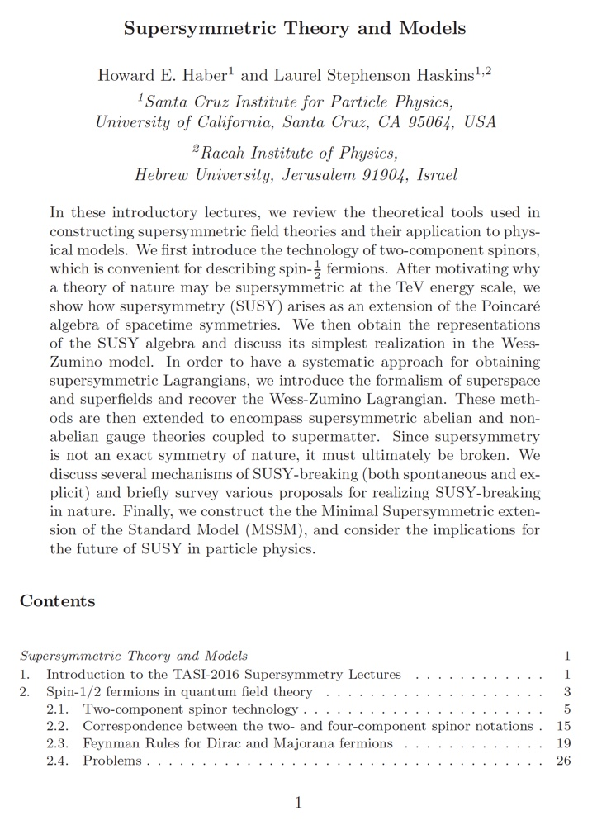

Slide 37
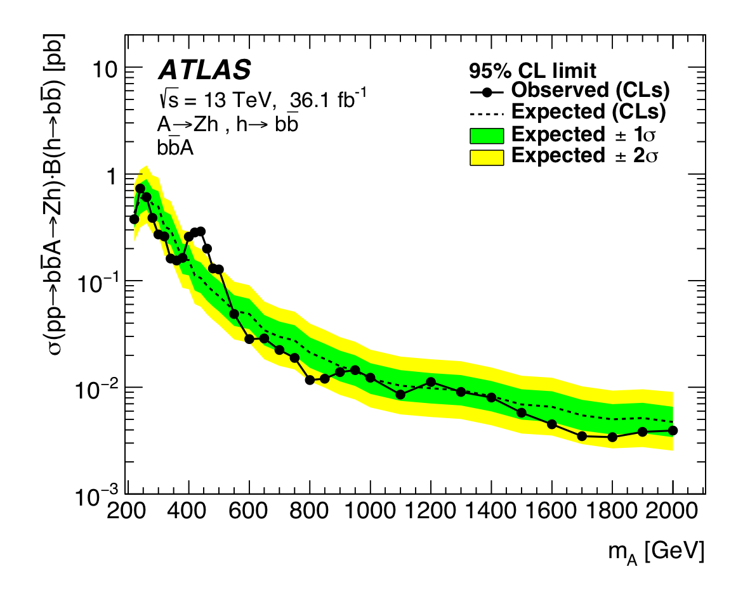
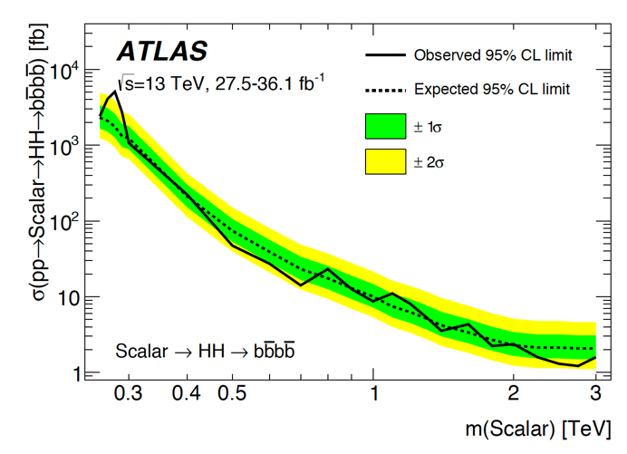
My current Ph.D. students and their projects
2HDM high energy flavor alignment (with S. Gori and E. Shahly)
  Neutral Higgs-mediated flavor violation in the lepton sector.
Phenomenological aspects of more general 2HDMs (with J. Connell and P. Ferreira)
  Exploring some (local) 3𝝈 deviations in ATLAS searches for new Higgs bosons, with implications for the flavor-aligned 2HDM.
ATLAS Collaboration, JHEP 1803 (2018) 174
ATLAS Collaboration, arXiv:1804.06174

Slide 38
Other Ongoing and Future Activities
Natural alignment without decoupling (with P. Draper,…)
  Achieving a SM-like Higgs boson without fine-tuning.
Theoretical studies of the CP-violating 2HDM (with J.P. Silva,…)
Basis-invariant treatment of the 3HDM (with V. Keus)
P-even CP-violating signals in scalar-mediated processes (with
V. Keus, T. Stefaniak and S. Thomas)
Higgs alignment at one loop (with S.J.D. King and S. Moretti)
Higgs alignment in 2HDM effective field theory (with A. Dedes and J. Rosiek,…)
Higgs alignment in the Georgi-Machacek model (with P. Ferreira, H. Logan and Y. Wu)
Various other projects are waiting for the right Ph.D. student…

