Slide 1
Research on the Theory of the TeV energy scale (Terascale)
Howard Haber
SCIPP Theory
January 22, 2020
For further details, check out my webpage:
http://scipp.ucsc.edu/~haber/

Slide 2
SCIPP Particle Theory Group
Michael Dine: supersymmetry, string theory, instantons, axions, inflation and the early universe
Stefania Gori: phenomenology of new physics beyond the Standard model, dark matter and dark sectors, Higgs physics
Howard Haber: Higgs bosons, collider physics, new physics beyond the Standard Model at the terascale (including supersymmetry)
Stefano Profumo: Theories of particle dark matter and their implications for astrophysics and collider phenomenology
Wolfgang Altmannshofer: Flavor physics theory and phenomenology, CP violation, neutrino physics, Higgs physics
In addition, Anthony Aguirre and Joel Primack work on a variety
of topics overlapping particle theory and astroparticle theory,
including dark matter, early universe cosmology, inflation, …

Slide 3

The Standard Model (SM) of Particle Physics
The elementary particles consists of three generations of spin-1/2 quarks and leptons, the gauge bosons of SU(3)xSU(2)xU(1), and
the Higgs boson.
Technically, massive neutrinos
require an extension of the Standard
Model, but most likely the relevant
scale of the new physics lies way
beyond the terascale.

Slide 4
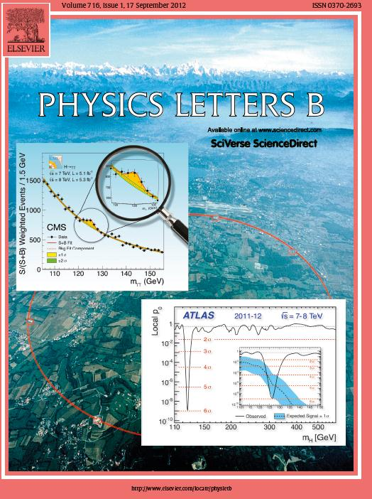
On July 4, 2012, the discovery
of a new boson is announced
which may be the long sought
after Higgs boson.
The discovery papers are
published two months later
In Physics Letters B.
ATLAS Collaboration:
Physics Letters B716 (2012) 1—29
CMS Collaboration:
Physics Letters B716 (2012) 30—61

Slide 5
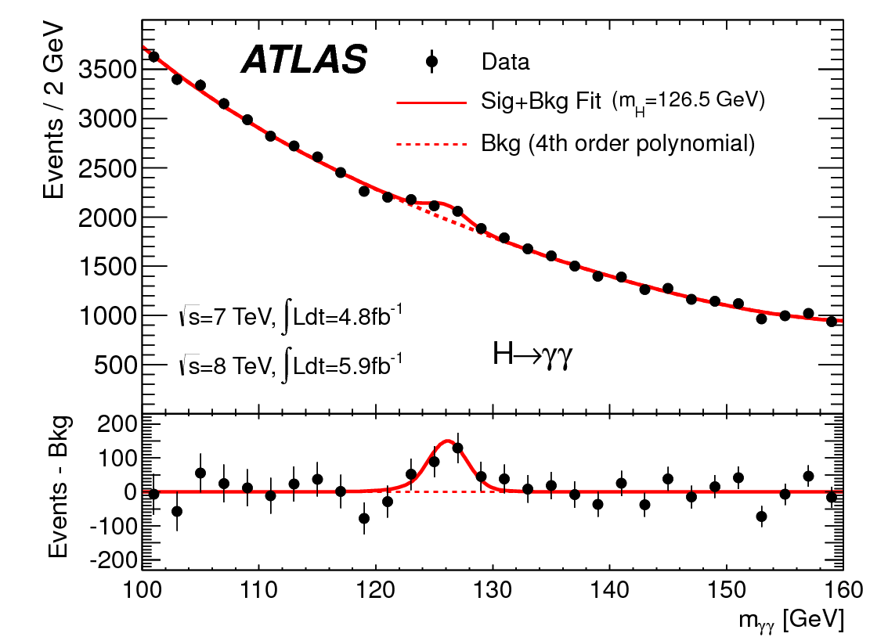
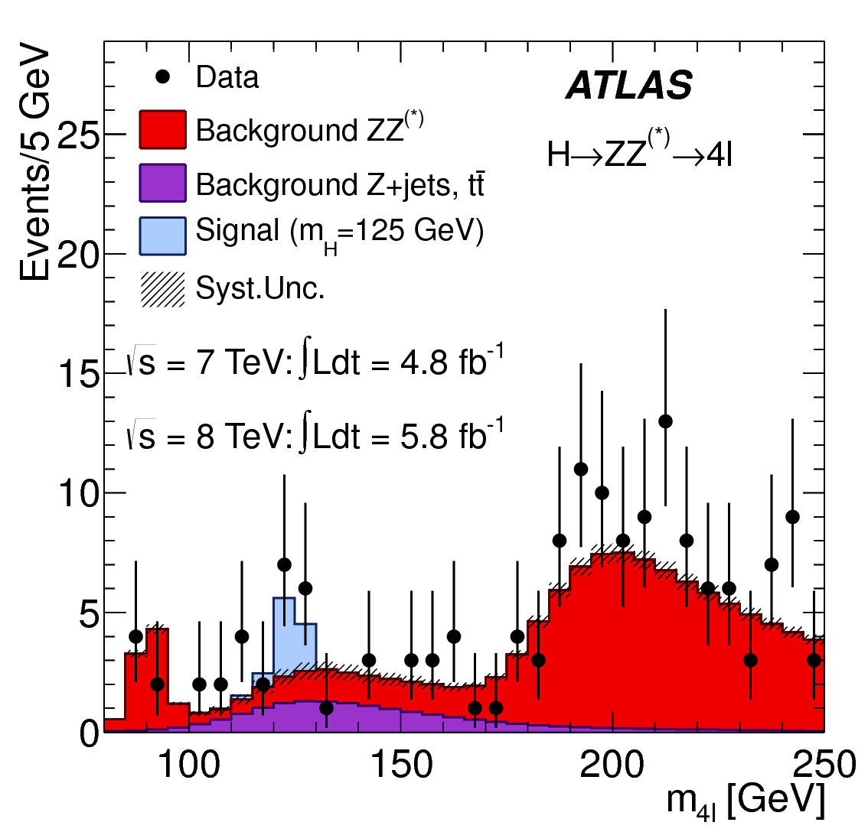
A boson is discovered at the LHC by the ATLAS Collaboration
Invariant mass distribution of diphoton candidates for the combined 7 TeV and 8 TeV data samples. The result of a fit to the data of the sum of a signal component fixed to
m_{H} = 126.5 GeV and a background component described by a fourth-order Bernstein polynomial is superimposed. The bottom inset displays the residuals of the data with respect to the fitted background component.
The distribution of the four-lepton invariant mass, m_{4l}, for the selected candidates, compared to the background expectation in the 80 to 250 GeV mass range, for the combination of the 7 TeV
8 TeV data. The signal expectation for a Higgs boson with m_{H}=125 GeV is also shown.
(Taken from Physics Letters B716 (2012) 1-29.)

Slide 6
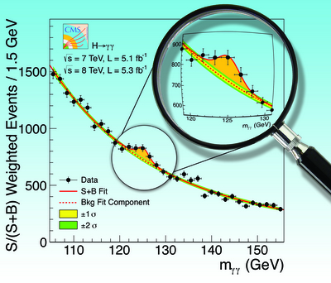
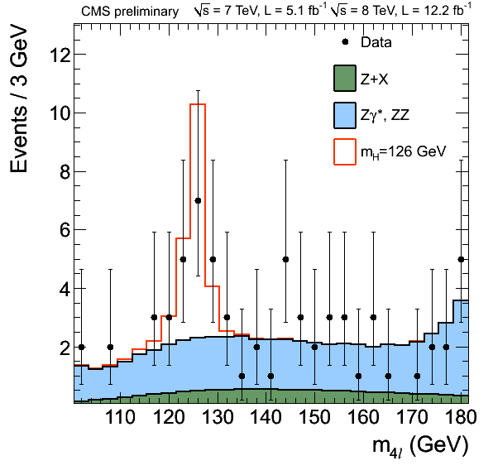
A boson is discovered at the LHC by the CMS Collaboration
The diphoton invariant mass distribution
with each event weighted by the S/(S+B)
value of its category. The lines represent the
fitted background and signal, and the colored
bands represent the ±1 and ±2 standard deviation
uncertainties in the background estimate. The
inset shows the central part of the unweighted
invariant mass distribution. Taken from
Physics Letters B716 (2012) 30—61.
Distribution of the four-lepton invariant mass for the
ZZ→4 leptons analysis. The points represent the data,
the filled histograms represent the background, and
the open histogram shows the signal expectation for
a Higgs boson of mass m_{H} = 126 GeV, added to the
background expectation. Taken from https://
twiki.cern.ch/twiki/bin/view/CMSPublic/Hig12041TWiki.

Slide 7

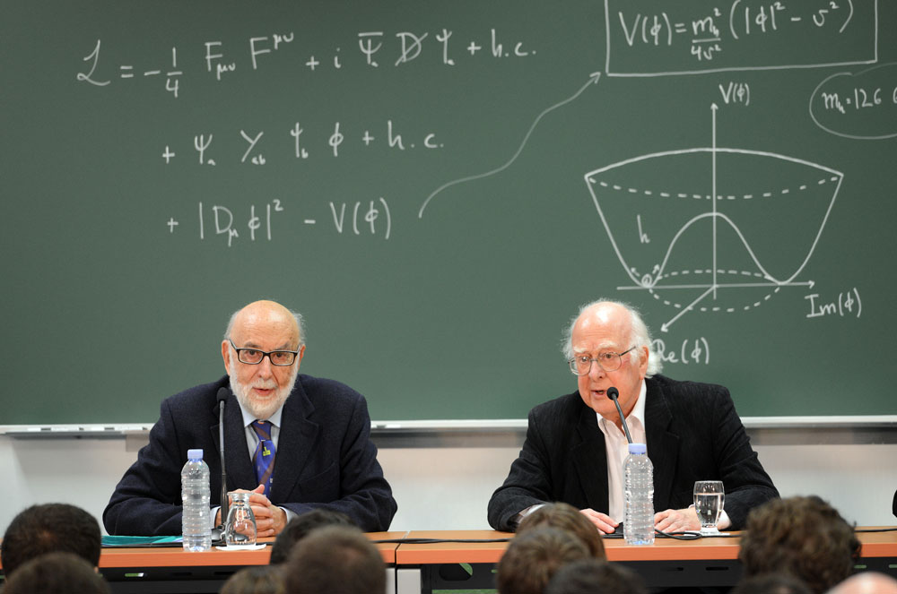
Winners of the 2013 Nobel Prize in Physics
François Englert
and
Peter Higgs

Slide 8
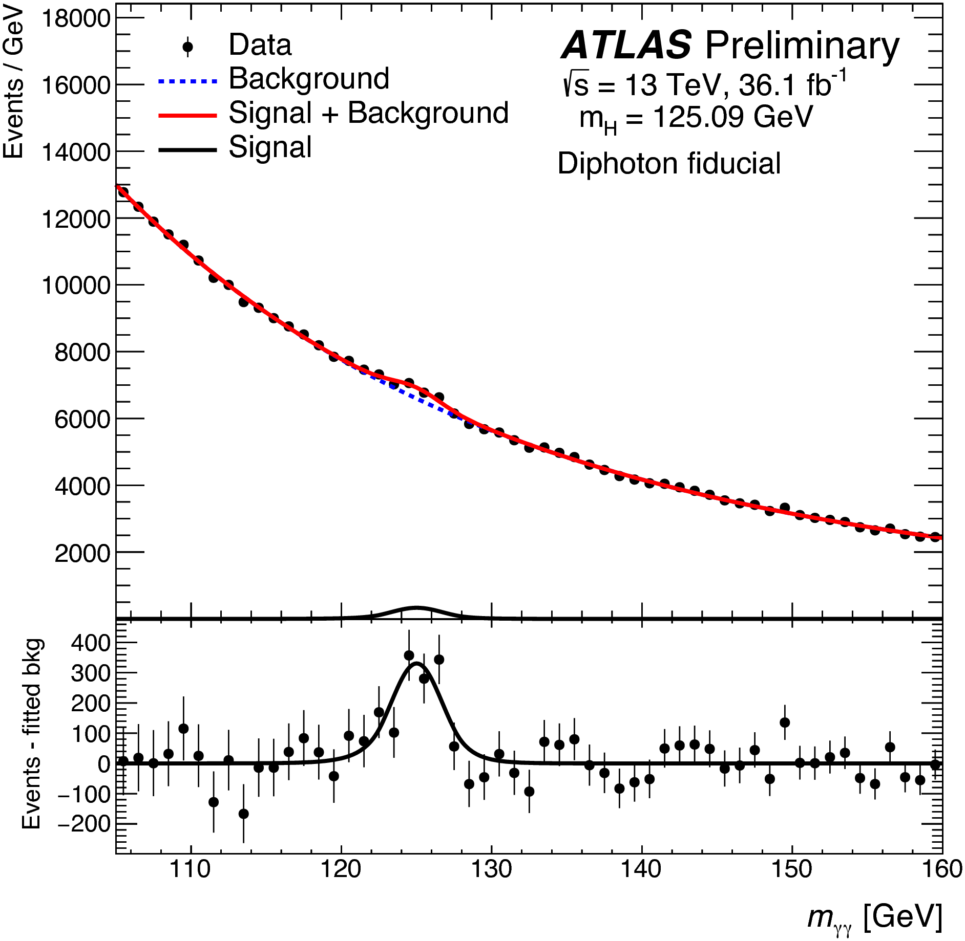
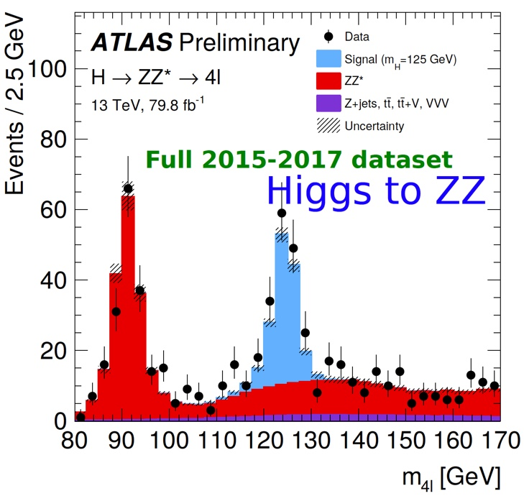
ATLAS Run-2 observations of the Higgs boson

Slide 9
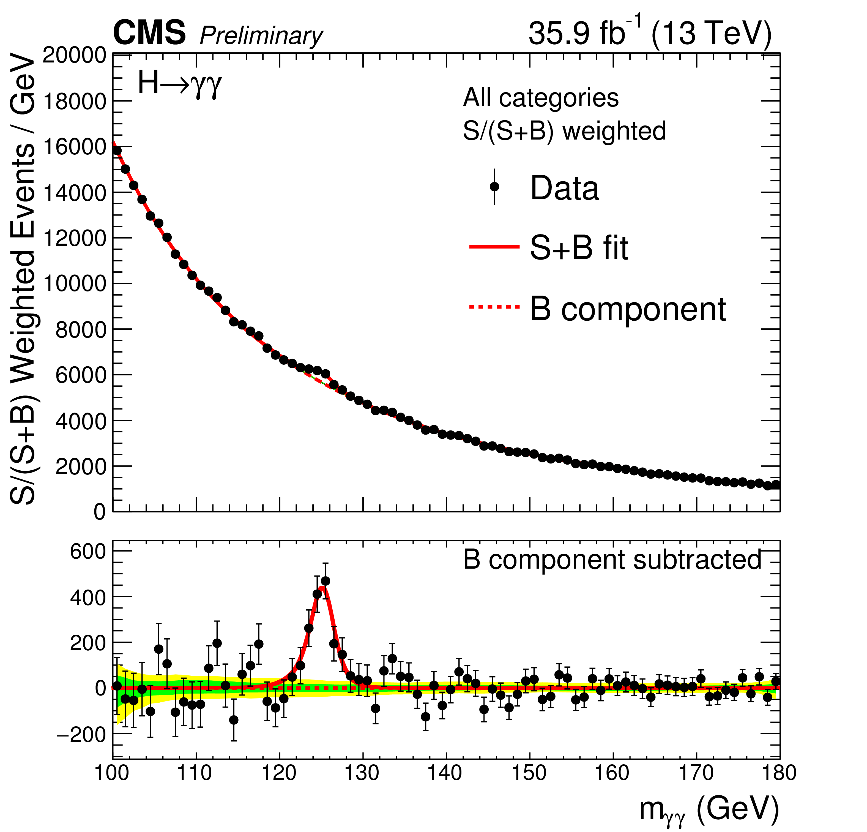
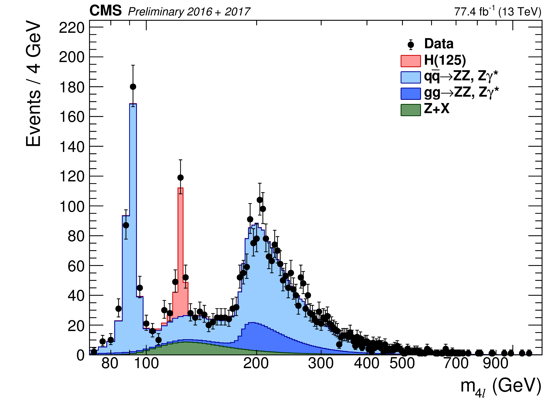
CMS Run-2 observations of the Higgs boson

Slide 11
Higgs boson production cross sections at a pp collider
With nearly 150 fb⁻¹ of data delivered by the LHC in Run 2 to both ATLAS and CMS in 2015—2018 at a center of mass energy of 13 TeV, roughly 7.5 million Higgs bosons per experiment were produced, assuming the Higgs mass is 125 GeV.

Slide 12
Higgs boson decay channels observed at the LHC
Higgs boson decay mode | Branching ratio (for m_{h} = 125 GeV)
H⁰ → bb | 0.582
H⁰ → 𝞃⁺ 𝞃 ⁻ | 6.27 x 10⁻²
h⁰ → 𝓵⁺ 𝓵⁻ 𝝂𝝂 (𝓵 = e or 𝞵) | 1.06 x 10⁻²
h⁰ → 𝛄𝛄 | 2.27 x 10⁻³
h⁰ → 𝓵⁺ 𝓵⁻ 𝓵⁺ 𝓵⁻ (𝓵 = e or 𝞵) | 1.24 x 10⁻⁴
Taken from https://twiki.cern.ch/twiki/bin/view/LHCPhysics/CERNYellowReportPageBR#Branching_Ratios
Remarks:
h⁰ ➞ WW* is observed primarily via the 𝓵⁺ 𝝂 𝓵⁻ 𝝂 (𝓵 = e or 𝞵) final state.
h⁰ ➞ ZZ* is observed primarily via the 𝓵⁺𝓵⁻ 𝓵⁺𝓵⁻ (𝓵 = e or 𝞵) final state.
In the decays to the diboson final state, kinematics dictates that one of the vector bosons is off-shell (i.e., “virtual”) and is thus indicated by a superscript star.

Slide 13
Question: why not search
inclusively for Higgs bosons that decay into a pair of
b-quarks?
Answer: The Standard Model
background is overwhelming.
There are more than 10⁷ times as many b-quark pairs produced in proton-proton collisions as compared to
b-quark pairs that arise from a decaying Higgs boson.
Nevertheless, the observation of
H → bb in the VH channel was confirmed by ATLAS and CMS in 2018!

Slide 14
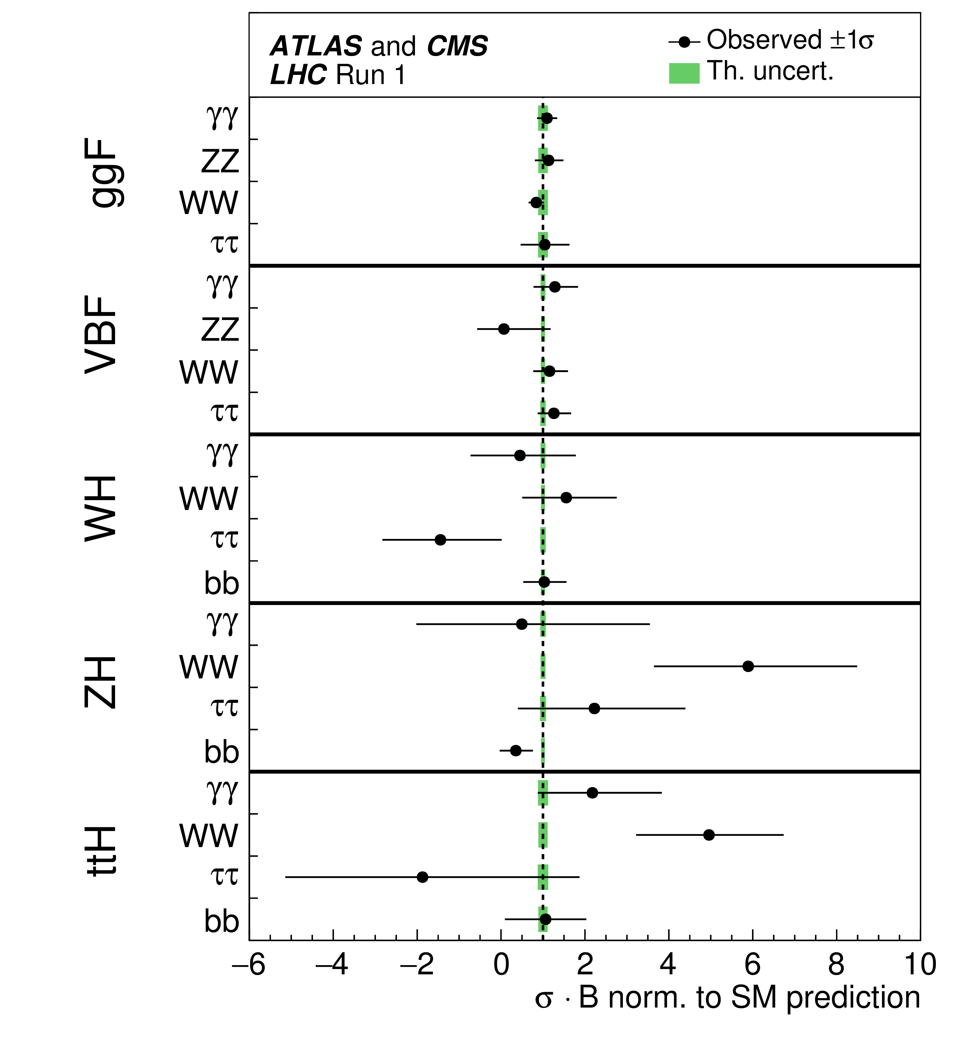
Is the observed 125 GeV scalar
the SM Higgs boson?
After the end of Run-1 of the LHC (2011—2013), the ATLAS and CMS Collaborations provided a combined analysis of the Higgs boson data.
The properties of the Higgs boson were consistent with Standard Model predictions (within the statistical power of the Higgs boson data).
The Higgs data taken at Run-2 of the LHC (2015—2018) have confirmed the Run-1 observations (with potential deviations from the Standard Model further reduced).
Taken from G. Aad et al. (ATLAS and CMS Collaborations) JHEP 1608 (2016) 045.

Slide 15
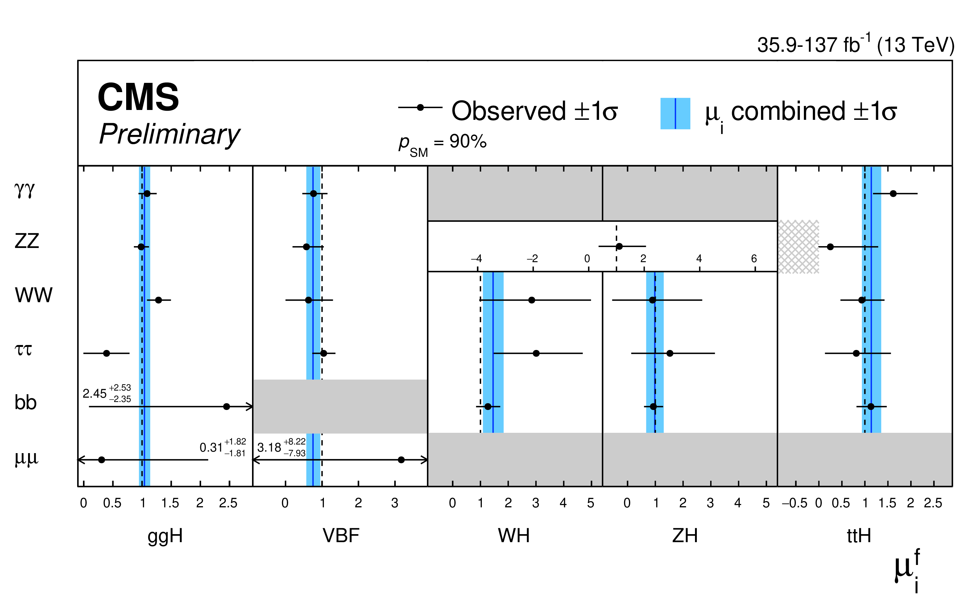
Taken from CMS Collaboration, CMS-PAS-HIG-19-005 (January, 2020).
Signal strength modifiers for the production times decay mode, μ^{f}_{i}. The black points and horizontal error bars show the best-fit values and 1σ confidence intervals, respectively. The arrows indicate cases where the confidence intervals exceed the scale of the horizontal axis. The gray filled boxes indicate signal strength modifiers which are not included in the model, while the gray hatched box indicates the region for which the sum of signal and background becomes negative in the fit for μ^{ZZ}_{ttH}. In the H→ZZ decay mode, a common modifier is fit to the WH and ZH production modes. The measured value and 1σ confidence interval for each production cross section modifier, μ_{i}, from the combination across decay channels, is indicated by the blue vertical line, and the blue bands, respectively. The indicated p-value is given for the production times decay mode signal strength modifiers.

Slide 16
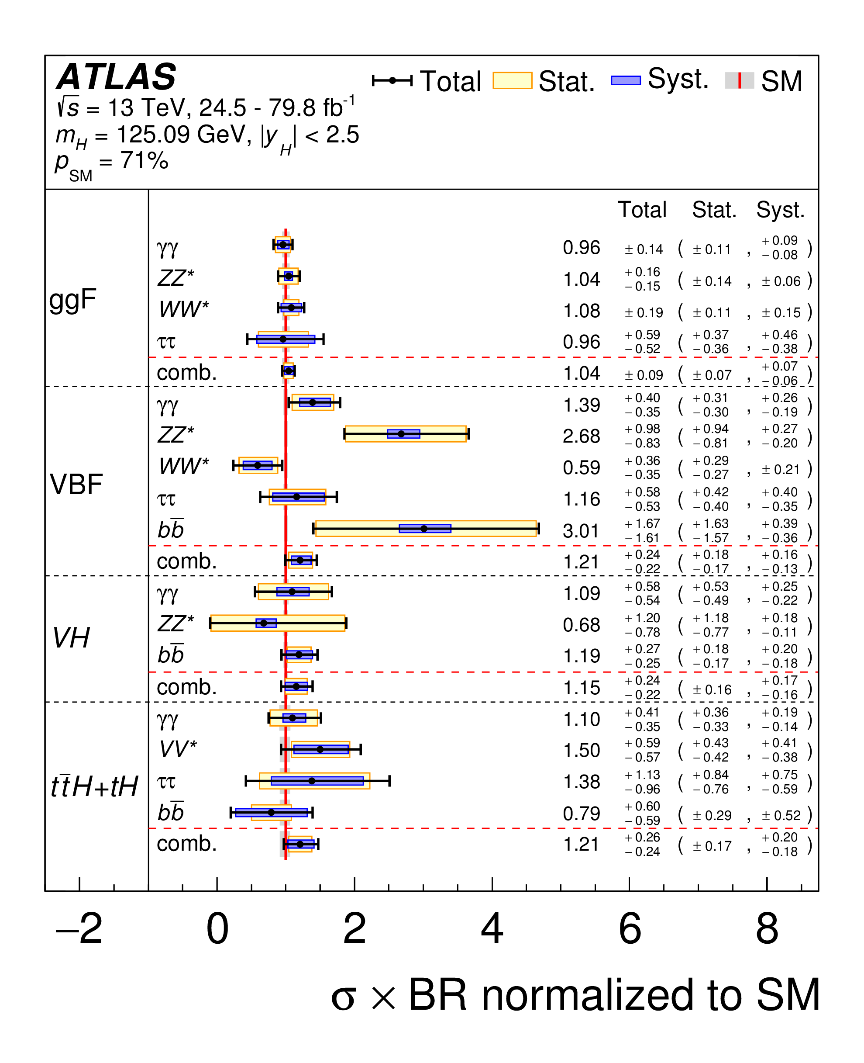
Taken from ATLAS collaboration,
Phys. Rev. D 101, 012002 (2020)
[arXiv:1909.02845].
Cross sections times branching fraction for ggF, VBF, VH and tt̄H+tH production in each relevant decay mode, normalized to their SM predictions. The values are obtained from a simultaneous fit to all channels. The cross sections of the ggF, H→bb̄, VH, H→WW* and VH, H→ττ processes are fixed to their SM predictions. Combined results for each production mode are also shown, assuming SM values for the branching fractions into each decay mode. The black error bars, blue boxes and yellow boxes show the total, systematic, and statistical uncertainties in the measurements, respectively. The gray bands show the theory uncertainties in the predictions.

Slide 17

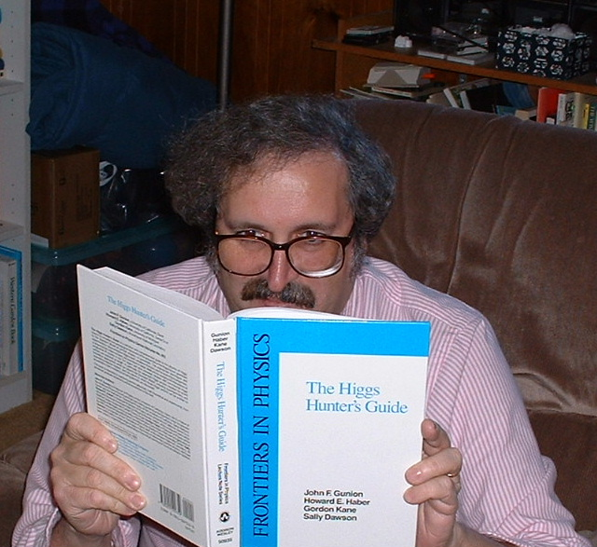
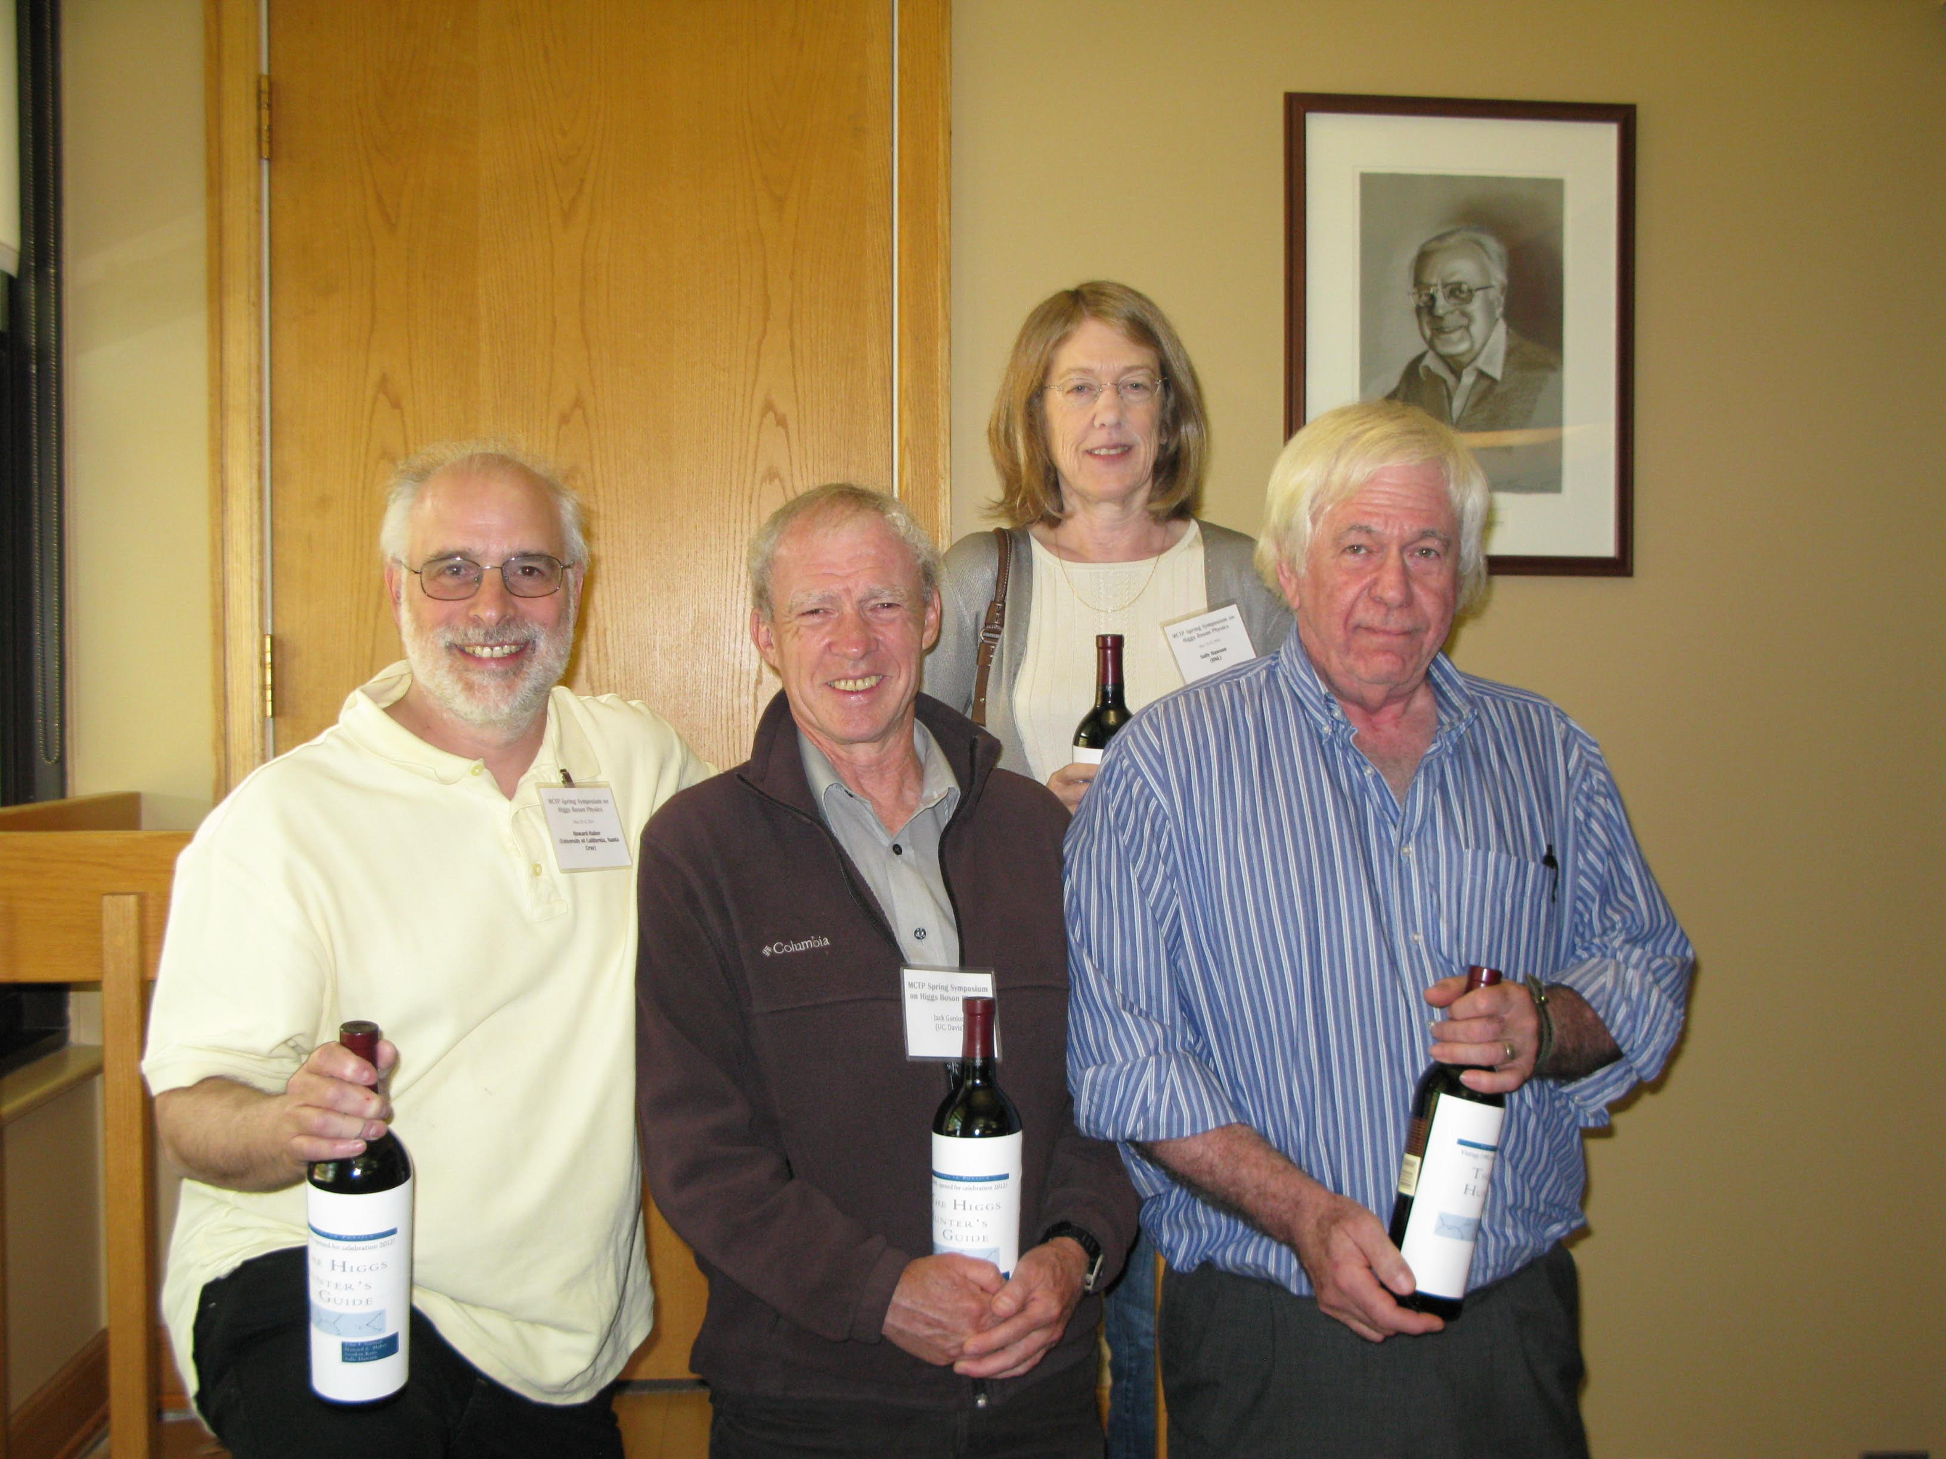
Research program 1: theory and phenomenology of Higgs bosons

Slide 18

Research program 2: theory and phenomenology of TeV-scale supersymmetry (SUSY)
For a review, see H.E. Haber, Supersymmetry Theory, in M. Tanabashi et al. [Particle Data Group Collaboration], Review of Particle Physics, Phys. Rev. D 98, 030001 (2018) pp. 790—806. The most recent 2019 update in collaboration with B.C. Allanach can be found at: http://pdg.lbl.gov/2019/reviews/rpp2019-rev-susy-1-theory.pdf.

Slide 19
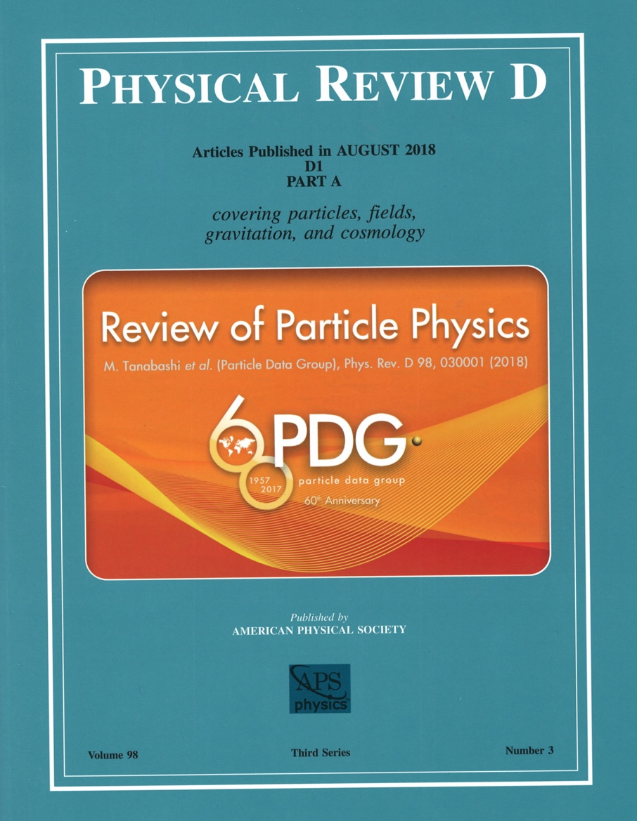
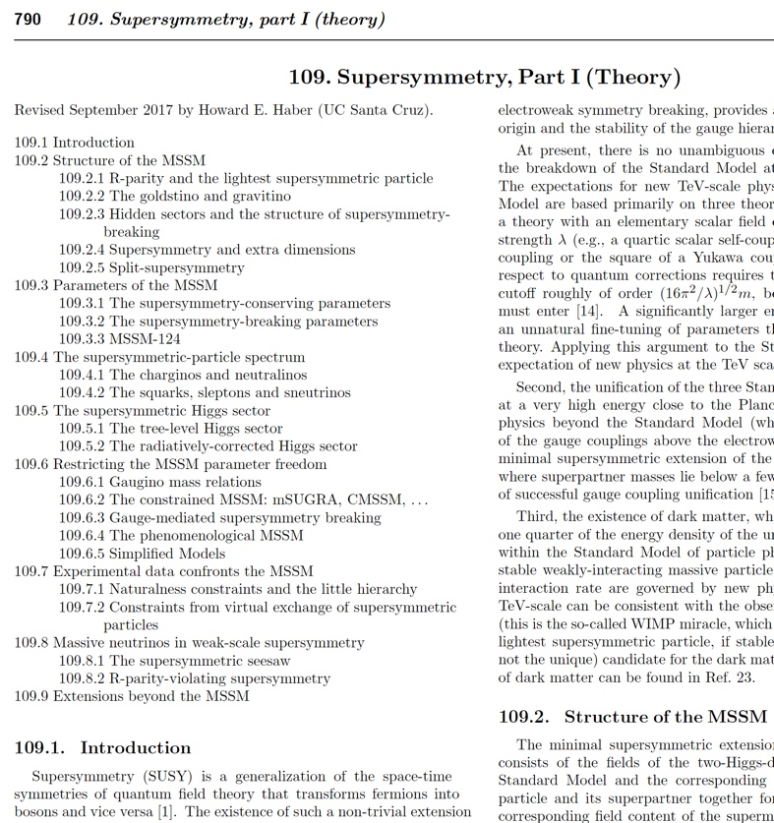
As a member of the Particle Data Group, I am the author
of the biennial Supersymmetry Theory review. This review
was recently updated in collaboration with B.C. Allanach.

Slide 20
Research program 3: explorations of the Terascale at the LHC and at future colliders
Studies of the non-minimal Higgs sector
Precision measurements of new physics observables
Distinguishing among different theoretical interpretations of new physics signals
Employing the ILC as a precision Higgs factory
Terascale footprints of lepton-number-violating physics (e.g. R-parity-violation or the SUSY seesaw)
New sources for CP-violation (Higgs and/or SUSY mediated)

Slide 21
Recent Publications
Basis-independent treatment of the C2HDM
R. Boto, T.V. Fernandes, H.E. Haber, J.C. Romão and J.P. Silva, arXiv:2001.01430 [hep-ph]
Symmetries and mass degeneracies in the scalar sector
H.E. Haber, O.M. Ogreid, Per Osland and M.N. Rebelo, JHEP 1901 (2019) 042.
Heavy Higgs boson decays in the alignment limit of the 2HDM
B. Grzadkowski, H.E. Haber, O.M. Ogreid and Per Osland, JHEP 1812 (2018) 056.
Multi-Higgs doublet models: the Higgs-fermion couplings and their sum rules
M.P. Bento, H.E. Haber, J.C. Romão and J.P. Silva, JHEP 1810 (2018) 143.
Approximate Higgs alignment without decoupling
H.E. Haber, in the Proceedings of the 53th Rencontres de Moriond, QCD Session, March 17—24, 2018, in La Thuile, Aosta Valley, Italy, edited by E. Augé, J. Dumarchez and J. Trân Thanh Vân (ARISF Publishers, France, 2018) pp. 139–142.
Supersymmetric theory and models
H.E. Haber and L. Stephenson Haskins, arXiv:1712.05926 [hep-ph], in Chapter 6 of TASI 2016: Anticipating the Next Discoveries in Particle Physics, edited by Rouven Essig and Ian Low (World Scientific, Singapore, 2018) pp. 355--499.
UCSC graduate student authors in red.

Slide 22
Should we expect an extended Higgs sector beyond the SM?
The fermion and gauge boson sectors of the SM are not of minimal form (“who ordered that?”). So, why should the spin-0 (scalar) sector be minimal?
Adding new scalar states can alleviate the metastability of the vacuum, allowing the Higgs-sector-extended SM to be valid all the way up to the Planck scale.
Extended Higgs sectors can provide a dark matter candidate.
Extended Higgs sectors can provide new sources of CP violation (which may be useful in baryogenesis).
Models of physics beyond the SM often require additional scalar Higgs states. E.g., two Higgs doublets are required in the minimal supersymmetric extension of the SM (MSSM).

Slide 23
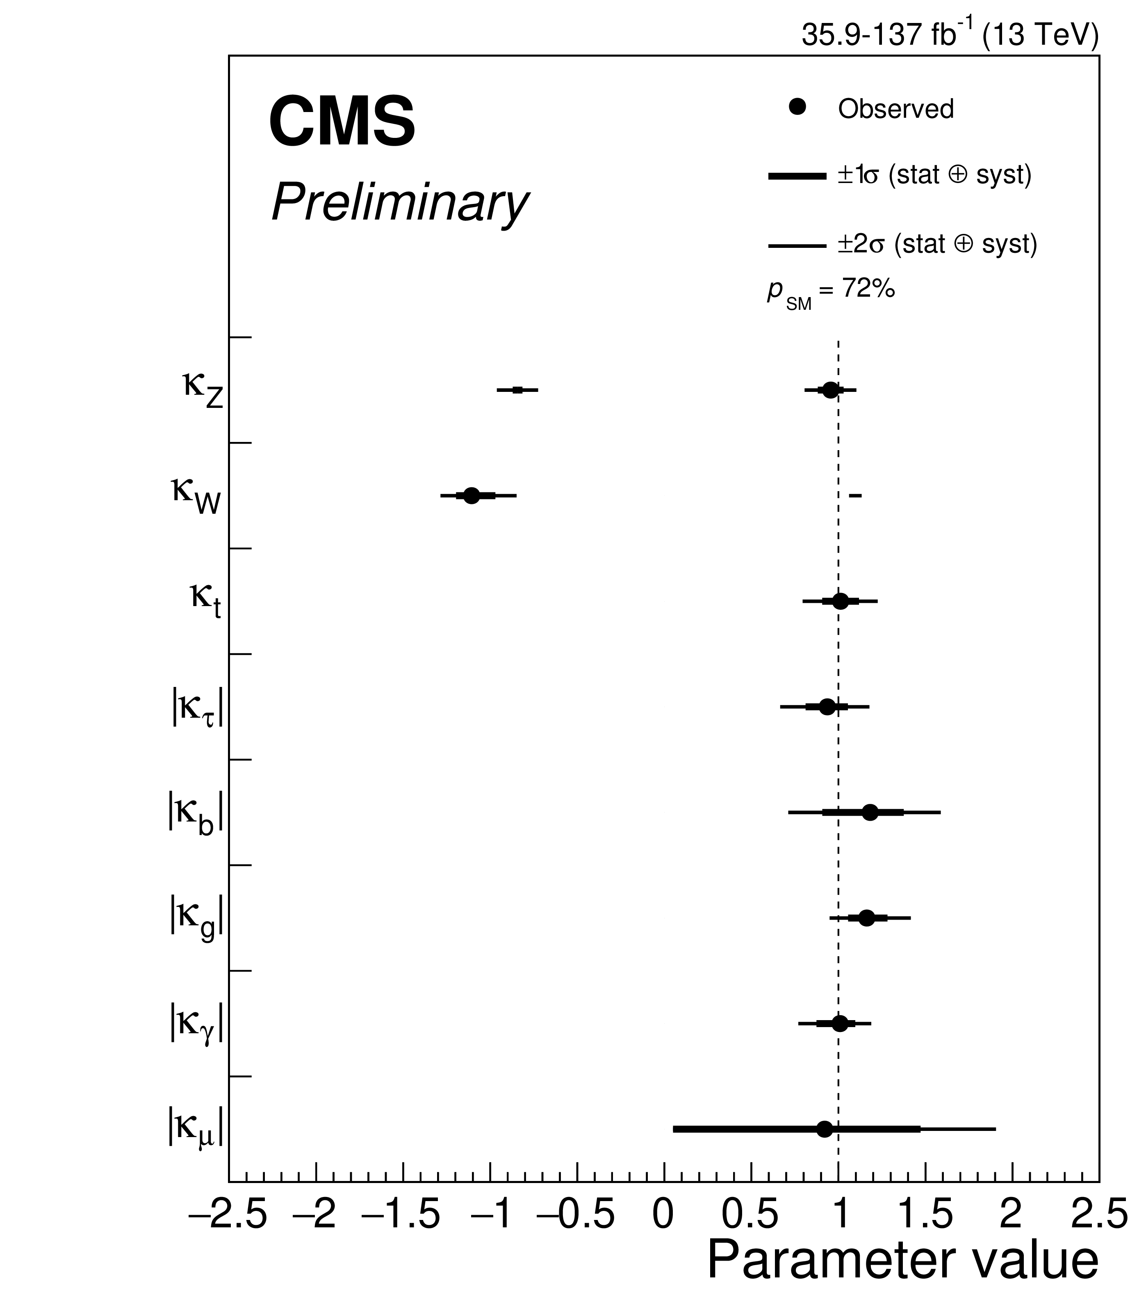
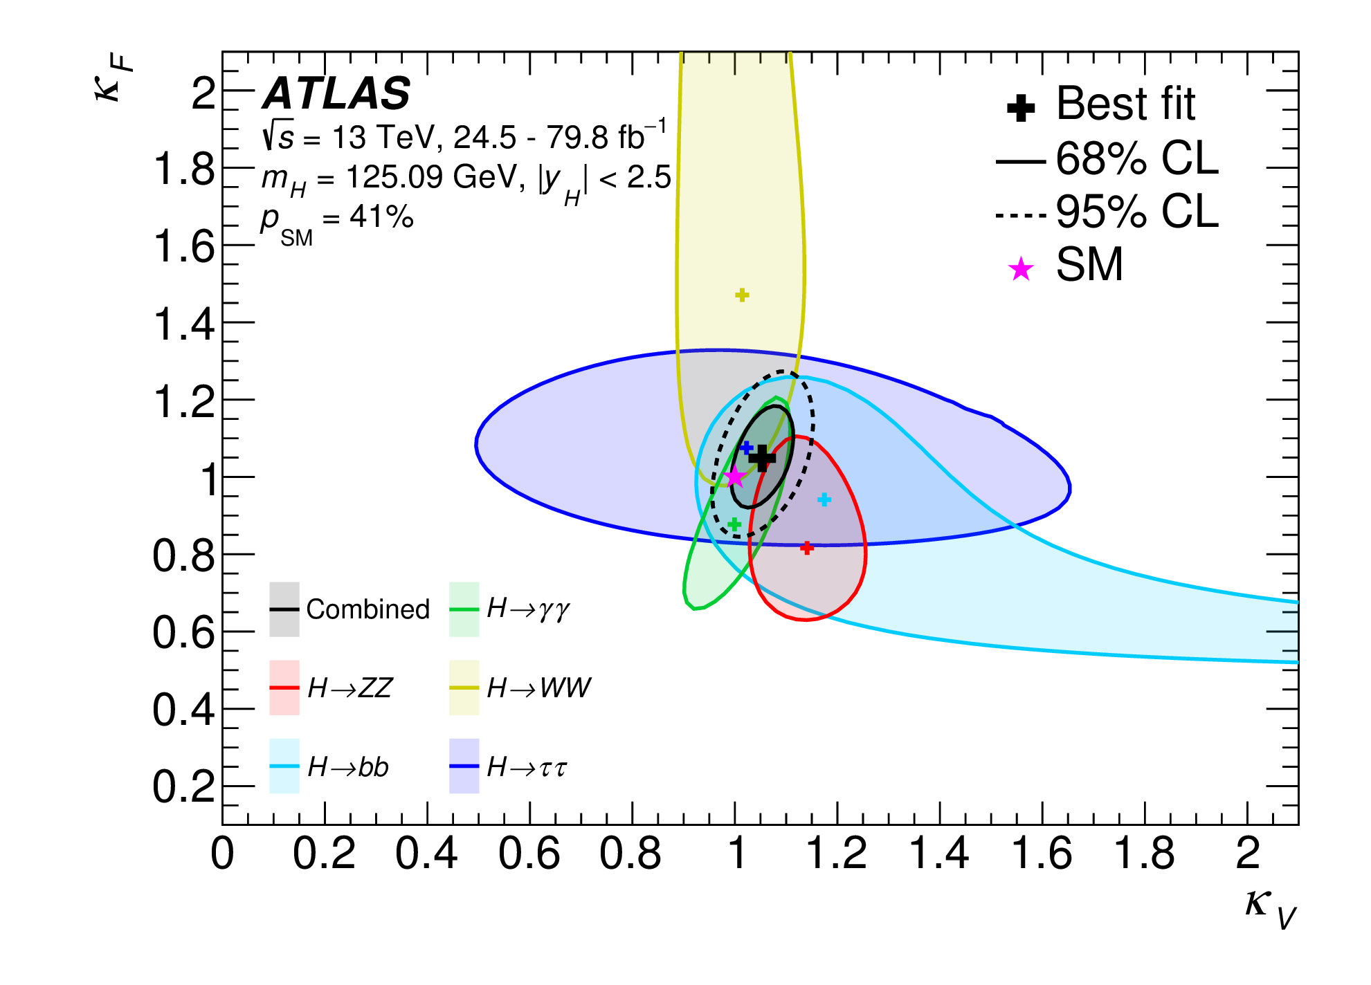
Search for deviations from SM-Higgs couplings
Negative log-likelihood contours at 68% and 95% CL in the (κ_{F} ,κ_{V}) plane for the individual decay channels and the combined fit, assuming that the coupling strengths to fermions and vector bosons to be positive. No contributions from invisible or undetected Higgs boson decays are assumed. The best-fit value for each measurement is indicated by a cross while the SM hypothesis is indicated by a star. Taken from ATLAS collaboration, Phys. Rev. D 101, 012002 (2020).
Summary of the κ framework model assuming that there are no additional BSM contributions to the Higgs boson width, i.e. BR_{BSM}=0. The points indicate the best fit values while the thick and thin horizontal bars show the 1𝜎 and 2𝜎 CL intervals, respectively. Taken from CMS Collaboration,
CMS-PAS-HIG-19-005 (January, 2020).

Slide 24
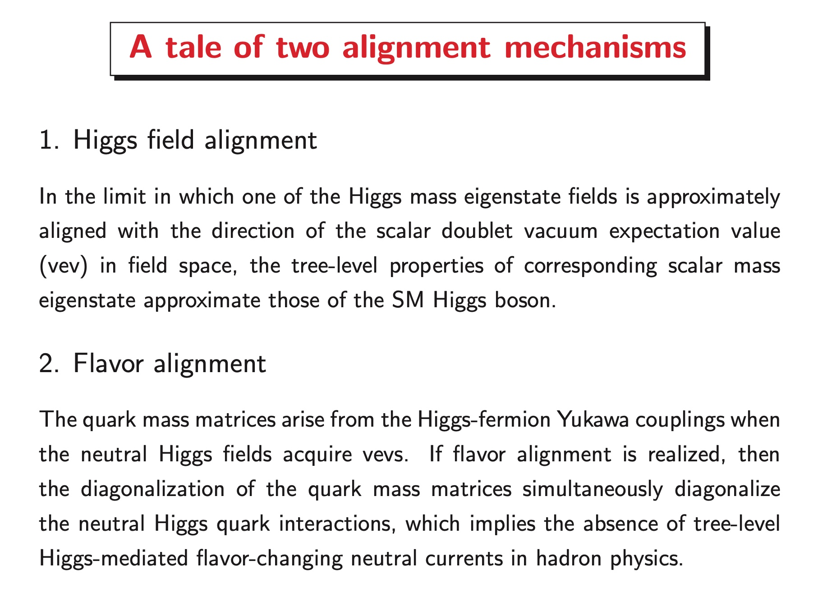

Slide 25
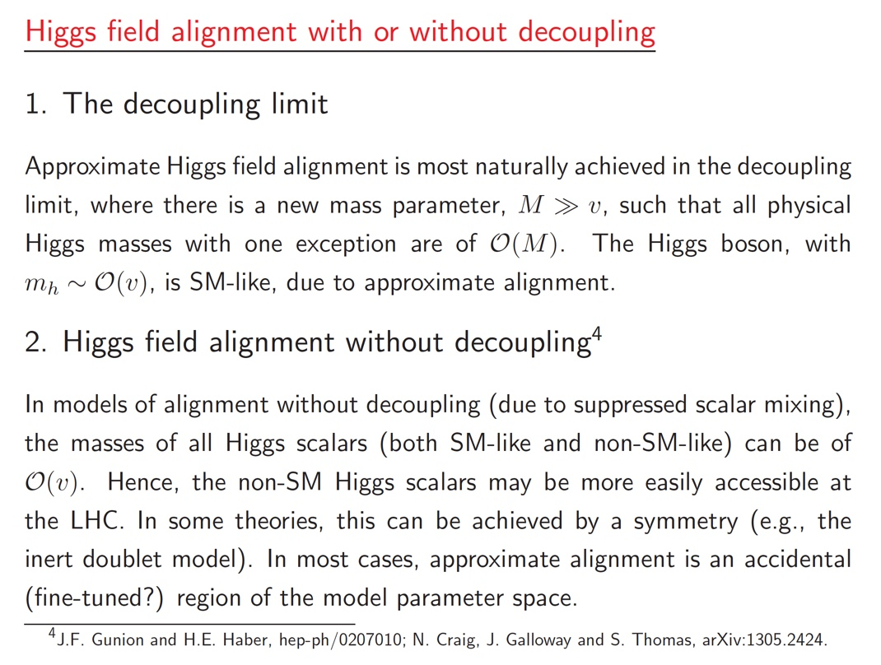

Slide 26
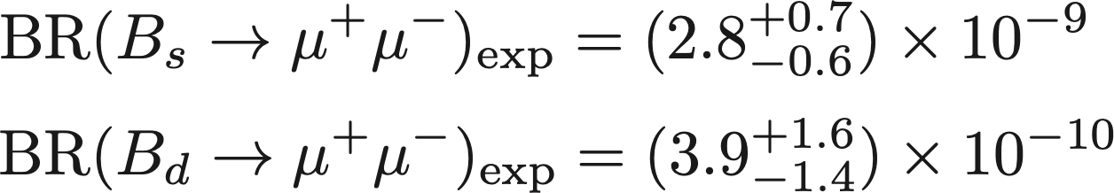

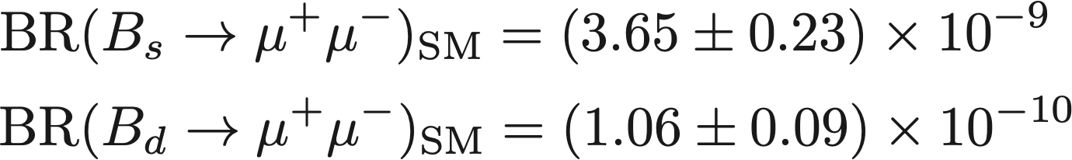
Evidence for new physics beyond the SM in B decays to muon pairs?
Recent results from LHCb and CMS at the LHC yield the following branching ratios (BR):
which should be compared with the SM predictions,
In S. Gori, H.E. Haber and E. Santos, JHEP 1706 (2017) 110, new contributions to these decays were considered in the two Higgs doublet model (2HDM) where flavor alignment is imposed at very high energies. However, renormalization group running generates small flavor-changing neutral Higgs couplings that do not exist in the SM and can contribute to neutral B decays.
The present data already puts interesting constraints on the flavor alignment parameters a^{U} and a^{D} of our model.

Slide 27
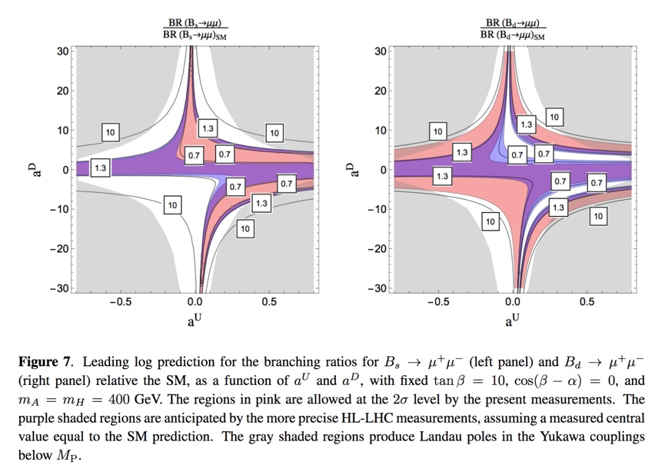

Slide 28
My recent Ph.D. students and their thesis projects
John Mason (2008): Hard Supersymmetry-Breaking “Wrong-Higgs” Couplings
of the MSSM
Deva O’Neil (2009): Phenomenology of the Basis-Independent CP-Violating
Two-Higgs Doublet Model (2HDM)
Laura Fava (2015): Precision Measurement of UED Coupling Constants Using
Like-Sign Leptons at the LHC
Edward Santos (2015): Renormalization Group Constraints on the Two-Higgs
Doublet Model
Where are they now?
J. Mason – following a three-year post doctoral research associate in particle
theory at Harvard University, John accepted a position as an
associate professor of physics at Western State College of Colorado
D. O’Neil – associate professor of physics at Bridgewater College (in Virginia)
L. Fava and E. Santos – participated in the Insight Data Science Fellows Program;
initially found employment in Silicon Valley.
E. Santos – presently works for Google

Slide 29
Recent Ph.D. student (co-advised with Michael Dine)
and her thesis project
Laurel Stephenson Haskins (2017): Supersymmetry , Inflation and Dark Matter
First postdoctoral position
Research Associate at the Racah Institute of Physics at the Hebrew University of Jerusalem
Current position
Working in data science in San Francisco
We collaborated on two projects:
1. M. Dine, P. Draper, H.E. Haber and L. Stephenson Haskins, Perturbation Theory in
Supersymmetric QED: Infrared Divergences and Gauge Invariance,
Phys. Rev. D 94, 095003 (2016).
2. H.E. Haber and L. Stephenson Haskins, Supersymmetric Theory and Models,
arXiv:1712.05926 [hep-ph], in Chapter 6 of TASI 2016: Anticipating the Next
Discoveries in Particle Physics, edited by Rouven Essig and Ian Low (World
Scientific, Singapore, 2018) pp. 355--499.

Slide 30
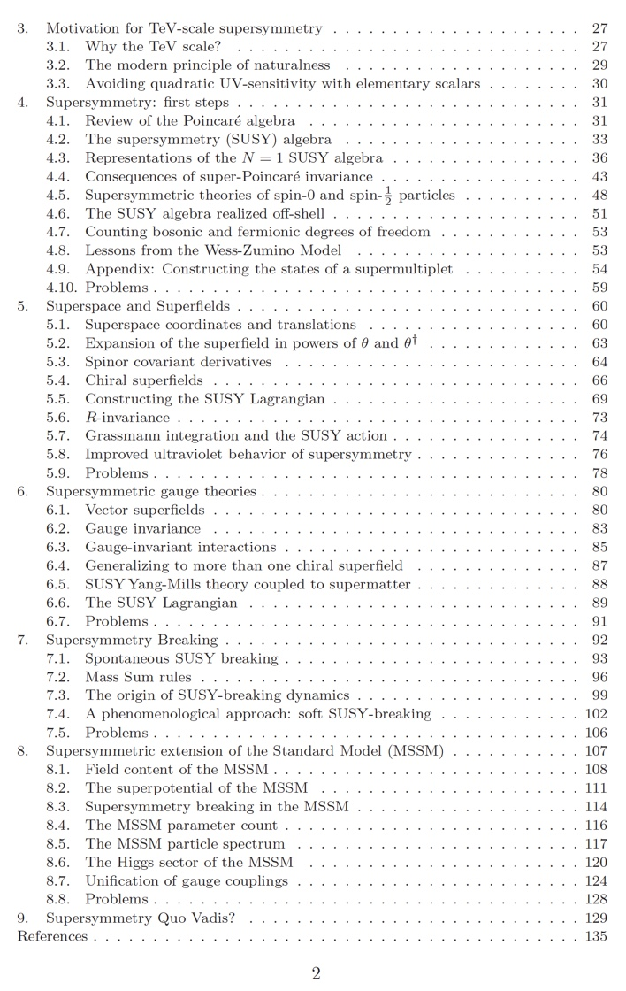
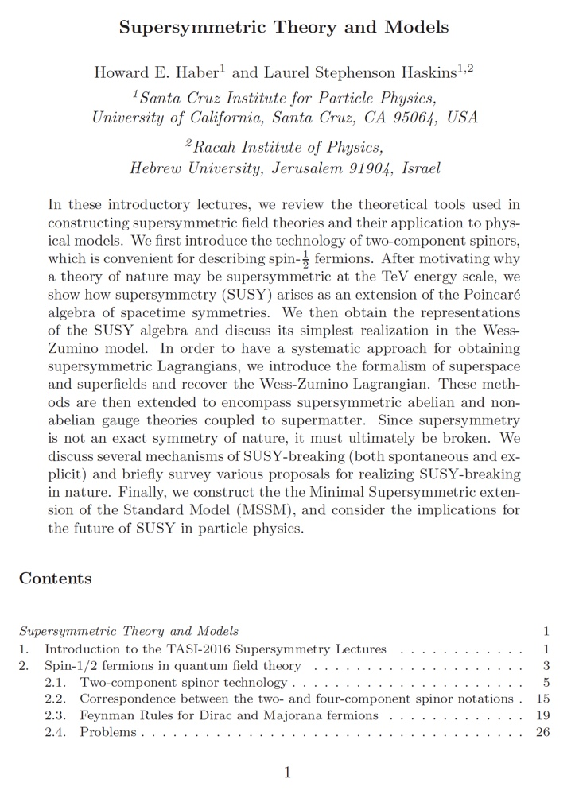

Slide 31
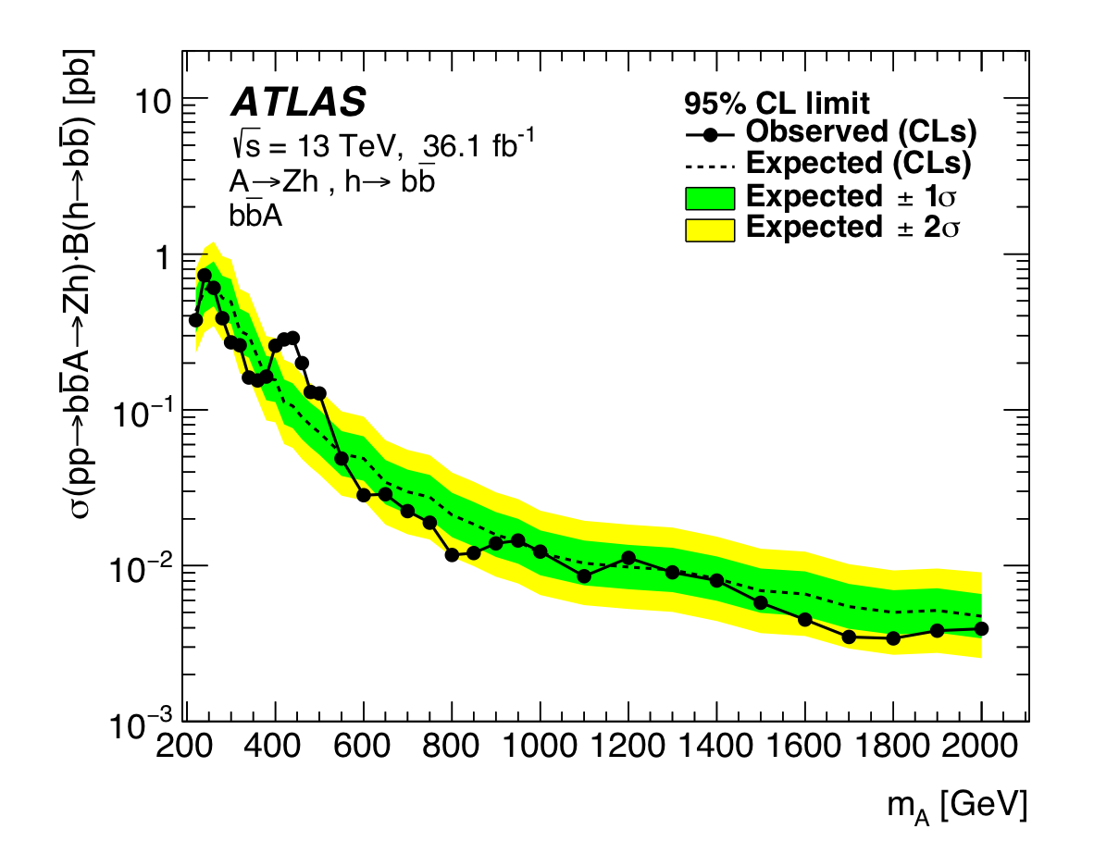
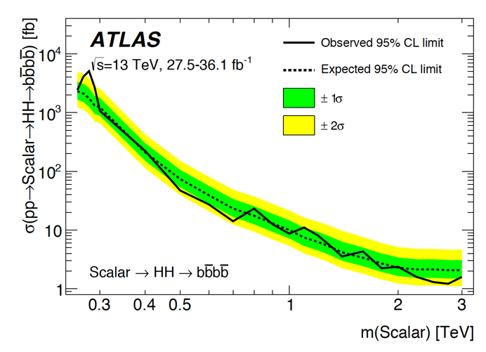
My current Ph.D. students and their projects
2HDM high energy flavor alignment (with S. Gori and E. Shahly)
  Neutral Higgs-mediated flavor violation in the lepton sector.
Phenomenological aspects of more general 2HDMs (with J. Connell and P. Ferreira)
  Exploring some (local) 3𝝈 deviations in ATLAS searches for new Higgs bosons, with implications for the flavor-aligned 2HDM.
ATLAS Collaboration, JHEP 1803 (2018) 174
ATLAS Collaboration, JHEP 1901 (2019) 030

Slide 32
Other Ongoing and Future Activities
Natural alignment without decoupling (with P. Draper,…)
  Achieving a SM-like Higgs boson without fine-tuning.
Theoretical studies of the CP-violating 2HDM (with J.P. Silva,…)
Basis-invariant treatment of the 3HDM (with V. Keus)
P-even CP-violating signals in scalar-mediated processes (with
V. Keus, and T. Stefaniak)
Higgs alignment at one loop (with S.J.D. King and H. Patel)
Higgs alignment in 2HDM effective field theory
Higgs alignment in the Georgi-Machacek model (with P. Ferreira, H. Logan and Y. Wu)
Various other projects are waiting for the right Ph.D. student…

