Slide 1


Howard E. Haber
Colloquium at UCSC
November 29, 2012

Slide 2
Outline
The Higgs boson explained in 60 seconds
The Higgs boson explained in 30 minutes
The Standard Model of particle physics
How do gauge bosons get their mass?
Electroweak symmetry breaking and the Higgs boson
Theoretical properties of the Higgs boson
Expectations for the Higgs boson mass
Discovery of the Higgs boson at the Large Hadron Collider (LHC)
Coming attractions
Beyond the Standard Model Higgs boson

Slide 3
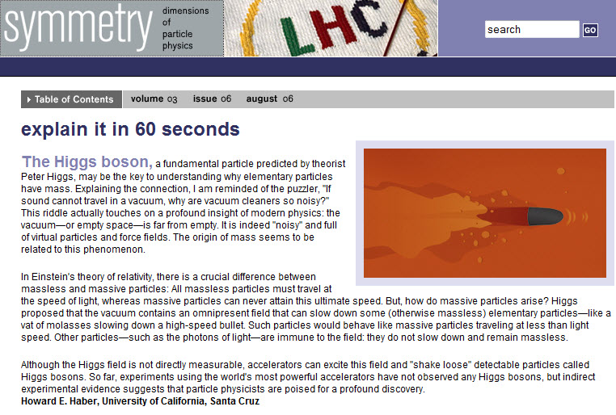

Slide 4
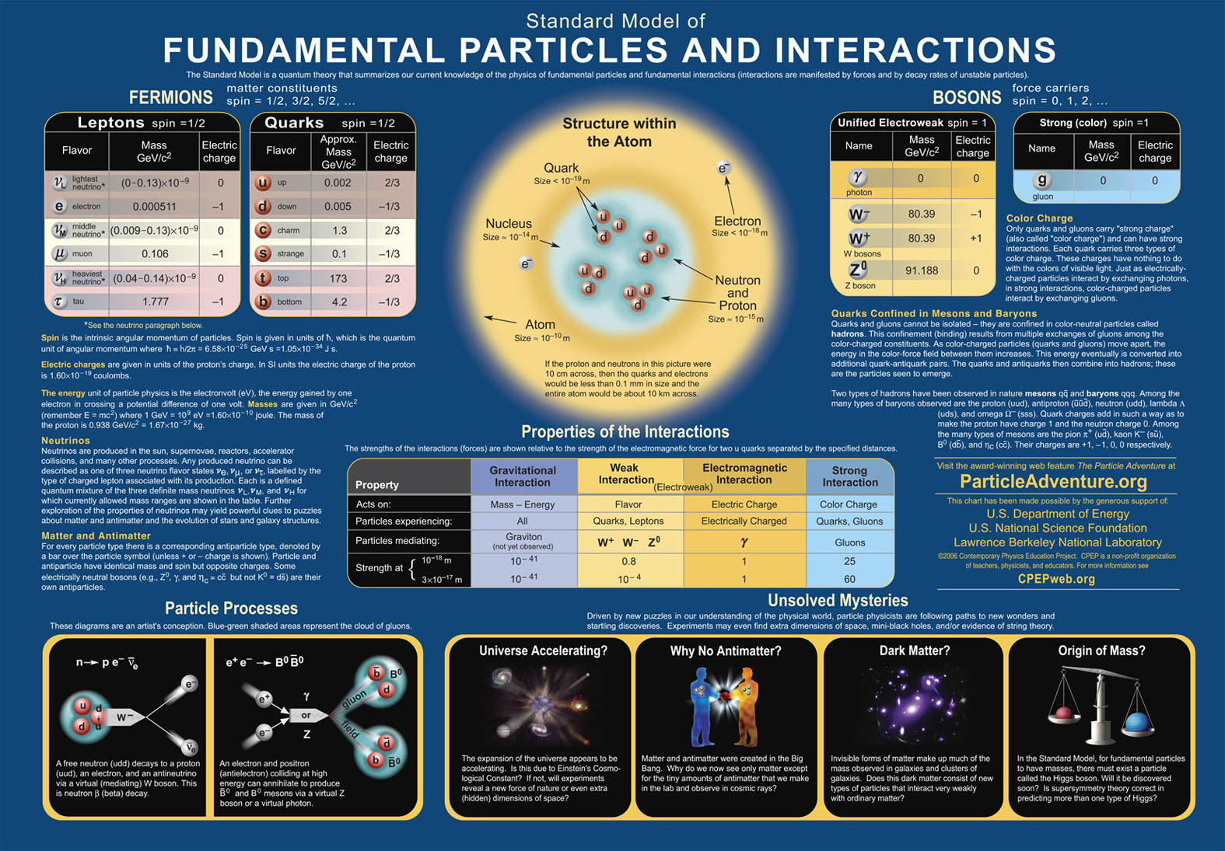

Slide 5
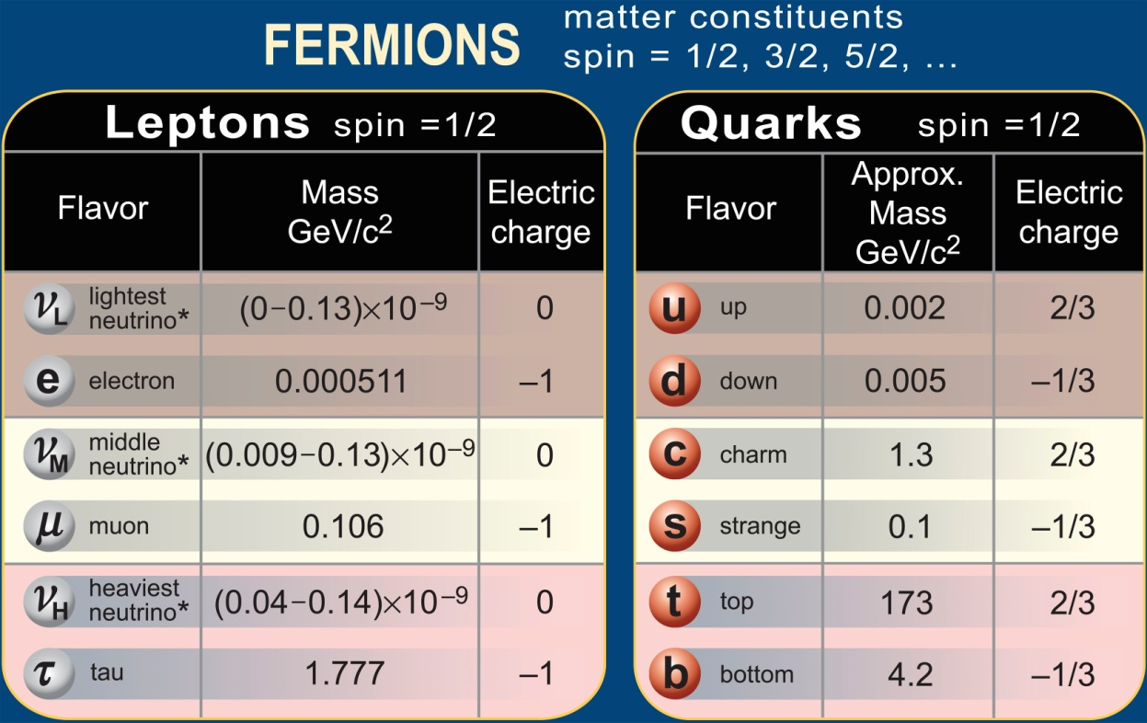
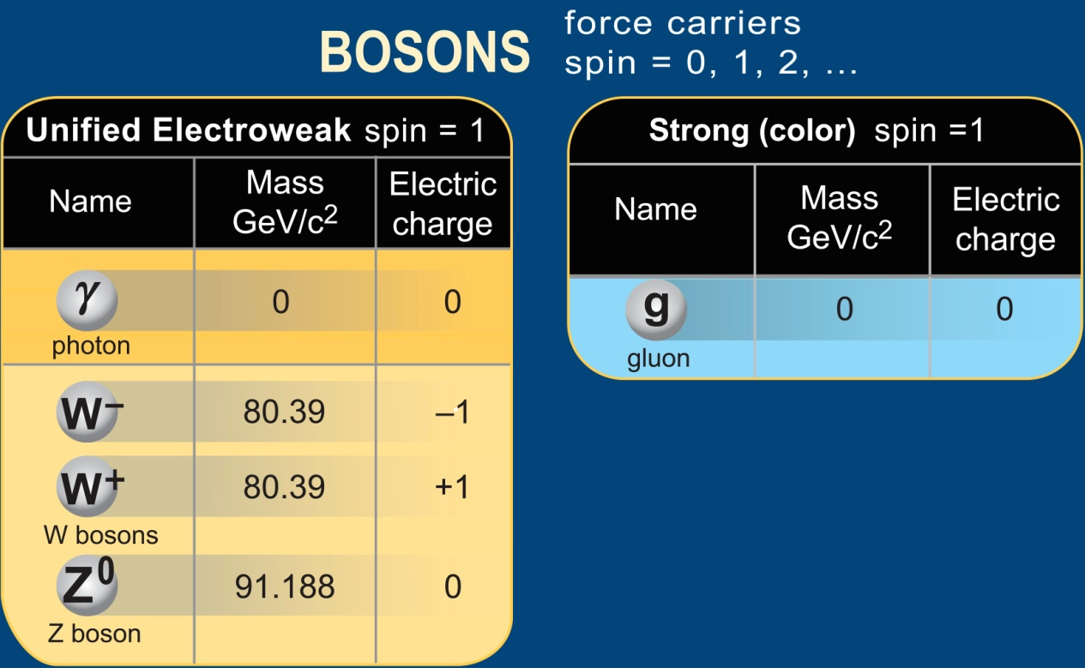
Particle
content
of the
Standard
Model
Something is
missing…

Slide 6
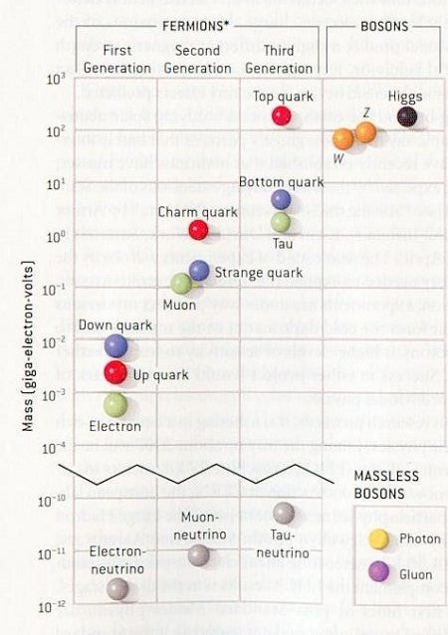

Slide 7
Ingredients of the Standard Model of Particle Physics
Quantum field theory (marriage of quantum mechanics and special relativity)
Elementary spin-1/2 fermions (the quarks and leptons)
Forces (electromagnetic, weak and strong) mediated by spin-1 gauge bosons
Mathematical consistency seems to require massless gauge bosons (e.g., the photon and the gluons)

Slide 8
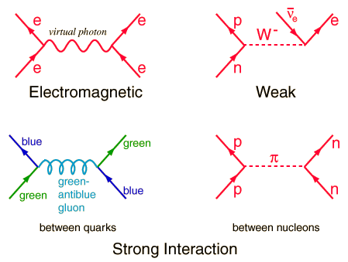
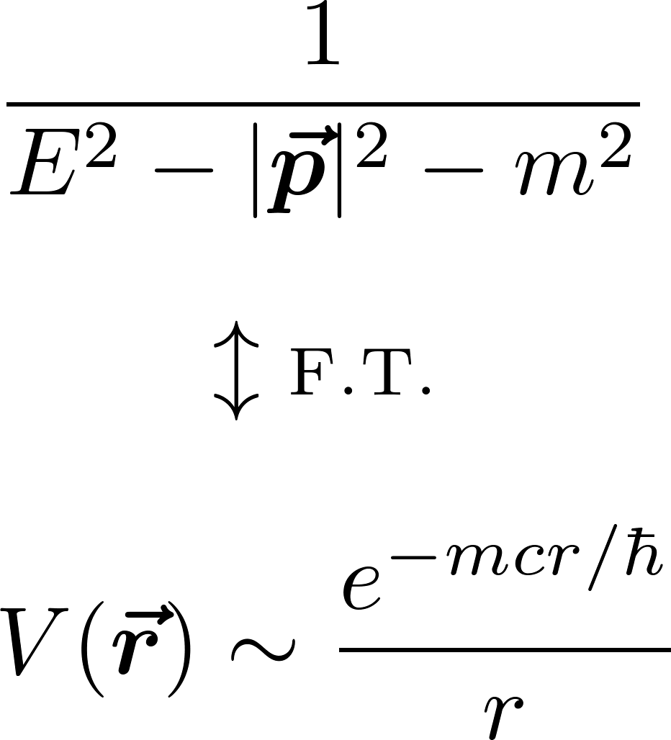
Contrast between massless and massive bosons
The potential energy between interacting particles is the Fourier transform of the quantum mechanical amplitude for “particle exchange.”
m=0: yields
long-range 1/r
Coulomb potential
m>0: yields
short-range
Yukawa potential

Slide 9
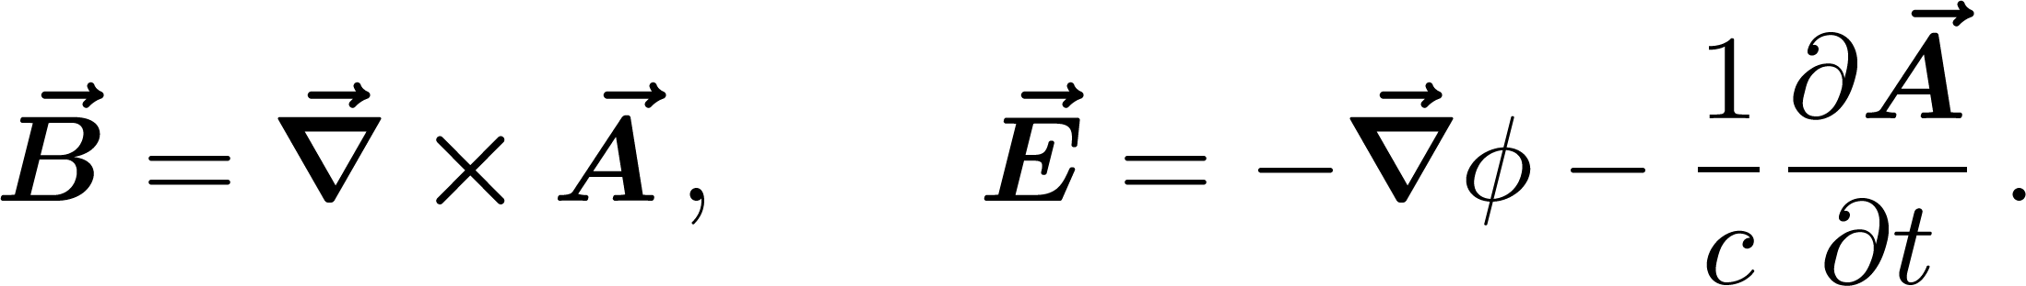
Gauge invariance in quantum mechanics
The time-dependent Schrodinger equation in an external
electromagnetic field:
where the magnetic and electric fields are defined in terms of the vector and scalar potentials:
The Schrodinger equation is invariant under the gauge transformation:

Slide 10
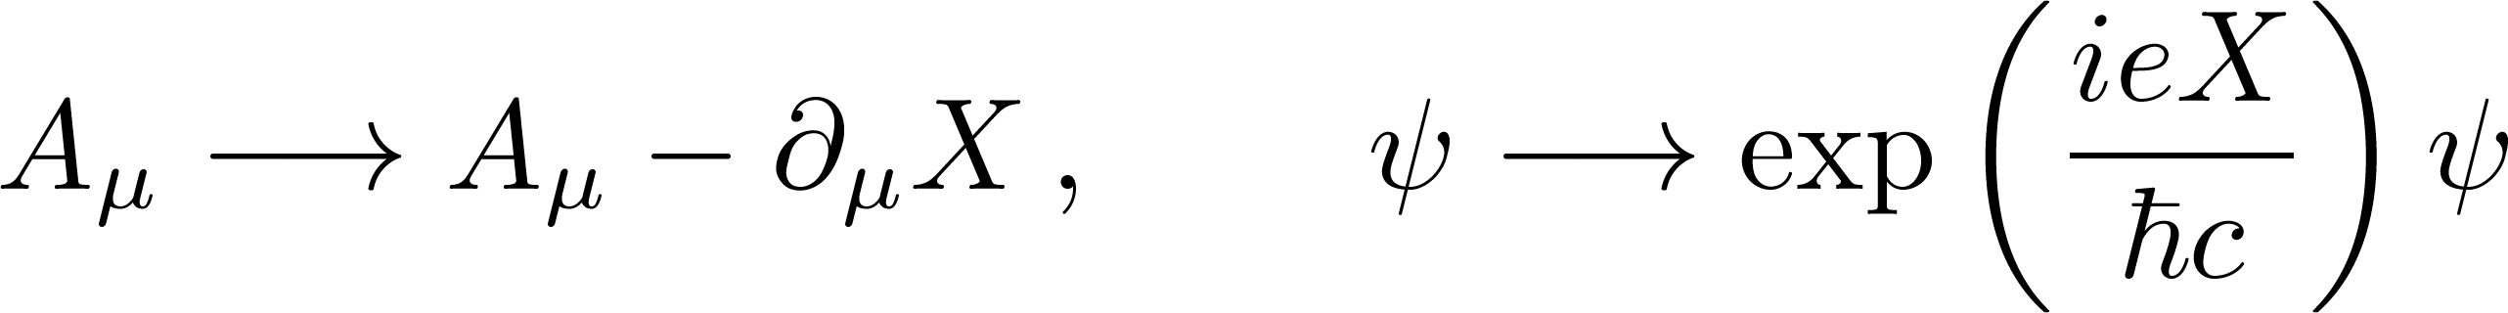
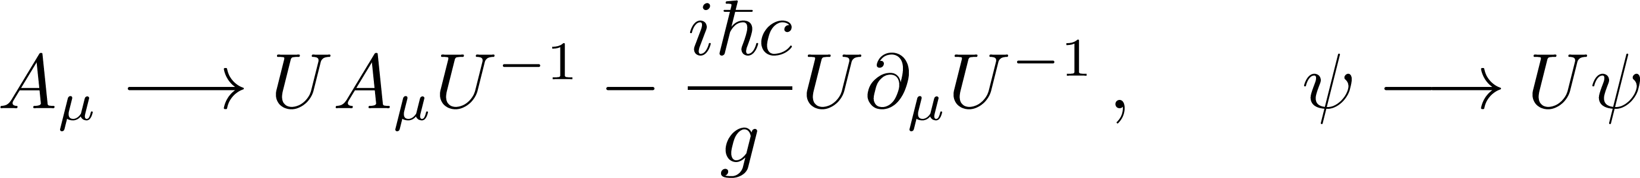
Gauge invariance in quantum field theory
In relativity, introduce four-vectors:
U(1)-gauge invariance (electromagnetism):
Non-abelian (Yang-Mills) theory:
with invariance under generalized gauge transformations:

Slide 11
Implications of gauge symmetry
Mathematically consistent theories containing
charged (self-interacting) spin-one particles MUST be gauge theories
Gauge invariance forbids an explicit mass term in the Lagrangian of a spin-one gauge boson
But, the gauge symmetry of the Lagrangian may not be respected by the vacuum
Gauge boson masses can potentially be generated by quantum corrections (due to the interactions with other sectors of the theory)

Slide 12
Constructing a theory of the weak interactions
Use a non-abelian gauge theory to describe the photon and the gauge bosons
that mediate the weak interactions (W⁺, W¯, Z⁰).
Particles that feel the electromagnetic force possess electric charge. Particles
that feel the weak force possess a “weak” charge.
The combined electroweak theory is invariant under generalized gauge
transformations that reflect the underlying electroweak symmetry.
Mathematically , the electroweak symmetry is called SU(2) x U(1),
corresponding to the matrices involved in the generalized gauge
transformation [S means determinant=1 and U means unitary].
The gauge symmetry leads to massless gauge bosons, in conflict with
the observed massive W⁺, W¯, Z⁰. So, the electroweak symmetry must
be broken.

Slide 13
How to break the electroweak symmetry?
Explicit breaking (add masses “by hand” for the W⁺, W¯, Z⁰)
Not viable: leads to mathematical inconsistencies (infinities,…)
Spontaneous breaking
The fundamental laws respect the symmetry
The ground state (a.k.a. the “vacuum”) violates the symmetry
Example: the type-1 superconducting ground state
Cooper pairs (e¯e¯ bound states) condense in the vacuum. The vacuum
is therefore charged, and the electromagnetic symmetry of the vacuum is
broken. Thus, photons propagating in this vacuum behave as if they are
massive. The electromagnetic force is no longer long-range but exponentially
damped. This is called the Meissner effect (static magnetic fields are screened
from the interior of the bulk superconductor).

Slide 14
To break the electroweak symmetry, we must find some quantity that
possesses “weak” charge that can condense in the vacuum. Since the
vacuum of the universe is Lorentz-invariant, the quantity we seek must
be a scalar (which is invariant with respect to Lorentz transformations).
Possible choices for the condensate:
An elementary spin-0 (scalar) field that possesses a weak charge
A bound state of known particles that possesses a weak charge
(example: a bound state of a top quark and anti-top quark)
A bound state of unknown particles that possess a weak charge
Steven Weinberg proposed a theory of electroweak interactions in 1967 that
employed a new elementary spin-0 field to break the electroweak symmetry.
Later this theory became known as the Weinberg-Salam model.
Weinberg was inspired by the 1964 paper of Peter Higgs, who suggested that
scalar fields could be used to break gauge symmetries. This idea was also
suggested around the same time by Robert Brout and Francois Englert, and soon
afterwards by Gerald Guralnik, C.R. Hagen and Tom Kibble.

Slide 15
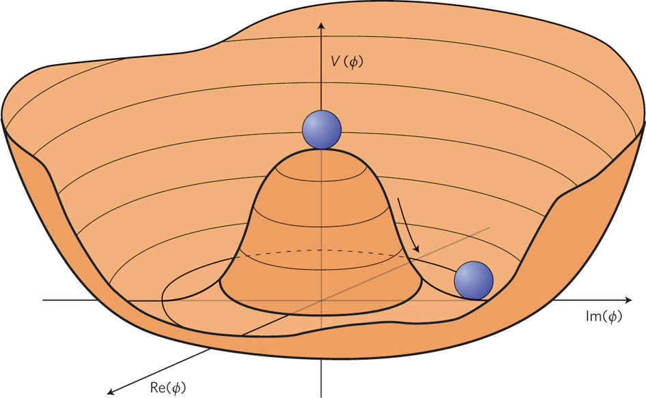
If the potential energy density V(φ) of the scalar fields is arranged so that the lowest
energy state corresponds to a non-zero value of the field, then the vacuum will possess
a non-zero weak charge (condensation), and the electroweak symmetry is broken.
But excitations around the bottom of the “Mexican hat” do not cost energy, and
correspond to the excitation of a new massless spin 0 particle---the Goldstone boson.

Slide 16
The Goldstone boson puzzle and the
gauge boson mass problem: RESOLVED
In the early 1960s, theorists were very troubled by the
mechanism of spontaneous symmetry breaking, as it seemed
to lead to the prediction of a new massless spin-0 particle.
No evidence for such a particle has ever been seen in nature.
The remarkable discovery of Brout, Englert, Higgs, Guralnik,
Hagen and Kibble was that when the symmetry-breaking
mechanism was incorporated into gauge theories, the
would-be Goldstone boson no longer appears as a physical
particle. Instead, it provides the longitudinal polarization
for the massive gauge boson. This is now unfairly called the
“Higgs mechanism.”

Slide 17
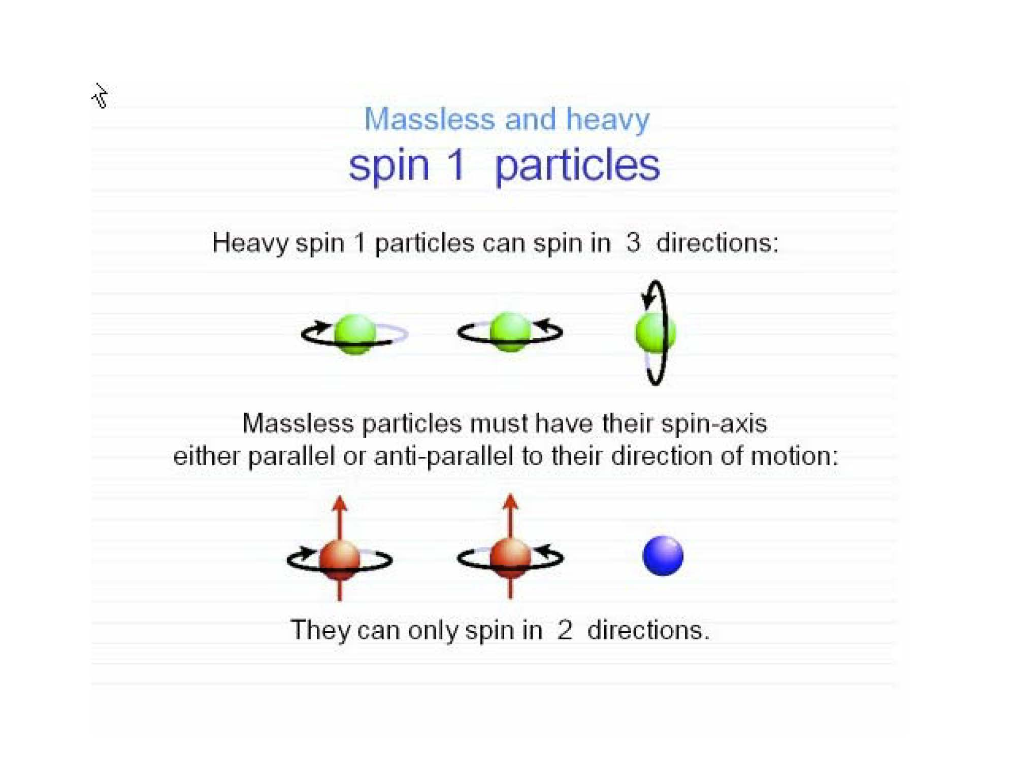

Slide 18
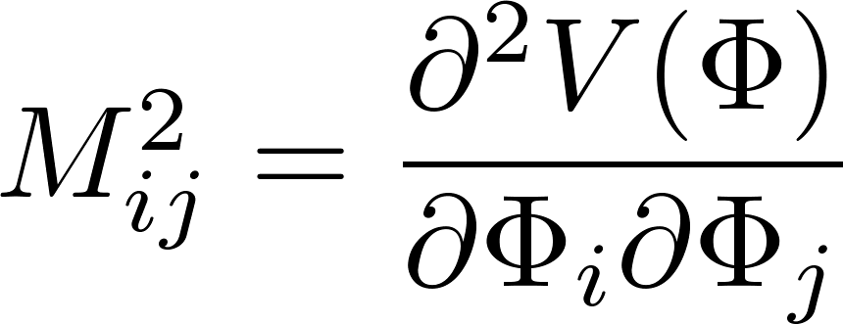
That is, a gauge boson that is originally massless (due to the gauge symmetry) “swallows up” the Goldstone boson,
thereby providing a mathematically consistent Lorentz-invariant mechanism for generating mass.
In 1964, Peter Higgs also noticed that the mechanism of spontaneous symmetry breaking by scalar fields can also produce excitations that are orthogonal to the Goldstone direction. These excitations cost energy and correspond to a new massive spin-0 particle, which now bears the name of its inventor---the Higgs boson.
The scalar squared masses are eigenvalues
of M²; these are related to the curvatures
of the scalar potential at its minimum.

Slide 19
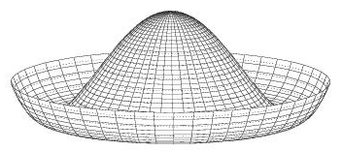
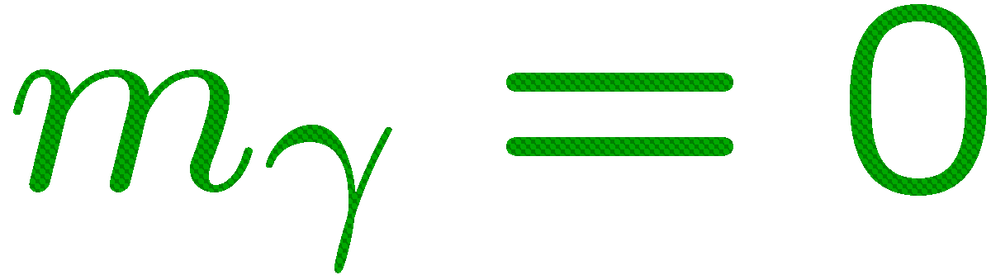
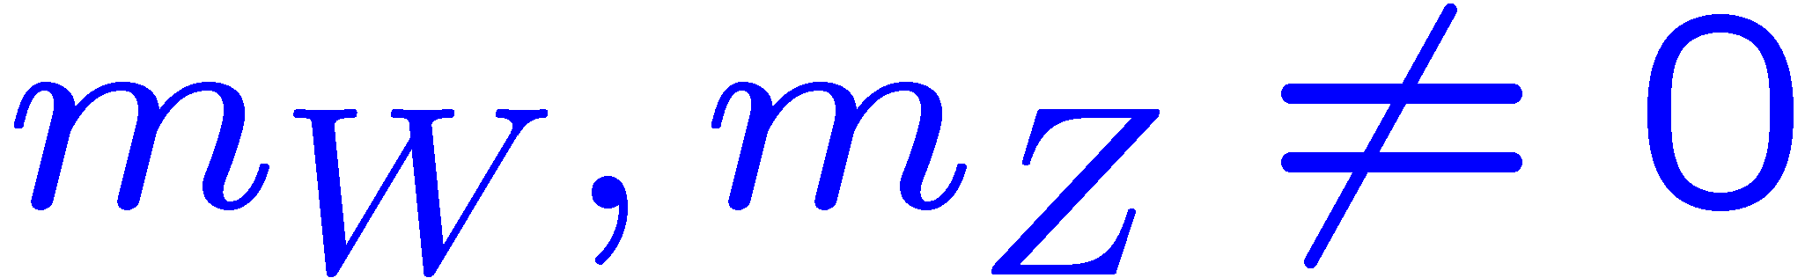
Breaking the Electroweak Symmetry
Higgs imagined a field filling all of space, with a “weak charge”.
Energy forces it to be nonzero at bottom of the “Mexican hat”.
energy stored
in Higgs field
symmetric
Higgs boson
broken symmetry
extra W,Z polarization
value of Higgs field

Slide 20
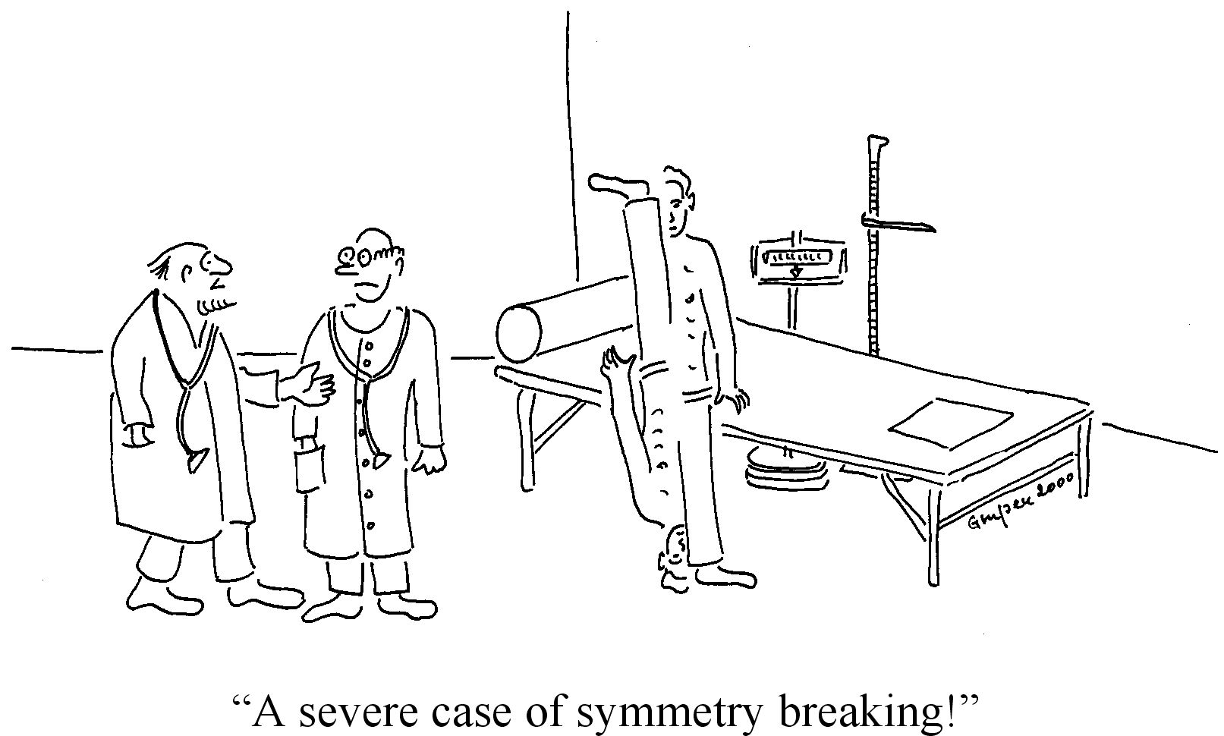

Slide 21
Timeline for the confirmation of electroweak theory
1964: the invention of the “Higgs mechanism” and the “Higgs boson.”
1967: Weinberg incorporates the Higgs boson into a theory of the electroweak force.
1971: Gerard `t Hooft proves the renormalizability of spontaneously broken gauge
theories, thereby confirming the mathematical consistency of such theories.
1978: The structure of the weak force mediated by the Z⁰ is confirmed at SLAC.
1983: Discovery of the W⁺, W¯, Z⁰ at CERN.
1995: Discovery of the top quark at the Fermilab Tevatron.
1989—2000: Precision tests of electroweak theory at CERN, Fermilab and SLAC.
2001—2011: Further precision tests at the Fermilab Tevatron.
But, where is the Higgs boson?

Slide 22
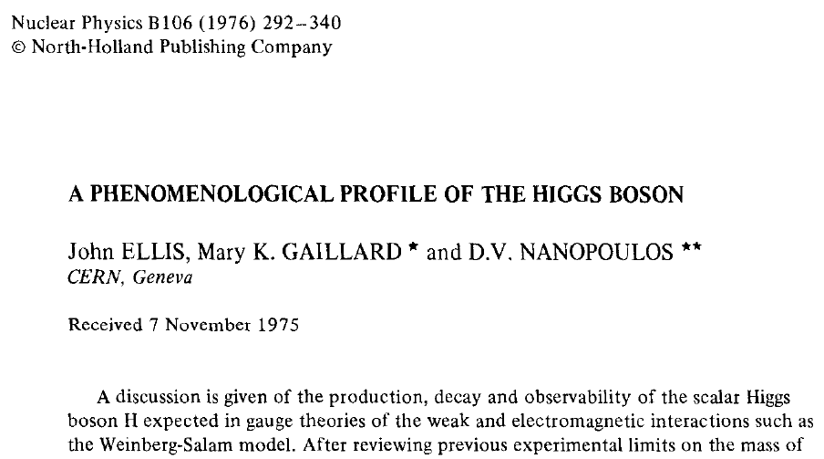
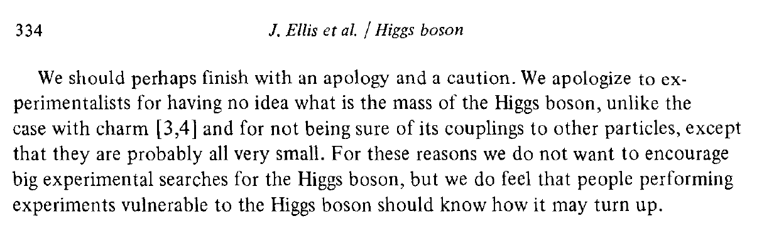
1976: The first comprehensive
study of how to search for the
Higgs boson

Slide 23

Michael Peskin (from SLAC) peruses the Higgs Hunter’s Guide,
published in 1990.

Slide 24
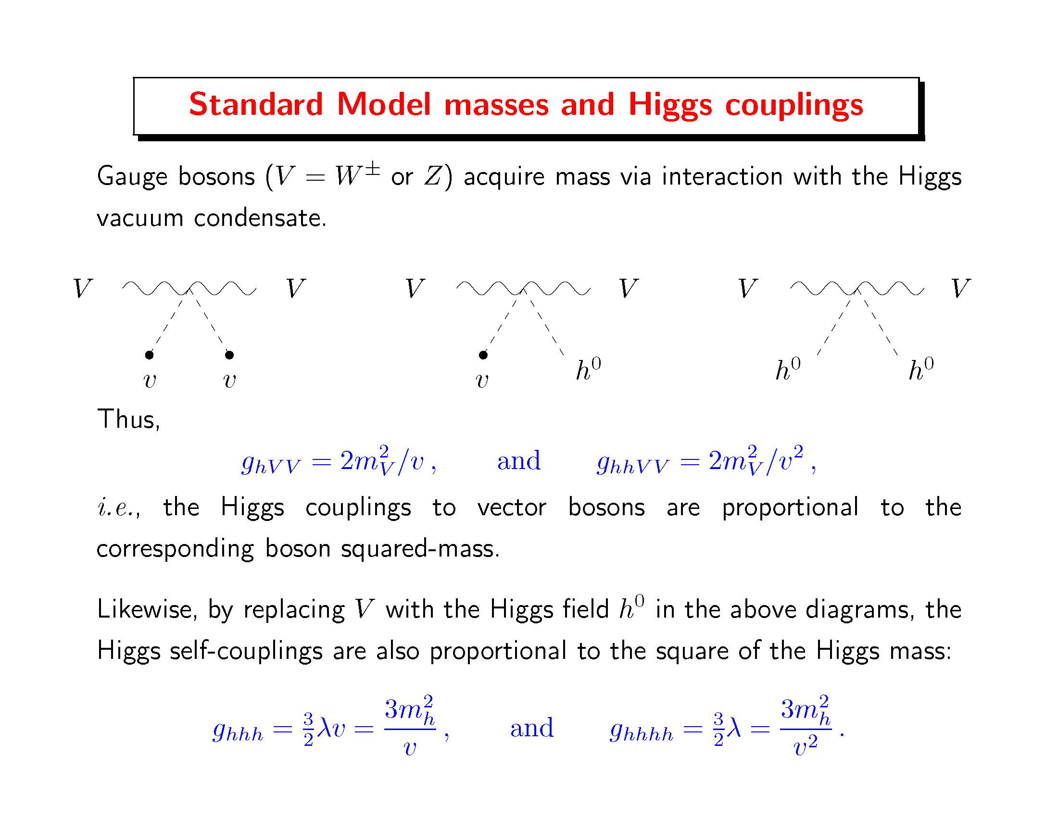

Slide 25
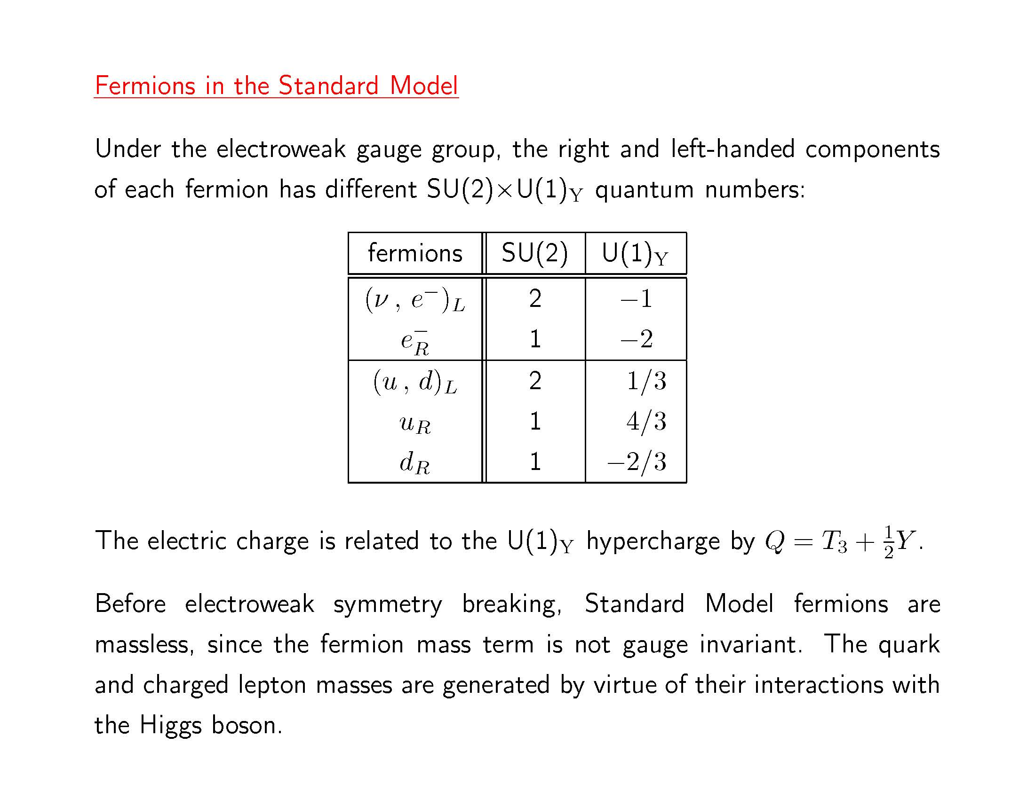

Slide 26
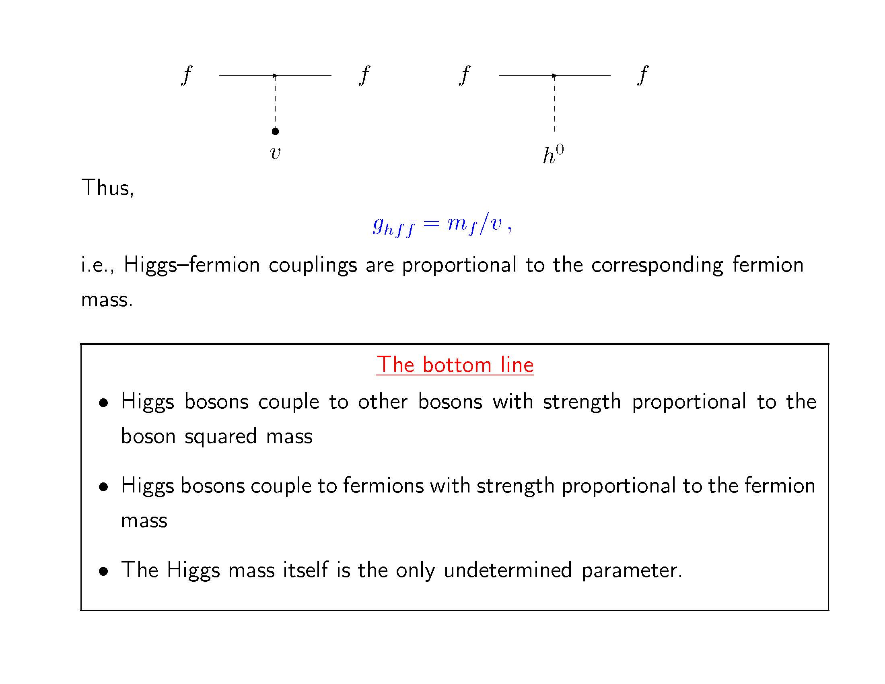

Slide 27
Theoretical expectations for the Higgs boson
The interactions of the Higgs field with the gauge bosons, quarks and charged leptons generate masses for all these fundamental particles. As a result, the strengths of the interaction of these particles with the Higgs boson is proportional to the corresponding particle masses.
That is, the Higgs boson prefers to couple to the heaviest fundamental objects of the Standard Model. Thus, the Higgs boson couples strongest to the W⁺, W¯, Z⁰ and top quark.
The mass of the Higgs boson (M_{H}) is NOT predicted by the theory.
However, for a given Higgs mass, one can predict the production
rate for Higgs bosons at colliders and the rates for Higgs boson
decays to various Standard Model particles.

Slide 28
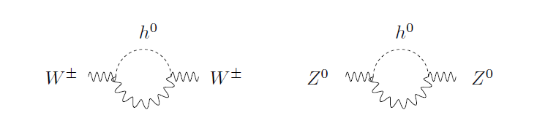
The LEP Collider at CERN spent ten years searching for the Higgs boson. Since no Higgs bosons were observed, experimenters
at LEP concluded that its mass must be larger than 114 GeV.
Meanwhile, the analysis of precision electroweak data provides
an indirect determination of the Higgs mass, assuming that the Standard Model is correct. In particular, the “virtual” emission
and reabsorption of Higgs bosons by the W⁺, W¯, Z⁰ affects the mass and interactions of these gauge bosons.
Window of opportunity: 114 GeV < M_{H} < 153 GeV

Slide 29
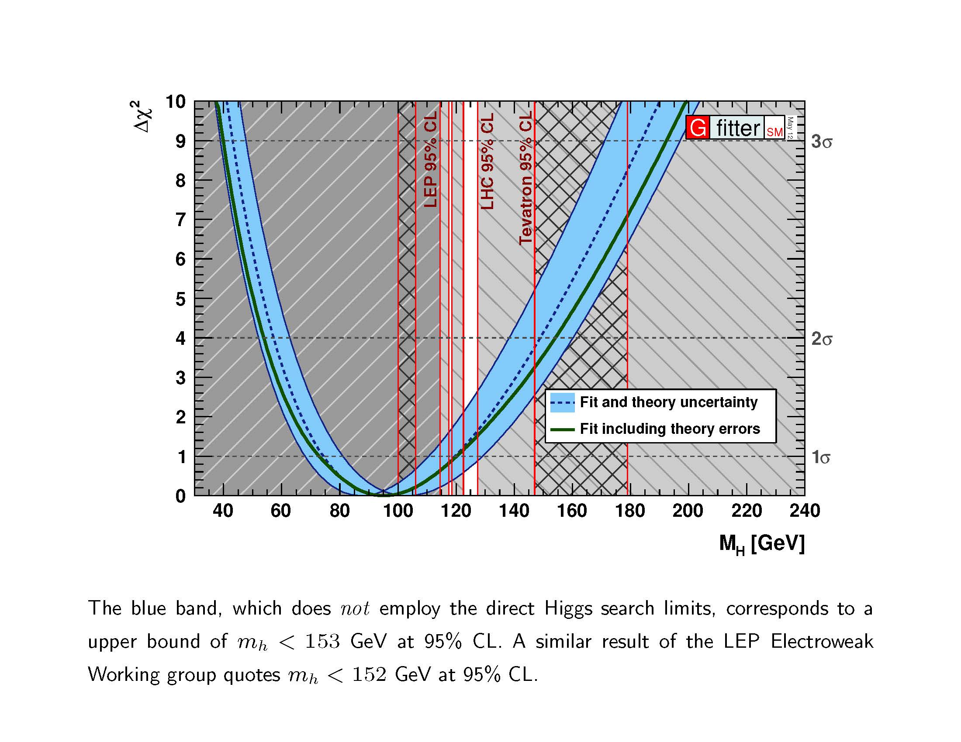

Slide 30
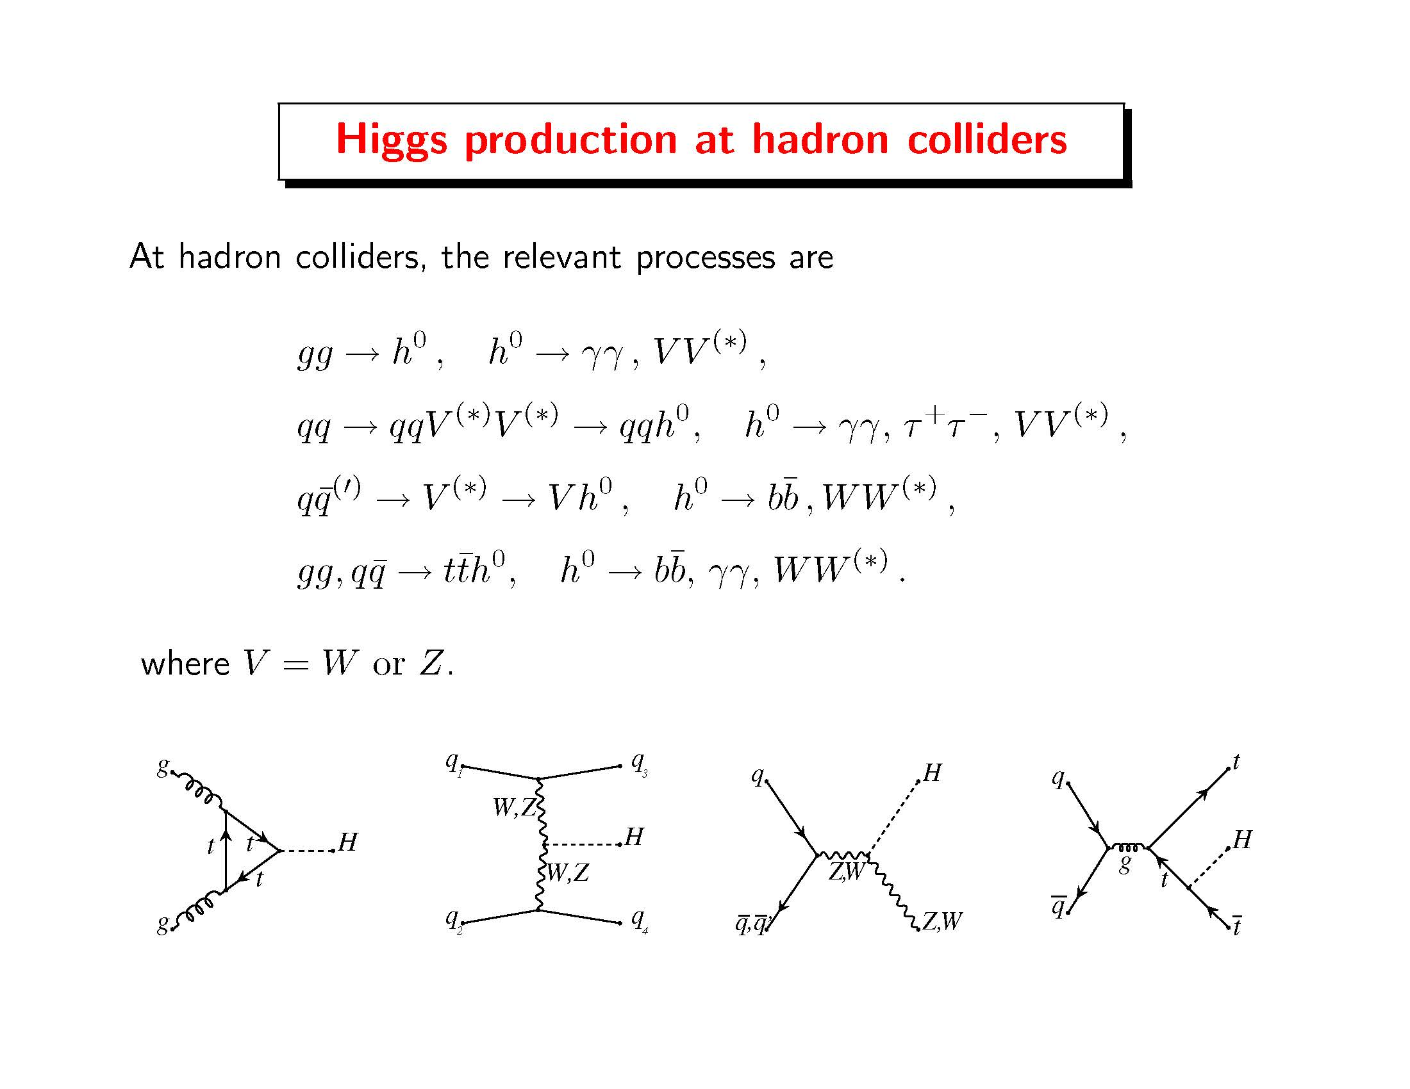

Slide 31
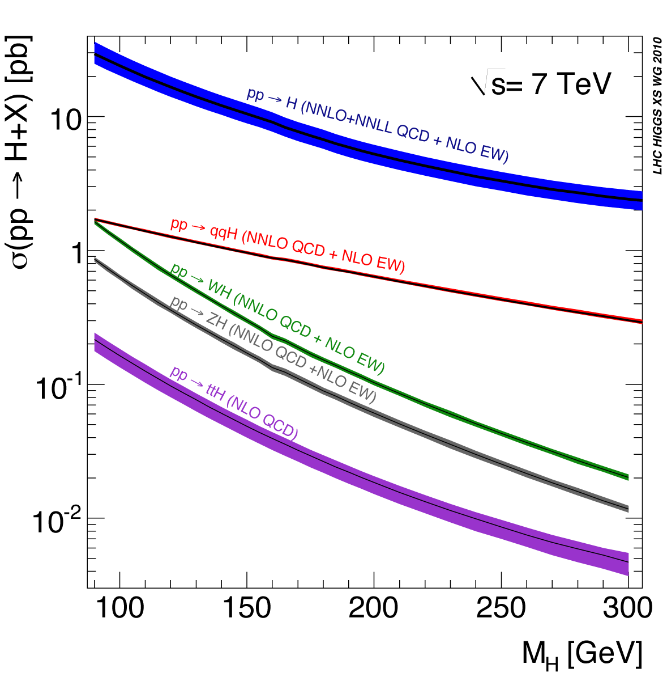
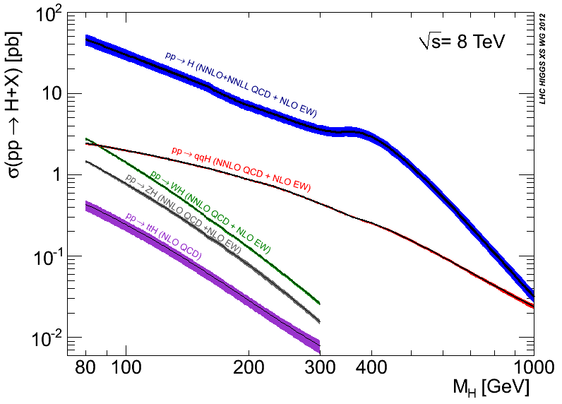
Higgs boson production cross sections at a pp collider
With 35 fb⁻¹ of data, one would expect
to produce roughly 500,000 Higgs bosons
if the Higgs mass was, say, M_{H} = 125 GeV.

Slide 32
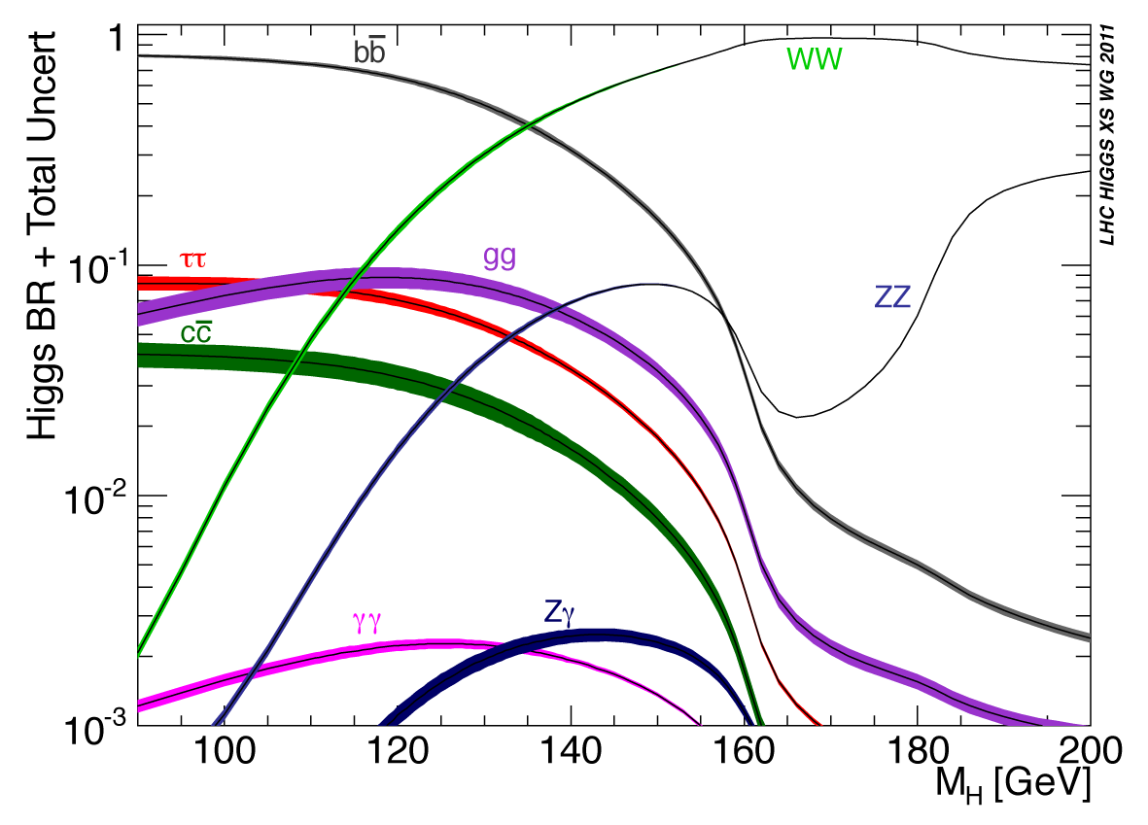
Probability of Higgs boson decay channels

Slide 33
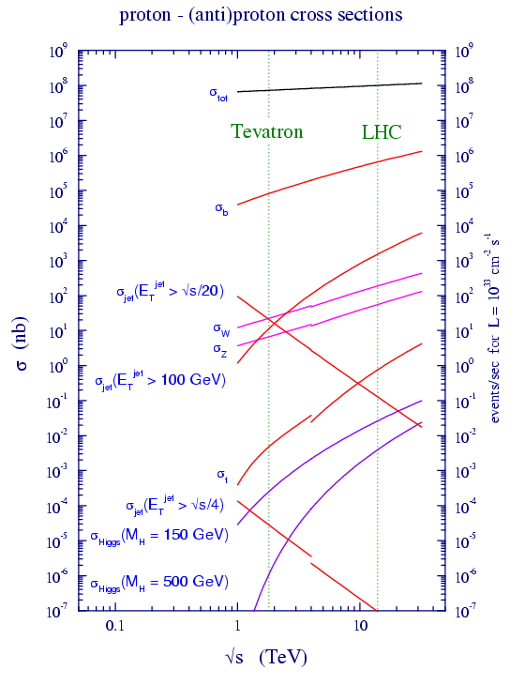
Question: why not search
for Higgs bosons that decay
into a pair of b-quarks?
Answer: The Standard Model
background is overwhelming.
There are more than 10⁷ times
as many b-quark pairs produced
in proton-proton collisions as
compared to b-quark pairs that
arise from a decaying Higgs boson.

Slide 34
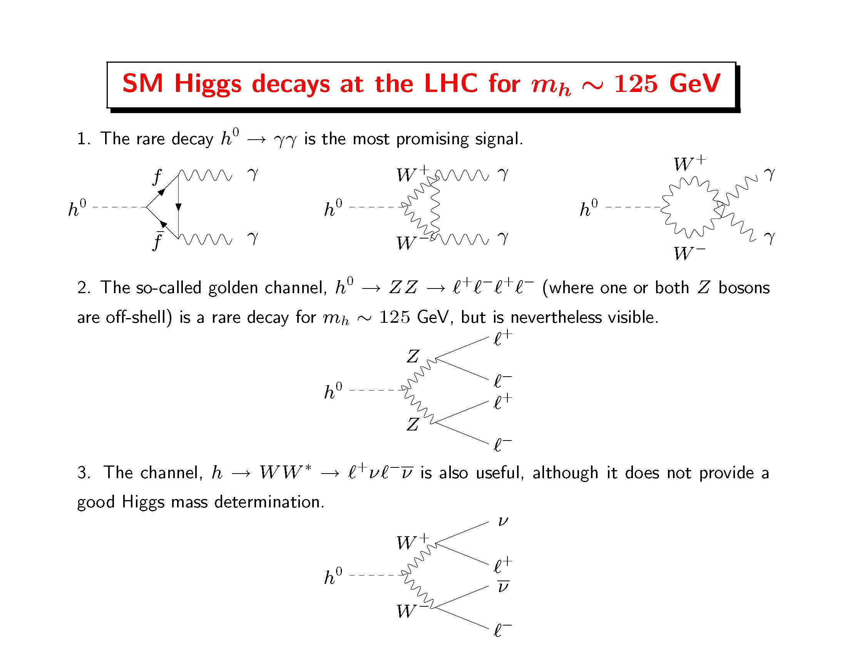

Slide 35
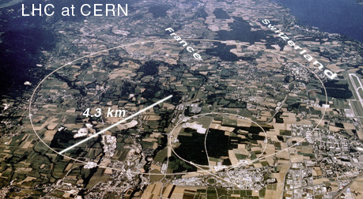
The Large Hadron Collider (LHC) at CERN

Slide 36
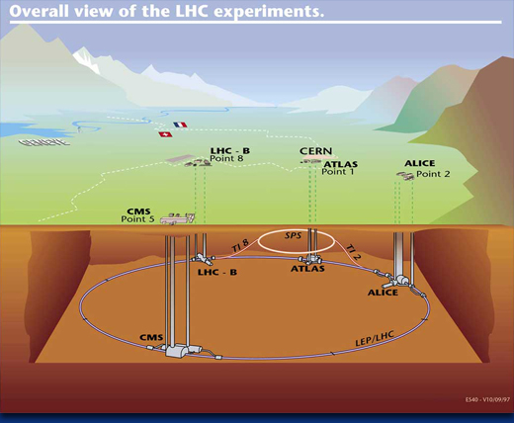

Slide 37
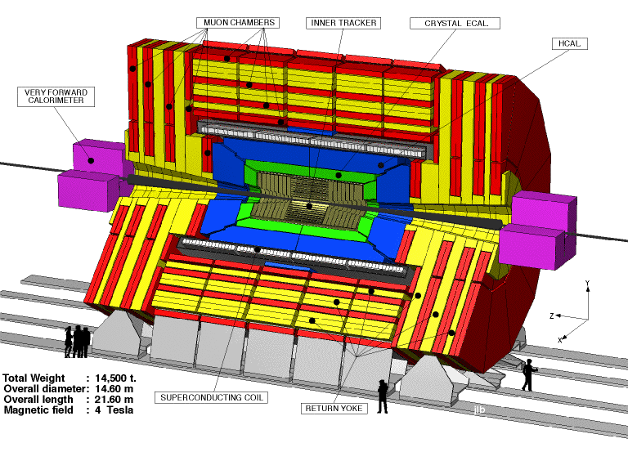
The CMS detector

Slide 38
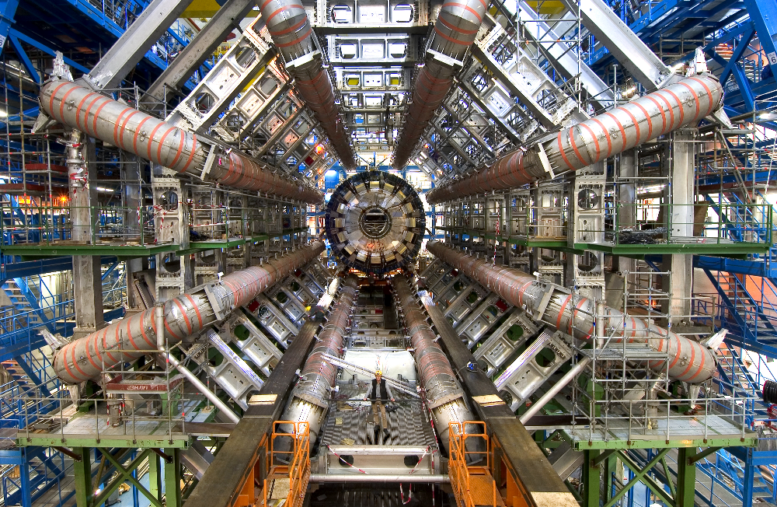
The ATLAS detector

Slide 39
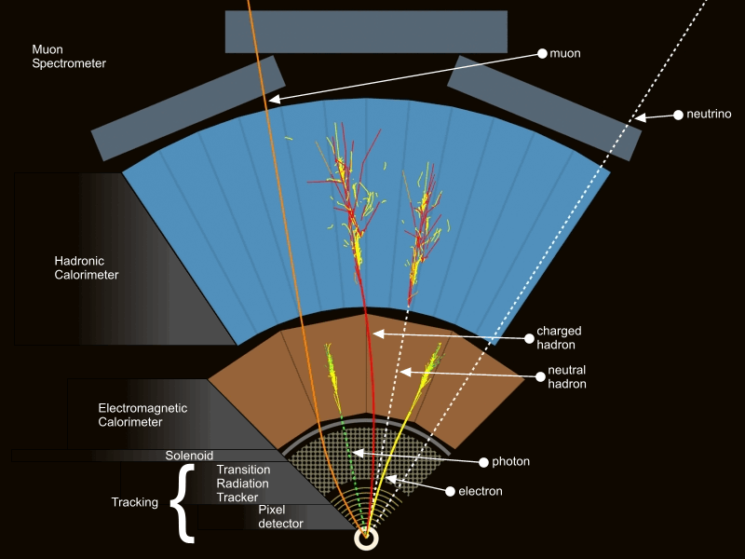
Different elements of the detector help to distinguish particles that are produced in the collision.

Slide 40
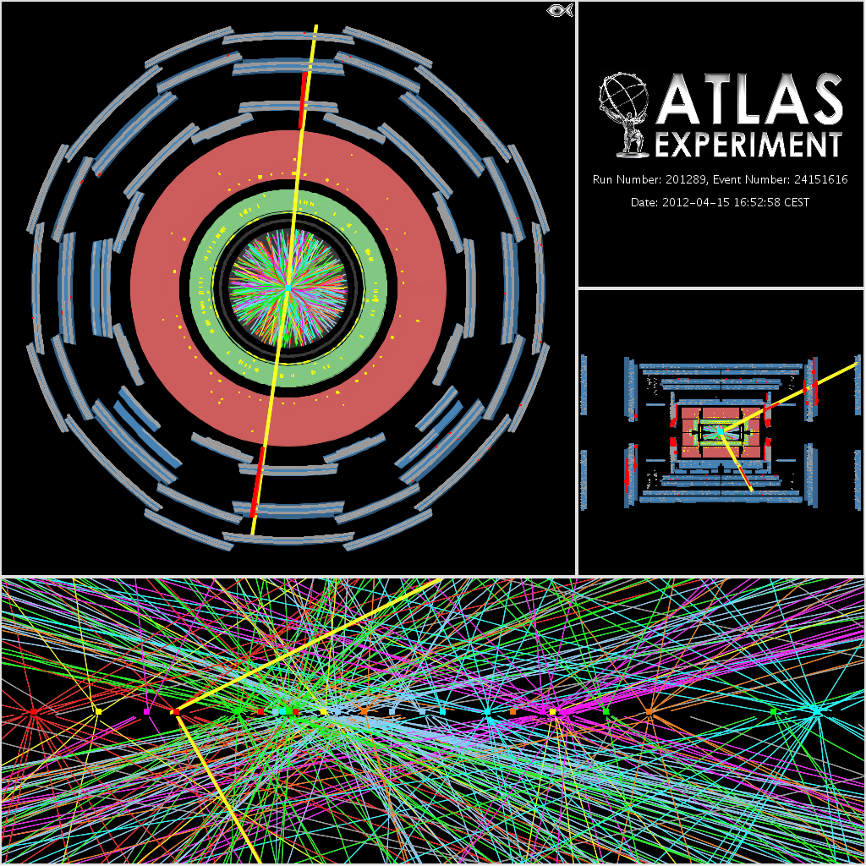
A challenging
environment
for analysis
A candidate Z boson event in the dimuon decay with 25
reconstructed vertices.
This event was recorded by the
ATLAS collaboration on April 15th 2012 and demonstrates the high pileup environment in 2012 running. For this display the track p_{T} threshold is 0.4 GeV and all tracks are required
to have at least 3 Pixel and
6 SCT hits. The vertices shown
are reconstructed using tracks with p_{T} greater than 0.4 GeV, but with tighter requirements on the number of hits on the
tracks than in the 2011
reconstruction.

Slide 41

The LHC Discovery of 4 July 2012
The CERN update of the
search for the Higgs boson,
simulcast at ICHEP-2012
in Melbourne, Australia

Slide 42
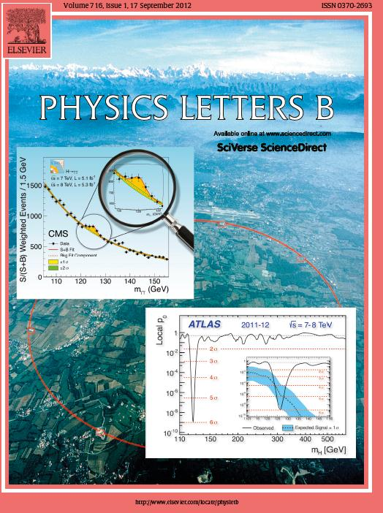
The discovery of the new
boson is published in
Physics Letters B.
ATLAS Collaboration:
Physics Letters B716 (2012) 1—29
CMS Collaboration:
Physics Letters B716 (2012) 30—61

Slide 43


Slide 44
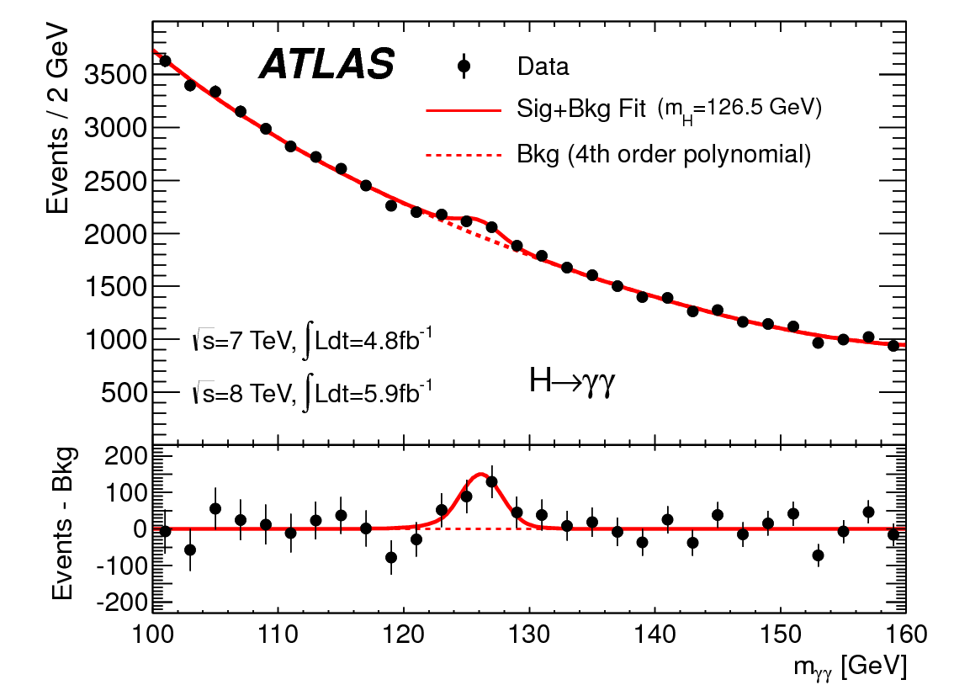
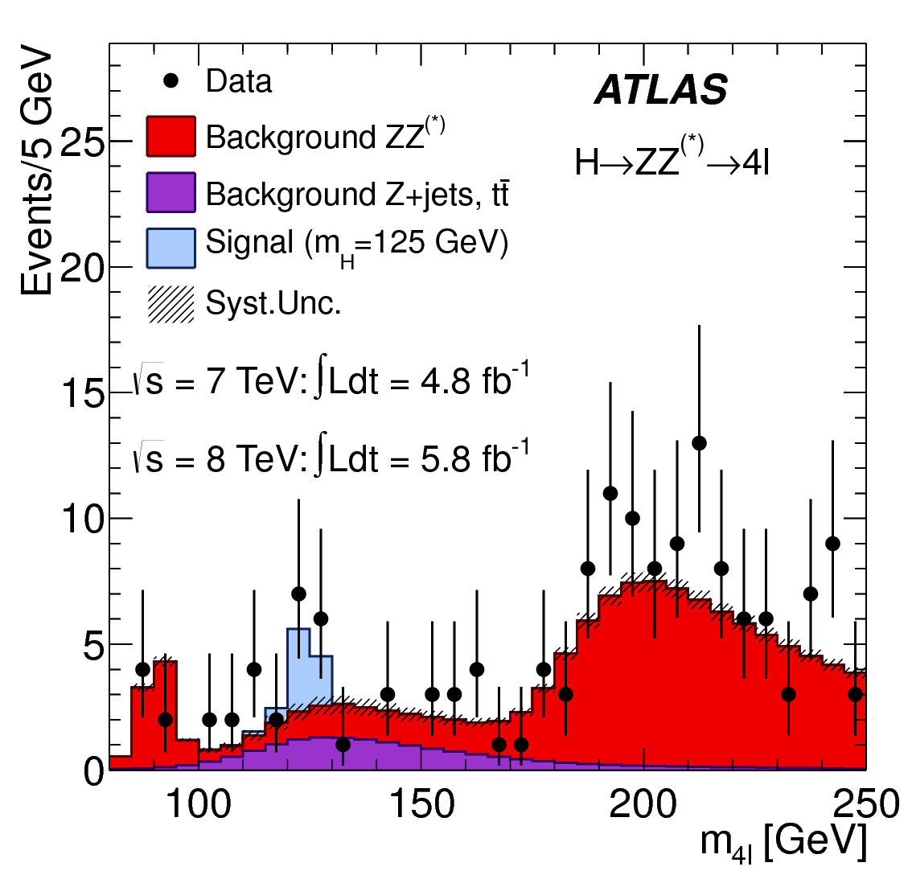
A boson is discovered at the LHC by the ATLAS Collaboration
Invariant mass distribution of diphoton candidates for the combined 7 TeV and 8 TeV data samples. The result of a fit to the data of the sum of a signal component fixed to
m_{H} = 126.5 GeV and a background component described by a fourth-order Bernstein polynomial is superimposed. The bottom inset displays the residuals of the data with respect to the fitted background component.
The distribution of the four-lepton invariant mass, m_{4l}, for the selected candidates, compared to the background expectation in the 80 to 250 GeV mass range, for the combination of the 7 TeV
8 TeV data. The signal expectation for a Higgs boson with m_{H}=125 GeV is also shown.
(Taken from Physics Letters B716 (2012) 1-29.)

Slide 45
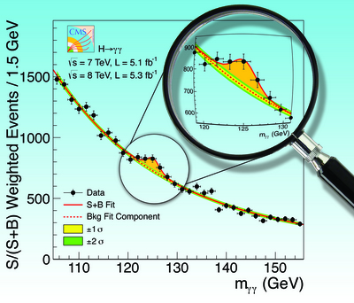
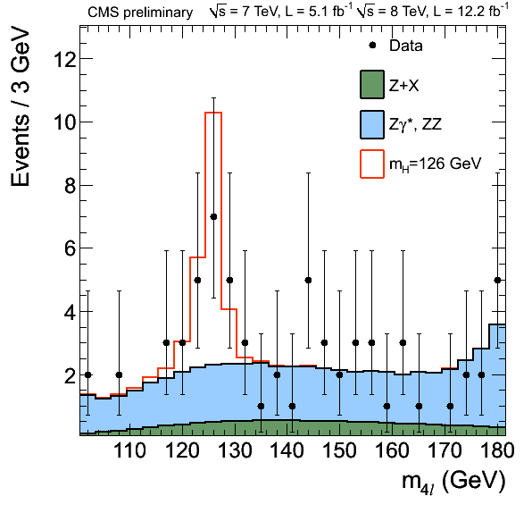
A boson is discovered at the LHC by the CMS Collaboration
The diphoton invariant mass distribution
with each event weighted by the S/(S+B)
value of its category. The lines represent the
fitted background and signal, and the colored
bands represent the ±1 and ±2 standard deviation
uncertainties in the background estimate. The
inset shows the central part of the unweighted
invariant mass distribution. Taken from
Physics Letters B716 (2012) 30—61.
Distribution of the four-lepton invariant mass for the
ZZ→4 leptons analysis. The points represent the data,
the filled histograms represent the background, and
the open histogram shows the signal expectation for
a Higgs boson of mass m_{H} = 126 GeV, added to the
background expectation. Taken from https://
twiki.cern.ch/twiki/bin/view/CMSPublic/Hig12041TWiki.

Slide 46
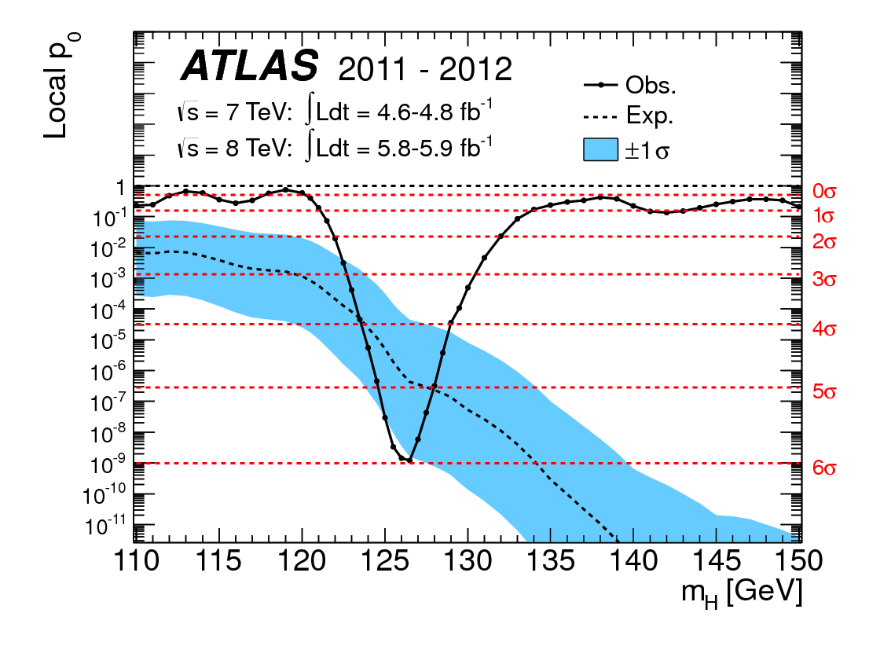
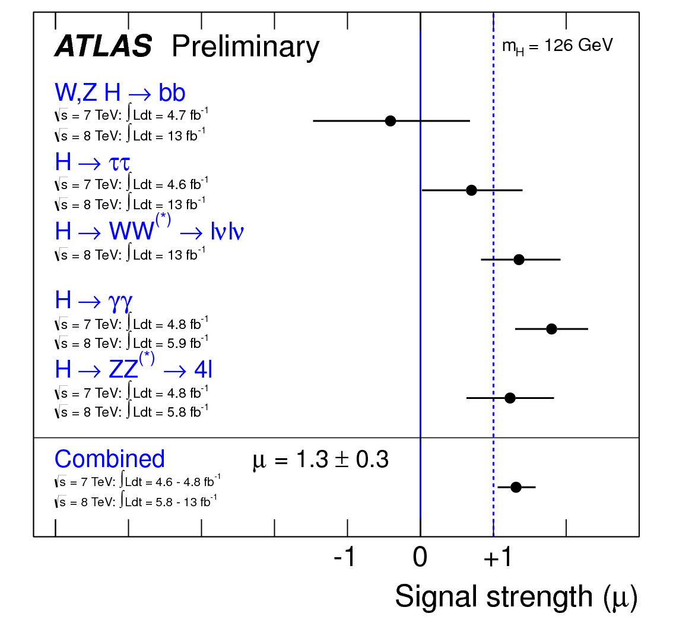
The local probability p₀ for a background-only experiment
to be more signal-like than the observation in in the low mass range of this analysis as a function of m_{H}. The dashed curves show the median expected local p₀ under the hypothesis of a Standard Model Higgs boson production signal at that mass. The horizontal dashed lines indicate the p-values corresponding to significances of 1σ to 6σ. (Taken from Physics Letters B716 (2012) 1-29.)
Summary of the individual and combined
best-fit values of the strength parameter for
a Higgs boson mass hypothesis of 126 GeV.
(Taken from ATLAS-CONF-2012-162,
13 November 2012.)

Slide 47
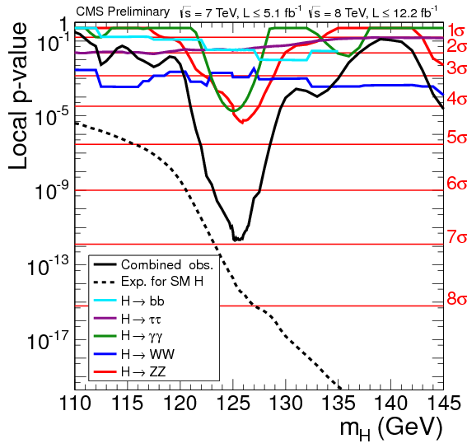
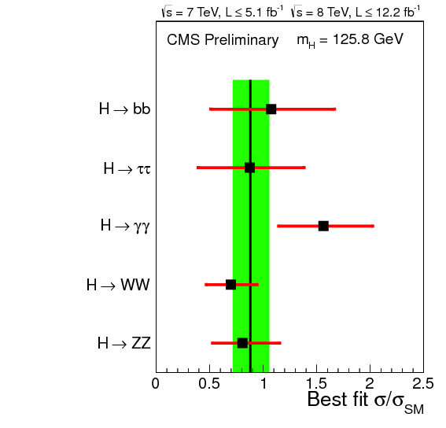
The observed local p-value p₀ for five subcombinations by decay mode and the overall combination as a function of the SM Higgs boson mass. The dashed lines show the expected local p-value p₀(m_{H}), should a Higgs boson
with a mass m_{H} exist.
Values of μ̂ = σ/σ_{SM} for the combination (solid vertical line) and for sub-combinations grouped by decay mode (points). The vertical band shows the overall μ̂ value 0.80 ± 0.22. The horizontal bars indicate the ±1σ uncertainties on the μ̂ values for individual channels; they include both statistical and systematic uncertainties.
Taken from https://twiki.cern.ch/twiki/bin/view/CMSPublic/Hig12045TWiki

Slide 48
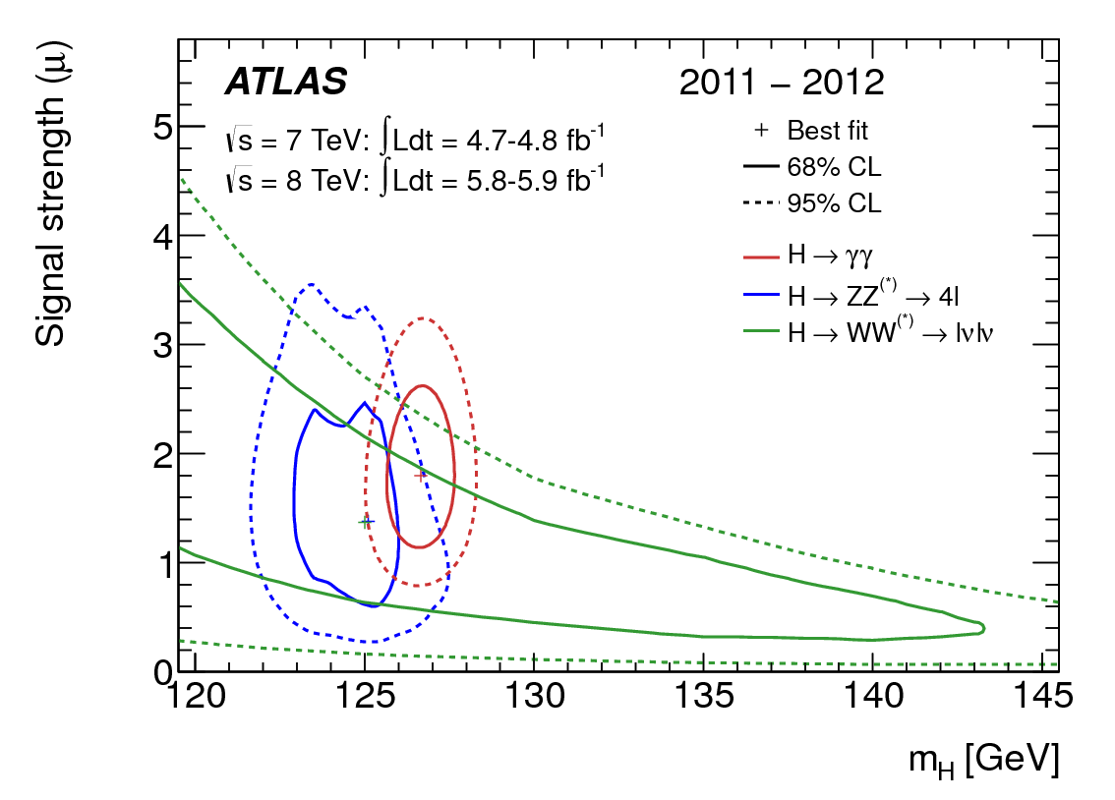
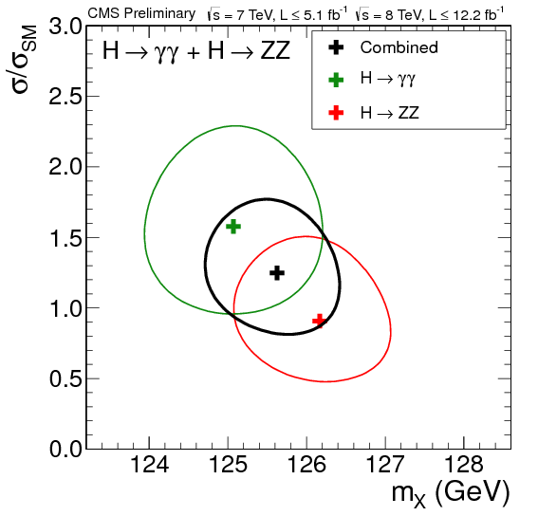
ATLAS and CMS mass determinations of the
newly discovered boson
m_{H} = 126.0 ± 0.4 (stat)
± 0.4 (syst) GeV
m_{H} = 125.8 ± 0.4 (stat)
± 0.4 (syst) GeV

Slide 49
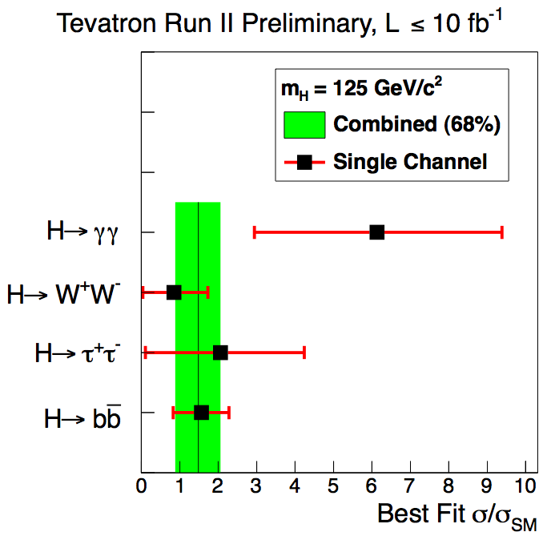
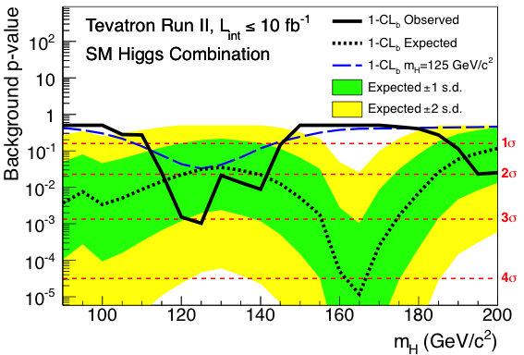
For m_{h}=125 GeV, Higgs bosons at the Tevatron decay primarily into bb.
The local p-value distribution for background-only hypothesis, for the combination of the CDF and D0 analyses. The green and yellow bands correspond to the regions enclosing 1 σ and 2σ fluctuations around the median predicted value in the background-only hypothesis, respectively.
Best fit signal strength for a hypothesized Higgs boson mass of 125 GeV for the combination (black line) and for the three sub-combinations. The band corresponds to the ± 1σ uncertainties on the full combination.
Reference: Aurelio Juste, presentation at the HCP Symposium in Kyoto, Japan, November 15, 2012.

Slide 50
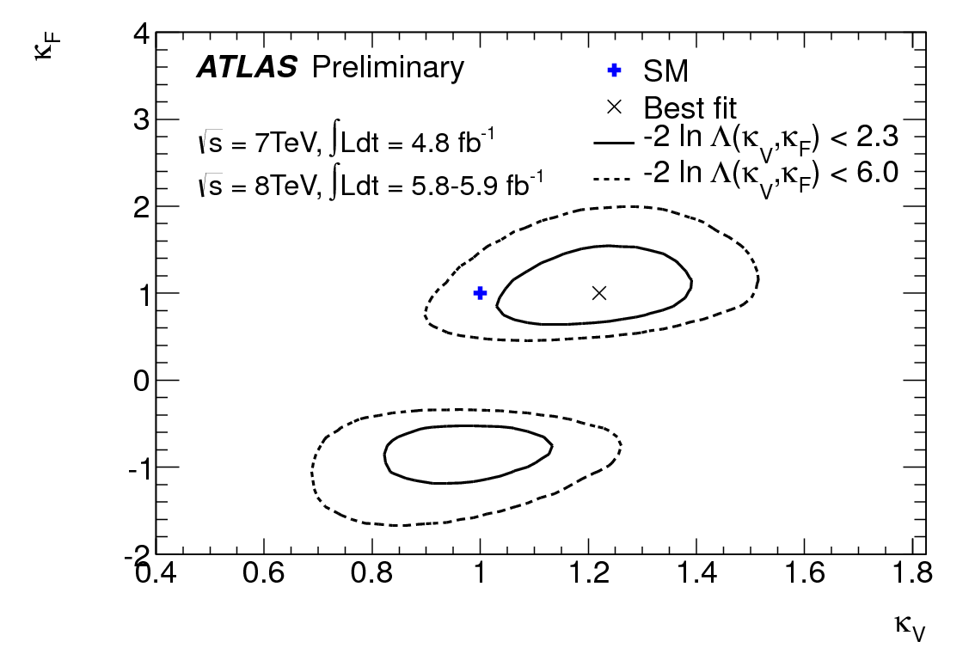

How well does ATLAS Higgs
data fit the Standard Model
expectations for Higgs couplings?
Top figure: Fits for 2-parameter benchmark models
probing different Higgs coupling strength scale factors for fermions and vector bosons, under the assumption that there is a single coupling for all fermions t, b, τ (κ_{F}) and a single coupling for vector bosons (κ_{V}).
Bottom figure: Fits for benchmark models probing for contributions from non-Standard Model particles: probing only the gg → H and H→ γγ loops, assuming no sizable extra contribution to the total width. The
magnitudes of the ggH and γγH couplings relative to their Standard Model values are denoted by κ_{g} and κ_{γ}.
Reference:
ATLAS-CONF-2012-127 (September 9, 2012)

Slide 51


How well does CMS Higgs data fit the Standard Model expectations for Higgs couplings?
Tests of fermion and vector boson couplings of the Higgs boson. The Standard Model (SM) expectation is (κ_{V} , κ_{F} )=(1,1).
Test of custodial symmetry: the Standard Model expectation is λ_{WZ} = κ_{W} /κ_{Z} = 1.
Taken from: https://twiki.cern.ch/twiki/bin/view/CMSPublic/Hig12045TWiki

Slide 52


CMS Higgs couplings summary
Overall good compatibility with SM predictions
Still limited precision
Marco Zanetti, presentation
at HCP 2012, Kyoto

Slide 53
Coming Attractions
The reported data seems roughly consistent with Standard Model expectations.
Nevertheless, there are a few intriguing (statistically insignificant) deviations:
The h→γγ signal appears to be enhanced beyond the Standard Model
predictions by about 50%. This enhancement is seen by both ATLAS and CMS.
A hint of a mass difference between the observed Higgs signals in
the γγ and ZZ*→4 lepton channels.
If these anomalies persist and become statistically significant, then it could portend
the existence of new fundamental physics beyond the Standard Model!!
More information will be forthcoming from the LHC experiments when the
full 2012 data set is reported at the March 2013 Winter conferences .

Slide 54
More Higgs data is on its way….
The current data set includes 5 fb⁻¹ at 7 TeV and 13 fb⁻¹ at 8 TeV.
(The latter includes an additional 7 fb⁻¹ of data that was reported two weeks
ago at the HCP Symposium in Kyoto, although only some analyses were updated
based on the new data.)
A further update of the Higgs data and analysis will be presented at the next CERN
council meeting (12—14 December 2012). [ATLAS: “major updates” expected]
At the Moriond Meeting (4—8 March 2013), an additional 10 fb⁻¹ of data
at 8 TeV will be presented, and all Higgs analyses will be updated.
The new data will provide improved analyses, updated coupling measurements,
and first results on the spin and parity determinations (a Higgs boson of the
Standard Model must be spin 0 and parity even).
At the international Lepton-Photon conference in San Francisco (24—29 June 2013),
one expects a statistical combination of the full 2011—2012 ATLAS and CMS data
sets (corresponding to an effective total luminosity of 60 fb⁻¹).

Slide 55
Looking beyond 2012
LHC shuts down in 2013—2014 to make repairs and improvements,
and to upgrade the energy to the full design energy of 14 TeV.
LHC resume running in 2015 at the full energy and an increased
luminosity. Significant measurements of the Higgs boson properties,
are anticipated.
Meanwhile, serious discussions concerning a Higgs factory based on
a high energy e⁺e¯ collider (called the International Linear Collider or
ILC for short) may lead to a project in Japan. At such a facility,
precision measurements of Higgs boson properties are possible
(improving the precision of LHC measurements in some cases by an
order of magnitude).
Future directions for US high energy physics are now under discussion,
with a critical planning meeting scheduled for the summer of 2013.

Slide 56
New physics beyond the Standard Model
The dynamics responsible for breaking the electroweak gauge symmetry may be something other than the simplest Higgs model
  more than one Higgs boson (some neutral and some charged)
  composite Higgs bosons (bound states of new particles)
  dynamical electroweak symmetry breaking (modeled after
  Cooper pair condensation in a superconductor)
New symmetries beyond the Standard Model
  new gauge forces
  supersymmetry
Extra dimensions of space (beyond the 3 we know and love)
Unexpected effects of gravity at the TeV energy scale

Slide 57
Beware of theorists who take statistically insignificant deviations too seriously
Is there a simple model of Higgs physics that can lead to enhanced γγ signal and a
a difference in masses as measured via the γγ and ZZ*→4 lepton channels?
In a two Higgs doublet model, suppose there are two neutral scalars that are nearly degenerate in mass. If one has approximately SM-like couplings to ZZ, then the other will be nearly decoupled from the ZZ channel. Yet, both scalars can be produced in gluon-gluon fusion, and both scalars can decay to γγ.
Result: Some regions of the parameter space yield an enhanced γγ signal and different Higgs mass measurements
in the γγ and ZZ*→4 lepton channels.
Prediction: an enhanced ττ signal.
Reference: P.M. Ferreira, Howard E. Haber, João P. Silva and Rui Santos, arXiv:1211.3131

Slide 58

Supersymmetry
A new kind of symmetry that relates fermions and bosons---all particles have a supersymmetric partner differing by half a unit of spin
For every elementary particle already seen, a new one will show up at the LHC
The lightest supersymmetric particle could be dark matter
Comes with at least 5 Higgs bosons (three neutral and a charged pair)

Slide 59



In the minimal supersymmetric extension of the Standard Model (MSSM), the Higgs boson
self-couplings are not free parameters but are related to the known gauge couplings. This led
to the initial prediction of model, m_{H} ≤ m_{Z} , in conflict with experimental observation.
In 1991, H.E. Haber and R. Hempfling discovered that the Higgs mass bound was significantly
increased by including quantum corrections. In the years following more precise calculations
were done, which raised the upper bound to about 135 GeV (assuming
Taken from M. Carena and H.E. Haber, “Higgs boson theory and
phenomenology,'' Prog. Part. Nucl. Phys. 50, 63 (2003)
Taken from M.W. Cahill-Rowley, J.L. Hewett, A. Ismail and T.G. Rizzo, “The
Higgs Sector and Fine-Tuning in the pMSSM,” Phys. Rev. D86, 075015 (2012)

Slide 60
Conclusions
The discovery of the Higgs boson provides a profound confirmation of our theoretical understanding of mass.
We are in the early stages of the discovery. It will be important
to confirm that the newly discovered boson has spin 0.
Have we discovered the Higgs boson of the Standard Model?
One must check that the properties of the newly discovered boson are consistent with the predictions of the Standard Model.
If deviations from Standard Model properties were to be
confirmed, then the fun really begins!!
Fundamental physics does not end with the Higgs boson. The LHC may be on the brink of even greater discoveries…

