Slide 1
Research on the Theory of the Terascale
Howard Haber
SCIPP Theory
January 12, 2015

Slide 2
SCIPP Particle Theory Group
Thomas Banks: supersymmetry, string theory, gravity, and the early universe
Michael Dine: supersymmetry, string theory, and the early universe
Howard Haber: Higgs bosons, collider physics, new physics beyond the Standard Model at the terascale (including supersymmetry)
Stefano Profumo: Theories of particle dark matter and their implications for astrophysics and collider phenomenology
In addition, Anthony Aguirre and Joel Primack work on a variety
of topics overlapping particle theory and astroparticle theory,
including dark matter, early universe cosmology, inflation, …

Slide 3
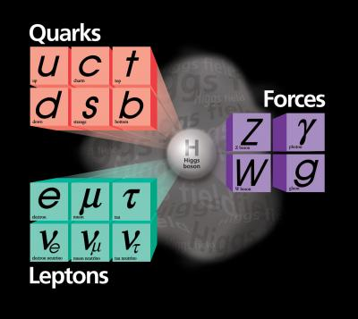
The Standard Model (SM) of Particle Physics
The elementary particles consists of three generations of spin-1/2 quarks and leptons and the gauge bosons of SU(3)xSU(2)xU(1).
Technically, massive neutrinos
require an extension of the Standard
Model, but most likely the relevant
scale of the new physics lies way
beyond the terascale.

Slide 4
Origin of mass for elementary particles
Naively, an SU(3)xSU(2)xU(1) gauge theory yields massless gauge bosons and massless quarks and leptons, in conflict with observation. The Standard Model introduces the Higgs mechanism for mass generation. The gauge invariance is spontaneously broken. In the simplest implementation, a spinless physical Higgs scalar is predicted.

Slide 5
From Symmetry Magazine, volume 3, issue 6, August 2006

Slide 7
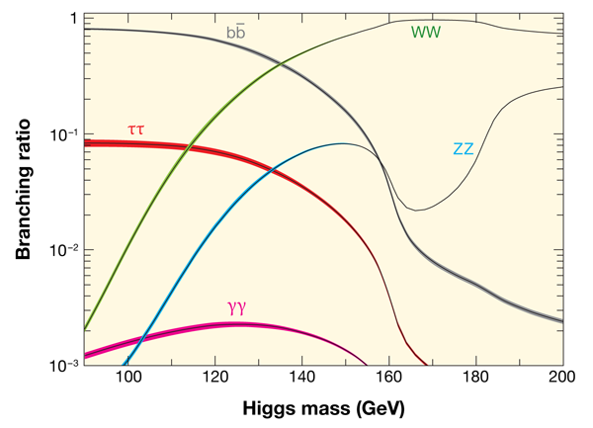
Probability of Higgs boson decay channels

Slide 8
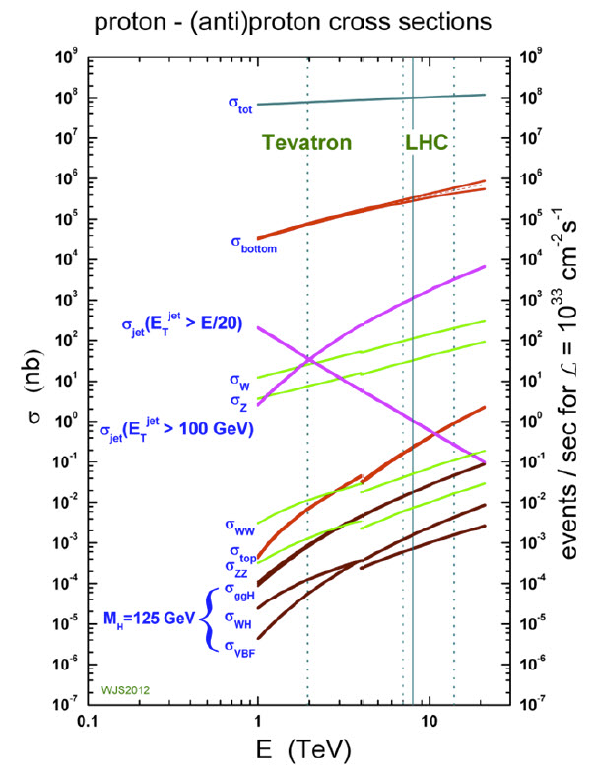
Question: why not search
for Higgs bosons produced
in gluon-gluon fusion that
decay into a pair of b-quarks?
Answer: The Standard Model
background is overwhelming.
There are more than 10⁷ times
as many b-quark pairs produced
in proton-proton collisions as
compared to b-quark pairs that
arise from a decaying Higgs boson.
Roughly 250,000 Higgs bosons
per experiment were produced
at the LHC from 2010—2013.

Slide 10
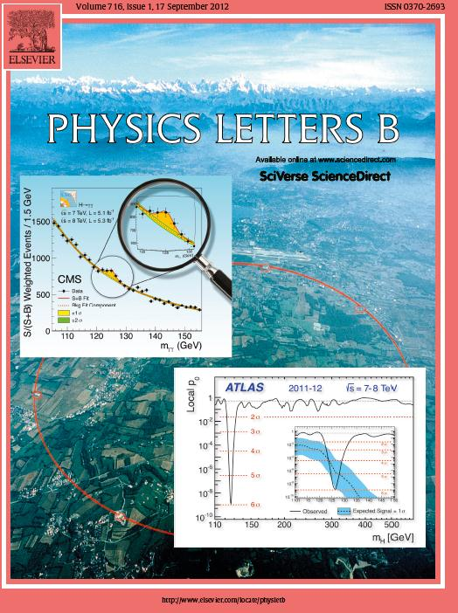
On July 4, 2012, the discovery
of a new boson is announced
which may be the long sought
after Higgs boson.
The discovery papers are
published two months later
In Physics Letters B.
ATLAS Collaboration:
Physics Letters B716 (2012) 1—29
CMS Collaboration:
Physics Letters B716 (2012) 30—61

Slide 11
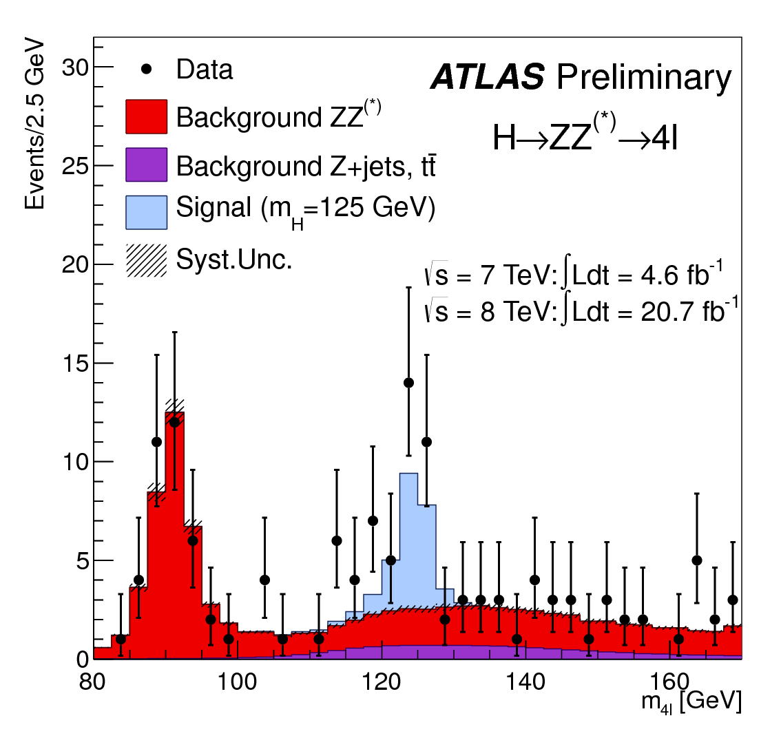
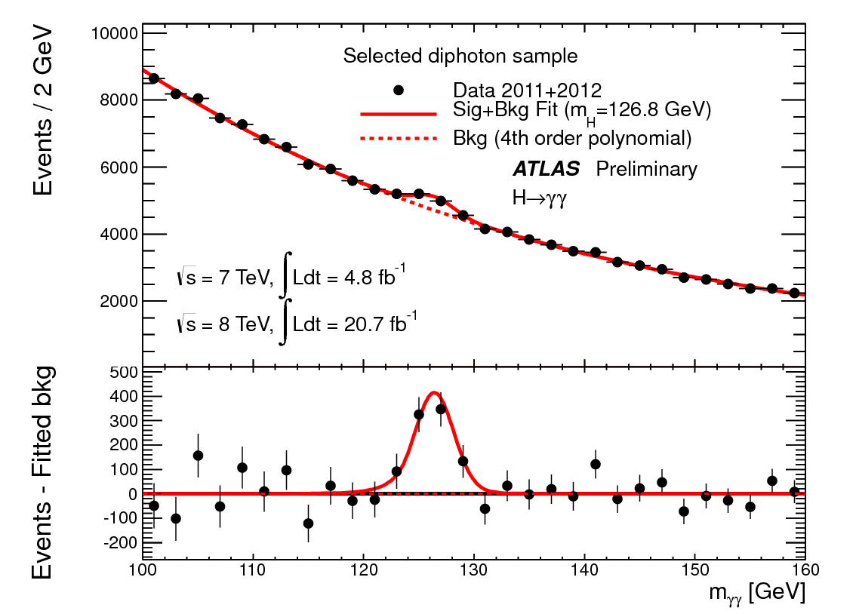
A boson is discovered at the LHC by the ATLAS Collaboration
Invariant mass distribution of diphoton candidates for the combined 7 TeV and 8 TeV data samples. The result of a fit to the data of the sum of a signal component fixed to
m_{H} = 126.8 GeV and a background component described by a fourth-order Bernstein polynomial is superimposed. The bottom inset displays the residuals of the data with respect to the fitted background component. Taken from
ATLAS-CONF-2013-012 (March, 2013).
The distribution of the four-lepton invariant mass for the selected candidates, compared to the background expectation in the 80 to 170 GeV mass range, for the combination of the 7 TeV
8 TeV data. The signal expectation for a Higgs boson with m_{H}=125 GeV is also shown. Taken from ATLAS-CONF-2013-013 (March, 2013).

Slide 12
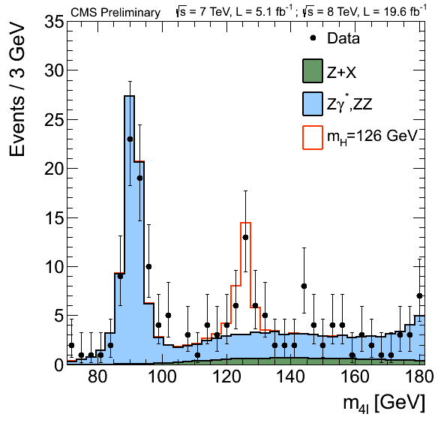
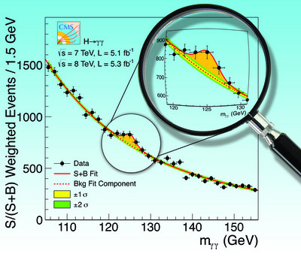
A boson is discovered at the LHC by the CMS Collaboration
The diphoton invariant mass distribution
with each event weighted by the S/(S+B)
value of its category. The lines represent the
fitted background and signal, and the colored
bands represent the ±1 and ±2 standard deviation
uncertainties in the background estimate. The
inset shows the central part of the unweighted
invariant mass distribution. Taken from
Physics Letters B716 (2012) 30—61.
Distribution of the four-lepton reconstructed mass in full mass range for the sum of the 4e, 4μ, and 2e2μ channels. Points represent the data, shaded histograms represent the background and unshaded histogram the signal expectations. The expected distributions are presented as stacked histograms. The measurements are presented for the sum of the data collected at √s = 7 TeV and √s = 8 TeV. [70-180] GeV range - 3 GeV bin width. Taken from
CMS-PAS-HIG-13-002 (March, 2013).

Slide 13
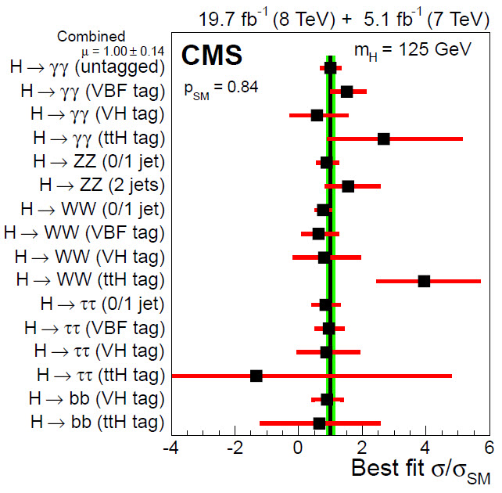
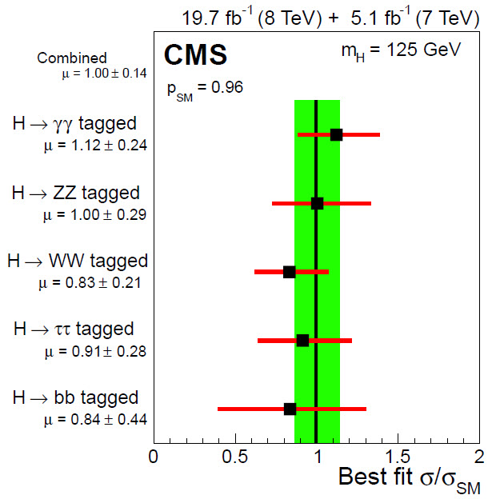
CMS evidence for a Standard Model (SM)—like Higgs boson
Values of the best-fit σ/σ_{SM} for the combination (solid vertical line) and for subcombinations by predominant decay mode and additional tags targeting a particular production mechanism. The vertical band shows the overall σ/σ_{SM} uncertainty. The σ/σ_{SM} ratio denotes the production cross section times the relevant branching fractions, relative to the SM expectation. The horizontal bars indicate the ±1 standard deviation uncertainties in the best-fit σ/σ_{SM} values for the individual modes; they include both statistical and systematic uncertainties. Taken from arXiv:1412.8662 (December, 2014).
Values of the best-fit σ/σ_{SM} for the combination (solid vertical line) and for subcombinations by predominant decay mode. The vertical band shows the overall σ/σ_{SM} uncertainty. The σ/σ_{SM} ratio denotes the production cross section times the relevant branching fractions, relative to the SM expectation. The horizontal bars indicate the ±1 standard deviation uncertainties in the best-fit σ/σ_{SM} values for the individual modes; they include both statistical and systematic uncertainties. Taken from arXiv:1412.8662 (December, 2014).

Slide 14
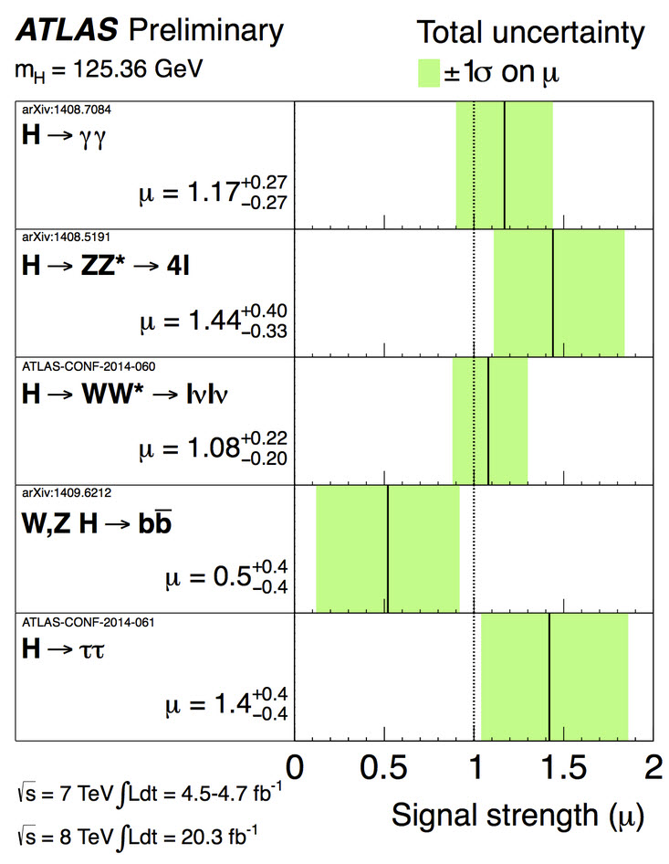
ATLAS evidence for a SM-like Higgs boson (from a CERN seminar
October 7, 2014)

Slide 15
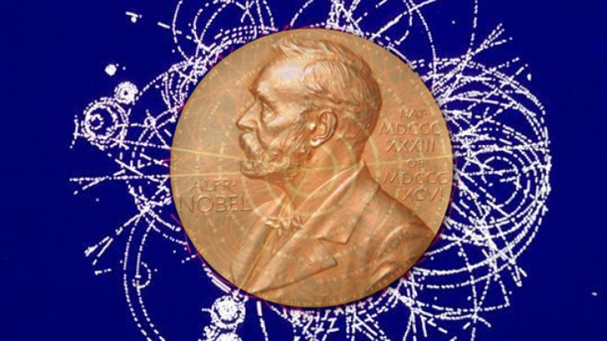
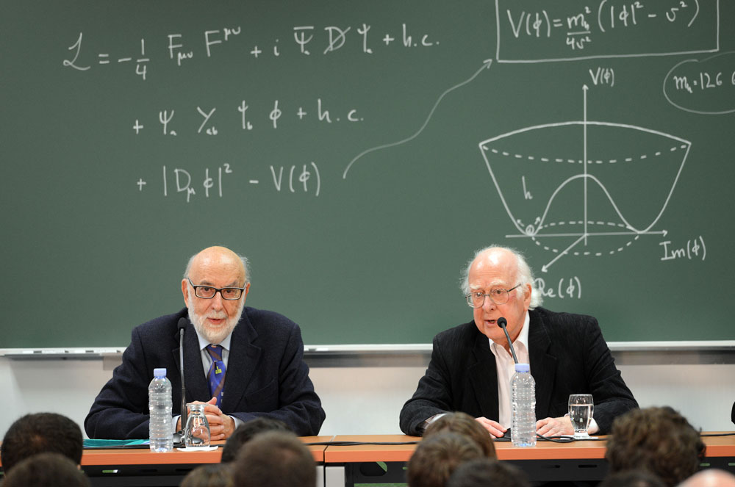
Winners of the 2013 Nobel Prize in Physics
François Englert
and
Peter Higgs

Slide 16
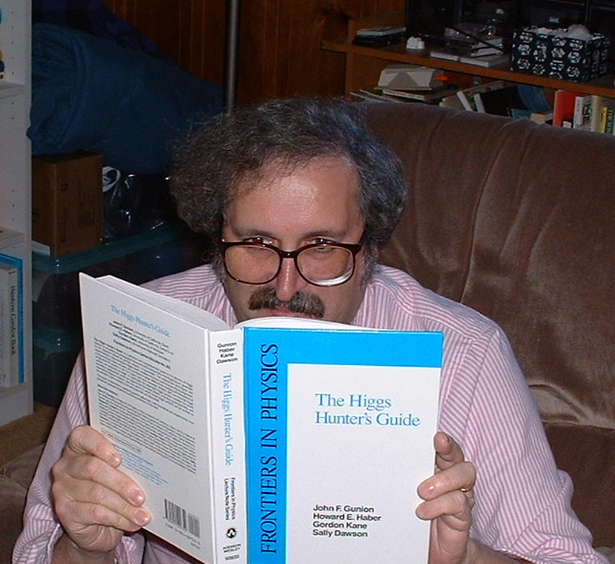
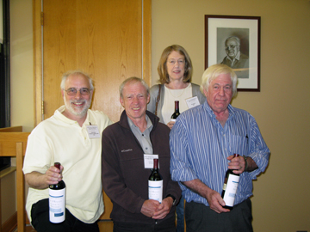
Research program 1: theory and phenomenology of Higgs bosons

Slide 17
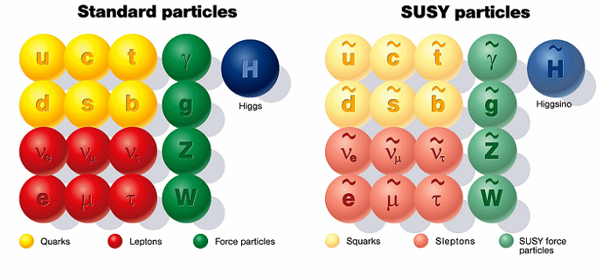
Research program 2: theory and phenomenology of TeV-scale supersymmetry (SUSY)
For a review, see H.E. Haber, Supersymmetry Theory, in the 2013 partial update for the
2014 edition of the Review of Particle Physics, to be published by the Particle Data Group
[http://pdg.lbl.gov/2013/reviews/rpp2013-rev-susy-1-theory.pdf].

Slide 18
Research program 3: explorations of the Terascale at present and future colliders (LHC and ILC)
Studies of the non-minimal Higgs sector
Precision measurements of new physics observables
Distinguishing among different theoretical interpretations of new physics signals
Employing the ILC as a precision Higgs factory
Terascale footprints of lepton-number-violating physics (e.g. R-parity-violation or the SUSY seesaw)
New sources for CP-violation (Higgs and/or SUSY mediated)

Slide 19
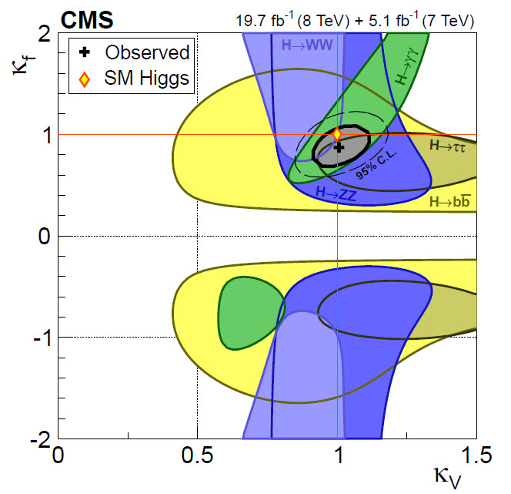
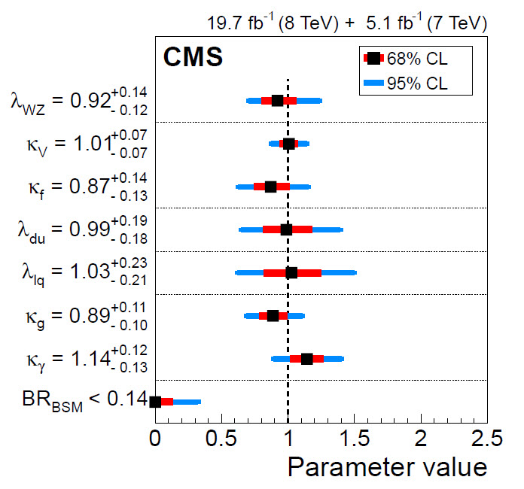
CMS search for deviations from SM-Higgs couplings
2D test statistics q(κ_{V}, κ_{F}) scan for individual channels
(colored swaths) and for the overall combination (thick curve).
The cross indicates the global best-fit values. The dashed
contour bounds the 95% CL region for the combination. The
yellow diamond shows the SM point (κ_{V}, κ_{f}) = (1, 1). Two
quadrants corresponding to (κ_{V}, κ_{f}) = (+,+) and (+,−) are
physically distinct. Taken from arXiv:1412.8662 (December, 2014).
Summary plot of likelihood scan results for the different parameters of interest in benchmark models separated by dotted lines. The BR_{BSM} value at the bottom is obtained for the model with three parameters (κ_{g}, κ_{γ}, BR_{BSM}). The inner bars represent the 68% CL confidence intervals while the outer bars represent the 95% CL confidence intervals. Taken from arXiv:1412.8662 (December, 2014).

Slide 21
Is it possible that the Higgs coupling to bottom quarks and tau leptons have the expected magnitude but the opposite sign to their predicted SM values?

Slide 22
Taken from P.M. Ferreira, J.F. Gunion, H.E. Haber and R. Santos,
Probing wrong-sign Yukawa couplings at the LHC and a future linear collider Phys. Rev. D89, 115003 (2014).

Slide 25
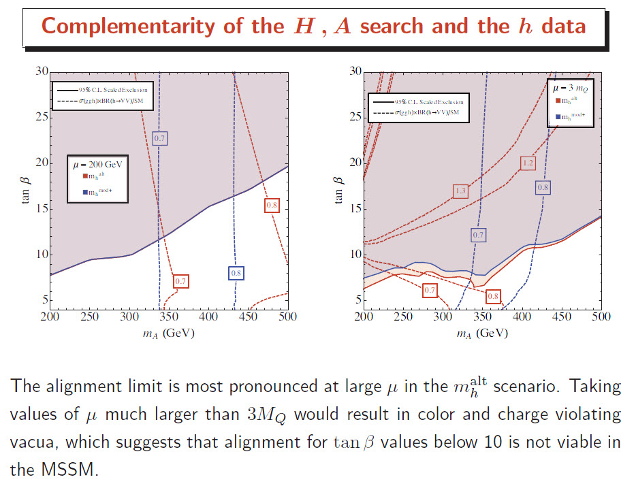
M. Carena, H.E. Haber, I. Low, N.R. Shah and C. E.M. Wagner, Complementarity Between
Non-Standard Higgs Searches and Precision Higgs Measurements in the MSSM, arXiv:1410.4969 [hep-ph], Physical Review D91 (2015) in press.

Slide 26
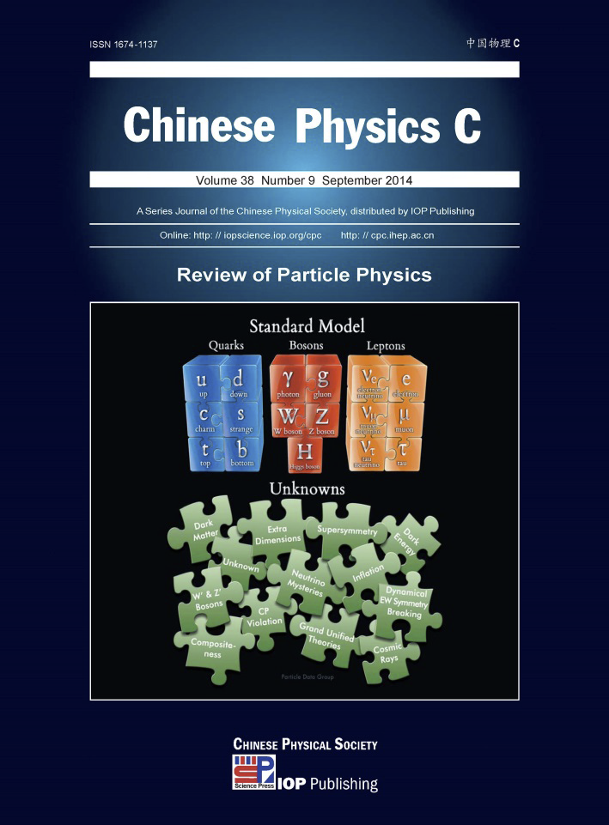
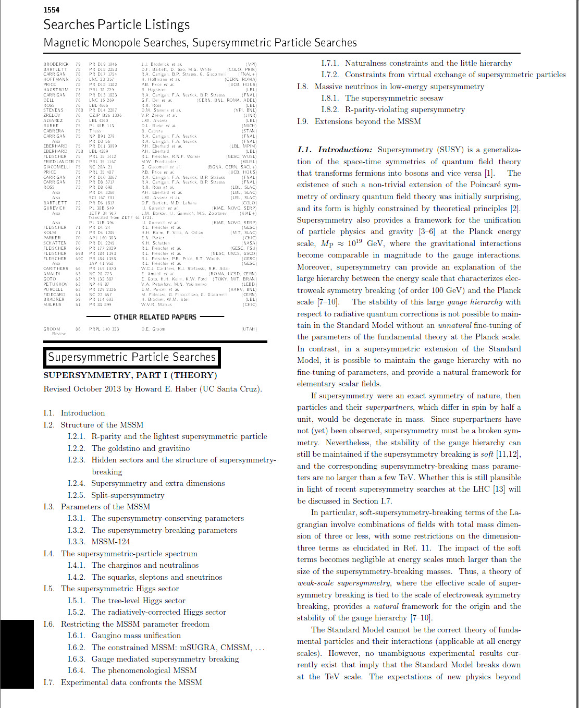
As a member of the Particle Data Group, I am the author
of the biennial Supersymmetry Theory review

Slide 27
My recent Ph.D. students and their thesis projects
Douglas Pahel (2005): CP-Violating Effects in W and Z Boson Pair Production at the
the ILC in the Minimal Supersymmetric Standard Model
John Mason (2008): Hard supersymmetry-breaking “wrong-Higgs” couplings of
the MSSM
Deva O’Neil (2009): Phenomenology of the Basis-Independent CP-Violating
Two-Higgs Doublet Model
Where are they now?
D. Pahel – working in industry
J. Mason – following a three-year post doctoral research associate in particle
theory at Harvard University, John accepted a position as an
assistant professor of physics at Western State College of Colorado
D. O’Neil – assistant professor of physics at Bridgewater College (in Virginia)

Slide 28
My current Ph.D. students and their projects
Laura Fava: Precision measurements of couplings at the LHC
and tests of theories of UED (universal extra
dimensions).
Eddie Santos: Renormalization group running in the general
CP-violating two-Higgs doublet model;
predictions for Higgs-mediated flavor
changing neutral current processes.
I am also working with:
Laurel Stephenson Haskins: Puzzle in the relation between the
quark anomalous dimension and the mass anomalous
dimension in supersymmetric non-abelian gauge theory.

Slide 29
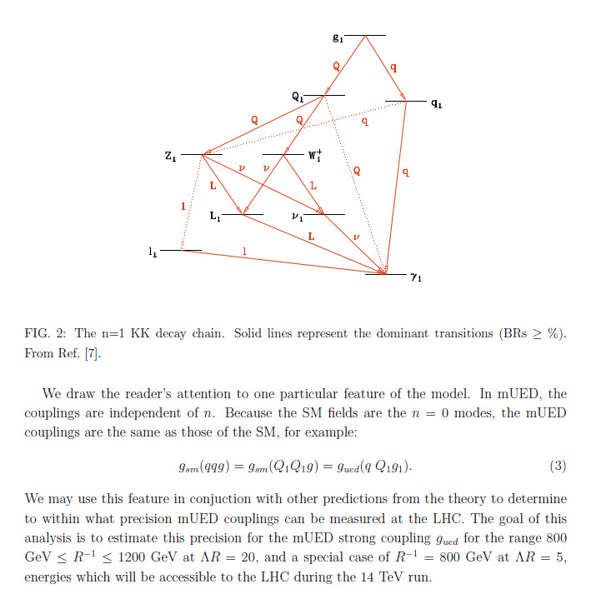
Project with Laura Fava: study the potential for precision coupling measurements in the minimal Universal Extra Dimensions (mUED) model. Look for events with like-sign dileptons, associated hadronic jets and missing transverse energy.

Slide 30
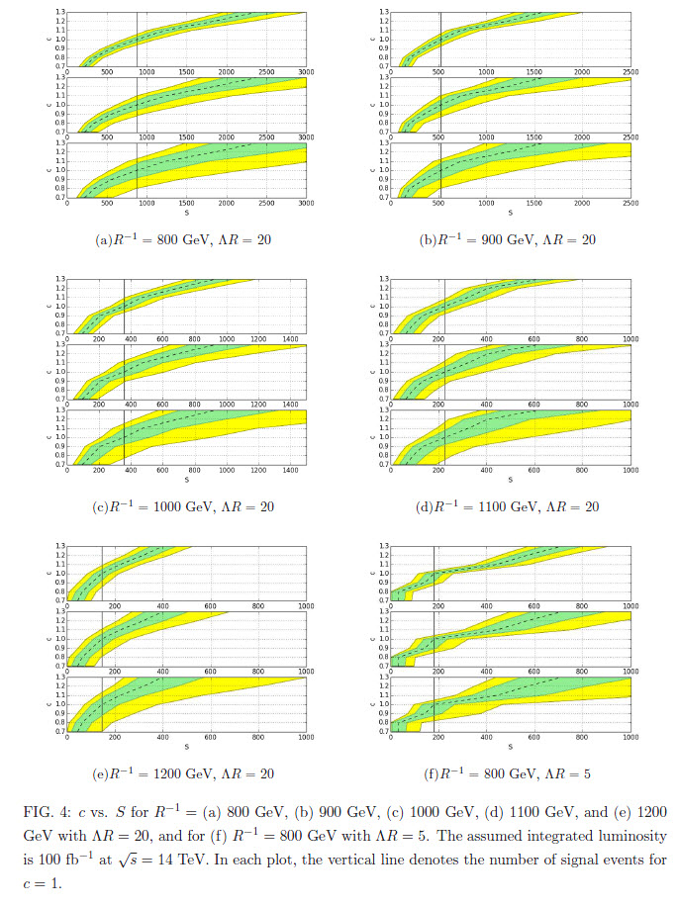
Preliminary results
S=number of signal
events observed
c= ratio of the strong UED
coupling to the QCD
coupling
R= compactification
radius of the extra
dimension
Λ=cutoff energy scale
of the mUED model
Brazil plots:
green—68% CL
yellow—95% CL

Slide 31
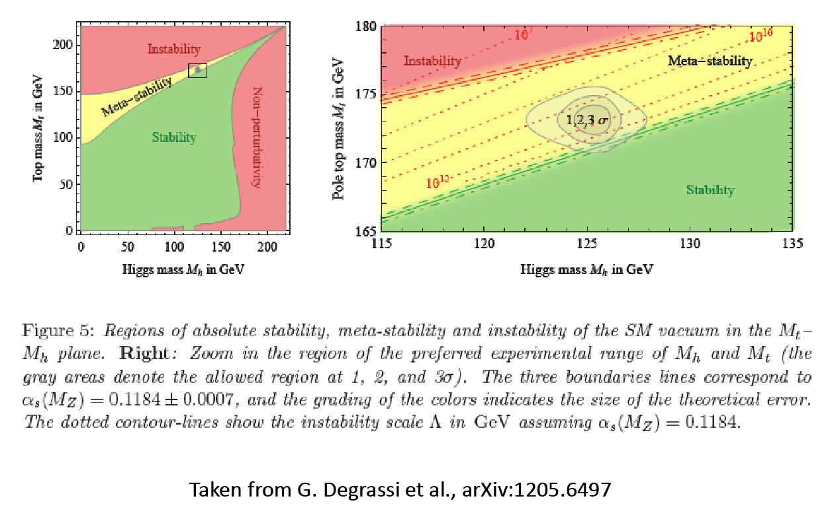
Implication of the Higgs data for the stability of the vacuum

Slide 32
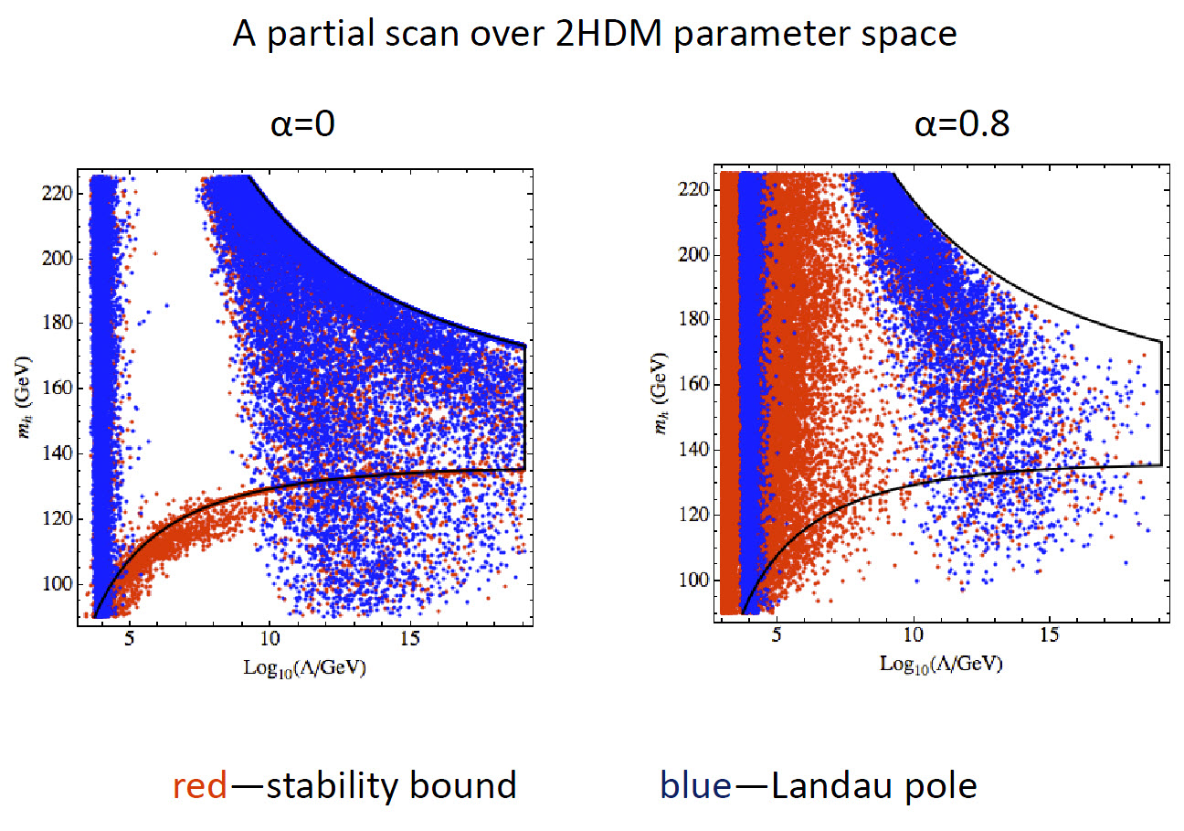
Project with Eddie Santos: Investigate whether stability up to the Planck scale
is possible in the two-Higgs-doublet model (2HDM)

